Slide 1
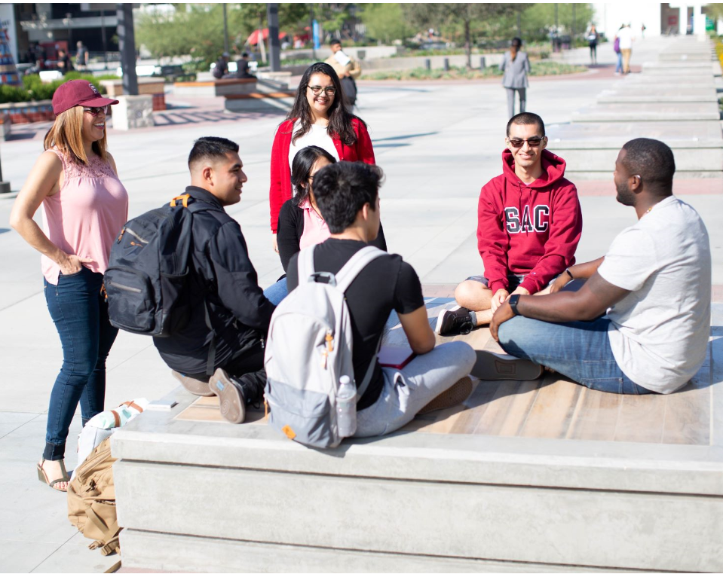
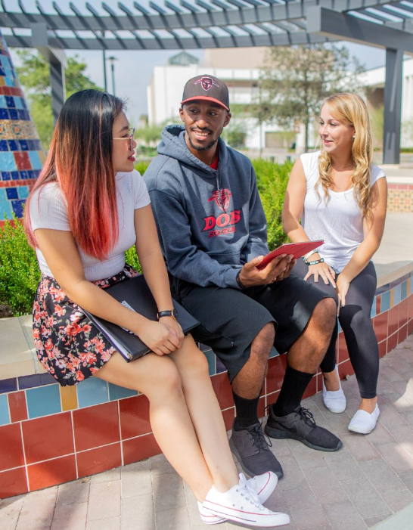


SAC Student Satisfaction Survey 2019
Paula Kincaid, M.A.Ed., MPA, Research Analyst
1

Slide 2
Overview
The survey was created through a collaboration of the Santa Ana College Research Office and the Rancho Santiago Community College District Research, Planning, and Institutional Effectiveness Department
Administered in July 2019 to students enrolled spring 2019
Overall experience and satisfaction responses = 1574

Slide 3
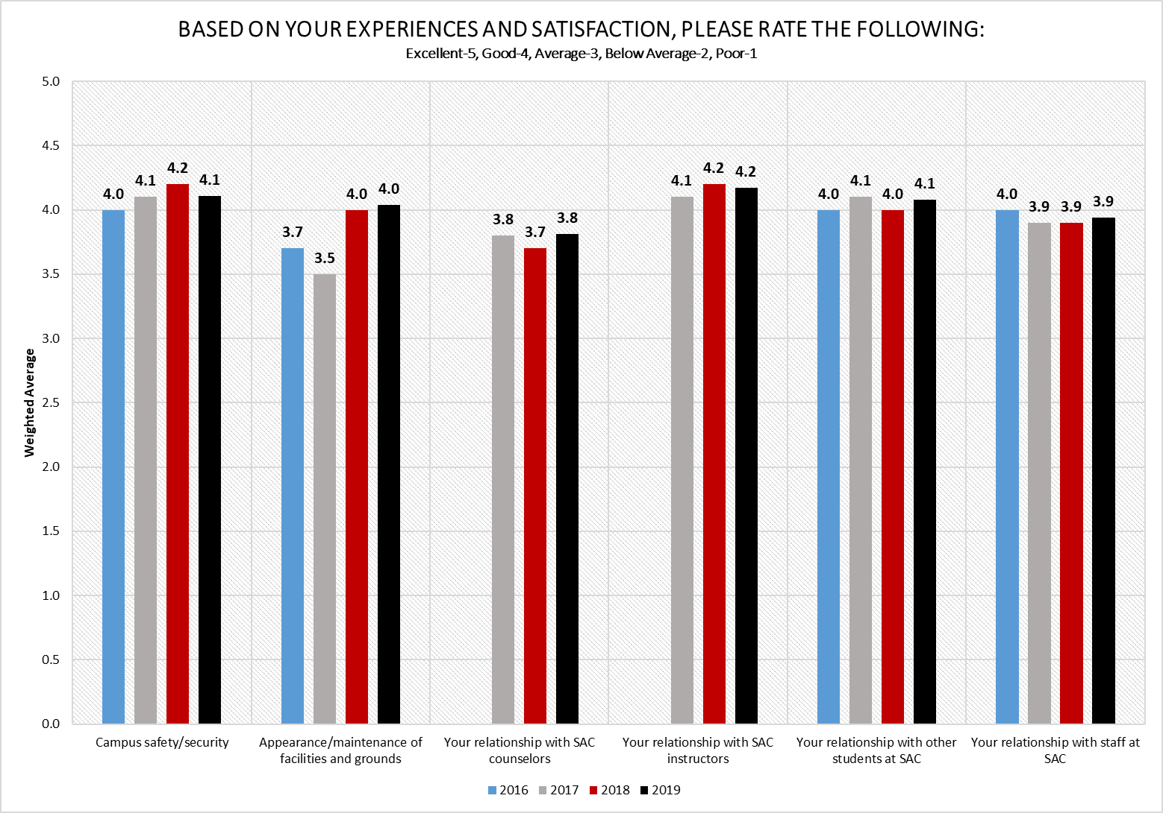
*2018=4.03
*2019=4.04
Source: RSCCD SAC Student Satisfaction Survey 2016-2019-PK

Slide 4
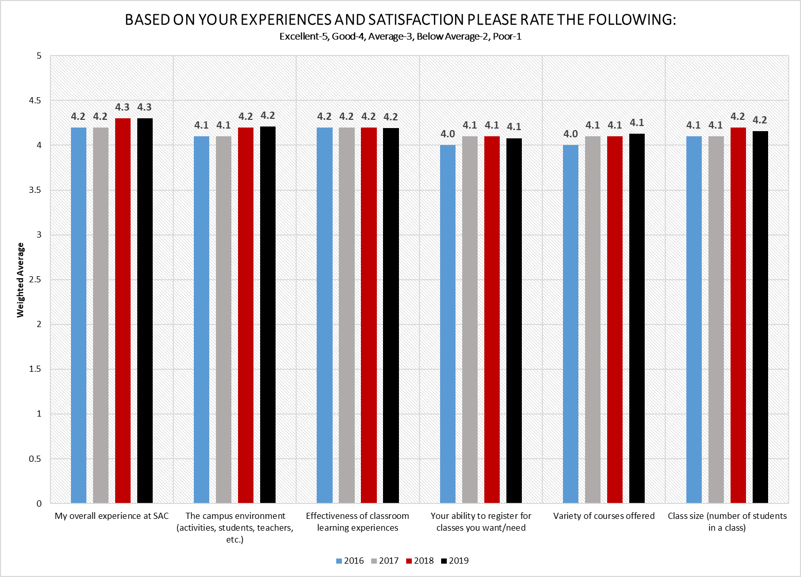
Source: RSCCD SAC Student Satisfaction Survey 2016-2019-PK

Slide 5
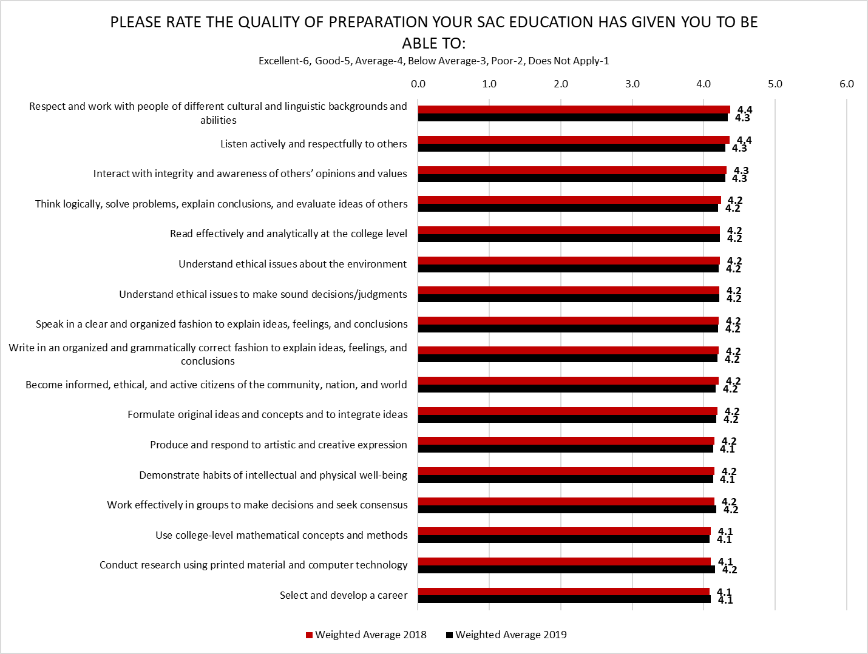
Source: RSCCD SAC Student Satisfaction Survey 2018-2019-PK

Slide 6
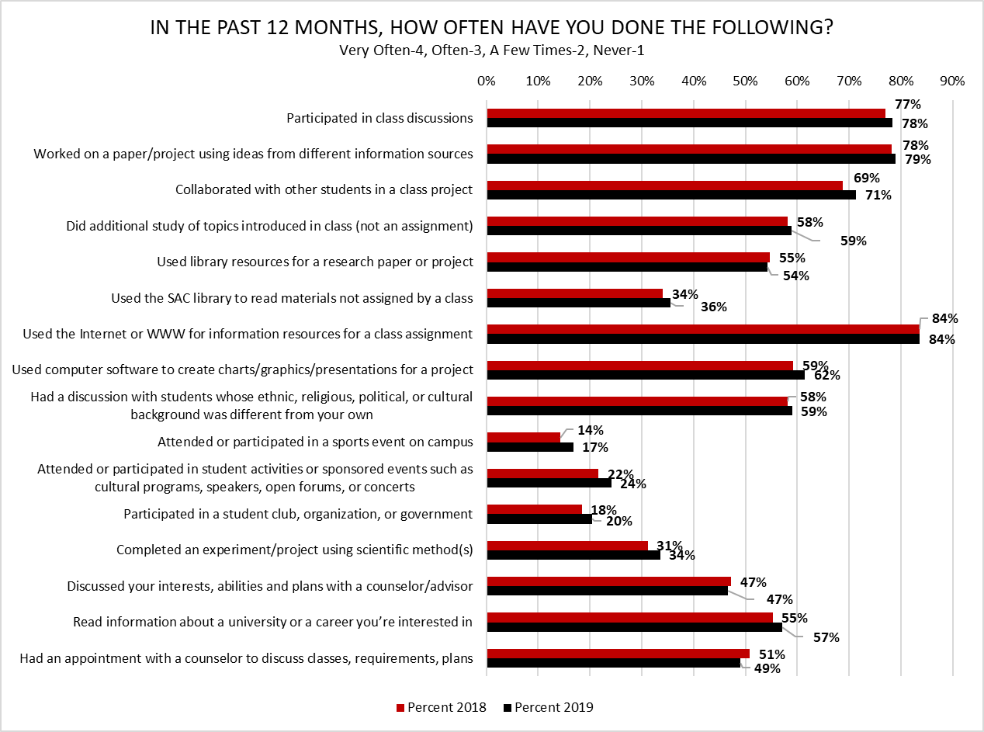
Total percent of students who selected “Very Often” or “Often” response options
Source: RSCCD SAC Student Satisfaction Survey 2018-2019-PK

Slide 7
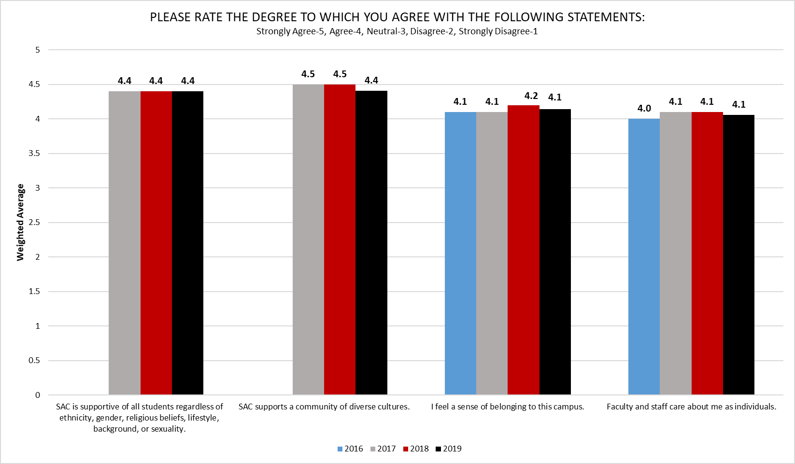
Source: RSCCD SAC Student Satisfaction Survey 2016-2019-PK

Slide 8
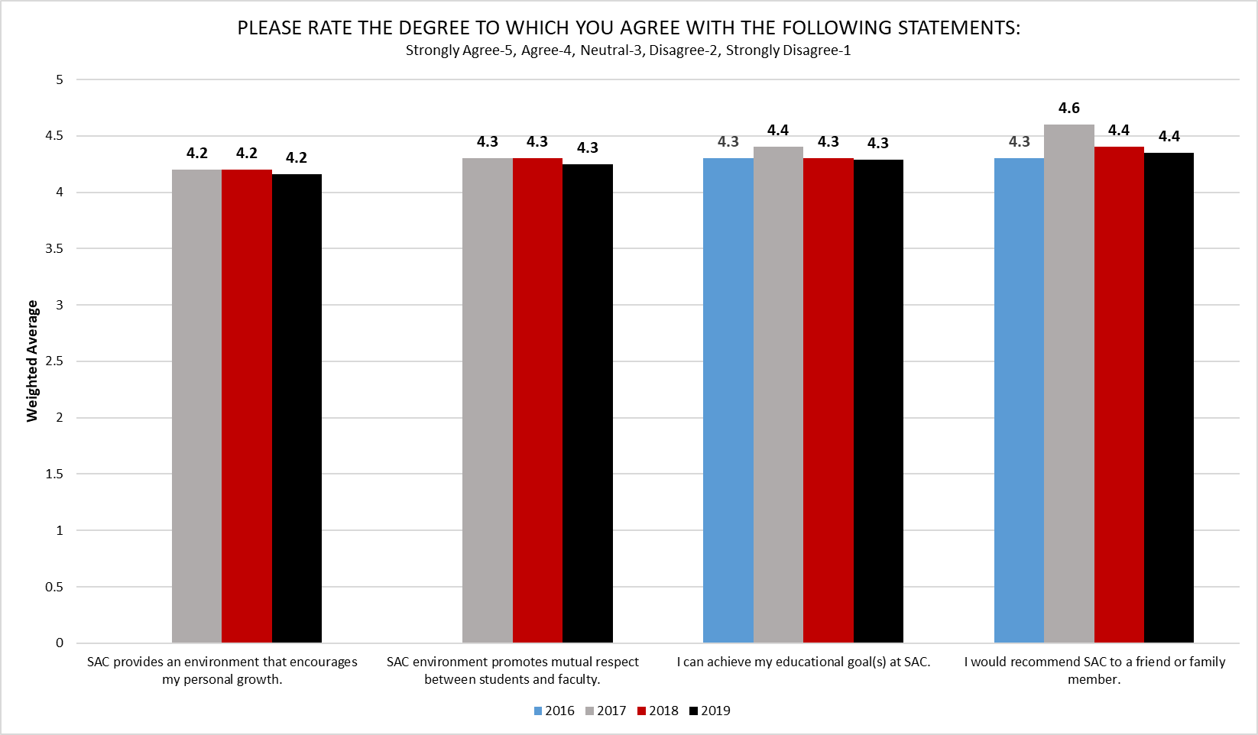
Source: RSCCD SAC Student Satisfaction Survey 2016-2019-PK

Slide 9
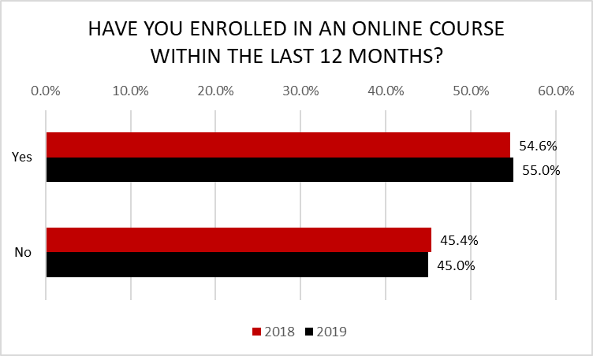
Source: RSCCD SAC Student Satisfaction Survey 2018-2019-PK

Slide 10
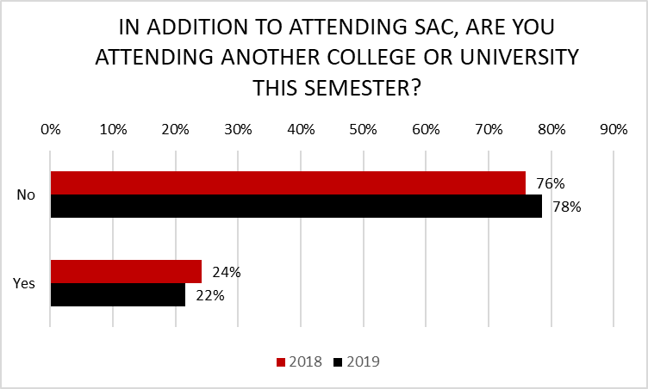
Source: RSCCD SAC Student Satisfaction Survey 2018-2019-PK

Slide 11
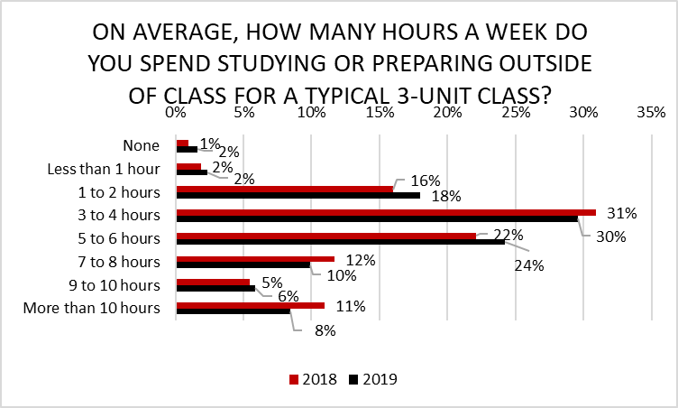
Source: RSCCD SAC Student Satisfaction Survey 2018-2019-PK

Slide 12
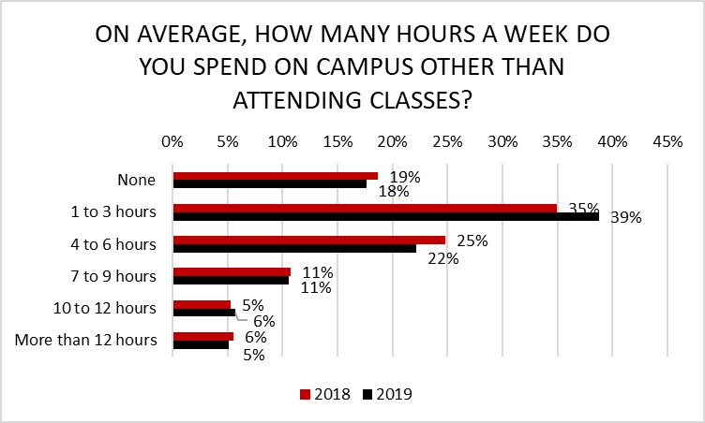
Source: RSCCD SAC Student Satisfaction Survey 2018-2019-PK

Slide 13
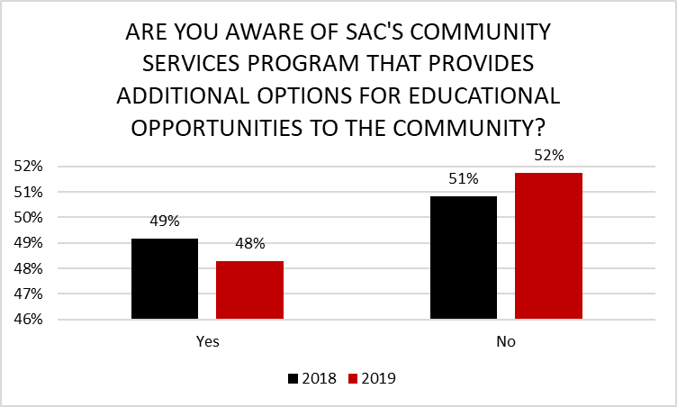
Source: RSCCD SAC Student Satisfaction Survey 2018-2019-PK

Slide 14
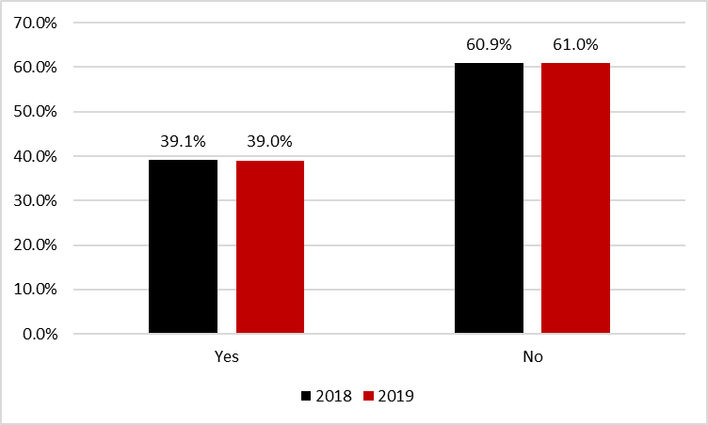
ARE YOU AWARE OF THE NONCREDIT PROGRAM ON CAMPUS THAT OFFERS FREE SHORT-TERM, ENTRY-LEVEL EMPLOYMENT PREPARATION PROGRAMS, SUCH AS VOCATIONAL CONSTRUCTION TECHNOLOGY, CUSTOMER SERVICE REPRESENTATIVE, PARAPROFESSIONAL MENTAL HEALTH, AND CLASSES THAT LEAD TOWARD THE ATTAINMENT OF AN ADULT HIGH SCHOOL DIPLOMA?
Source: RSCCD SAC Student Satisfaction Survey 2018-2019-PK

Slide 15
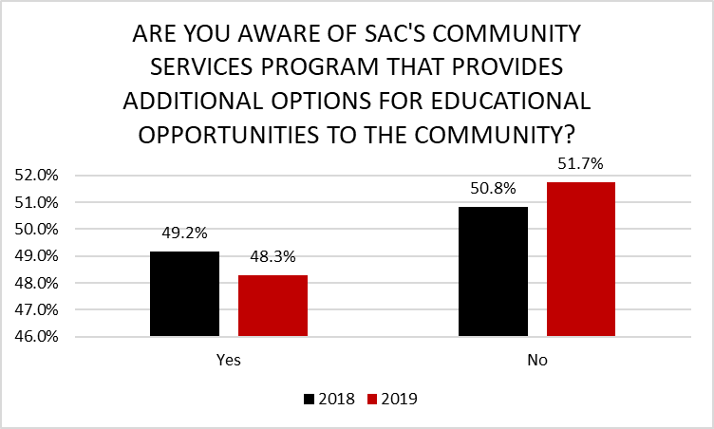
Source: RSCCD SAC Student Satisfaction Survey 2018-2019-PK

Slide 16
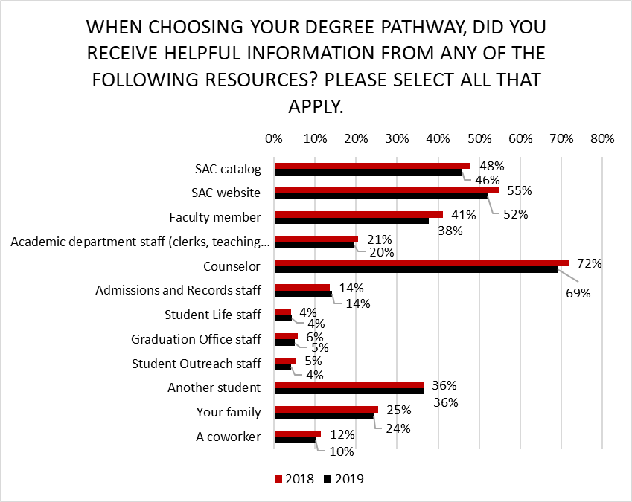
Source: RSCCD SAC Student Satisfaction Survey 2018-2019-PK

Slide 17
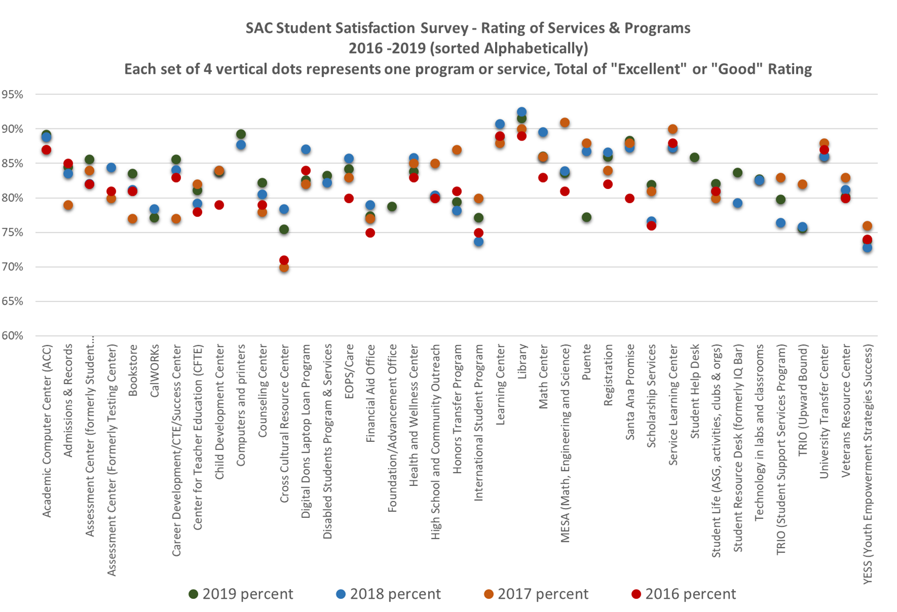
Source: RSCCD SAC Student Satisfaction Survey 2016-2019-PK

Slide 18
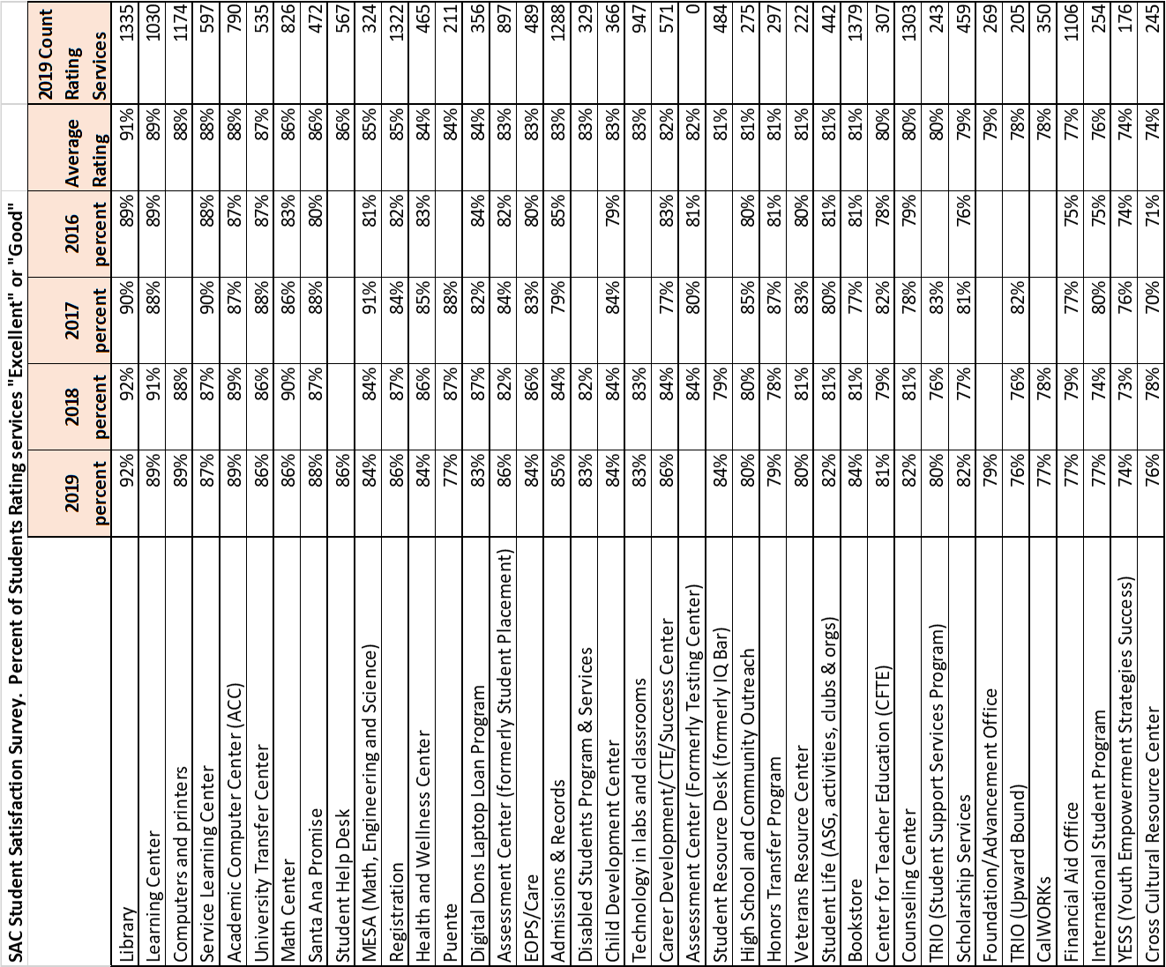
Source: RSCCD SAC Student Satisfaction Survey 2016-2019-PK

Slide 19
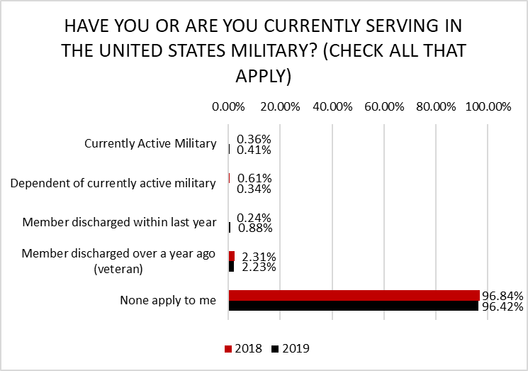
Source: RSCCD SAC Student Satisfaction Survey 2018-2019-PK

Slide 20
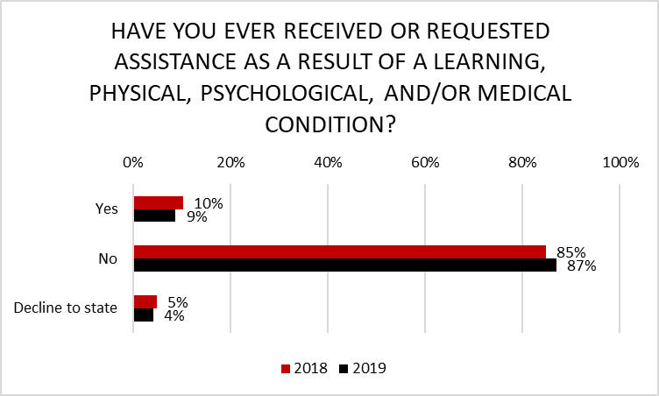
Source: RSCCD SAC Student Satisfaction Survey 2018-2019-PK

Slide 21
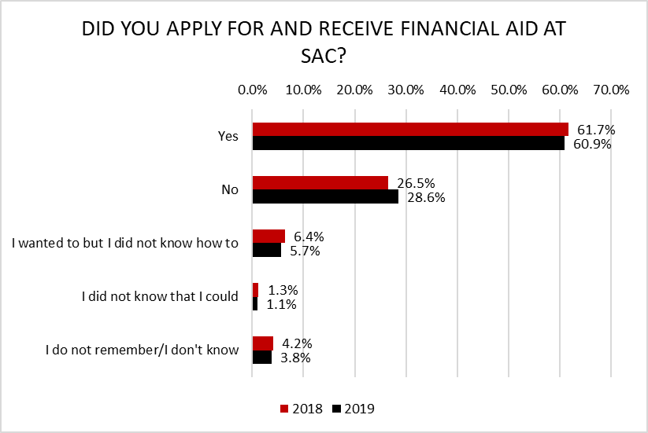
Source: RSCCD SAC Student Satisfaction Survey 2018-2019-PK

Slide 22
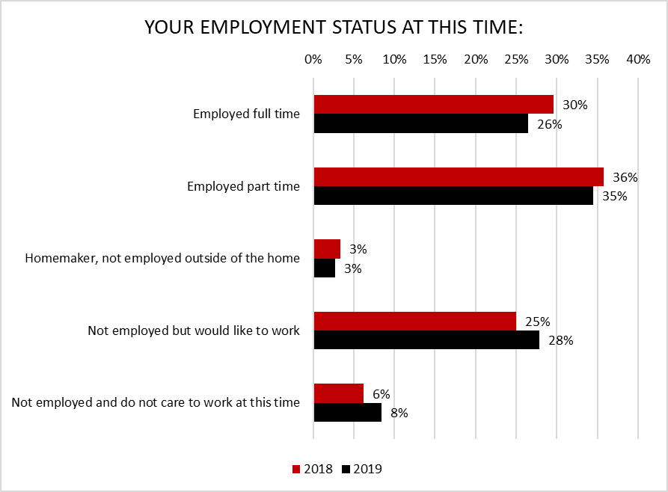
Source: RSCCD SAC Student Satisfaction Survey 2018-2019-PK

Slide 23
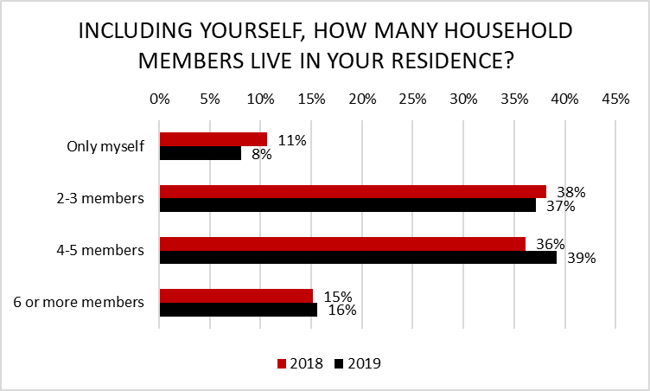
Source: RSCCD SAC Student Satisfaction Survey 2018-2019-PK

Slide 24
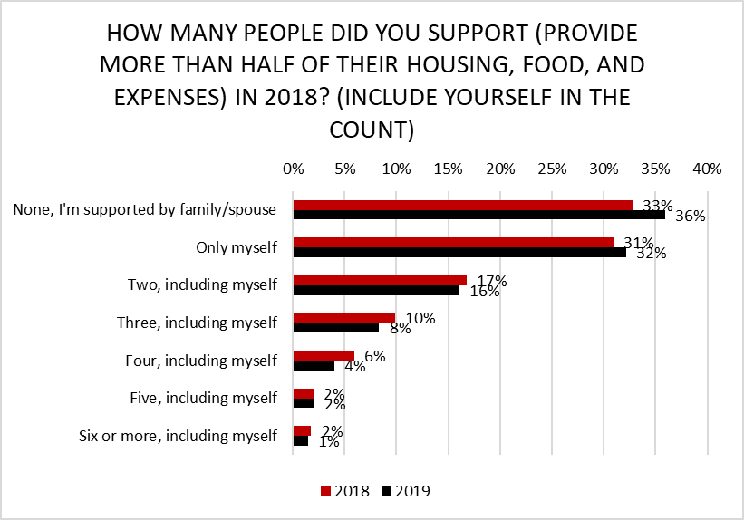
*2018 Percentages were taken from the 2017 Survey
Source: RSCCD SAC Student Satisfaction Survey 2018-2019-PK

Slide 25
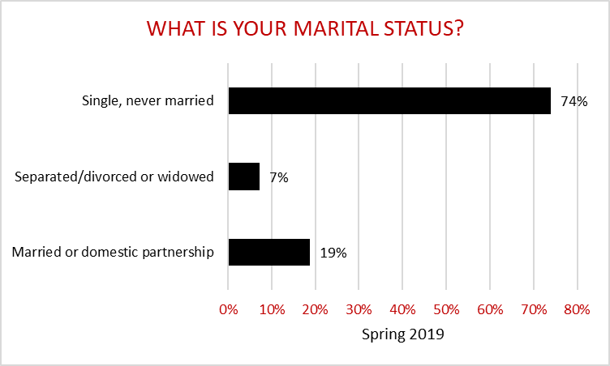
*12% are single parents (fathers and mothers combined)
*10% are single mothers
Source: RSCCD SAC Student Satisfaction Survey 2019-PK

Slide 26
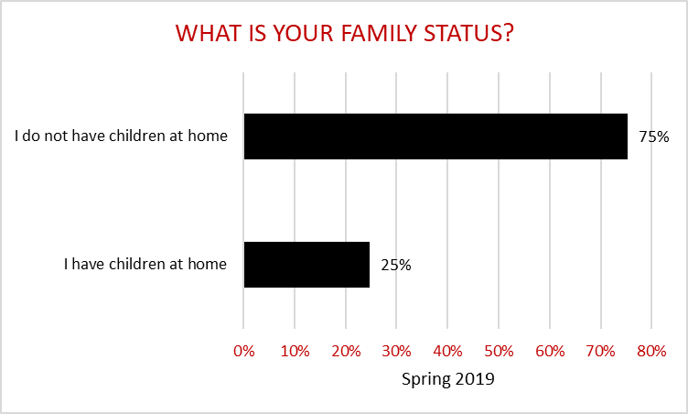
Source: RSCCD SAC Student Satisfaction Survey 2019-PK

Slide 27
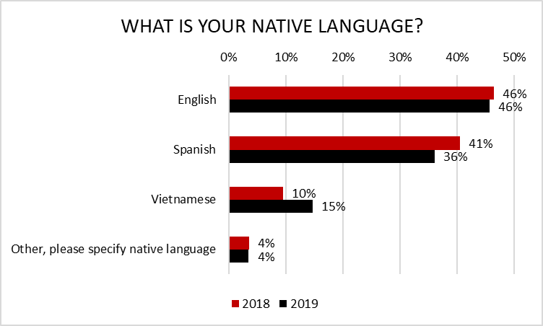
Source: RSCCD SAC Student Satisfaction Survey 2018-2019-PK

Slide 28
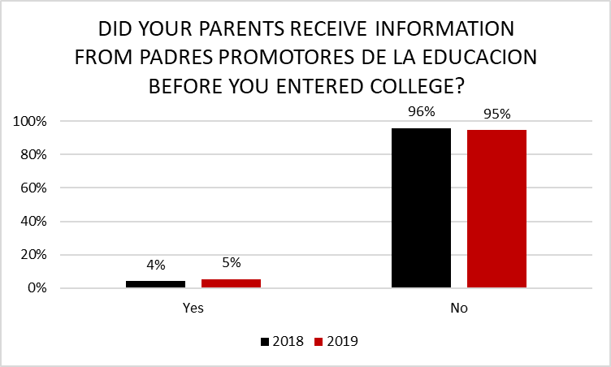
Source: RSCCD SAC Student Satisfaction Survey 2018-2019-PK

Slide 29
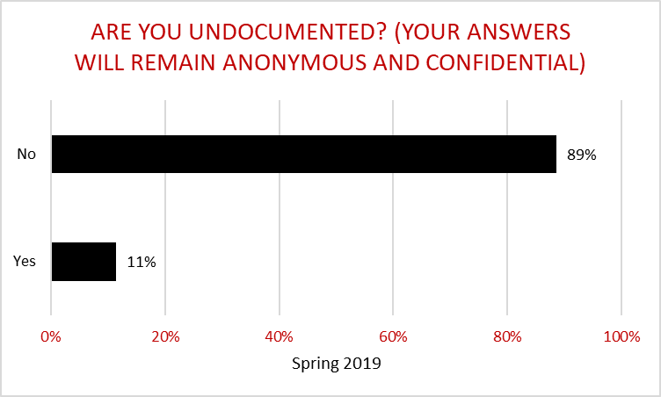
Source: RSCCD SAC Student Satisfaction Survey 2019-PK

Slide 30
Student Comments
“Overall, I am very happy to attend this college because almost all professors are great. However, I would like for the restrooms to be remodeled and clean and neat. Also, more healthy delicious food. The food taste horrible and it's super expensive. Clerical staff needs to be more professional and patient. “
“There is discrimination on the campus.”
“Love the instructors and counselors”
Source: RSCCD SAC Student Satisfaction Survey 2019-PK

Slide 31
Student Comments
“I qualify for financial aid but I don’t know how to fill out the application correctly. I would like more help if possible. “
“Thanks for everything you do for students. Keep the good work!! “
“I adore the staff and, faculty for always being supportive of students. Construction is a huge constraint. Cannot wait to see how the campus will look when it’s completed. “
Source: RSCCD SAC Student Satisfaction Survey 2019-PK

Slide 32
Student Comments
“Use measure C, etc. money to build a parking structure/garage. “
“The classrooms, labs, and restrooms were often dirty. “
“There needs to be a variety of times core classes offered and more afternoon classes for working students. “
Source: RSCCD SAC Student Satisfaction Survey 2019-PK

Slide 33
Student Comments
“SAC is an excellent school. I love that it is small and it feels like home. I truly enjoyed my experience while I was a student. “
“SAC should try to include Middle College High School students because after all we too are college students and deserve the same services as any other SAC student. We attend school from Mon-Fri on SAC campus, yet we don’t feel included or part of the SAC community. “
“Why do you care about cultural diversity? It seems to me like you should not factor this, and should instead focus on more on the school itself. The diversity should just come with time, applicants, and location.”
Source: RSCCD SAC Student Satisfaction Survey 2019-PK

Slide 34
Student Comments
“I am entering my third semester in the nursing program and feel very supported overall by staff. “
“I chose to go to a private nursing program instead of SAC because of the waitlist.”
“The tutors in the Math Lab and Learning Center are OUTSTANDING!”
Source: RSCCD SAC Student Satisfaction Survey 2019-PK

