Slide 1
Student Equity & Achievement Program Committee

Slide 2
Charge: The Student Equity and Achievement Program
Evaluate, recommend, and approve student success initiatives;
Discuss the integration of the programs and services into the new Guided Pathways framework.
Analyze success, equity, and achievement data and set goals for improvement on an annual basis;
Identify and promote interventions with the potential to address;
Achievement/outcome gaps, assist students, and strengthen the institution;
Create and interpret related policies and procedures, as well as monitor implementation efforts underway;
Create incentives for broad involvement in implementation activities as appropriate.

Slide 3
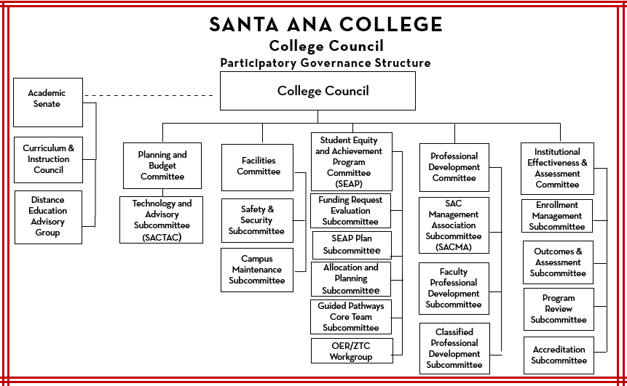

Slide 4
Subcommittee’s
Guided Pathways Core Team-Stephanie Clark
Funding Request Evaluation: Jessica Hamman, John Nguyen, Tyler Johnson, Janet Cruz-Teposte, Maria Aguilar Beltran
Purpose
  Fall semester-review the mid-year reports and evaluate the outcomes of the requests.
  Spring semester-review the new equity request for the coming year, mid-year reports, and make recommendations to approve/deny funding.
  Meet as needed to evaluate any request that would require a change approved equity awards.
SEAP Plan: Dr. Vaniethia Hubbard, Dr. Jeffrey Lamb, Dr. Fernando Ortiz, Dr. Maria Dela Cruz, Research Director, Maria Aguilar Beltran, Janet Cruz-Teposte
Purpose
  Review and update the equity plan
  Review USC data and plan analysis
  Allocation and Planning:

Slide 5
Workgroups (ongoing)
OER/ZTC: Annie Knight and Jodi Coffman
AB 943: Janet Cruz-Teposte, Alicia Kruizenga, Alejandro Moreno, Maria Aguilar Beltran
Purpose
  Fall & Spring-review AB 943 student emergency grant applications and make award recommendations
  Applications for Spring 2021 will be made available to students Tuesday, February 16th.

Slide 6
Taskforce (short term or as needed)
College Mascot "El Don": Alicia Kruizenga, Athletics Department
Purpose
  Explore the history and meaning of El Don.
  Are there actions we can take to decolonize our mascot name?
  Recommendations on other options?
Men of Color: Dr. Fernando Ortiz, Dr. Armando Soto, Leo Pastrana, Dr. Marty Romero, invite: Kalonji Saterfield, Alondo Campbell, John Nguyen, Chris Sanchez, SCE Member
Purpose
  Why are we not retaining man of color at our campus?
  What are some systemic strategies?
  What can we do to support man of color?

Slide 7
SEAP Committee
 | Goal: | Measurable Outcome | Means of Assessment | Link to Strategic Goal | Completion Date | Responsible Person / Group | Notes
1. | Effective use of research
2. | Men of Color
3. | OER/ZTC marketing
4. | Impact of COVID on DI groups
5. | Update Equity plan/links to GP equity elements
6. | Outcomes on Equity funded projects over the years

