Slide 1
New Faculty Institute
4-year Framework, Themes, & Experiences Plan

Slide 2
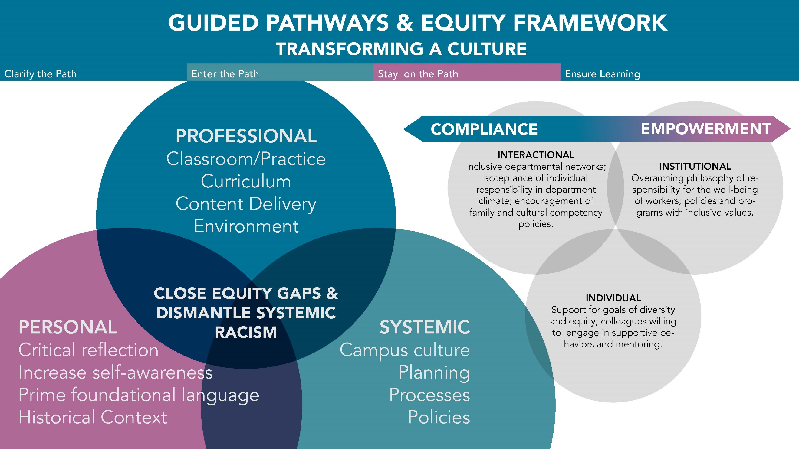

Slide 3
State & Local Goals
SoAA Ensure Learning 4a, 4b, 4c, 4d, 4e, & 4g
Integrated Plan: Professional development opportunities for faculty and staff
Professional Development 2-Year Plan
Vision for Success Goal 1, 2, 3, 4, and 5
Goal: Develop a community of First-Generation Equity-minded Practitioners that will support the systemic transformation of our institution.

Slide 4
Guiding Principles
Equity Principles:
Equity-Minded schema includes being race conscious, institutionally focused, evidence based, systemically aware, and action oriented
Willing to examine and question deficit-minded language, biases, institutional racism, and the power dynamics that help maintain white supremacy historical values
Using our Guided Pathways framework, our goal is to develop a comprehensive and holistic professional development experience for new faculty using our Guided Pathways and Equity Framework.
As we continue to develop our plan-of-action, we are interrogating our work through the lens of four value systems:
OPEN CAMPUS CULTURE: Advance a program that affirms an inclusive and diverse campus culture.
FACULTY EMPOWERMENT & AGENCY: Expose faculty to an empowering onboarding experience that creates internal and external community connections and supports.
COURAGEOUS LEADERSHIP: Train faculty in leading inquiries, challenging issues, addressing policies and processes, and transforming the campus community.
CULTURAL CONSCIOUSNESS & EQUITY: Ensure that faculty have robust equity-minded PD training that supports the ongoing transformation of their teaching practices and student experience.

Slide 5
Year 1: FOUNDATIONAL KnowledgE
The personal involves us having a common understanding of the equity and social justice terminology, learn about the inequitable historical context of our institution, and engage in ongoing critical reflection that leads to increasing our self-awareness and deepening our intrapersonal and interpersonal practice.
Proposed Group Oversight: Guided Pathways & Equity Learning & Engagement Team supported by the Professional Development Workgroup.
OVER-ARCHING YEAR-LONG THEMES
Empowerment
Intrusive & Intentional Faculty Support - Introduce outlets and workgroups to assist in navigating tenure. (policies/best practices/curriculum design/union & contract, misc.)
Campus Culture (What is it? Finding your place.)
Foundational Language - State-wide acronyms, initiatives, local vocabulary and the grants/offices addressing these
Campus tour, including key areas in Student Services and SCE (Advice on connecting students with resources. Overview of teaching modalities and tools.)
Community introduction and outreach. Visit/connect with key areas of the community.
Mentor assigned (Equity Minded Teaching & Learning Institute Certified)
Foundational Language - Pathways & DEI Vocabulary & Practices - classroom culture/learning/content/outcomes/portfolio design

Slide 6
Year 2: Professional Practice
The professional involves incorporating equity-minded and culturally responsive andragogy practices, services, and environment for students.
Proposed Group Oversight: Guided Pathways & Equity Learning & Engagement Team
Completion Badge
Focused on teaching and/or services, programs. Documenting change and improvement.
Engage in community of praxis.
Interdisciplinary Collaborations (SOAA 4-b)
Equity-Minded Teaching & Learning Institute (Curriculum, Syllabus, Grading, Outcomes, Redesign & Pillar 4)
Engage in ongoing interrogation of course data, student surveys, etc.
OVER-ARCHING YEAR-LONG THEMES
Empowerment & Transformative Practice Development
Continue working with Mentor from Year 1

Slide 7
Year 3: Service & Leadership Training
The systemic involves evaluating, transforming, and designing flexibility in our campus culture, policies, processes, and procedures to support the diverse needs of our students.
Proposed Group Oversight: Racially Inclusive Senate Workgroup
Completion Badge
Courageous Leadership Institute: A focus on equitizing our systems (recommendation by the Academic Senate Racially Inclusive Workgroup)
Continue to work with mentor and collaborate with department/division.
Institutional involvement – Assist with placing faculty on Committees, Senate, etc.
OVER-ARCHING YEAR-LONG THEMES
Professional Showcase – Showcase the transformative practices & creative pedagogy of our new faculty (PD workshops, etc.)
Empowerment, Civic Engagement & Ally-ship
Academy of College Excellence with Diego Navarro (FELI)
Train new faculty as mentors – this will be done within the leadership institute - Begin mentoring year 1 cohort.

Slide 8
Year 4: Leaders & Facilitation
The systemic involves evaluating, transforming, and designing flexibility in our campus culture, policies, processes, and procedures to support the diverse needs of our students.
Proposed Group Oversight: Professional Development Workgroup & Senate Exec. Board
Empowerment & Courageous Leadership
Deeper Self-Reflection: opportunities, access and support for intensive/immersive professional development (individual and campus-wide PD, for example, Skyline, USC Race Institute, Lumen Circle, 3CSN, CoP, OEI/OER, etc.).
Expand new faculty leadership involvement (Co-Chair a committee, attend AS Plenary, get involved at the state level, etc.)
Invite 4th year new faculty to lead institute trainings
Continue mentoring 2nd Year new faculty
OVER-ARCHING YEAR-LONG THEMES
Celebrate tenure!

Slide 9
Tenured (5th Year) On-Going PD
Proposed Group Oversight: Professional Development Workgroup, Senate Exec Board, & Institutional Effectiveness & Assessment Committee
Chair Training / Evaluations
OVER-ARCHING THEMES
Program Review (annual & 4-year, best practices and tools)
Ongoing institutional service
Mentoring
Administration & Coordination (up-skilling)
Courageous & Transformative Leadership

Slide 10
Resources
Diablo College PD Plan
First Generation Equity-Minded Practitioner
Vision for Success

