Slide 1
Student Equity & Achievement Program Committee

Slide 2
Charge: The Student Equity and Achievement Program
Evaluate, recommend, and approve student success initiatives;
Discuss the integration of the programs and services into the new Guided Pathways framework.
Analyze success, equity, and achievement data and set goals for improvement on an annual basis;
Identify and promote interventions with the potential to address;
Achievement/outcome gaps, assist students, and strengthen the institution;
Create and interpret related policies and procedures, as well as monitor implementation efforts underway;
Create incentives for broad involvement in implementation activities as appropriate.

Slide 3
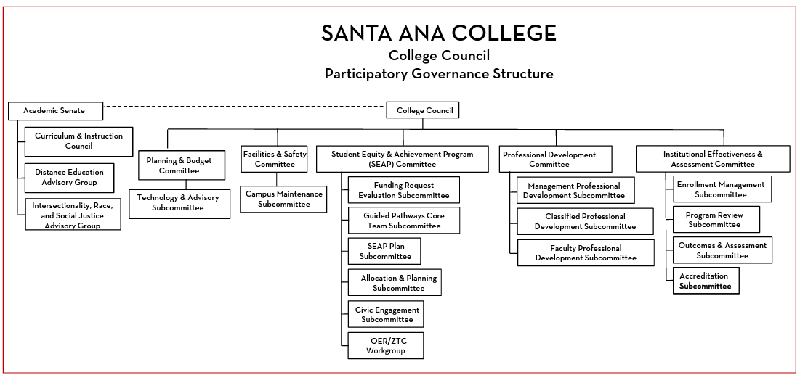

Slide 4
Subcommittee’s
Funding Request Evaluation: Prior Members: Jessica Hamman, John Nguyen, Tyler Johnson, Janet Cruz-Teposte, Maria Aguilar Beltran
Fall 2022: TBD (Jessica and John- No longer at SAC)
Purpose
  Fall semester-review the mid-year reports and evaluate the outcomes of the requests.
  Spring semester-review the new equity request for the coming year, mid-year reports, and make recommendations to approve/deny funding.
  Meet as needed to evaluate any request that would require a change approved equity awards.
SEAP Plan: Prior Members Dr. Vaniethia Hubbard, Dr. Jeffrey Lamb, Dr. Fernando Ortiz, Dr. Maria Dela Cruz, Dr. Daniel Martinez-Research Director, Maria Aguilar Beltran, Janet Cruz-Teposte
Fall 2022: Dr. Maria Dela Cruz (confirmed)
Purpose
  Review and update the equity plan
  Review USC data and plan analysis
Allocation and Planning: Executive Team: Dr. Vaniethia Hubbard, Dr. Jeffrey Lamb, Chantal Lamourelle
Fall 2022: Members remain the same
Purpose
  Meets after the Funding Request Evaluation Subcommittee has completed request evaluation review to make final recommendations

Slide 5
Workgroups (ongoing)
OER/ZTC: Annie Knight and Jodi Coffman-
“To increase equity through the promotion, marketability, accessibility, recommendation, and awareness of quality Open Educational Resources (OER) and Zero Textbook Cost (ZTC) initiatives for the Santa Ana College students.”
AB 943: Prior Members: Janet Cruz-Teposte, Alicia Kruizenga, Alejandro Moreno, Maria Aguilar Beltran, Vanessa Orozco-Martinez
Fall 2022: Janet Cruz-Teposte, Vanessa Orozco-Martinez (confirmed)
Purpose
  Fall & Spring-review AB 943 student emergency grant applications and make award recommendations
  $50,000 available per semester

Slide 6
Taskforce (short term or as needed)
College Mascot "El Don": Prior Members: Maria Aguilar Beltran, Alicia Kruizenga, Athletics Department, Geoff Jones, Cammie Lewis, Luis Fernandez, Kristen Guzman, Selina Lievanos, Jordan Clark, John Nguyen, Michelle Sandoval, Raul Quinonez, Sarah Bennet, Dalilah Davaloz, Stephanie Clark, Dr. Merari Weber, Dr. Kevin Kawa, Mary Hegarty, Denise Bailey
Fall 2022: Amberly Chamberlain (confirmed)
Purpose
  Explore the history and meaning of El Don.
  Are there actions we can take to decolonize our mascot name?
  Recommendations on other options?

Slide 7
Taskforce (short term or as needed)
Men of Color: Prior Members: Dr. Fernando Ortiz, Dr. Armando Soto, Leo Pastrana, Dr. Marty Romero, invite: Kalonji Saterfield, Alondo Campbell, John Nguyen, Chris Sanchez, SCE Member
Fall 2022: TBD
Purpose
  Why are we not retaining men of color at our campus?
  What are some systemic strategies?
  What can we do to support men of color?

