Slide 1
Student Equity Plan 2022-2025 Webinar

Slide 2
Welcome & Introductions

Slide 3



Housekeeping
Closed Captioning
Click the tab to read live captions.
Question and Answer
Click this tab to enter questions for the presenters and read their responses. Some questions will be answered live at the end of this session.
Chat
Click this tab to chat with attendees and speakers.

Slide 4
Presenters for Today
Michael Quiaoit, Dean, Student Services and Support, California Community Colleges Chancellor’s Office
Anthony Amboy, Program Assistant, Student Equity and Achievement Program, Guided Pathways Program, California Community Colleges Chancellor’s Office
Dr. Ray Ramirez, Director, Student Equity & Success, Fresno City College
Dr. Laura Lara-Brady, Regional Coordinator, Foundation for California Community Colleges
Dr. Eric R. Felix, Assistant Professor, CCHALES Research Collective, San Diego State University
Sabrina Sencil, Interim Director, Research and Equity, Cosumnes River College | RP Group Regional Board Member
Alexandra Lozanoff, Senior Project Manager, WestEd
Karen Beltramo, Senior Project Manager, WestEd
Michael Tran, Program Analyst, Student Equity and Achievement Program, Guided Pathways Program, California Community Colleges Chancellor’s Office

Slide 5
Agenda
Welcome and Introductions
Background Behind the Design of the 2022-25 Student Equity Plan
Student Equity Plan Tutorial
Student Equity Plan Data
Key Points from Presentation
Q & A
Key Dates and Information

Slide 6
An Intentional Student Equity Plan
Notes:
Laura & Ray

Slide 7
Intentions of Student Equity Plan 2.0
Context
National landscape changes since 2014
Collaborative with colleagues from the field
Multiple pandemics (racial reckoning, COVID)
Increase collaboration and integrating with other areas at the college
Keeps students at the center
Opportunity to transform institutions in new ways
Stronger alignment to the Vision for Success Goals and the Call to Action
New Iteration
Notes:
Laura & Ray

Slide 8
Changes in Design
Student Equity Plan 1.0
2018-2022
Student Equity Plan 2.0
2022-2025
Transactional
Compliance oriented
One and done
Race-neutral
Standalone plan
Compartmentalized funding
Transformational
Community driven, thoughtful/meaningful, reflective
Fluid and dynamic
Race-consciousness
Inform other institutional plans
Braiding of funds (trenza)
Notes:
Laura & Ray

Slide 9
SEP Workgroup’s Approach to the Data
Our approach was informed by our commitment to take action and responsibility for inequities experienced by racially minoritized student populations at our colleges.
The SEP Workgroup focused on disaggregated data that:
supports alignment with Guided Pathways and Vision for Success
raises awareness and helps colleges prioritize actions that serve student populations experiencing the disproportionate impact at the colleges
are accessible to all colleges via the dashboard, data-on-demand files, or local data to strengthen their ongoing capacity building efforts
Notes:
Sabrina
framing that is empowering rather than compliance
Data and understanding your student success metrics should empower colleges to take action.
Make the data connection between the metrics and Guided Pathways and Vision for Success.
Building capacity to do what

Slide 10
Race-Conscious Design and
A Shift Away from “Activities”
Notes:
Eric working with Anthony Amboy
2/16 Lesley w/Ray

Slide 11
Race-Conscious Design
“SEA-ing” the Racial Possibilities
But…All Students Matter
See Racial Inequity, Explicitly Address Racial Inequity
New Context, New Collective, New Opportunities
Notes:
ERF
2/16 Lesley

Slide 12
A Shift Away from “Activities”
No One-Offs or Disconnected Equity Activities
Go Beyond Student Services and Into the Classroom and Curriculum
Let’s Leverage Existing Work and Build Efforts Across Campus Reforms
Systemic Inequities, Require Systemic Responses
Notes:
ERF
2/16 Lesely

Slide 13
Please share race-conscious equity efforts occurring at your college!
Let us know in the chat!
Ask the Audience:
Notes:
Anthony
After we’ve talked about these changes, inquire the audience to ask the chat to share and acknowledge work already being done. Shift slide over to a audience engagement.
If there is little to no response in the chat, then I think it’d be okay to say that we understand each college may be at a different point in their equity journey, and our hope is that these plans and their implementation will result in a more robust dialogue about the race-conscious transformative equity work moving forward.
and then transition through the walk through.

Slide 14
Student Equity Plan Tutorial

Slide 15
Student Equity Plan Data
WestEd

Slide 16
Student Equity Plan Data
Who is managing the data?
What data will campuses receive?
How will Disproportionate Impact be determined?
Where will campuses access the data?
When will the data be available?

Slide 17
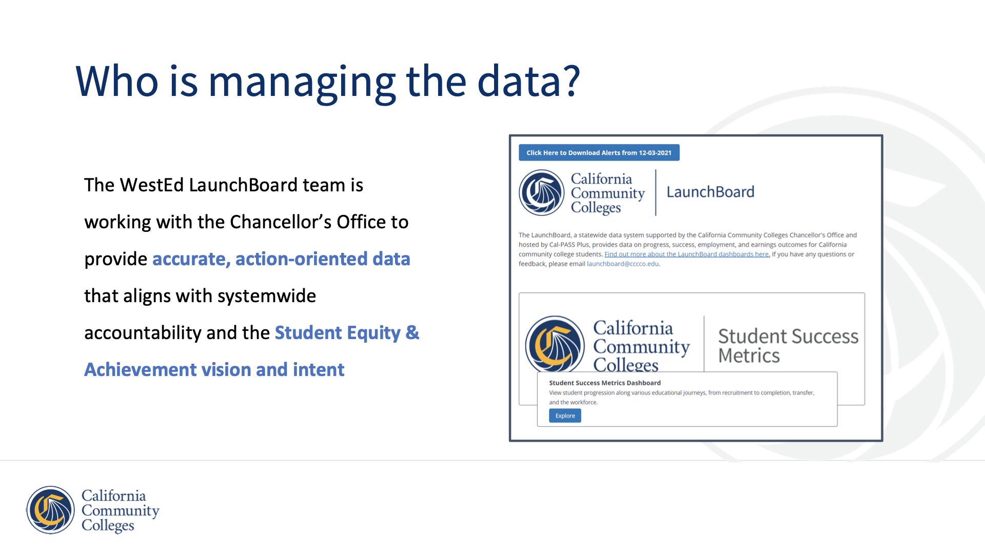
Student Equity Plan Data 2/2)
Who is managing the data?
What data will campuses receive?
How will Disproportionate Impact be determined?
Where will campuses access the data?
When will the data be available?

Slide 18
What data will colleges receive?
Disaggregated Data on these Student Outcomes
Successful Enrollment in the first year
Completed Transfer Level Math & English in the first year
Persisted from First Primary Term to Subsequent Primary Term
Attained the Vision for Success Definition of Completion within three years
Transferred to a Four-Year Institution within three years
Notes:
These five metrics are essentially the same metrics as those provided from the SSM dashboard three years ago for the 2019 SEP. However, the definitions have refined over time based on CO decisions and alignment with other accountability frameworks.

Slide 19
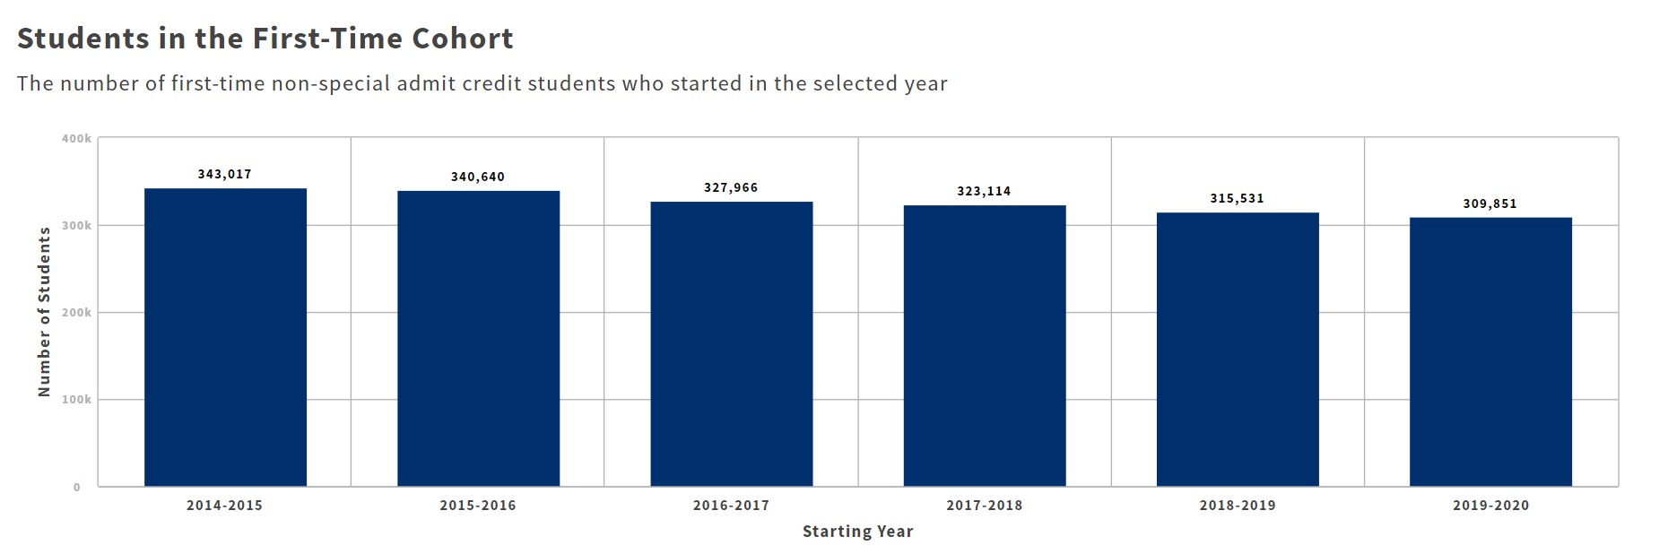
Student Cohort Data
Outcomes will be provided for first-time cohort students
Notes:
Highlight that the data will be for first-time students. This graph shows the number of students in each cohort. For example, there were 340,640 students who enrolled in a CCC for the first-time in 16-17. We’ll have information on the percent of those 340,000 students who reached out five target outcomes.

Slide 20
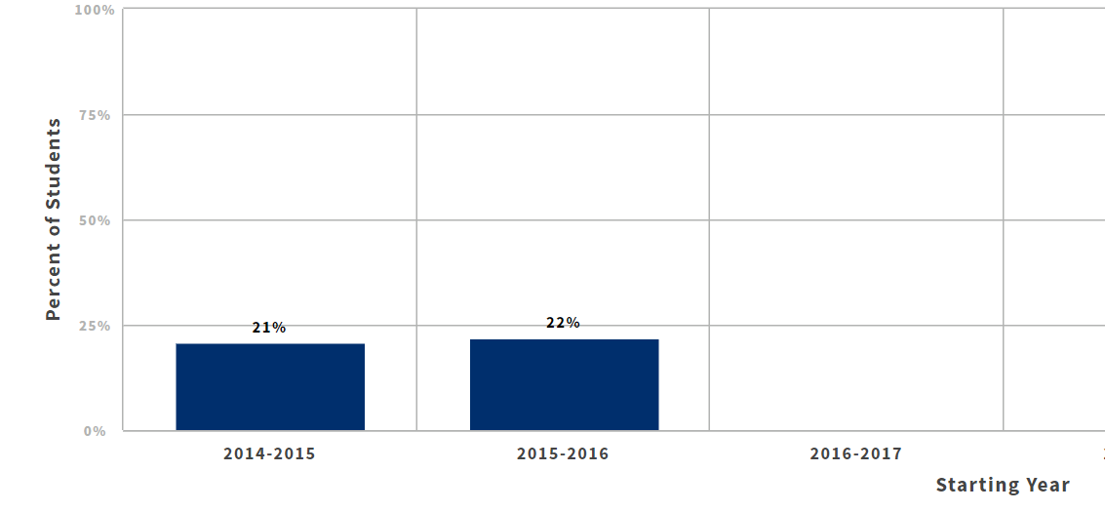
Systemwide Data
Systemwide data that provides information that is not otherwise not available:
Includes only students who are first-time in the system
Includes student outcomes who achieved outcomes beyond a single college
Matches exited students to enrollment at four-year postsecondary institutions
Transferred to a Four-Year Institution within three years
Notes:
As a reminder: this data is systewide, which means it has information that is not otherwise available to a single college or district
beyond a single college - see students who complete transfer-level math and english anywhere in the district
excited the system - a college may not know when a student had left to another college or whether they transferred
Use this slide to explain that for the metrics related to transfer, we’ll only have data for students who enrolled for the first time in 14-15, 15-16 or 16-17 (when the next round of data is updated). Explain that we won’t know what percentage of students who started in 19-20, for example, until it’s been three years sinc they first started OR – use the following slide of a more detailed explanation – OR don’t mention the timeframe/incomplete data issue at all

Slide 21
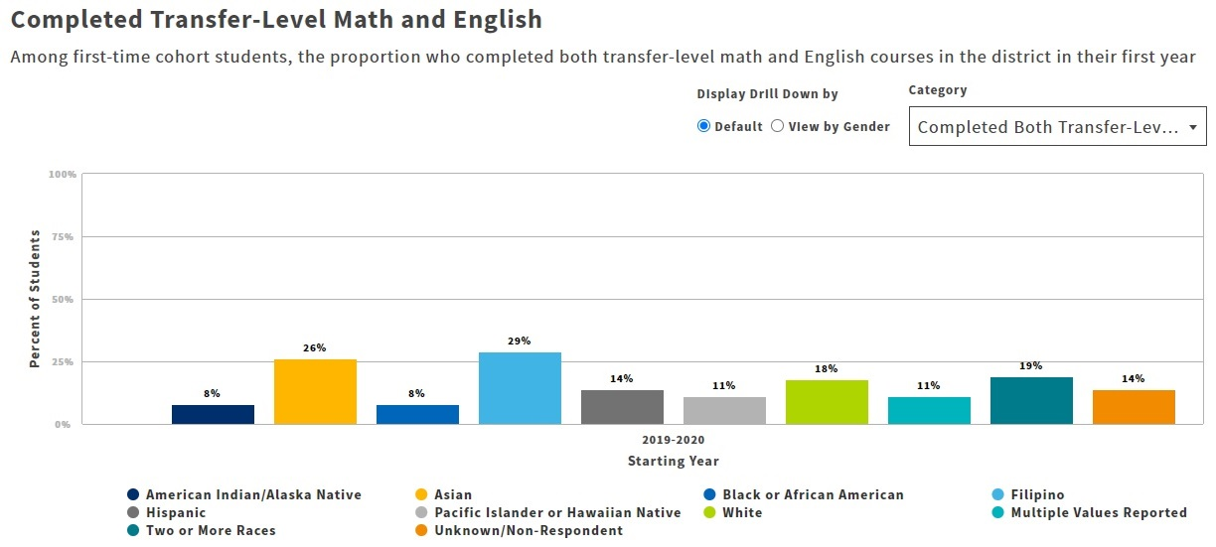
Disaggregated Data on Student Outcomes
oRace/Ethnicity
oGender
oLGBT
oPerkins Economically Disadvantaged
oFirst Generation
oFoster Youth
oStudents with Disabilities
oVeterans
oHomeless
Notes:
All these disaggregations are spelled out in the SEA legislation, except for first-generation, which was added based on requests from the field. We want to note that homeless is a new disaggregation this year, and is data that has newly begun to be collected by campuses

Slide 22
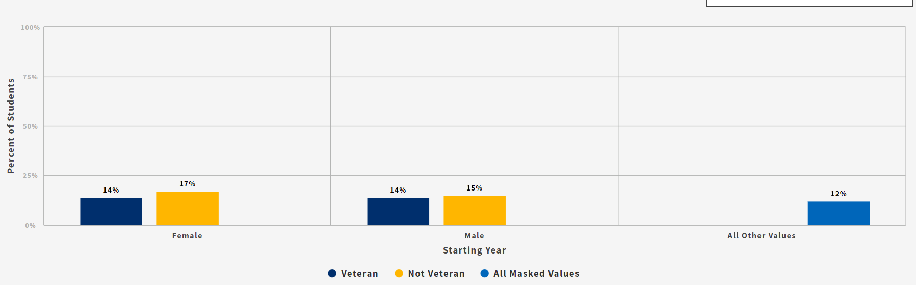
Further Disaggregated Data on Student Outcomes
Outcomes for all disaggregations will be further disaggregated by gender
Completed Transfer-Level Math & English
Among first-time cohort students, the proportion who completed both transfer-level math and English courses in the district in their first year

Slide 23
How will Disproportionate Impact be determined?
Methodology: Percentage Point Gap - 1
Compare the outcomes of students in a specific subgroup to the outcomes of all other students
When the gap is larger than a specific threshold, that group is considered to be disproportionately impacted and flagged
If DI is flagged, then the minimum number to meet the threshold and full number of students needed to close the equity gap are calculated
Note: The Chancellor’s Office will complete these calculations and highlight all groups that are experiencing DI based on this system wide methodology
To learn more about the PPG method for calculating Disproportionate Impact, please go to: https://www.cccco.edu/-/media/CCCCO-Website/About-Us/Divisions/Digital-Innovation-and-Infrastructure/Research/Files/PercentagePointGapMethod2017.ashx
Notes:
As an example, let’s consider the percent of Hispanic students who transfer with the percent of all other students who transfer. The PPG-1 method removes Hispanic students from all students for comparison of transfer rates in order to mitigate failing to detect disproportionate impact for HIspanic students (or other subgroups that might make up a large proportion of the population at a school) since you'd largely be comparing Hispanic students or any other large student subgroup populations to themselves and would not detect DI.
Let’s say we see that 10% of Hispanics and 15% of all other students (overall - hispanics) in the cohort transferred to a four-year within the 3-yr timeframe. Then there is a negative 5 percentage point gap. If our threshold or margin of error is 2, then that gap is considered significant since 5 is greater than 2. So, Hispanic students are experiencing DI for transfer. If the gap was only 1.8% or less than 2%, then the subgroup would not be flagged as experiencing DI.

Slide 24
Where will colleges access this data?
3 files will be delivered to districts through Data on Demand:
2022 SEP data file: csv file with the latest year available for first-time cohorts for each of the five metrics
Historical: csv file with the all of the years of data for all first-time cohorts included in the SSM cohort view for each of the five metrics
Instructions: Read Me First file to explain the data
Notes:
As a reminder, in the historical data, you will not have completion and transfer outcomes for cohorts that started in recent years, because a full three years have not yet passed to count the metric.

Slide 25
2022 SEP data file: latest year(s) available
Metrics | Available data for each cohort (based on 3-year timeframe)
Starting Academic Year of First Time Cohorts | 2016-17 | 2017-18 | 2018-19 | 2019-20 | 2020-21
Successful Enrollment in the first year | ☑️ | ☑️ | ☑️ | ☑️ | 2022 SEP Data File
Completed TL Math & English in the first year | ☑️ | ☑️ | ☑️ | ☑️ | 2022 SEP Data File
Persisted from First Primary Term to Next | ☑️ | ☑️ | ☑️ | 2022 SEP Data File
Attained Vision Goal Definition of Completion* | ☑️ | 2022 SEP Data File
Transferred to a 4-Year Institution | 2022 SEP Data File
*REMINDER: The Vision for Success Goal definition of completion includes CO approved certificates 8+ unis, associate degrees and community college bachelor degrees
Notes:
We are showing this chart again, which highlights the data that you will receive in the 2022 SEP data file.
The 2022 data file will include the percent of students in the 2021 cohort who successfully enrolled in their first year and who completed TL math and english in the first year. The transfer data that will be included with be the percentage of students in the 18-19 cohort who attained the vision goal definition of completion – and that’s because that the first cohort of students for whom three years have passed since they first started.

Slide 26
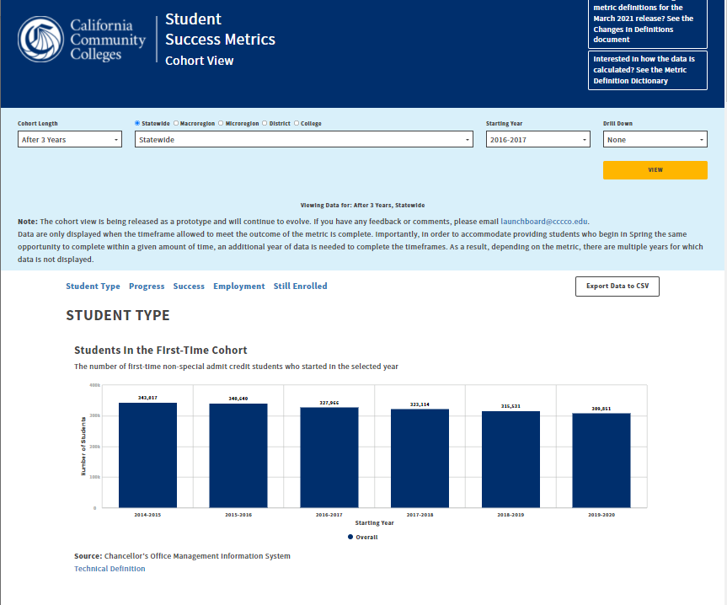

Where can campuses access this data?
Get a preview with data visualizations using the Student Success Cohort View
Proceed carefully! The dashboards will not provide critical information you need for your plans:
Unmasked data
Calculations for disproportionate impact
Access the dashboard: https://www.calpassplus.org/Launchboard/Student-Success-Metrics-Cohort-View

Slide 27
SSM Cohort View compared to Data on Demand
Student Success Metrics Cohort View
Data on Demand
Available to everyone
Designed for ease of use and visualizations
Some data will be masked to protect students’ privacy
Sent to districts to distribute to campuses
CSV files only (no data visualizations)
UnFERPA suppressed data
Disproportionate Impact Calculations
Notes:
mention the link in NOVA if it is shown earlier in the webinar

Slide 28
When will the data be available?
March 2022
Data on the Student Success Metrics Cohort View will be updated to include the most recent academic year (2020-21) data.
Unsuppressed data files with DI calculations will be available on Data on Demand for districts to download.

Slide 29
Student Equity Plan Data
Ongoing Support
Webinar: Overview of Student Equity Plan Data
Overview of the five metrics
Understanding how disproportionate impact is identified
Target audience: Administrators, faculty and practitioners
When: March
Webinar: Deep-Dive into Student Equity Plan Data
Detailed review of csv files
Detailed review of DI methodology
Target audience: Institutional Researchers or those who want to get into the details of the data
When: April
Each webinar will be followed by office hours
Notes:
Emphasize that:
Webinar #1 is specifically for people who will be applying the data to inform the action they will take on campus; people who will be not just writing but also implementing the plans. Stress that we will not get into the details of the methodology of calculations during this webinar.
Webinar #2 is specifically for those Institutional Researchers who will receive and work with the cvs files. Stress that the content of the webinar will be geared to those who are already comfortable with statistical concepts and calculating disproportionate impact with their own local data

Slide 30
Recap: Intentional Design, Targeted Action, Streamlined Metrics and Data-driven Continuous Improvement

Slide 31
Student Equity Plan, 2022-2025
Student Equity Plan, 2022-2025
Intentional Design
Transformational
Community driven, thoughtful/meaningful, reflective
Fluid and dynamic
Race-consciousness
Inform other institutional plans
Braiding of funds
Data-Driven
Available March 2022, Updates to the Student Success Metrics will complete. At that time:
Data on the Student Success Metrics Cohort View will be updated to include the most recent data.
Unsuppressed data files with DI calculations will be available on Data on Demand for districts to download.
Metrics that Support:
Alignment with Guided Pathways and Vision for Success
Accessibility and standardization, all colleges having the ability to use the same data via the dashboard
Colleges’ ability to identify student populations experiencing the most disproportionate impact
Use of DI to Support:
College plans that center and prioritize student populations experiencing the most disproportionate impact for each metric
The understanding that when we direct efforts to address the inequities for the population experiencing the most disproportionate impact, our efforts benefits other student populations, as well.

Slide 32

Question and Answer Session

Slide 33
Key Dates and Information
SEP will be available in NOVA by the end of March 2022
Communication Packet: template, guidance, and sample plan will be available in early March 2022
Monthly Office Hours forthcoming
April - November
Notes:
(In the chat)
Please take a moment to provide us feedback: https://www.surveymonkey.com/r/QMRPGR6

