Slide 1
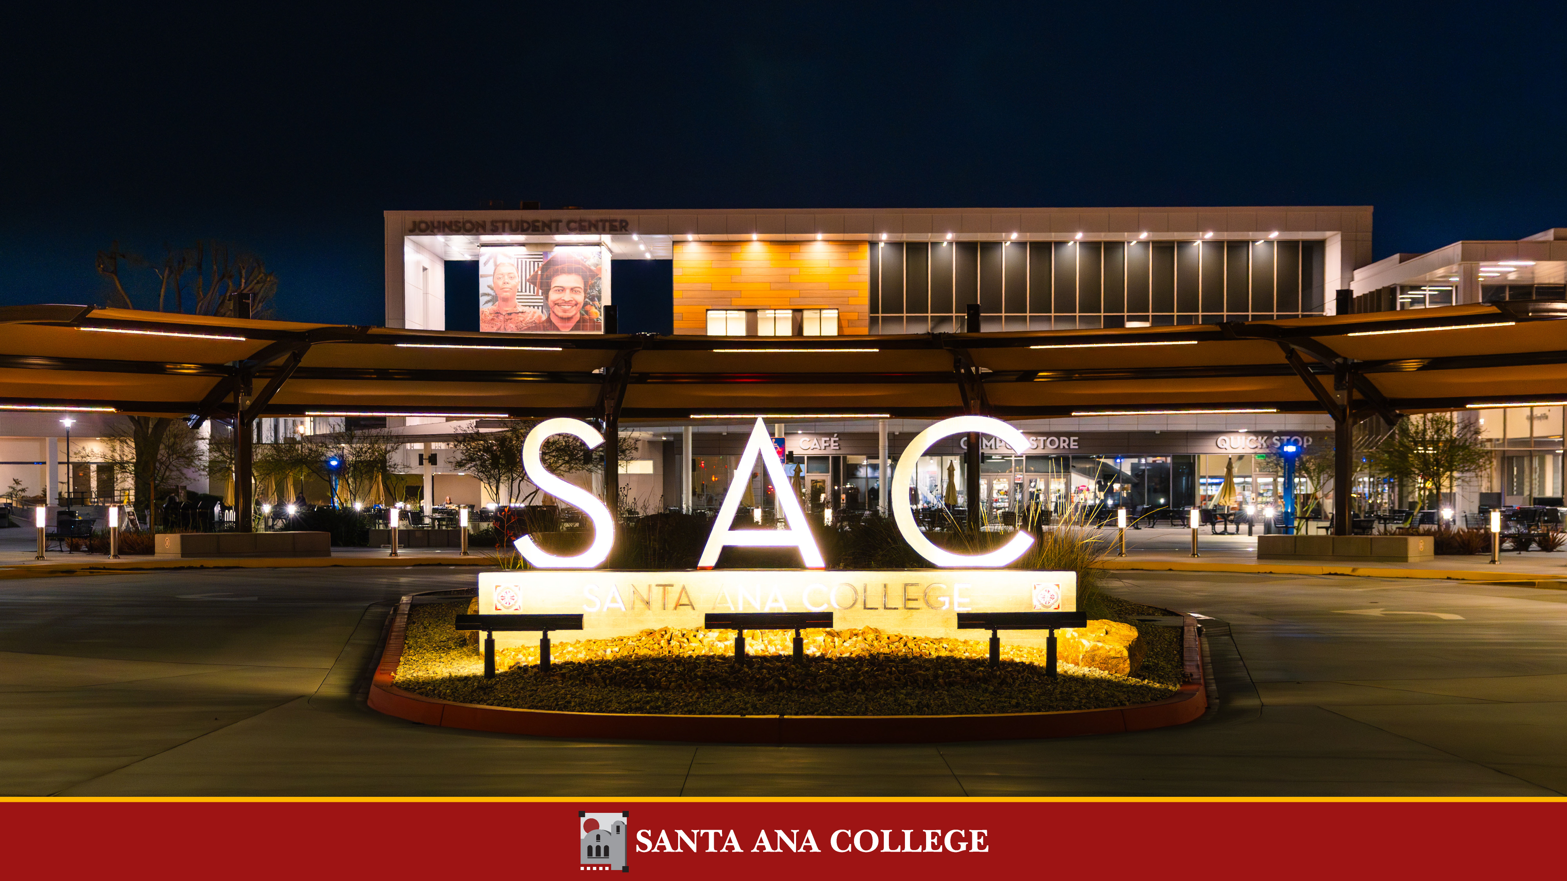
College Council Orientation 2026

Slide 2
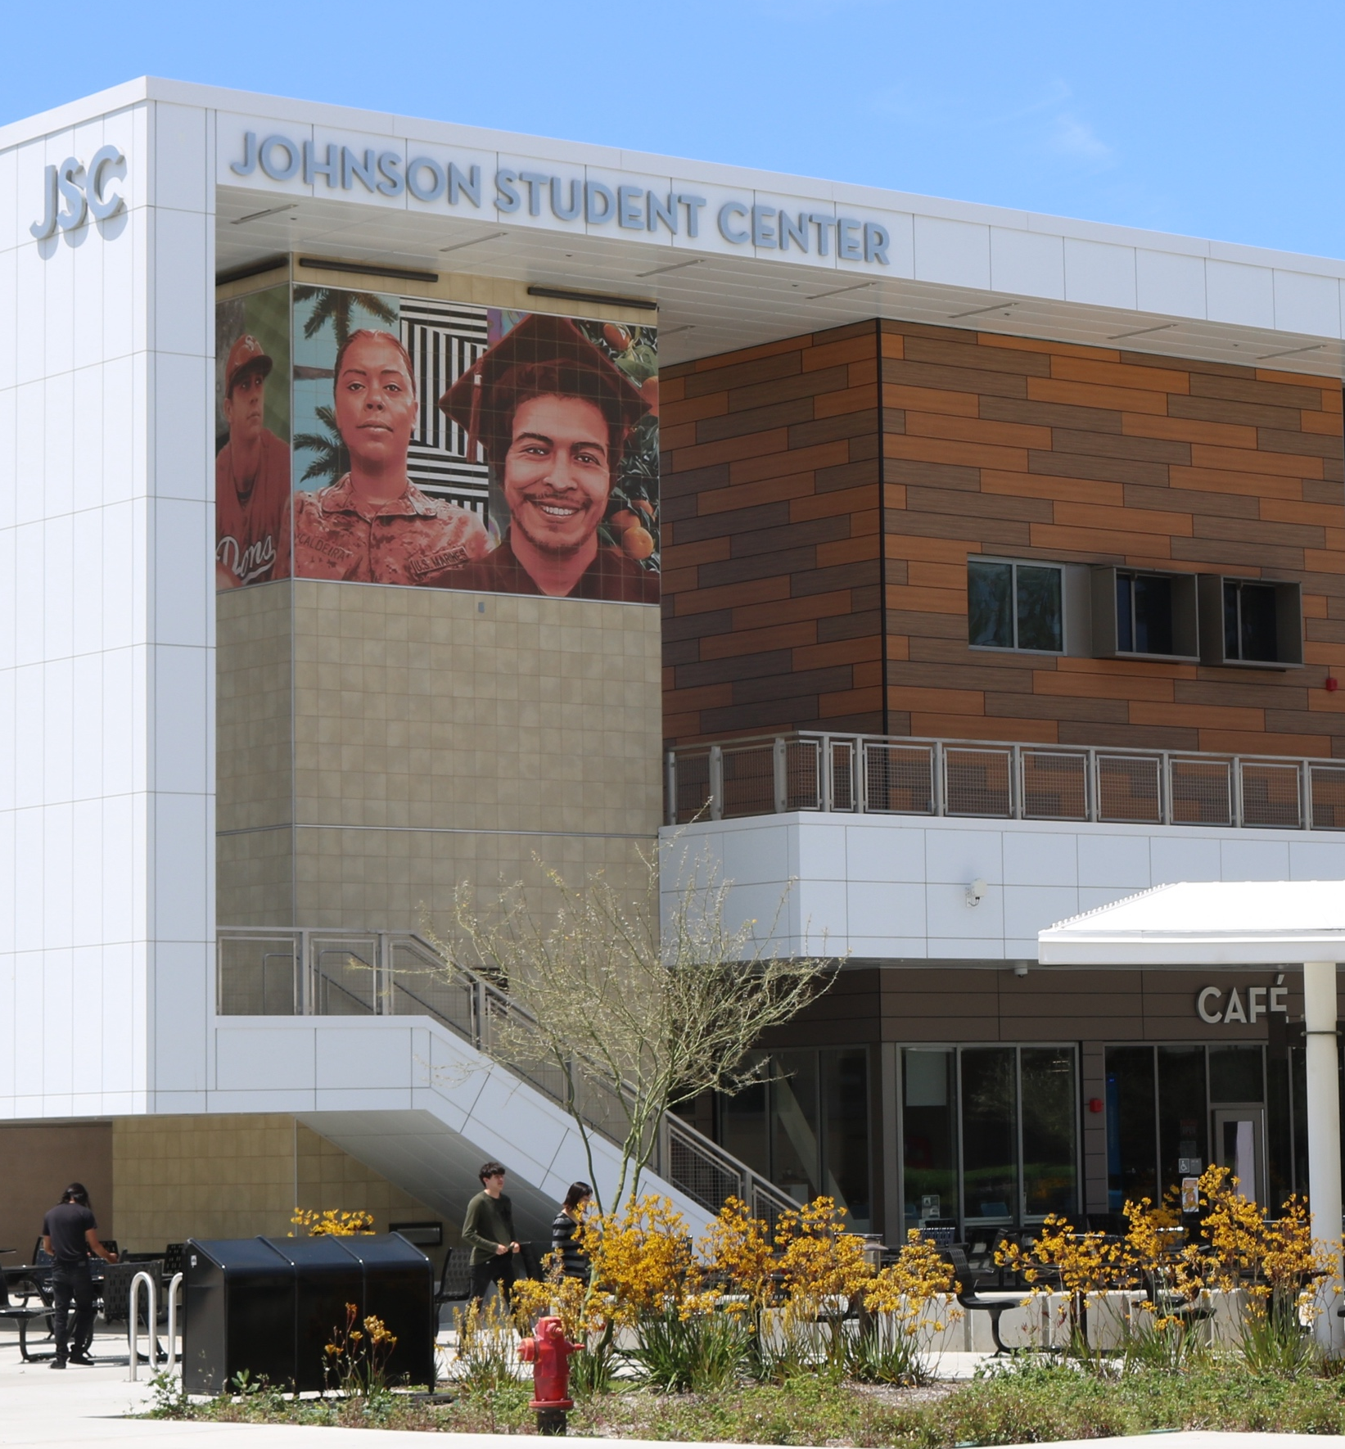
Learning Objectives
The Law: AB 1725, Ed Code & Title 5
Governance Roles Across All Four Constituencies
College Council: Role, Purpose & Membership
From Structure to Culture, and Our Committees

Slide 3
The Law: AB 1725 & Title 5
Why We Have Participatory Governance
The California Community College Board of Governors establishes minimum standards, and local governing boards adopt procedures consistent with those standards, to ensure that faculty, staff, and students have the right to participate effectively in district and college governance, and that academic senates hold primary responsibility for recommendations on curriculum and academic standards.
Title 5, Section 53203
The governing board adopts policies for appropriate delegation of authority and responsibility to its academic senate, requiring, at minimum, that the board or its designees consult collegially with the academic senate when adopting policies and procedures on academic and professional matters.
Faculty, classified professionals, and students each have their own statutory basis for this right — explored by constituency on the next slide.

Slide 4
Legal Grounding
by Constituency
FACULTY
Ed Code §70902(b)(7)
§ 87359 (b), § 87360, § 87458 (a)
Title 5 §53200–53206
STUDENTS
Ed Code §70902(b)(7)
Title 5 §51023.7(a)
CLASSIFIED
Ed Code §70902(b)(7)
Title 5 §51023.5(a)
ADMINISTRATION
Ed Code §70902(a)(1) & (d)
Authority delegated from the Board of Trustees
Not addressed in Title 5

Slide 5
How Participatory Governance
Works at SAC
Committees & Senates
The four constituency groups are represented through committees and senates that contribute to ongoing planning and decision-making in fulfillment of the college’s mission. These bodies are the foundation for communication, collaboration, and integration of institutional planning, budgeting, and decision-making. All meetings are open, and everyone in the campus community is welcome to attend. Committee bylaws define responsibilities and reporting relationships.
Administration’s Role
SAC is managed by a college president and a team of vice presidents, deans, associate deans, and directors. This administrative team provides institutional leadership by coordinating integrated planning, budgeting, decision-making, and resource allocation, working in partnership with the college's students, faculty, and classified professionals to ensure decision-making is inclusive, transparent, and grounded in the principles of shared governance..

Slide 6
Collegial Consultation with Academic Senate:
Curriculum including establishing prerequisites and placing courses within disciplines
Degree and certificate requirements
Grading policies
Educational program development
Standards or policies regarding student preparation and success
District and college governance structures, as related to faculty roles
Faculty roles and involvement in accreditation processes, including self-study and annual report
Policies for faculty professional development activities
Processes for program review
Processes for institutional planning and budget development
+1. Other academic and professional matters as are mutually agreed upon between the governing board and academic senate

Slide 7
Students provided an opportunity to Participate Effectively (9+1)
Grading policies
Codes of student conduct
Academic disciplinary policies
Curriculum development
Courses or programs which should be initiated or discontinued
Processes for institutional planning and budget development
Standards and policies regarding student preparation and success
Student services planning and development
Student fees within the authority of the district to adopt
+1. Any other district and college policy, procedure, or related matter that the district governing board determines will have a significant effect on students

Slide 8
Classified Professionals provided an Opportunity to Participate Effectively (4CS Framework)
Standards or policies regarding student support and success
Districtwide governance structures, as related to classified roles
Classified roles and involvement in accreditation processes
Policies for classified professional development activities
Processes for program review
Processes for institutional planning and budget development
Curriculum systems integration and implementation
Processes related to awarding degrees and certificates
Institutional program development, as related to classified roles
+1. Any other district or college policy, procedure, or related matter that will have a significant effect on classified professionals

Slide 9
The Role and Purpose of College Council
Provide collegial consultation by reviewing recommendations from reporting committees.
Gather constituent input and facilitate communication across the college community.
Make recommendations to the College President on broad college practices and procedures.
College Council serves as the primary forum where broad college policies, practices, and procedures are discussed through participatory governance before action is taken by the College President.
Through consultation with the Academic Senate, Classified Professionals, Administration, and Associated Student Government, the Council helps ensure inclusive decision-making and reviews recommendations brought forward by its reporting committees.

Slide 10
Membership
FACULTY (8)
STUDENTS (4)
ADMINISTRATION (8)
CLASSIFIED PROFESSIONALS (8)

Slide 11
Membership (28 voting and 4 non-voting)
President, Chair
Vice President, Academic Affairs
Vice President, Administrative Services
Vice President, Continuing Education
Vice President, Student Services
1 Academic Affairs Manager
1 Continuing Education Manager
1 Student Services Manager
8 Classified Representatives (appointed by CSEA 579)
Academic Senate President
Plus, 7 additional faculty members (appointed by Academic Senate)
ASG President
Plus, 3 additional student (appointed by ASG)
Ex-Officio (non-voting members)
  Associate Dean, Research, Institutional Effectiveness, and Planning
  Public Information Officer
  Executive Director, Office of College Advancement
  Director, Student Information Support

Slide 12
From Structure to Culture
Legal frameworks give us the rules of the game.
Title 5 and Ed Code establish the minimum floor of participation for every constituency — who must be consulted, and how.
Culture shapes how we play together.
The law sets the floor; day-to-day practice determines whether governance actually feels collegial.
Key cultural commitments for governance at SAC:
Respect — every constituency's expertise is treated as relevant, not just heard
Transparency — reasoning behind decisions is shared, not just the outcome
Accountability — commitments made in meetings are followed through on
Shared purpose — student success as the common measure of a good decision

Slide 13
Expectations and Engagement
Open and honest communication; anticipate the impact of your comments.
Participate fully; expect discomfort if learning.
Speak from personal experience.
Listen respectfully; listen to learn.
Seek to understand; expect disagreement and listen harder.
Share air-time; move in, move out.
Be fully present.
Be open to new perspectives.
Explore and take responsibility for impact; acknowledge intent.
Expect people to learn and grow; don’t freeze-frame others.
Take risks; learn into discomfort, be brave, engage.
Respect and maintain confidentiality
Notice/describe what you see happening in the group, in you.
Recognize your triggers; share if you feel triggered.
Trust that dialogue will take us to deeper understanding and acceptance
Engage and embrace this opportunity; we won’t be finished.

Slide 14
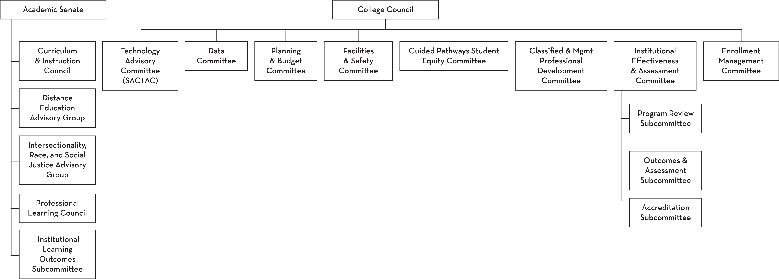
College Council
Participatory Governance Structure

Slide 15
Committee Functions
Discuss campus-wide issues and make recommendations as appropriate
Oversee the College’s strategic planning process
Make recommendations to President/College Council
Create ad-hoc task forces
Campus-wide communication tool

Slide 16
College Council Committees
Technology Advisory Committee (SACTAC)
Data Committee
Planning & Budget Committee
Facilities & Safety Committee
Student Equity & Achievement Program/ Guided Pathway Committee
Classified and Management Professional Development Committee
Institutional Effectiveness and Assessment Committee
Enrollment Management Committee

Slide 17
Classified and Management
Professional Development Committee
Co-Chairs:
Liliana Oropeza
Sarah Salas
The Classified and Management Professional Development Committee is responsible for planning, developing, offering, and evaluating professional development activities that empower Classified Professionals and managers.
These activities will focus on enhancing professional skills, educational knowledge, and personal growth to support the goals of our educational community. Additionally, collaborative efforts will be made for college wide professional development with all stakeholders, as needed.

Slide 18
Data Committee
Quad Chairs:
Xi Zhang
Mark DeAsis
Matthew Morin, Ph.D.
John Steffens
The Data Committee is the participatory governance committee responsible for evaluating and providing feedback regarding the data quality, usefulness, clarity, and consistency of information produced by college and district groups, as well as publicly available information based on college or district data, to the extent it meets the planning and decision-making needs of the College.

Slide 19
Enrollment Management Committee
Quad Chairs:
Matthew Morin, Ph.D.
Mark DeAsis
Lorena Chavez
Jose Lopez Mercedes, Ed.D.
The Enrollment Management Committee (EMC) serves as Santa Ana College’s primary strategic body for ensuring alignment between institutional planning, schedule development, resource allocation, and Student-Centered Funding Formula (SCFF) performance metrics.
The EMC functions as a strategic recommending body that reports to College Council and provides recommendations to inform institutional planning and resource allocation decisions.

Slide 20
Facilities & Safety Committee
Co-Chairs:
Dr. James Kennedy, Ed. D.,
Suzanne Freeman
The Facilities and Safety Committee is responsible for identifying scheduled and other maintenance projects to ensure an aesthetic and safe environment for faculty, staff, students and community.
It serves as an information and exchange body for facilities projects that are under construction or that are being planned.

Slide 21
Guided Pathways and
Student Equity Committee
Quad Chairs:
Tanisha Burrus
Claire Coyne
Rick Corp
Matthew Morin, Ph.D.
The purpose of GPS is grounded in the directives of the Comprehensive Educational Plan (CEP) and its explicit dedication to the goals of the Equity Plan and Guided Pathways principles.
The CEP requires the college to align all planning efforts with four institutional goals, each supported by measurable objectives. The new council will serve as the mechanism that converts those goals and objectives into campuswide strategies, ensuring coherence between Guided Pathways, SEAP, and the broader CEP implementation cycle.

Slide 22
Institutional Effectiveness & Assessment Committee
Co-Chairs:
Claire Coyne
Xi Zhang
The Institutional Effectiveness & Assessment (IE&A) Committee is the participatory governance committee responsible for reviewing all college planning efforts and making recommendations to College Council regarding systematic and integrated planning.
The Institutional Effectiveness & Assessment Committee reviews the plans, goals, and strategies of college governance committees, including subcommittees and workgroups, to ensure alignment with the college’s Comprehensive Educational Plan.

Slide 23
Planning & Budget Committee
Co-Chairs:
Dr. James Kennedy, Ed. D.,
Reza Mirbeik, Ed.D.
The Planning and Budget Committee is the participatory governance committee responsible for recommending budget priorities, procedures, and processes to College Council.
The Planning and Budget Committee also functions as a community liaison for fiscal affairs with the college community.

Slide 24
Technology Advisory Committee (SACTAC)
Co-Chairs:
John Steffens
Alexander Natale, Ph.D.
The purpose of the Santa Ana College Technology Advisory Committee (SACTAC) is to serve as a hub for academic and administrative technology planning at the college.

Slide 25
Thank You!
Any questions? Discussion

