Slide 1

SAC 7-Year
Classroom Technology Refresh Plan (CTRP FY26-27)
February 2026

Slide 2
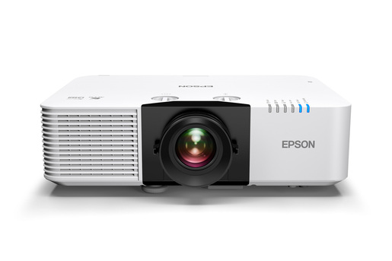
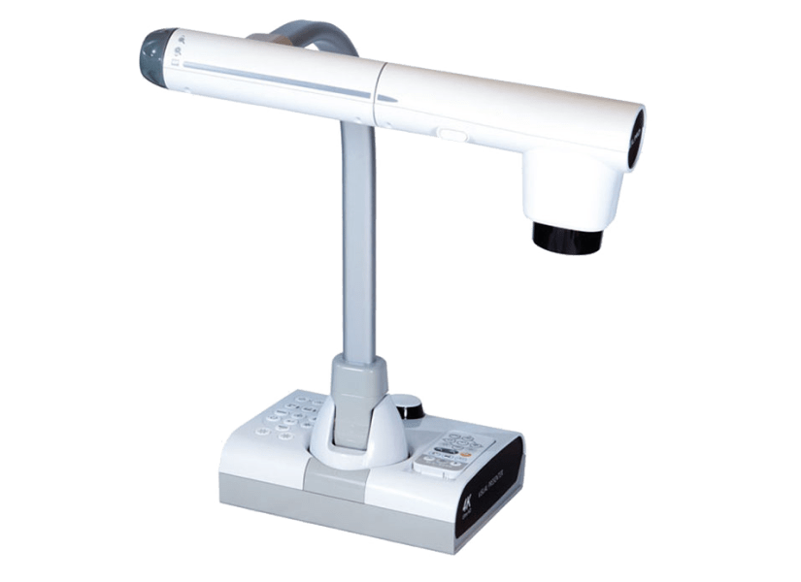
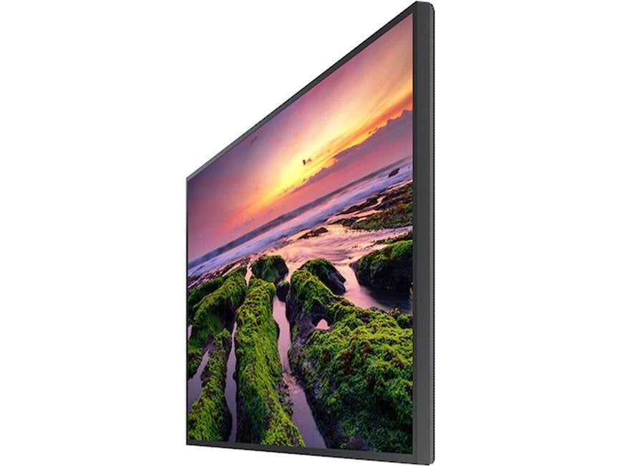
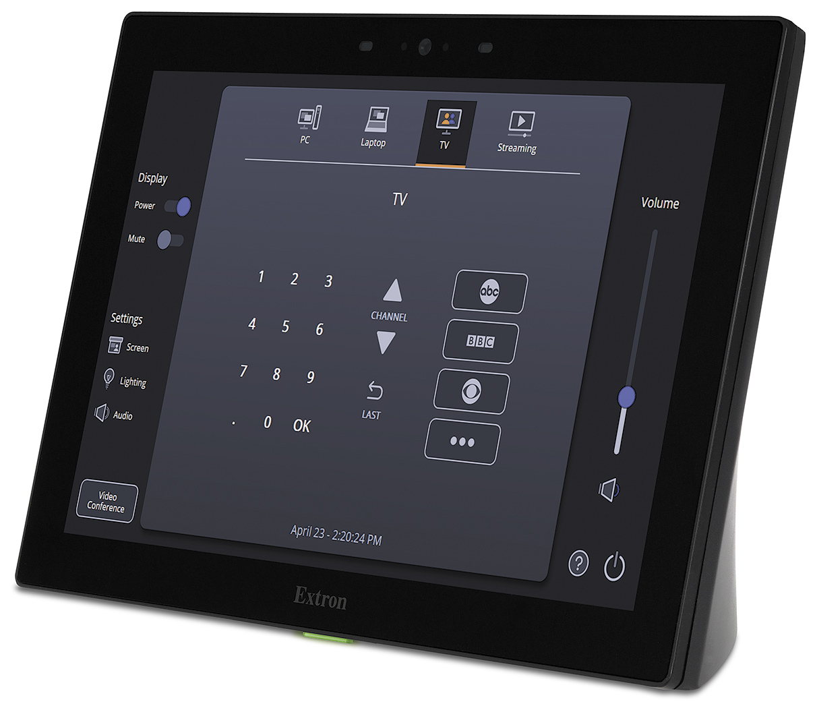
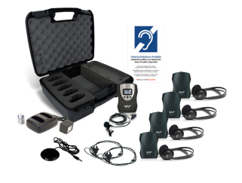
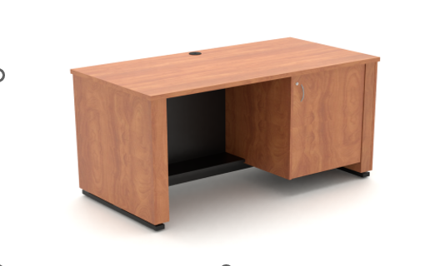
Scope of Work - Modernize 29 classrooms with state-of-the-art A/V equipment
Epson L690U
  New 6500+ lumens laser projectors, projection screens, and document cameras
  New flat panel displays where needed
  New ceiling and/or wall mounted speakers
  New lecterns with e-lift (ADA)
  New touch panels for simple presentation control and laptop inputs
  New A/V cabling with 25-year warranty
  Update electrical and increase capacity where needed
  Hyflex-ready infrastructure where needed
  New Portable Assistive Listening System (ALS) for each classroom
  Remote support capabilities for faster response
  Professional Architectural and Engineering Services (DSA approval required)
ELMO TT12W Doc camera
Samsung QBC 75”
Extron 10: Tabletop Touch Panel
Williams and Sound Portable ALS
Nova ADA compliant Lectern

Slide 3
7-Year CTRP Aging Report – Location and Room count
 | Building / Area | # Rooms
FY 23 - 24 | I, Continuing Education | 46
FY 24 - 25 | Phillips Theater, D | 42
FY 25 - 26 | A, S, W, G | 30
FY 26 - 27 | C, G (Main Gym), H, N, Athletic Fields | 29
FY 27 - 28 | J, K, L, T | 23
FY 28 - 29 | SC, JSC | 31
FY 29 - 30 | HS, CJA | 19

Slide 4
FY 26-27 CTRP - Scope of Work
Modernize 29 classrooms with state-of-the-art A/V equipment
  New 6500+ lumens laser projectors, projection screens, and document cameras
  New flat panel displays where needed
  New ceiling and/or wall mounted speakers
  New lecterns with e-lift (ADA)
  New touch panels for simple presentation control and laptop inputs
  New A/V cabling with 25-year warranty
  Update electrical and increase capacity where needed
  Hyflex-ready infrastructure where needed
  New Portable Assistive Listening System (ALS) for each classroom
  Remote support capabilities for faster response
  Professional Architectural and Engineering Services (DSA approval required)
Purchase spare A/V equipment to help quickly troubleshoot equipment in classrooms in the event of equipment failure

Slide 5
7-Year CTRP Aging Report - Cost
 | 26-27 | 27-28 | 28-29 | 29-30 | 30-31 | 31-32 | 32-33
Classrooms | 29 | 23 | 31 | 19 | 46 | 42 | 30
Total | $1.64M | $828K | $1.1M | $684K | $1.37M | $1.35M | $1.1M

Slide 6
FY 26-27 CTRP Pricing Forecast
 | Scope | Cost
Refresh A/V technology in C, G, H, N, Athletic Fields and Main Gym | 29 classrooms | $1.35M
Architectural and Engineering Services | Structural/Electrical/DSA | $250K
Spare parts | Replacement Spares | $35K
Total |  | $1.64M

Slide 7
Thank You

