Slide 1
Quizlet: Study Smarter, Not Harder!
21st Annual Road To Teaching Conference
November 18, 2017
Santa Ana College
Dr. tj naman
Notes:
Prep
Open PPT
Open Quizlet
Check sound
Put out handouts
Prizes
Study sets to use
Welcome attendees
Introduce myself
Find out about attendees: teachers, students (college, high school), anyone already use Quizlet?

Slide 2
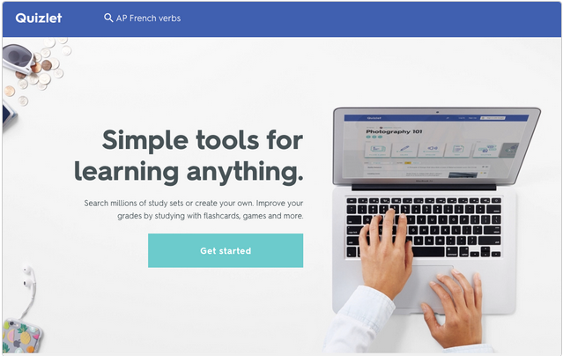
What is Quizlet?
Notes:
Quizlet is a suite of powerful tools that help students learn more efficiently and effectively – so they can study smarter, not harder. Using different activities, students can learn in the classroom or at their own pace in whatever way works for them.
You can study anything, anywhere for free and share.
Show video: https://quizlet.com/teachers

Slide 3
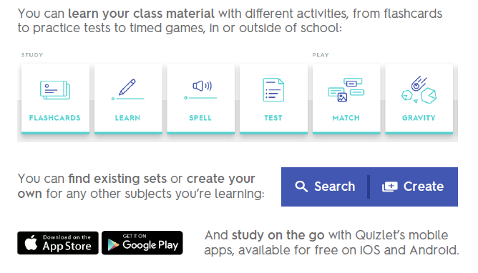
What can I do on Quizlet?
Notes:
Teachers: Provide study materials for students. Use the various activities in the classroom or assign activities as homework to reinforce a subject.
Students: can learn class material through a variety of activities.
Cover the Quizlet Ribbon
https://quizlet.com/help/2444083/what-is-quizlet-and-how-can-i-use-it

Slide 5
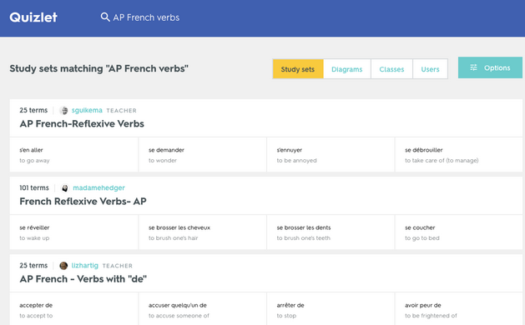
Quizlet Study
Search created sets
create your own sets
create a diagram set.
Notes:
1. Find study sets, select the magnifying glass icon at the top of any page on Quizlet. Then, type in your subject or the name of the exam you're studying for and press Enter to see a list of results.
You'll see a preview of the first four terms in each set on the search results page. To see the full set, select the title to view all terms and definitions on the set page. You can also open the Options menu to sort search results by relevancy or creation date.
Create your own content
Add sets with text, images (users with free Quizlet accounts can add images from the Quizlet gallery; upgraded users can choose from Quizlet gallery or upload their own)
Invite students
https://quizlet.com/help/2444100/creating-a-new-set
https://edshelf.com/tool/quizlet/ - good tutorial
https://quizlet.com/features/learn

Slide 6
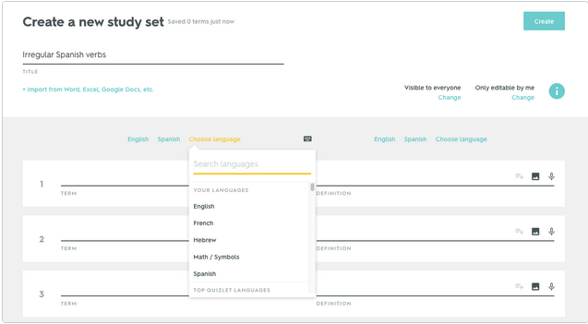
Notes:
How to create a new set
https://quizlet.com/help/2444100/creating-a-new-set

Slide 7
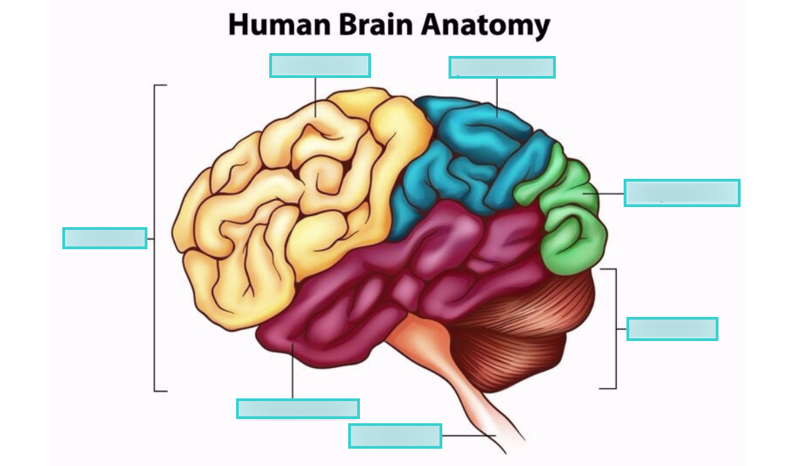
Quizlet Diagram
Notes:
How to create a diagram
https://quizlet.com/216252324/anatomy-and-physiology-human-brain-diagram/

Slide 8
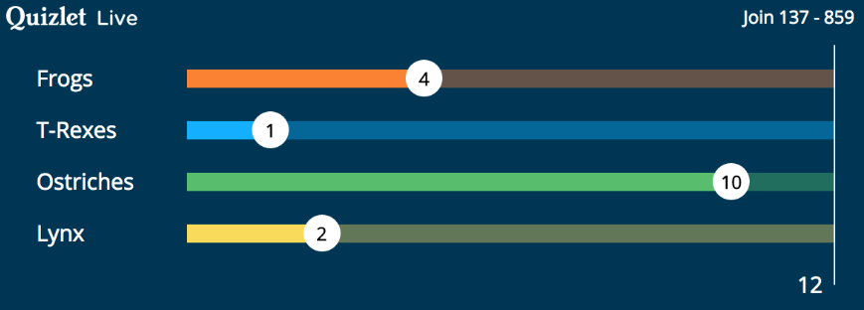
Quizlet Live
Notes:
How to use quizlet live
Do quizlet live game w/prizes

Slide 9
How do I get started?
Notes:
The best way to get started on Quizlet as a student or a teacher is to search for sets made by other Quizlet users. Students and teachers create new study sets all the time, so it's quite likely that you'll be able to find what you're looking for.

Slide 10
Student Creations
Go to quizlet.com
Sign up for free
Do one of the following:
Search for a study set
Create a study set
Search for a diagram
Play with the activities
Share experience
Notes:
https://quizlet.com/help/2444128/getting-your-students-signed-up

Slide 11
Teacher Quick-start Guide
Follow the Quick-Start on the Quizlet site
Walk teachers through sign-up
Create a class
Search for study sets
Create a set
Quizlet Diagrams
Play Quizlet Live
Students create study set or diagram

Slide 12
Notes:
Quizlet is a suite of powerful tools that help students learn more efficiently and effectively – so they can study smarter, not harder. Using different activities, students can learn in the classroom or at their own pace in whatever way works for them.
You can study anything, anywhere for free and share.
Teachers:
Students:

