Slide 1
Using Multiple Perspectives in the History Classroom: A Pathway to Understanding
Mr. Robert Chodola
Mission Vista High School
November 22, 2014

Slide 2
Introduction
Robert Chodola
UCSD, BA in History, 2009
UCI, MAT, 2013
Experience
University High School, 2013
U.S. History
Fallbrook High School, 2014
A.P. American Literature, English 11, Honors English 9
Mission Vista High School, 2014-present
U.S. History, Government, Economics, A.P. U.S. History

Slide 3
Today’s Objectives
Introduce some of the content-specific issues that arise in the History-Social Science classroom
Explain why these issues exist in today’s educational climate and how to address them in one’s teaching methods
Provide strategies, sample lessons, and external resources that create a foundation for teaching History using the concept of multiple perspectives

Slide 4
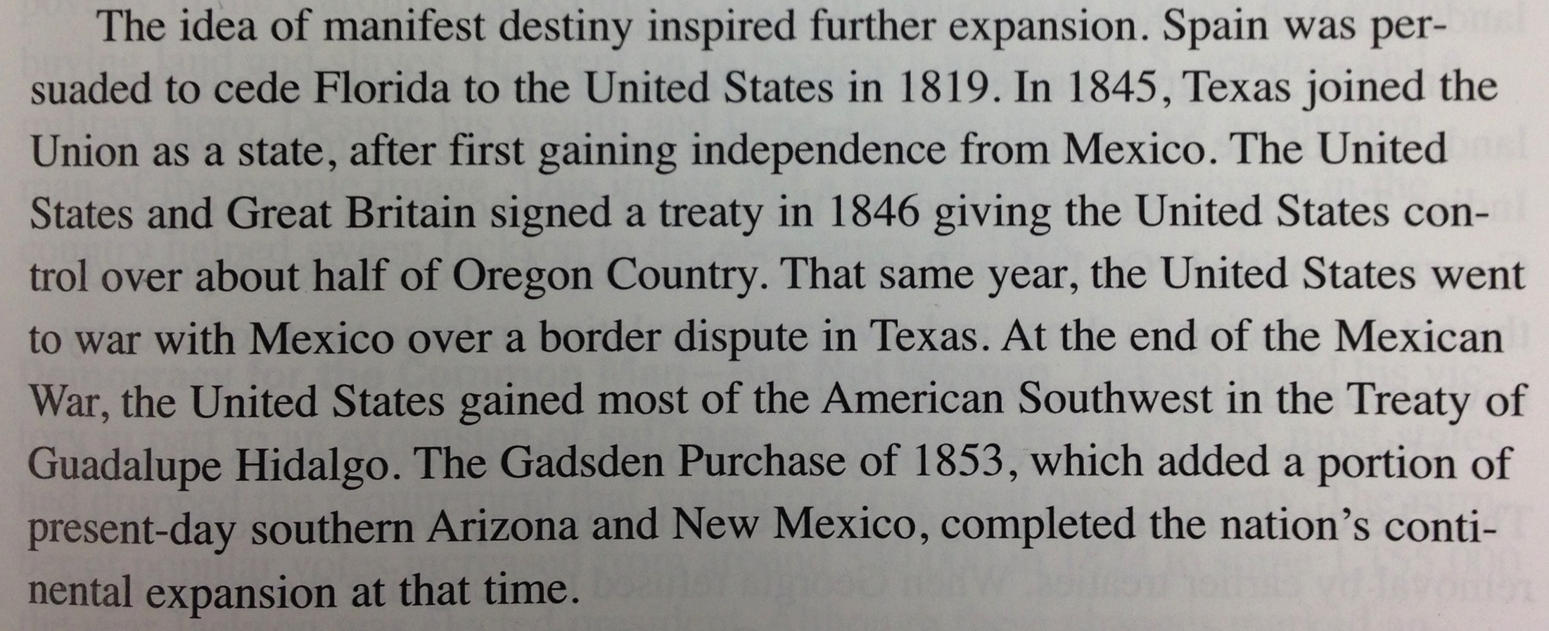
Starter Question
Read the following excerpt from the high school U.S. History textbook “History Alive!”
Imagine that you are a high school student, and this is ALL you have EVER read about the Mexican-American War. What would be your understanding of this topic?

Slide 5
The Trouble with Textbooks
History textbooks are written NOT by historians, but by publishing companies whose sole aim is to make more MONEY
History textbooks are written to be both concise and apolitical.
Result: History textbooks often OMIT certain aspects of historical events and eras in order to avoid seeming BIASED and potentially offending their customers.

Slide 6
The Trouble with Textbooks
Let’s be honest: Publishing companies need to sell their textbooks, and in order to do that they must make choices about what to include and what to exclude
But here’s the problem: what happens when the customer is tailoring their needs to purposely change the way our history is told?

Slide 7
The Trouble with Textbooks
Examples
The Texas Board of Education has tried prevent textbooks from using the term “slave trade” or even mentioning that some of the Founding Fathers owned slaves
When explaining the influences on American government, Texas textbooks also list Moses as having an equal influence as John Locke and other Enlightenment thinkers

Slide 8
Facts about the Mexican-American War
Based on the textbook, you would know that it was a war that started in 1846 between Mexico and the U.S. over a border dispute and that the U.S. gained territory from this war.
What this leaves out:
The U.S. government had been wanting to expand into Mexican territory, the President even ran his campaign on the promise of gaining California, but Mexico wouldn’t sell
The U.S. government PROVOKED the war by placing troops in land that Mexico considered to be part of Mexico.
The war cost $100 million and killed 13,000 Americans

Slide 9
Implications
Why does this matter? We’re not in Texas!
Because Texas is one of the largest buyers of textbooks in the nation (millions are purchased every year), publishing companies write History textbooks to fit the needs of Texas, but as a result, this textbook is also sold to the rest of the country
If teachers only use the textbook to teach History (and in low-income / low-budget districts this is the trend) students are often learning dumbed-down, whitewashed versions of history

Slide 10
Implications
“He who controls the past controls the future. He who controls the present controls the past”
- George Orwell
If students only learn ONE side of history, then myths (and often outright lies) are perpetuated as facts
Thus, it is incumbent upon History teachers to try their best to break this trend and teach their students with multiple perspectives

Slide 11
Multiple Perspectives
Teaching using multiple perspectives means finding both primary and secondary sources on the same historical era or event that reveal the different opinions or points of view that exist on this topic, both in the original historical context and today.
Every single source has a bias and may omit certain facts in order to promote a certain message that may distort the truth
The key is to help students understand both sides of the issue, grounding that understanding through the use of evidence.

Slide 12
Why teach using multiple perspectives?
Students engage in historical analysis of actual historical sources, not dumbed down texts
Students must face the problem of interpreting the past when two sources say contradictory statements
Students must assess the reliability of sources and evidence to figure out the truth
In sum, students must use the skills that ACTUAL HISTORIANS use when trying to discover the past.

Slide 13
Strategies and Sample Lessons
We don’t have time for us to do all these lessons ourselves ☹
We’ll focus on the Abraham Lincoln lesson, and I’ll review the strategies and goals of the other two lessons afterwards

Slide 14
Abraham Lincoln on Race and Slavery: Was he a racist?
Pre-assessment
Before beginning to read the sources, respond to the questions in the top box
Anyone want to share?
Read through the primary source documents regarding Lincoln’s views on race and slavery.
Then, fill out the box according to your assigned stance with a neighbor. Make sure to cite the document from which you found evidence on him being/not being a racist

Slide 15
Abraham Lincoln on Race and Slavery: Was he a racist?
Pair with another pair of classmates who had the stance on Lincoln you did NOT research
Share out your responses, completing the empty chart on your paper as the other group shares and discuss what evidence exists for both sides
Then, as a group, come to a consensus about to what degree Lincoln can or cannot be considered a racist. Complete the last box individually based on your group discussion.

Slide 16
Lincoln Lesson: Driving Concepts
Driving concepts: Cognitive dissonance
Lincoln is one of the most revered figures in American history, but he did have views on race that contradict the perception of him as “the Great Emancipator”
Cognitive dissonance occurs when you force students to confront historical facts and perspectives that challenge their preconceptions
Driving concept: Deheroification
“Denying students the humanness [of our historical heroes] keeps [our youth] in intellectual immaturity. It perpetuates what might be called a Disney version of history. . . Our children end up without realistic role models to inspire them: - James Loewen, Lies My Teacher Told Me

Slide 17
Lincoln Lesson: Strategies
Pre-assessment
Allows students to get in the right frame of mind and the teacher to gauge student preconceptions
Primary source analysis
These are all Lincoln’s own words, which makes the perspective as “primary” as it can be
Guiding questions
Helps students know what questions they should be asking if they get confused
Collaborative group work
Multiple stages of group work (individual, pair, small group)
Graphic Organizers
Clear steps and stages of work through visual cues

Slide 18
Civil War Myths Lesson
Driving concept: Myth-busting
Students have preconceptions of our country’s history just by growing up here, but sometimes the “history” they first learn has little to do with historical facts
In this activity, students read one of five parts of a secondary source article that debunks 5 myths about the Civil War often perpetuated by Southerners to cover up the racism that drove the society and economy of the antebellum South

Slide 19
Civil War Myths Lesson: Strategies
Jigsaw
Students read one section alone, summarize/analyze it with students who read the same section, then move into 5-person groups with 1 person who read each section
Students share out in turn, summarizing and explaining their section so the others can understand
Graphic Organizers
Word Banks
Definitions of difficult words so students are still able to read highly academic sources

Slide 20
Battle of Little Bighorn Lesson
Taken from the Stanford History Education Group with slight changes in the questions
SHEG has dozens of lessons on both U.S. and World history using primary and secondary sources, along with an established protocol for how to analyze a historical document
Teach this explicitly at the beginning of the school year
Related activities are either question sets or graphic organizers

Slide 21
Battle of Little Bighorn Lesson: Strategies
Established method of analysis
Sourcing, Contextualization, Close Reading, Corroboration
Once students know it, you can use the same protocol in your own lessons using primary/secondary sources
Modified Language
SHEG will adapt the language of some primary sources to make them more readable for students
Textbook as a critical source
Uses a textbook except to compare with primary sources
An effective use of a typically ineffective resource

Slide 22
Final Thoughts
History education is often characterized as memorization of dates, facts, and figures, but there are so many more possibilities in this field
The trouble is that it requires more work on the teacher’s part to find or create the lessons that develop historical thinking skills
These are skills that students can use as adults in ANY FIELD in their futures

Slide 23
Final Thoughts
Why does it work? Today’s generation is very receptive to this depth of thinking because they are an increasingly tolerant and open-minded group when it comes to marginalized groups.
“If we choose to understand the other person's point of view, if we make the effort to understand before rushing to judgment, all kinds of different vistas might become apparent to us.” - J.K. Rowling

Slide 24
Resources
Stanford History Education Group
Zinn Education Project
History is a Weapon – Free online version of Howard Zinn’s A People’s History of the United States
Humanities Out There – UCI History Project
California History-Social Science Project
Books by James Loewen
Lies My Teacher Told Me
Lies Across America

