Slide 1
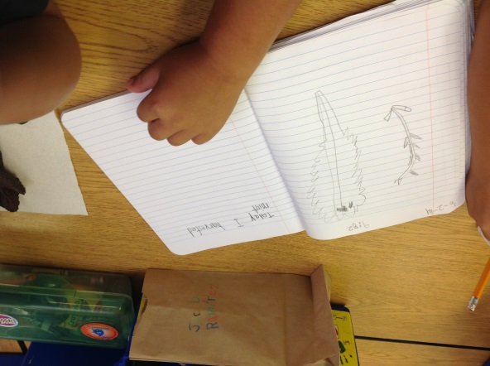
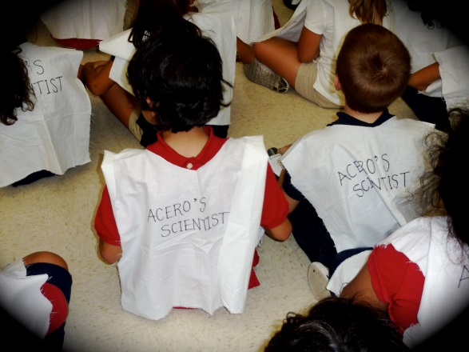
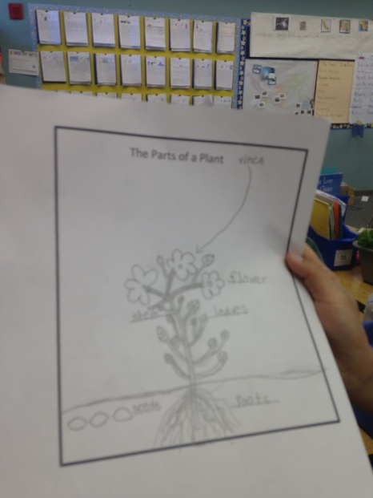
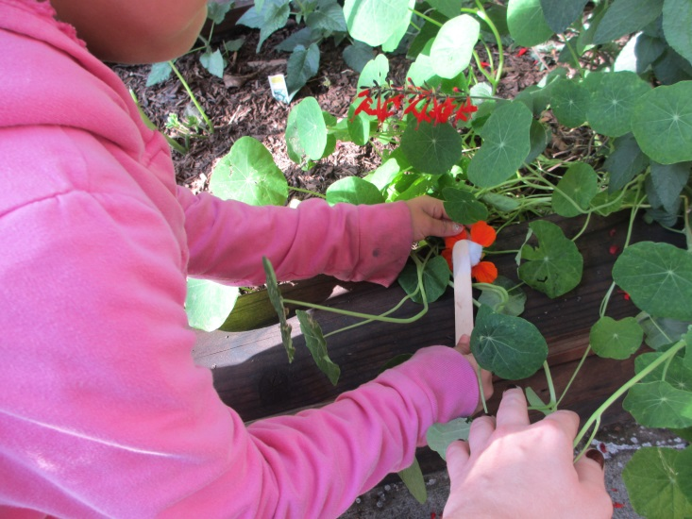
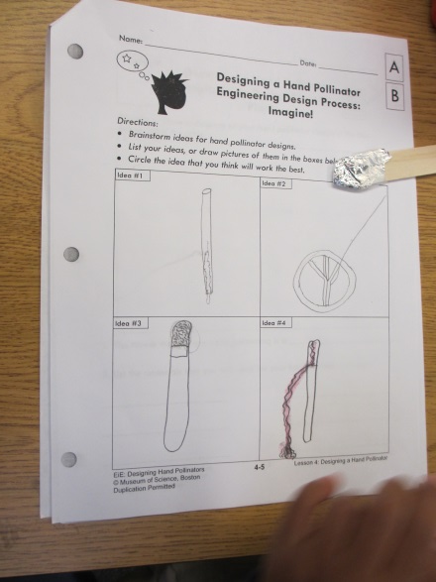
Science and Engineering Notebooks Grades K-5
STEM Education
By Marsha Johnson and Teresa Acero
STEM Specialists
Capistrano Unified School District

Slide 2
Science Technology Engineering Mathematics
What is STEM?

Slide 3
“STEM Education seeks to increase access to learning by preparing students for post-secondary study, the 21st century workforce, and becoming informed citizens.”
-Wesson 2013

Slide 4
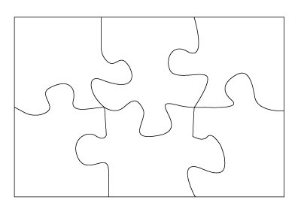
STEM is integrated learning.
“
Math
Engineering
Science
Art
Reading and
Technology
Language
Arts

Slide 5
NGSS Eight Scientific and Engineering Practices
1. Asking questions (for science) and defining problems (for engineering)
2. Developing and using models
3. Planning and carrying out investigations
4. Analyzing and interpreting data
5. Using mathematics and computational thinking
6. Constructing explanations (for science) and designing solutions (for engineering)
7. Engaging in argument from evidence
8. Obtaining, evaluating, and communicating information

Slide 6
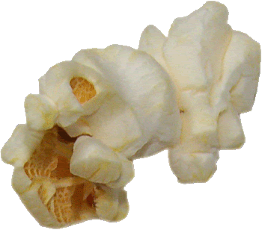
Watch this video to show how popcorn pops in slow motion:
http://www.popcorn.org/AboutUs/Media/PopVideos/tabid/114/Default.aspx

Slide 7
Engineering
Defining Problems and Designing Solutions
The Great Popcorn Challenge:
Design a container, with a fitted lid, to hold 293 kernels of POPPED Popcorn without leaving any extra space or popcorn overflowing the container.
Constraints:
The container should be made of construction paper and tape and have a fitted lid covering the popcorn.

Slide 8
Science and Engineering notebooks support STEM and NGSS.
Notebooks provide a platform for speaking, reading, and writing that supports:
Evidence based inquiry
Engaging activities
Integrated learning across disciplines
Problem Solving that promotes deep thinking
Powerful and thoughtful observation skills
Real world connections
Data collection and analysis
Academic vocabulary
Formative assessments for teaching and learning
21st Century Skills

Slide 9
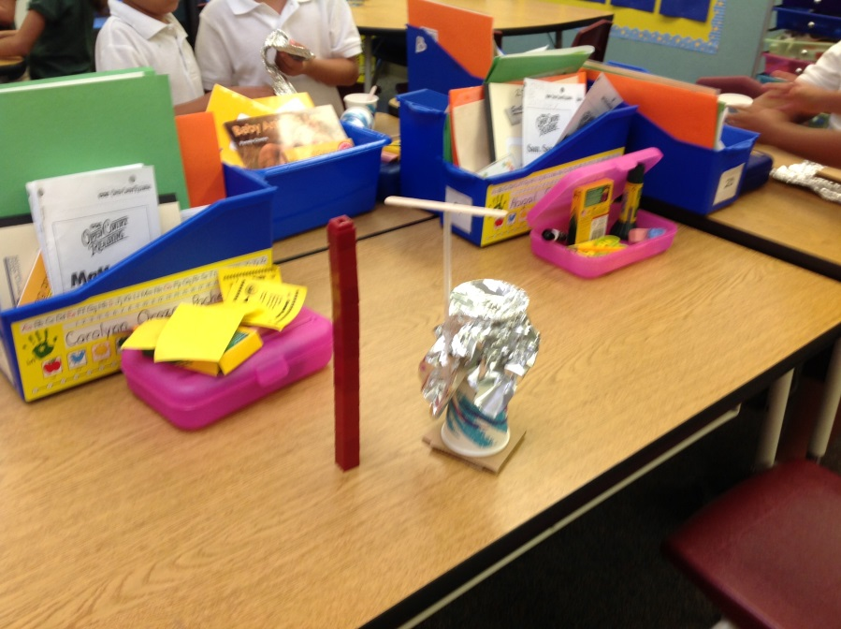
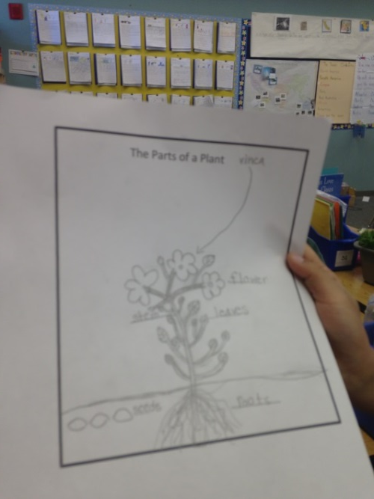
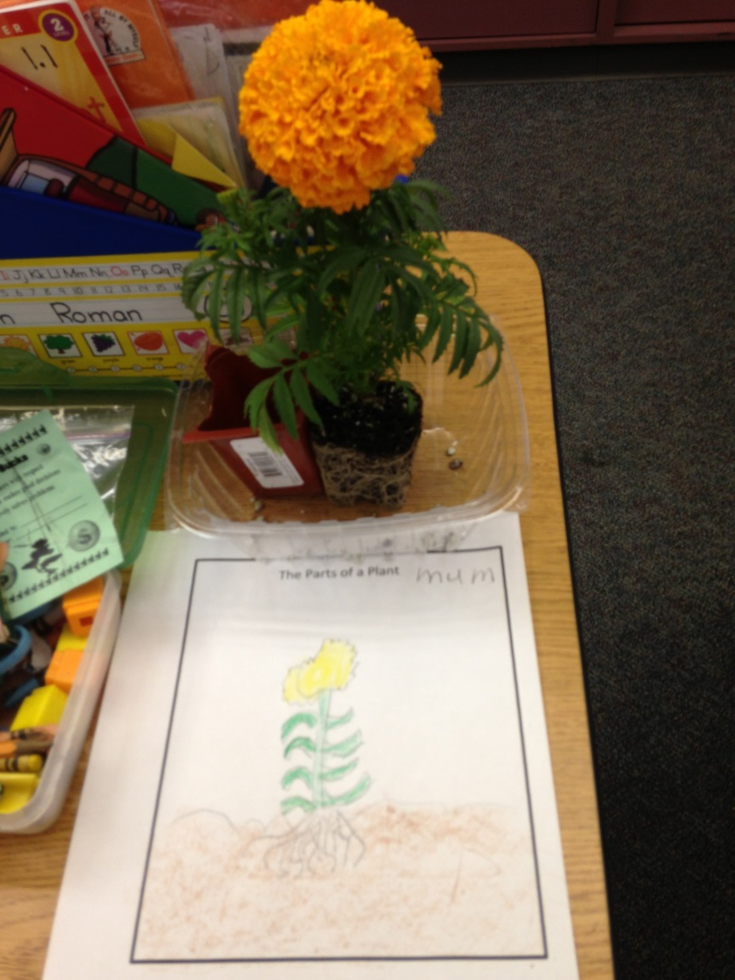
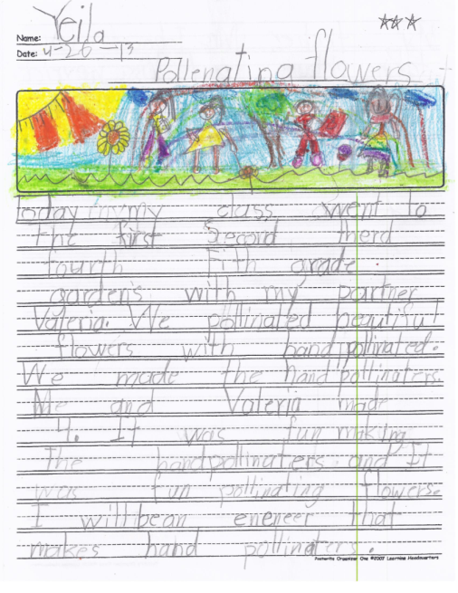
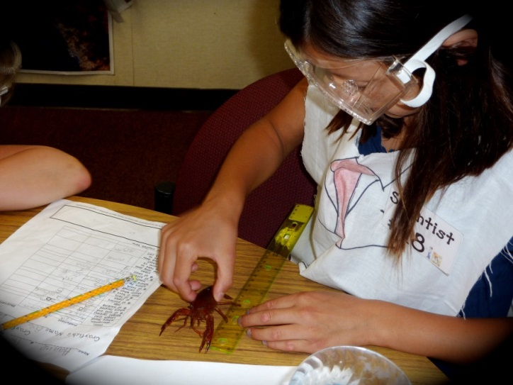
Scientists using notebooks integrate, math, writing, science, reading, and art.

Slide 10
Scientists collaboratively use notebooks to integrate speaking, critical thinking, and science.
Scientists share their results with each other.

Slide 11
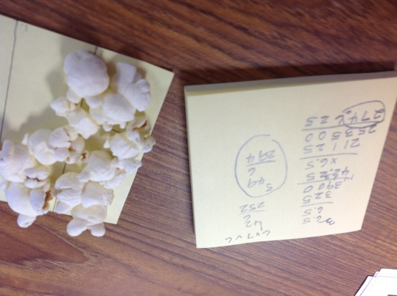
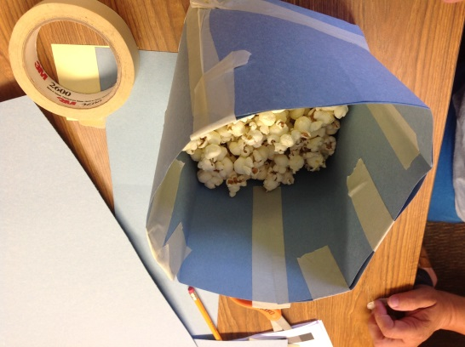
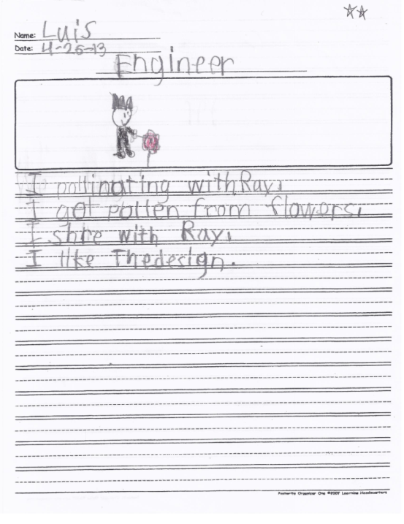
Engineers using notebooks integrate engineering, math, science, art, reading, and writing when designing solutions to real world problems:
Engineers design, test, and record their results.

Slide 12
Engineers test their best designs and enter the results in their notebooks.
Engineers apply their knowledge of science to solve real problems.

Slide 13
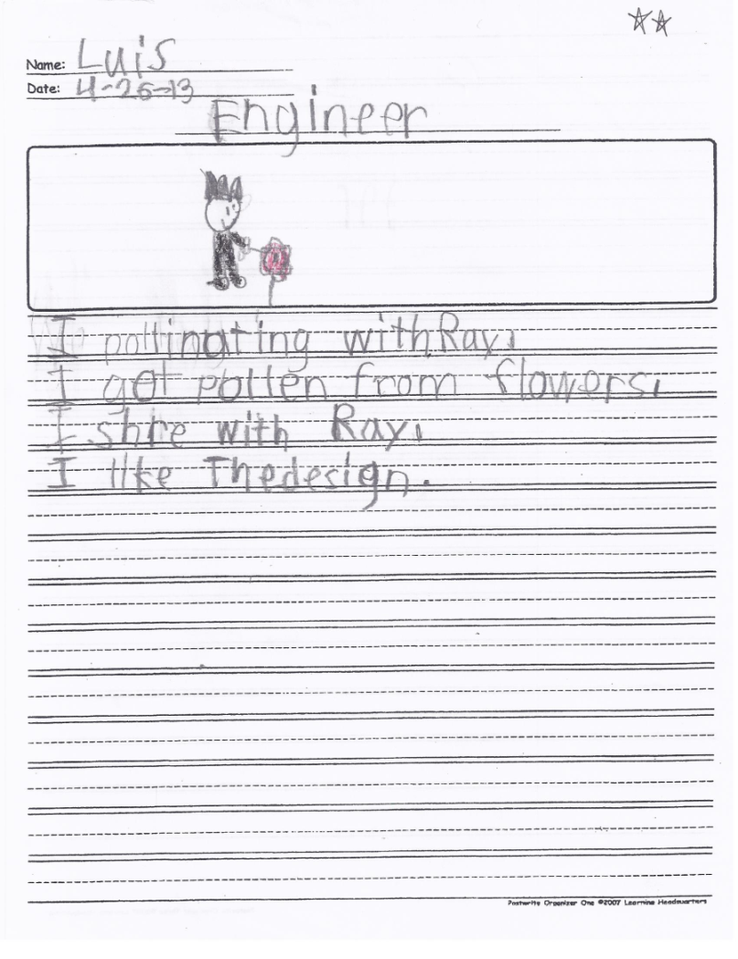
Scientists and engineers use notebooks to write about their investigations and designs.
Science and engineering gives students real reasons to write.

Slide 14
Scientists and engineers use the information in their notebooks to present their findings.
Engineers and scientists practice their presentations.

Slide 15
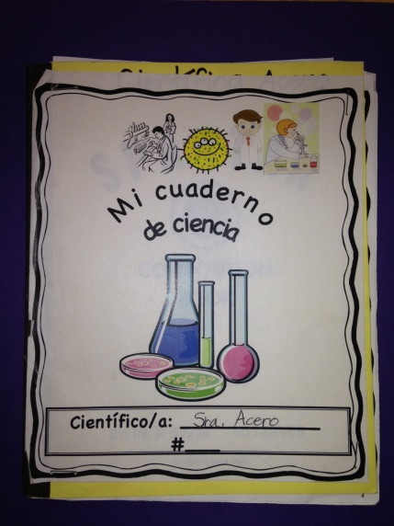
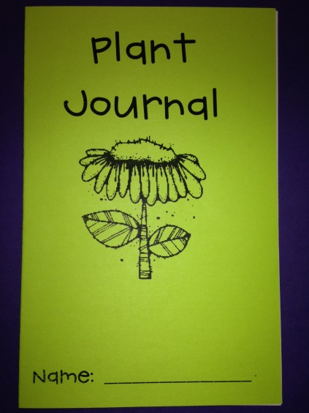
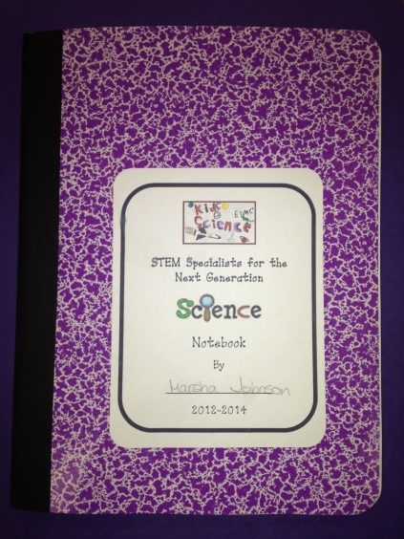
How do I make a notebook?
Use composition books, spiral notebooks, or make a packet.
Include the following:
- Cover Page
- Title Page
- Table of Contents
- Numbered Pages (volunteers can do this)
- Index (for second grade and older)

Slide 16
Activity – Make a Notebook
Water Tension Experiment

