Slide 1
Engineering in the Elementary Classroom
Presenter: Karin Barone NBCT
STEM Specialist w/Kids at Science
4th Grade GATE teacher OUSD
kbarone74@gmail.com

Slide 2


Slide 3

What is STEM education?
Interdisciplinary
Provides engagement
Promotes problem solving, critical thinking, and collaboration
Learner centered
Information rich
Teacher as facilitator

Slide 4


Slide 5
Why is STEM Education important?
The global economy has flattened in terms of skills and technology
A new workforce of problem-solvers, innovators, and inventors who are self-reliant and able to think logically is one of the critical foundations that drive a state economy's innovation capacity”

Slide 6
13 million Americans are Unemployed
But 3.8 million jobs in the U.S. remain unfilled in the STEM fields.

Slide 7
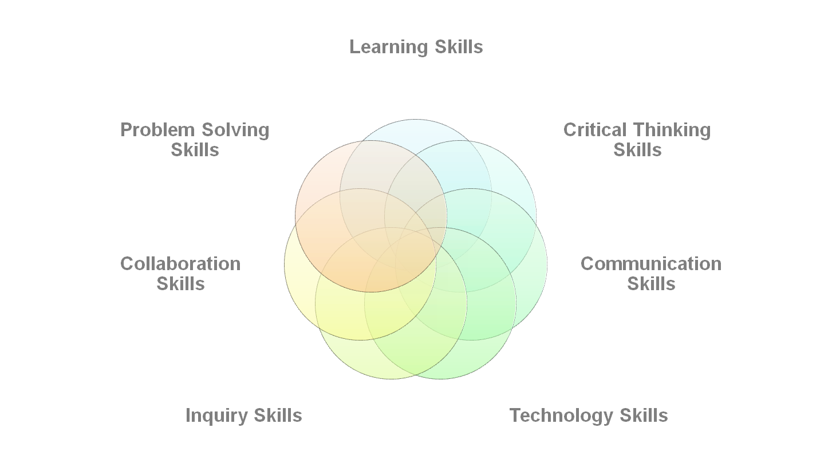
STEM Education Develops Skills That Allow for a Deeper Understanding of Content

Slide 8
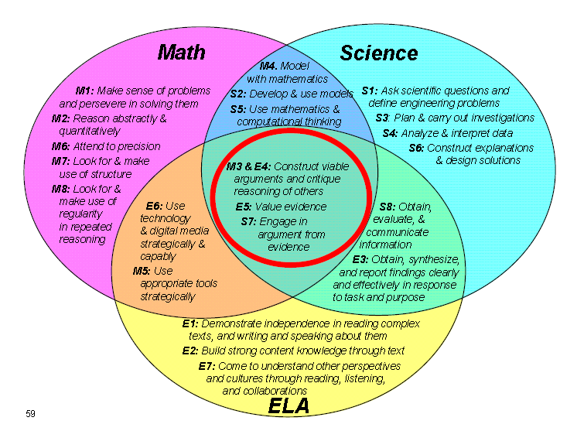

Slide 9
“Reading and writing comprise over half of the work of scientists and engineers.”
(NRC 2011)

Slide 10
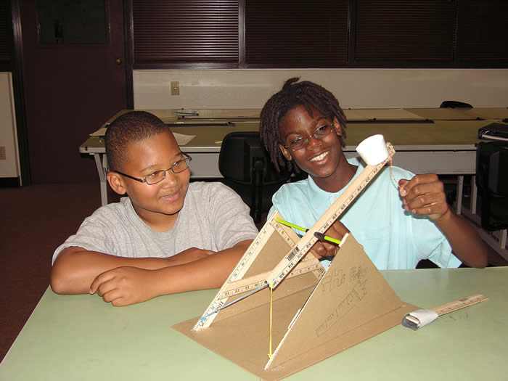
Where do you start?
with
Engineering

Slide 11


Slide 12
How to get started…
Path #1
Use the internet to find free engineering projects/units
Try these out to help you get started and understand how to set-up an engineering project
Look at the website suggestions on the hand-out

Slide 13
How to get started…
Path #2
You have to understand the engineering design process and how it differs from the scientific method
Look through your science TE’s and/or hands-on curriculum, social studies textbook, and language arts curriculum for engineering opportunities.
Take those opportunities and turn them into engineering projects using the design process

Slide 14
How to create an engineering project
What is the problem to be solved or what needs to be created.
Develop your constraints (materials/time)
Assign jobs and roles for the students
Create some sort of lab sheet that you want the students to be taking notes on
Create an assessment tool to evaluate the product at the end
Allow time for improvements or at least discussion of improvements
Above all else, reassure the students, and yourself, that it’s okay to fail

Slide 15


Slide 16
4th Grade Examples
Electricity/magnetism unit:
After learning about types of circuit, make electricity house, or an electric city.
Make a lunch box alarm (connects to Dear Mr. Henshaw)
Make a circuit board that can be used for content review with questions
Make a compass, or a telegraph

Slide 17
4th Grade examples
Language arts:
Sled design for HM story
Social Studies:
Design a way for Native Americans to communicate while living on the mission

Slide 18
4th Grade: Language arts/engineering
21st Century Learning Skills: Critical Thinking Creative Thinking Collaboration Communication | Objective: To work collaboratively to design an Iditarod sled to take Balto and his serum to Nome without falling out of the sled.
Constraints: 1 day to design 1 day to build Must be light enough to be pulled by washers Extra points awarded for creativity | Challenges: Yukon River Pull Pressure Ridges Open Lead

Slide 19
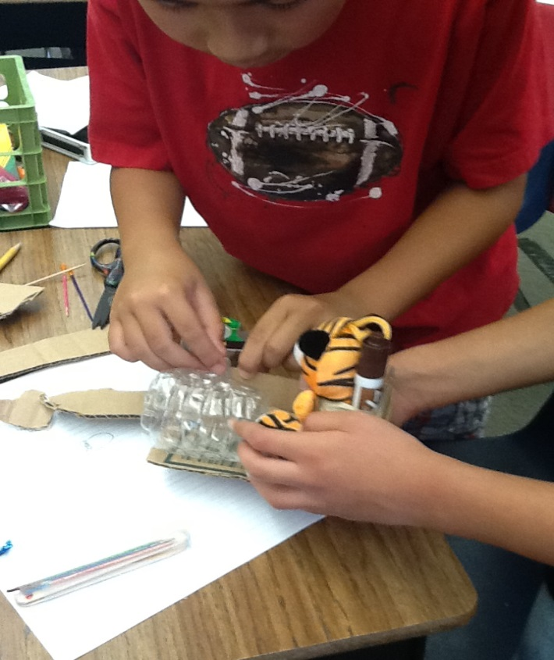
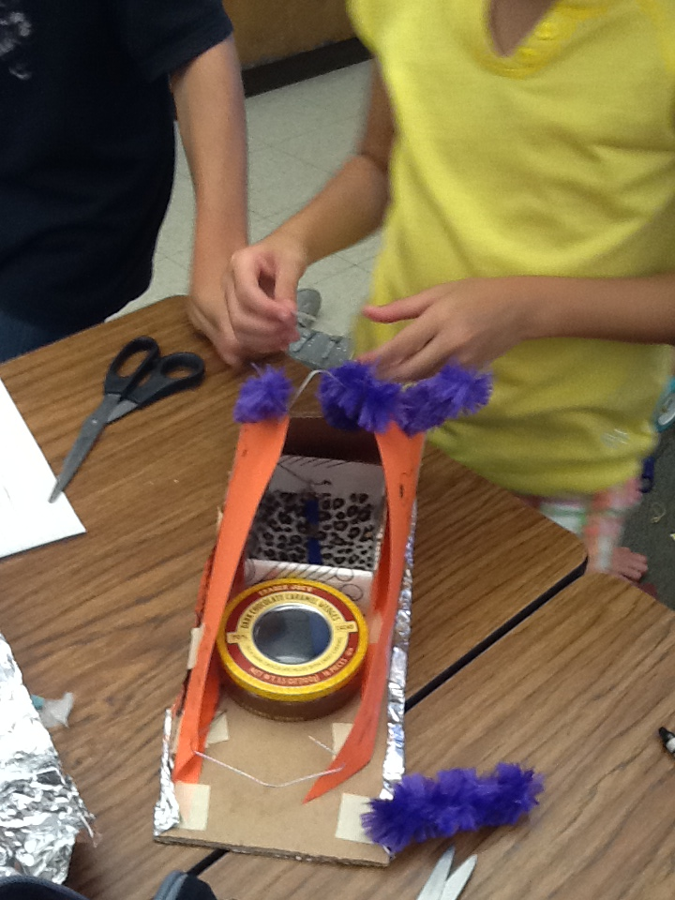
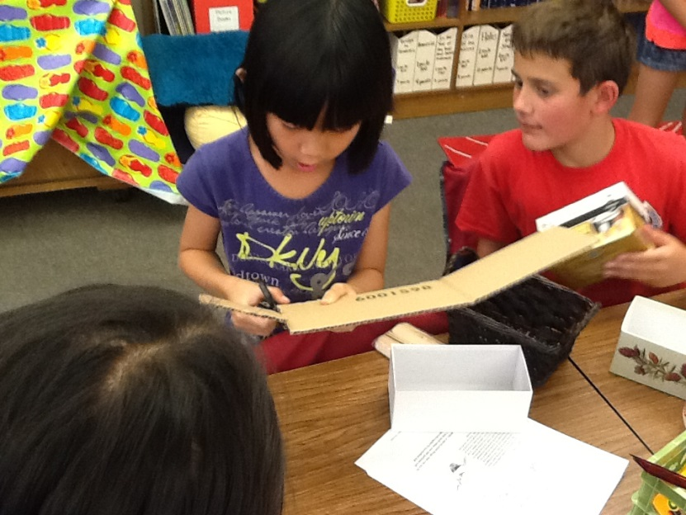
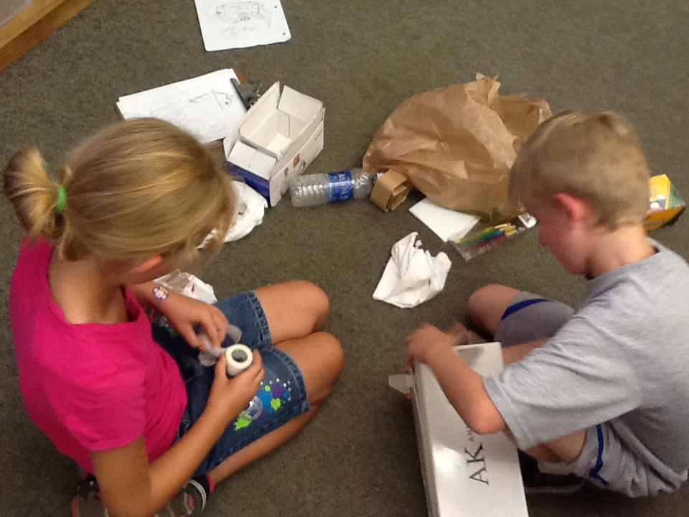
Sled Design

Slide 20
4th Grade Examples
Life Science:
Imagine and create a new species of animal. Build the animal, label the body parts, describe the environment it would live in.
Earth Science:
Make hieroglyphics in rock samples (EIE unit)

Slide 21
5th Grade examples
Life science:
Construct models of the different systems in the human body (working maybe?)
Design a knee brace only using given materials
Earth science:
Design and build working models of weather instruments, and record data over a period of time
Design and build a working model of the water cycle

Slide 22
5th grade: Science/Engineering/Math
21st Century Learning Skills: Critical Thinking Creative Thinking Collaboration Communication | Objective: To design and build a bridge with a given budget, to purchase materials, that must withstand a specified amount of weight and meet all length, height, and width requirements
Constraints: $1,500,000 to spend on materials Only cardboard, toothpicks, and glue can be used Two days to design Six days to build Follow all job descriptions | Challenge: To see how much weight your bridge can withstand before it breaks

Slide 23
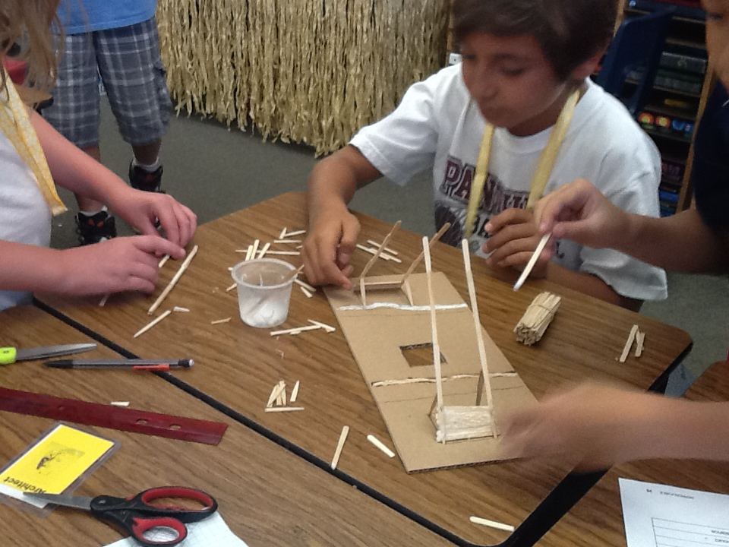
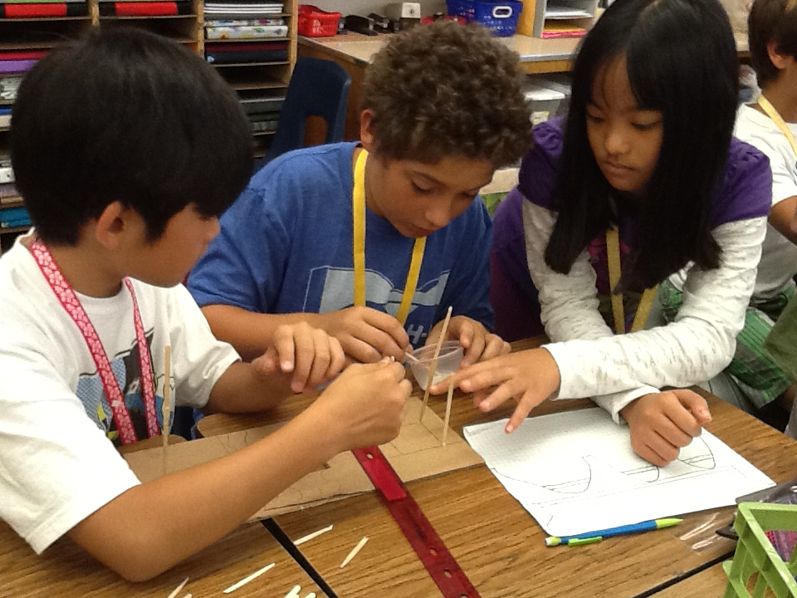
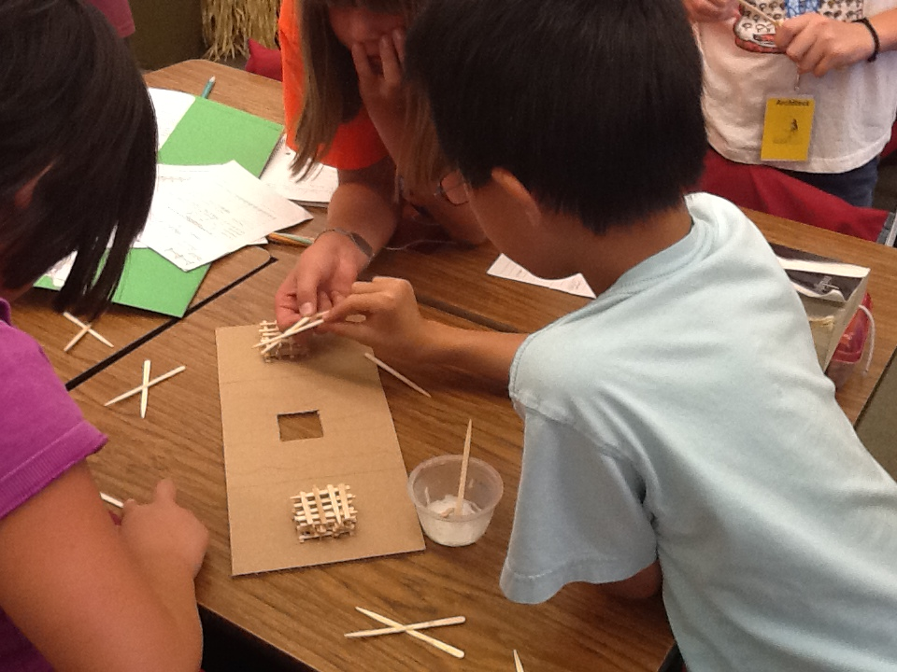
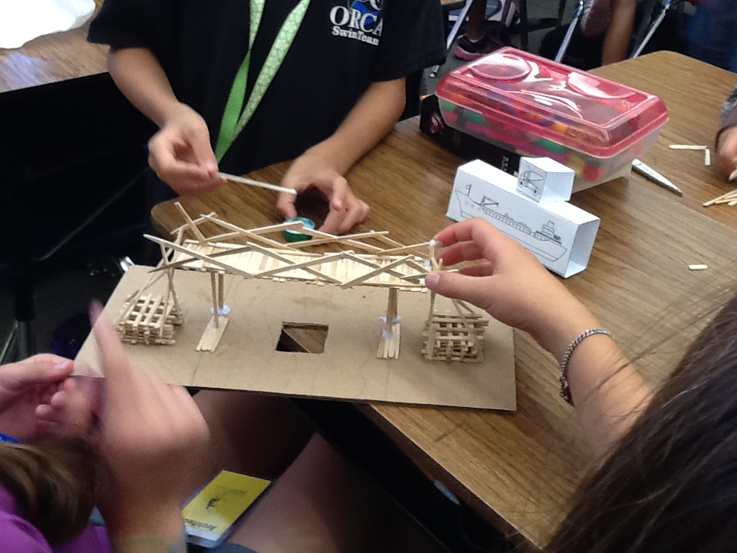
Bridge Design

Slide 24
6th Grade Examples
Design and build earthquake safe structures
Design and build a model that shows Pangaea and the current location of continents
Design and build solar houses and/or solar ovens
Design a method for cleaning up an oil spill
Build a working model that shows the three different types of plate boundaries.

Slide 25
6th grade: Science/Engineering/Math
21st Century Learning Skills: Critical Thinking Creative Thinking Collaboration Communication | Objective: To work collaboratively through the engineering design process to design a knee brace that will limit the range of motion of an injured knee.
Constraints: Three days to design and build One day to test range of motion using a goniometer Can only use materials provided by the teacher | Challenge: To design your knee brace so that the range of motion of the brace only allows the injured knee to bend backward. Points awarded for range of motion.

Slide 26
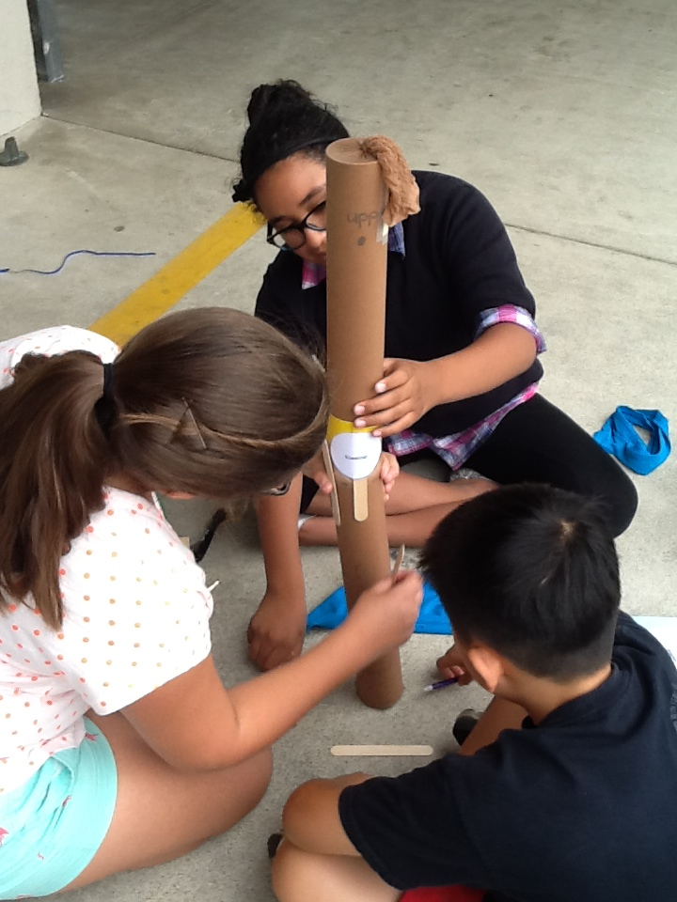
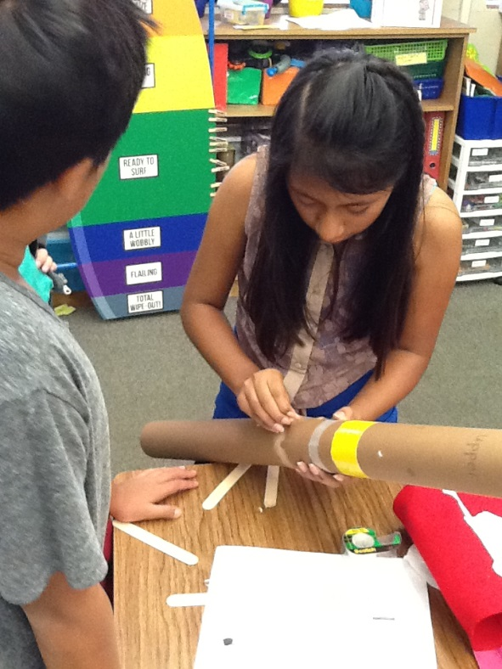
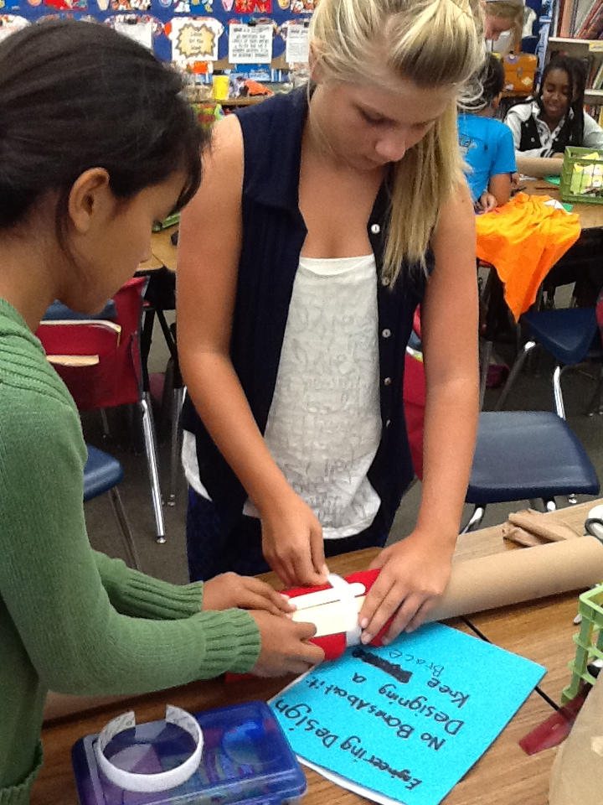
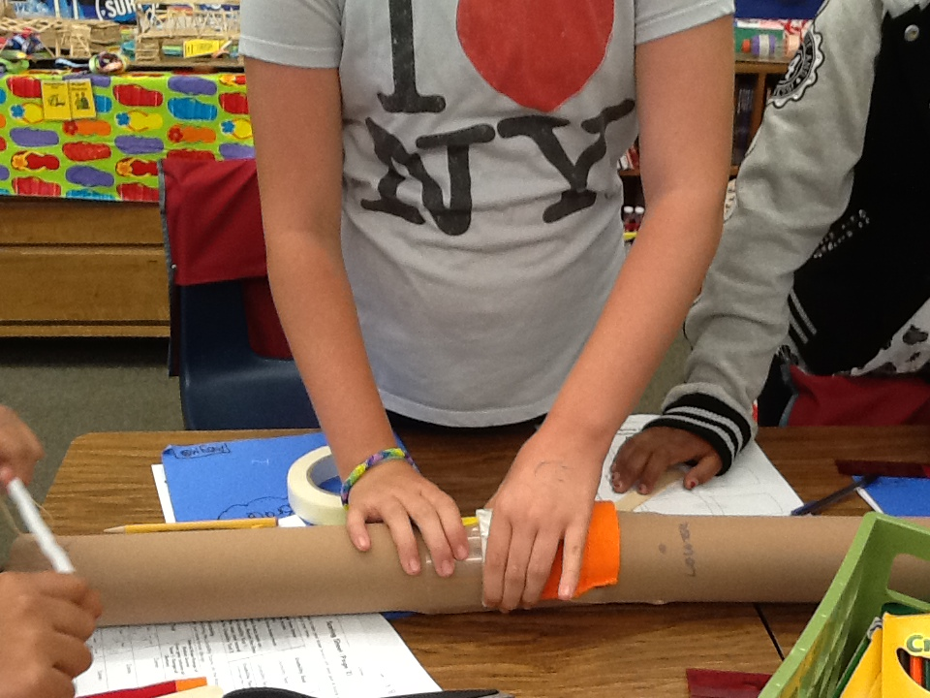
Knee Brace Design

Slide 27
Across grade levels
3x5 card towers
Bridge building
Parachute building
Egg drop container
Look at www.teacherspayteachers.com for many, many more

Slide 28
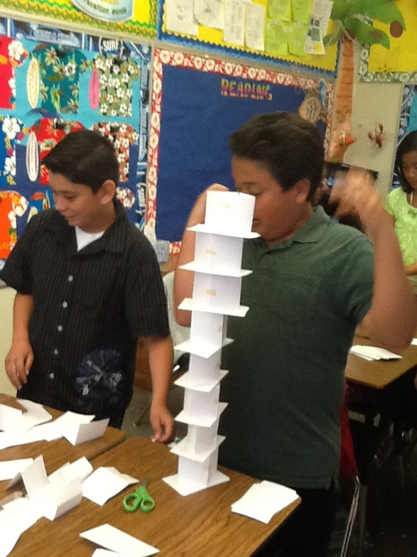
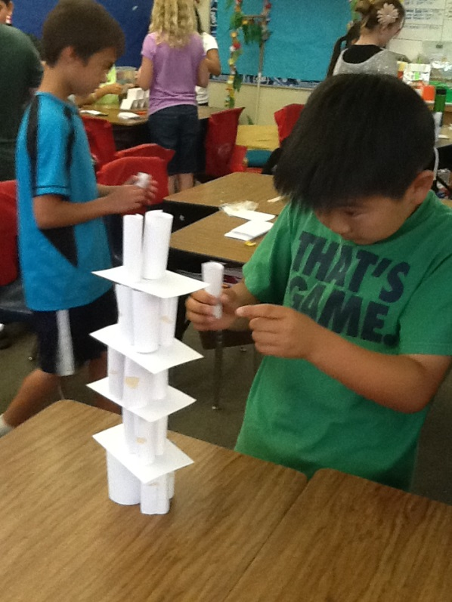
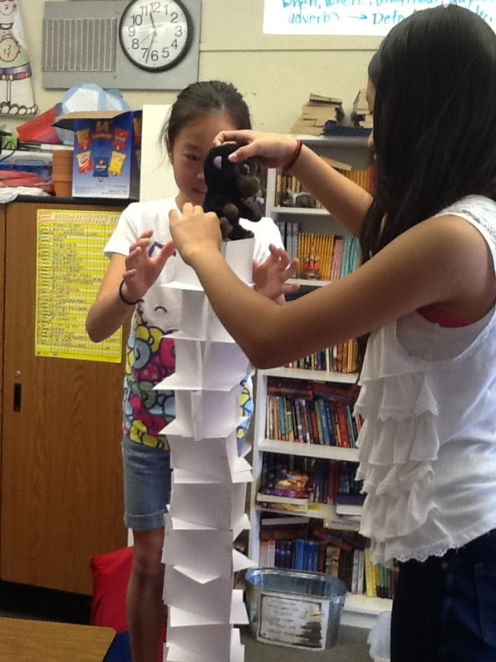
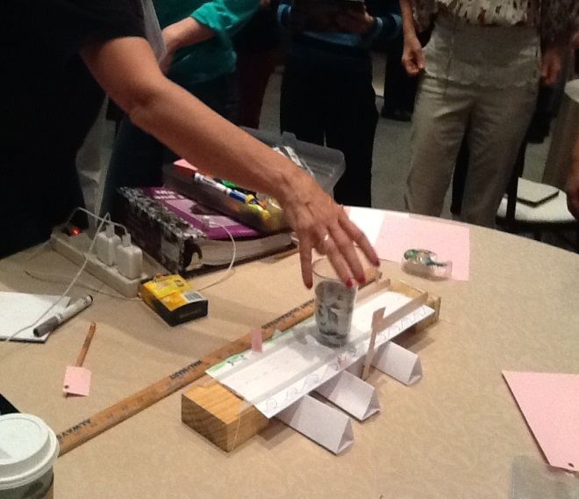
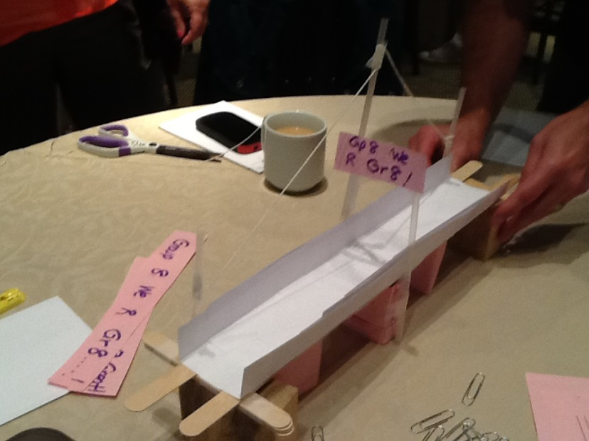
3x5 card towers
Bridge Building

Slide 29


Slide 30

STEM Proficient Students
Investigators and Problem Solvers
Logical Thinkers
Effective Communicators
Technologically, Scientifically, and Mathematically Literate

