Slide 1

Equity-Minded Teaching and Learning Institute
EQUITY-MINDED TEACHING & LEARNING INSTITUTE
SANTA ANA COLLEGE
Santa Ana College

Slide 2
GUIDED PATHWAYS & EQUITY
LEARNING & ENGAGEMENT TEAM MEMBERS
L&E Members: Maria Aguilar Beltran (Co-Chair), Stephanie Clark (Co-Chair), Jarek Janio, Amberly Chamberlain, Merari Weber, Janet Cruz-Teposte, Jose Lopez Mercedes, Maria Estrada, Arjun Nair
OER/ZTC Partners: Annie Knight, Jodi Coffman
Other Possible Identified Partners: Rebecca Ortiz, Betty Yimenu, Marty Romero, Steve Bautista, Mary Funaoka, Jaki King, Kim Smith, Lisa McKowan-Bourguignon, Academic Senate Exec Team, CiC Committee.
Most partners have participated in Skyline Equity Institute, 3CSN Equity 101 & 102 Course.

Slide 3
CALIFORNIA COMMUNITY COLLEGES
CHANCELLORS OFFICE

Slide 4
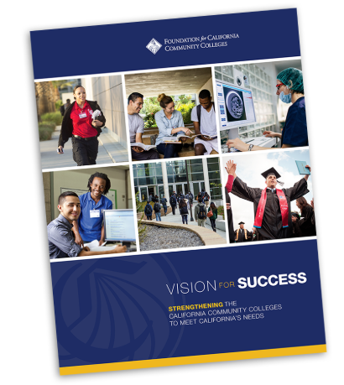
Vision for Success and Core Commitments
VISION FOR SUCCESS & CORE COMMITMENTS
Vision for Success
Increase credential obtainment by 20%
Increase transfer by 35% to UC and CSU
Decrease unit obtainment for a degree
Increase employment for CTE students
Reduce and erase equity gaps
Reduce regional gaps
Core Commitments
Focus on students’ goals
Design and decide with the student in mind
Pair high expectations and high support
Evidence-based decisions
Own student performance
Enable innovation and action
Cross-system partnership

Slide 5
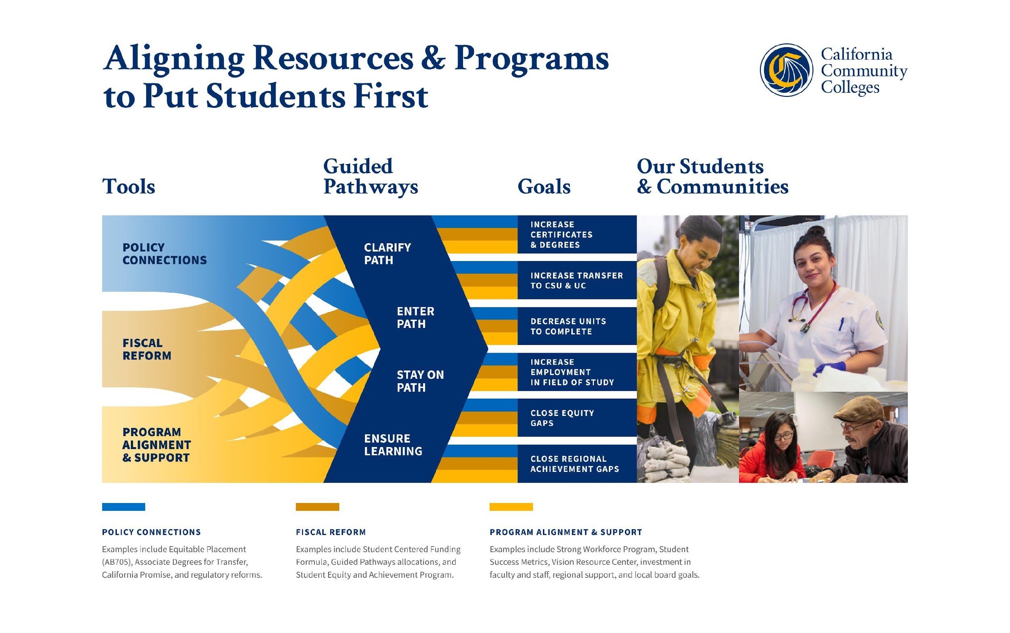
Notes:
Visual may be new
Familiar with guided pathways
Overlay policy, fiscal reform and programs to ensure students enter, persist in and successfully exit our system
GP is the change framework or apparatus for the VfS

Slide 6
ENSURE EQUITY THROUGHOUT THE PATHWAYS
Personal Equity
Institutional Equity
Professional Equity
Administrators, faculty & staff utilize equity-based practices to effectively support and actualize success for disproportionately impacted and marginalized populations.
Personally, individuals practice self-awareness and equity-mindedness; making a commitment to equitable educational practices; learning to recognize & combat personal biases.
College policies, practices, processes, curricula and structures actualize success for disproportionately impacted and marginalized populations.
Notes:
With the Call to Action, we began to dig deeper into HOW to achieve equity
[Overview framework]
This is applicable across all levels of leadership and all stakeholder groups in our system

Slide 7
State Community College Chancellor’s Office Diversity, Equity, & Inclusion Report
Vision for Success Commitment 2: Always design and decide with the student in mind
  Strategy A: Provide campus wide cultural competency and implicit bias training.
  Strategy B: Design professional development workshops to increase knowledge and understanding of cultural competency and diversity.
Vision for Success Commitment 3: Pair high expectations with high support
  Strategy B: Provide faculty and staff (classified and administrators) mentoring opportunities at colleges.
DEI Report

Slide 8
OUR DISTRICT SYSTEMIC COMMITMENT
OUR DISTRICT COMMITENT
RANCHO SANTIAGO COMMUNITY COLLEGE DISTRICT BOARD OF TRUSTEES RESOLUTION No. 20-10
"Take Action Against Structural Racism"
WHEREAS, the district and college teams must develop action plans that provide proactive support for faculty and staff in evaluating classroom learning cultures, curriculum, lesson plans and syllabi, and course evaluation protocols, looking comprehensively at inclusive curriculum that goes beyond a single course, such as ethnic studies, and evaluate all courses for diversity of representation and culturally-relevant content; and …
THEREFORE BE IT RESOLVED by the Board of Trustees of the Rancho Santiago Community College District that: Rancho Santiago Community College District commits to improving outcomes for all of its students, faculty, and staff using its position of influence and power to make a difference and actively strategize and take action against structural racism.

Slide 9
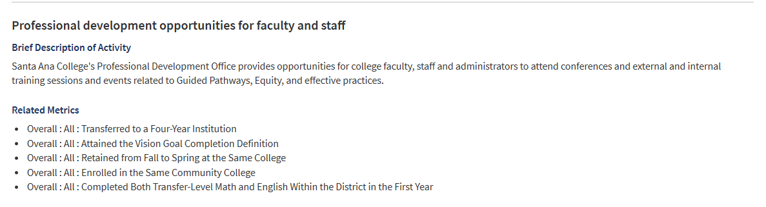
EQUITY PLAN 2019-2022: Focus Inward on Cultural Change Through Equity Minded Professional Development

Slide 10
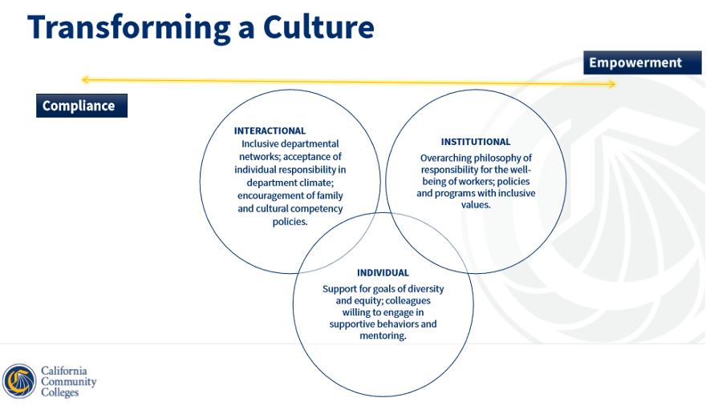
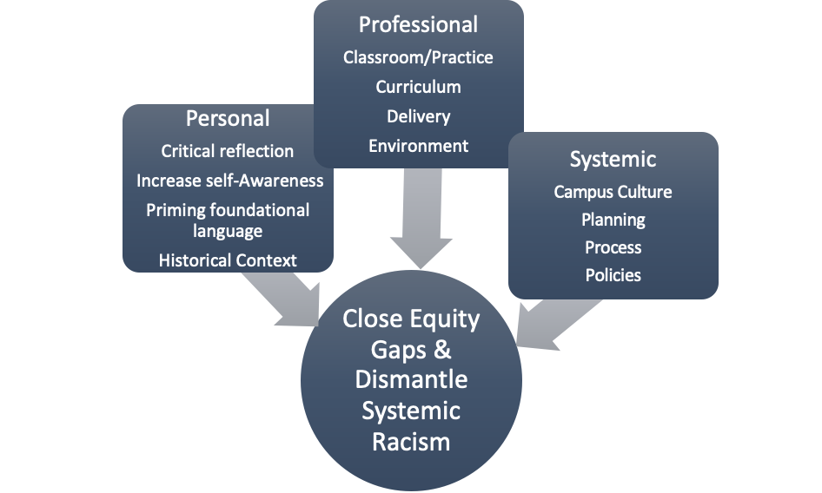
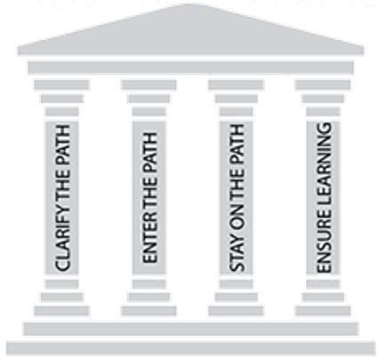
Guided Pathways and Equity Framework
GUIDED PATHWAYS & EQUITY FRAMEWORK
​Mission: Santa Ana College inspires, transforms, and empowers a diverse community of learners.

Slide 11
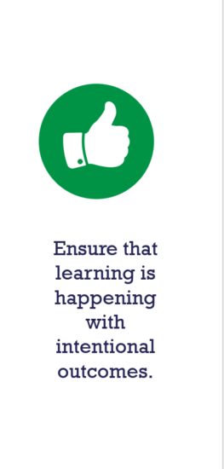
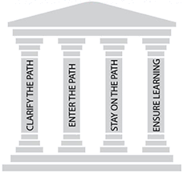
Goals of the Equity-Minded Teaching and Learning Institute
GOALS OF THE EQUITY-MINDED TEACHING & LEARNING INSTITUTE
G2: Redesign our courses using the T3 framework and anti-racist practices
G1: Engage in increasing self-awareness, learn to recognize and challenge implicit bias
Close Equity Gaps & Dismantle Systemic Racism
Personal
Critical reflection
Increase self-Awareness
Priming foundational language
Historical Context
Professional
Classroom/Practice
Curriculum
Delivery
Environment
Systemic
Campus Culture
Planning
Process
Policies
G3: Develop interdisciplinary equity minded communities of praxis & action.
Equitable

Slide 12

SAC Guided Pathways
Scale of adoption Assessment Highlights
Planning to Scale
Active & Applied Learning
4.b. Instruction across programs (especially in program introductory courses) engages students in active and applied learning, encouraging them to think critically, solve meaningful problems, and work and communicate effectively with others. (Note: This practice was added to SOAA in February 2019).

Slide 13
Equity-Minded Teaching & Learning Institute Intersectional Commitment & Focus
Equity-mindedness encompasses being:
Race conscious
Institutionally focused
Evidence based
Systemically aware
Action oriented
DEI Glossary of Terms

Slide 14
TEACHING & LEARNING INSTITUTE STRUCTURE
Transformative Curriculum Redesign
Priority Faculty Groups:
New faculty and faculty teaching courses in which there is Total enrollment (1,000+)
Cohort Model:
Interdisciplinary 10 Faculty first year pilot
Commitment:
(Fall & Spring)
Monthly 2 hour praxis meeting
Faculty Options:
Fulfill entire year of Flex Obligation
OR
Stipend/LHE
Deliverables:
COR Analysis, T3 Syllabus, Lesson Plan, Grading & Assessment, PowerPoint
Evidence Assessment & Data:
(Pre-Post)
Success, Retention, Performative Evaluation disaggregated
Canvas Course/Hybrid:
8 Modules
Think-Process-Partner:
Supportive Equity Ally to share & bounce ideas

Slide 15
Transformative Curriculum Redesign Commitment Proposed Days & Times
Total of 10 remote sessions during the 2021-2022 year.
Friday Meeting time: 9:00AM-11:00AM
Fall 2021 Dates:
  August 27th
  September 24th
  October 22nd
  November 19th
  December 10th
Spring 2022 Dates:
  February 11th
  March 18th
  April 15th
  May 20th
  June 3rd

Slide 16
MODULE 0: Guided Pathways & EQUITY OER/ZTC
Learning Outcomes
Utilize foundational equity language and concepts.
Apply foundational concepts to their professional practice.
Personal
Equity-Minded Teaching & Learning Institute
Professional
Systemic
Prior to first community of praxis meeting, faculty will complete this canvas course and Module 1.
SLO’s are included in the course.

Slide 17
MODULE 1: Goal Setting and Planning Worksheets
Learning Outcomes
Faculty will evaluate classroom equity metrics.
Faculty will develop an initial plan-of-action.
Canvas Course
(learning & reflection)
Student Equity & Success Goals: Planning Worksheet
Course Content: Planning Worksheet
The Classroom Experience: Planning Worksheet
Assignments & Assessments: Planning Worksheet
Grading & Student Feedback: Planning Worksheet
In-person
(professional practice)
Community Building Activity
Critical Reflection Activity focused on worksheets
Plan of Action
Addt’l Resources
(systemic change)
Equity-minded Teaching & Learning Institute
A Santa Ana College Guided Pathways & Equity Project

Slide 18
MODULE 2:Understanding and Responding to Data
Learning Outcomes
  Faculty will access SAC equity tools for planning.
  Faculty will define the student equity gaps in your classroom or program using quantitative and qualitative data.
  Faculty will categorize teaching practices using the T3 framework practices.
Canvas Course
(learning & reflection)
SAC Equity Plan & Goals
T3 Framework (Skyline)
The Seven Equity Precepts Into You Classroom
(Matt Lawrence 2019)
In-person
(professional practice)
SAC Student Success Data
SAC Student Equity Data
What is our plan for reducing Achievement Gaps?
Understanding Retention, Completion, Persistence
Reacting to the Data – Process and Respond/Reflect
Addt’l Resources
(systemic change)
USC review of the equity plans checklist
Equity-minded Teaching & Learning Institute
A Santa Ana College Guided Pathways & Equity Project

Slide 19
MODULE 3: Redesigning Course Content
Learning Outcomes
Faculty will redesign the syllabus to be transformative and accessible.
Faculty will incorporate students' life experiences and culture into the content.
Canvas Course
(learning & reflection)
Culturally Responsive Teaching
Critical Pedagogy
Paulo Freire, Pedagogy of the Oppressed
The Equity-Minded Syllabus Checklist
Accessibility Checklist - universal design
21st Century Job Market Skills
How to Keep Covering the Content from Killing Student Engagement (William Blake)
In-person
(professional practice)
Activity: Does You Content Represent Diverse Contributions?
Discussion: What are the specific skills and competencies students need to learn from the course relevant to their lives.
Activity: Transformative Syllabus/Liquid Syllabus
Activity: Teaching Philosophy Statement
Addt’l Resources
(systemic change)
SAC Examples
Humanizing your online teaching (curriculum) Link: https://onlinenetworkofeducators.org/humanizing-sp21/
Equity-minded Teaching & Learning Institute
A Santa Ana College Guided Pathways & Equity Project

Slide 20
MODULE 4: Redesigning The Classroom Experience
Learning Outcomes
  Faculty will implement community learning in the classroom.
  Faculty will create a lesson plan that incorporates community learning.
  Faculty will make a plan to check biases and be race conscious with students.
Canvas Course
(learning & reflection)
Implicit Bias
Race Consciousness-Colorism, Meritocracy
Stereotype Threat
101 Active Learning Strategies
Want to Reach All of Your Students? Here’s How to Make Your Teaching More Inclusive (Viji Sathy and Kelly Hogan)
In-person
(professional practice)
Activity: Understanding Implicit Bias
Getting to Know your Students
Archetype Educator (Skyline)
Things to Consider for Lage Section Courses
How to Build Community in a Classroom
Student Hours Coupon
Addt’l Resources
(systemic change)
Equity-minded Teaching & Learning Institute
A Santa Ana College Guided Pathways & Equity Project

Slide 21
MODULE 5: Redesigning Grading
Learning Outcomes
Faculty will be able to identify concepts that govern grading of SLO.
Faculty will be able to apply these concepts in their classroom.
Faculty will be able to define the concept of action research.
Faculty will be able to apply the concept of continuous improvement using student feedback.
Canvas Course
(learning & reflection)
Why redesign grades?
“Giving Wise Feedback” Based on Culturally Responsive Teaching & The Brain” Zaretta Hammond
In-person
(professional practice)
Grading Innovations Activity: Common practices and emerging opportunities
Activity: “A Two-Way Street”
Addt’l Resources
(systemic change)
What role does feedback play in our instructional practices? Do we have opportunities to discuss this in our departments/campus wide?
Equity-minded Teaching & Learning Institute
A Santa Ana College Guided Pathways & Equity Project

Slide 22
MODULE 6: Redesigning Assignments & Assessments
Learning Outcomes
Faculty will provide examples of assignments reflective of student lives & social justice.
Faculty will develop an assessment that allows students to demonstrate what they learned based on students' strengths.
Canvas Course
(learning & reflection)
Transparency in Teaching: Faculty Share Data and Improve Students’ Learning (Mary-Ann Winkelmes)
OR
Backward Design
Vanderbilt University
In-person
(professional practice)
Activity: Determine Types of Assessments for your Classroom:
Activity: Transparent Assignment Template
OR
https://wke.lt/w/s/lfsIjY
Addt’l Resources
(systemic change)
Goodman, S. (2018). It’s NOT About Grit. Trauma, Inequity, and Power of Transformative …
Jankowski, N. A., Montenegro, E. (2020) A New Decade for Assessment…
Jankowski, N. A., Montenegro, E. (2017). Moving Towards Culturally Responsive Assessment
Equity-minded Teaching & Learning Institute
A Santa Ana College Guided Pathways & Equity Project

Slide 23
MODULE 7: Equity-Minded Curriculum Redesign
Learning Outcomes
Faculty will apply equity-minded language into CORs and program review.
Faculty will integrate Culturally Responsive textbook options and/or OER/ZTC.
Faculty will devise an equity-minded research program plan-of-action.
Canvas Course
(learning & reflection)
Committee & Leadership Involvement
COR’s
Program Review-Jaki King
Course Commitments
In-person
(professional practice)
Activity:
COR Review: Language, add text and content that explicitly includes options that are race-conscious.
Examples of Equity-Minded COR’s
Research-follow up PPT Presentation.
Addt’l Resources
(systemic change)
Evaluate CiC Processes & Common Language
How to make recommendations? (CiC processes)
Workgroups/Taskforces
Equity-minded Teaching & Learning Institute
A Santa Ana College Guided Pathways & Equity Project

