Slide 1
Student Equity Achievement Program Committee Highlights
Thursday, December 3rd, 2020 Meeting

Slide 2

Timeline for 2020-2021 SEAP Funding
Mid-February | Student Equity funding request forms are sent out college wide
Late March | Funding requests are due back to Office of Student Success, Equity, and Inclusion
April | Committee reviews submitted funding requests
Late April | Funded equity requests are announced
Early December November (Nov. 11th, 2020) | Guidelines for Mid-Year Report are sent to requestors of funded projects
Prior to December Holiday | Requestors of funded projects submit requests to research department for Mid-Year Report data
January 29th, 2021 | Mid-Year Reports are due to the Office of Student Success, Equity, and Inclusion
Allocated funds must be used between July 1, 2020 and June 30, 2021; there is no carryover of funds to the next year.

Slide 3
Equity Request
Implementation Plan
1. Project Description – For each item listed under the cost section, describe how you plan to use the funds with as much detail as possible. When do you plan to implement this activity? When do you plan to have it completed by? Is this a multi-year project? Is this a one-time project? If ongoing, state that the activity is ongoing and state in which semesters you will offer these services to students. For 2021-2022 request, please consider how COVID may impact your request. We encourage that you include a back up plan in case your request includes items that require in-person activities, travel, etc. (300 word limit)

Slide 4
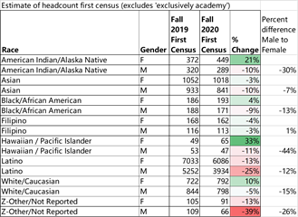
Research Data

Slide 5
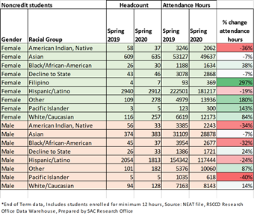

Slide 6
What Can We Still Do This Week?
Reach out to the man of color in your class and offer an individualized message of resilience and acknowledgment. Let them know you see them, and that you believe they can be successful this semester and the next.
Even if know the student will not pass your class, offer a message that highlights the strength that you noticed this semester.

Slide 7
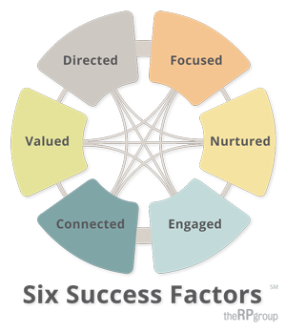
Intersession & Spring
Student Success Factors Definitions
Be intrusive Nurtured, Engaged, Connected, Valued
Be relational Directed & Connected
Be culturally relevant and affirming Connected & Valued
Be community focused Focused, Connected, Valued
Be race conscious Valued
Dr. J. Luke Wood & Dr. Frank Harris III Webinar: Employing Equity-Minded and Culturally Affirming Teaching and Learning Practices In Virtual Learning Communities

Slide 8
Equity, Anti-Racism, Resources/Information?
Contact: Maria Aguilar Beltran
beltran_maria@sac.edu

