Slide 1
Demystifying Dual Enrollment
A Faculty Perspective
Clarifying Dual & Concurrent Enrollment?
Pathways Example
Process
Looking at the numbers: Benefits & Challenges
History & Progress
Enrollment

Slide 2
Concurrent Enrollment is…
  Face-to-face
  Online
An opportunity for high school students to enroll in community college coursework on the college campus.

Slide 3
Dual Enrollment is…
  Courses are usually taught by high school faculty who meet the CCC minimum qualifications and have been interviewed by SAC faculty..
An opportunity for high school students to enroll in community college courses at their high school during their traditional school day.

Slide 4
An Example
Samueli Academy Digital Media Arts Partnership

Slide 5
High School Communication
It was so great to see you the other day. This is a reminder that I will have two classes (about 70 students) who will have taken Art 100, Art 110, Art 195 and Art 162 by the end of the spring semester. They will need two other courses for the Fall of 2021.
Agreement Began Fall 2018

Slide 6
High School Communication
It was so great to see you the other day. This is a reminder that I will have two classes (about 70 students) who will have taken Art 100, Art 110, Art 195 and Art 162 by the end of the spring semester. They will need two other courses for the Fall of 2021.
ART 100
ART 110
ART 195
ART 162
Graphic Arts Cert. of Proficiency
Agreement Began Fall 2018

Slide 7
High School Communication
It was so great to see you the other day. This is a reminder that I will have two classes (about 70 students) who will have taken Art 100, Art 110, Art 195 and Art 162 by the end of the spring semester. They will need two other courses for the Fall of 2021.
ART 100
ART 110
ART 195
ART 162
ART 122
or ART 121A
Graphic Arts Cert. of Proficiency
Agreement Began Fall 2018

Slide 8
High School Communication
It was so great to see you the other day. This is a reminder that I will have two classes (about 70 students) who will have taken Art 100, Art 110, Art 195 and Art 162 by the end of the spring semester. They will need two other courses for the Fall of 2021.
ART 130 ART 168
ART 100
ART 110
ART 195
ART 162
ART 122
or ART 121A
Graphic Arts Cert. of Proficiency
Graphic Design Degree
Agreement Began Fall 2018

Slide 9
High School Communication
ART 164 Elective
It was so great to see you the other day. This is a reminder that I will have two classes (about 70 students) who will have taken Art 100, Art 110, Art 195 and Art 162 by the end of the spring semester. They will need two other courses for the Fall of 2021.
ART 130 ART 168
ART 100
ART 110
ART 195
ART 162
ART 122
or ART 121A
Graphic Arts Cert. of Proficiency
Graphic Design Degree
+ Digital Media Arts Degree
Agreement Began Fall 2018

Slide 10
Getting started with Dual Enrollment?
A Faculty Perspective
1
2
3
4
Communicate with High School Instructors:
What are their goals?
What are our goals?
Find mutual or common objectives.
Identify & include stakeholders.
Basti Lopez & Dr. Ortiz can assist with this process.
Share Curriculum & Create a Plan:
CTE
IGETC
Major-oriented GEs
Start small.
Grow when the high school is ready.
Clarify. They are teaching our curriculum.
Review Instructor Qualifications
Interview & Hire
Observe & Evaluate
Maintain Communication
Is this a place for mentorship?
Is there a place for mutual curriculum development?
Course Creation & Enrollment
Basti Lopez & Dr. Ortiz can assist with this process.
In conjunction with Division Office.
PERKS: Students are now SAC Students with all the benefits and resources!

Slide 11
Just a Little About the Numbers
Schools & Pathways
Type of School’s | School’s | Pathways
Santa Ana Unified School District | Advanced Learning Academy-Early College Century HS Godinez Fundamental HS Lorin Griset Academy Saddleback HS Santa Ana HS Segerstrom HS Valley HS Middle College HS | IGETC Pathway IGETC, Teach Academy & Entrepreneurship Pathway. IGETC Pathway IGETC Pathway Biotechnology Pathway IGETC, FDM, & Fine & Performing Arts Pathway IGETC & Computer Science Pathway International Business, Food & Hospitality Pathway IGETC Pathway
Private School | Mater Dei High School | IGETC, Biotechnology, & Theatre Arts Pathway
Garden Grove Unified School District | Santiago High School | IGETC, Entrepreneurship Pathway, &Teacher Academy Pathway
Charter Schools | Magnolia Science Academy Orange County School of the Arts Samueli Academy | Biotechnology Pathway Digital Media Arts Pathway Digital Media Arts & IGETC Pathway

Slide 12
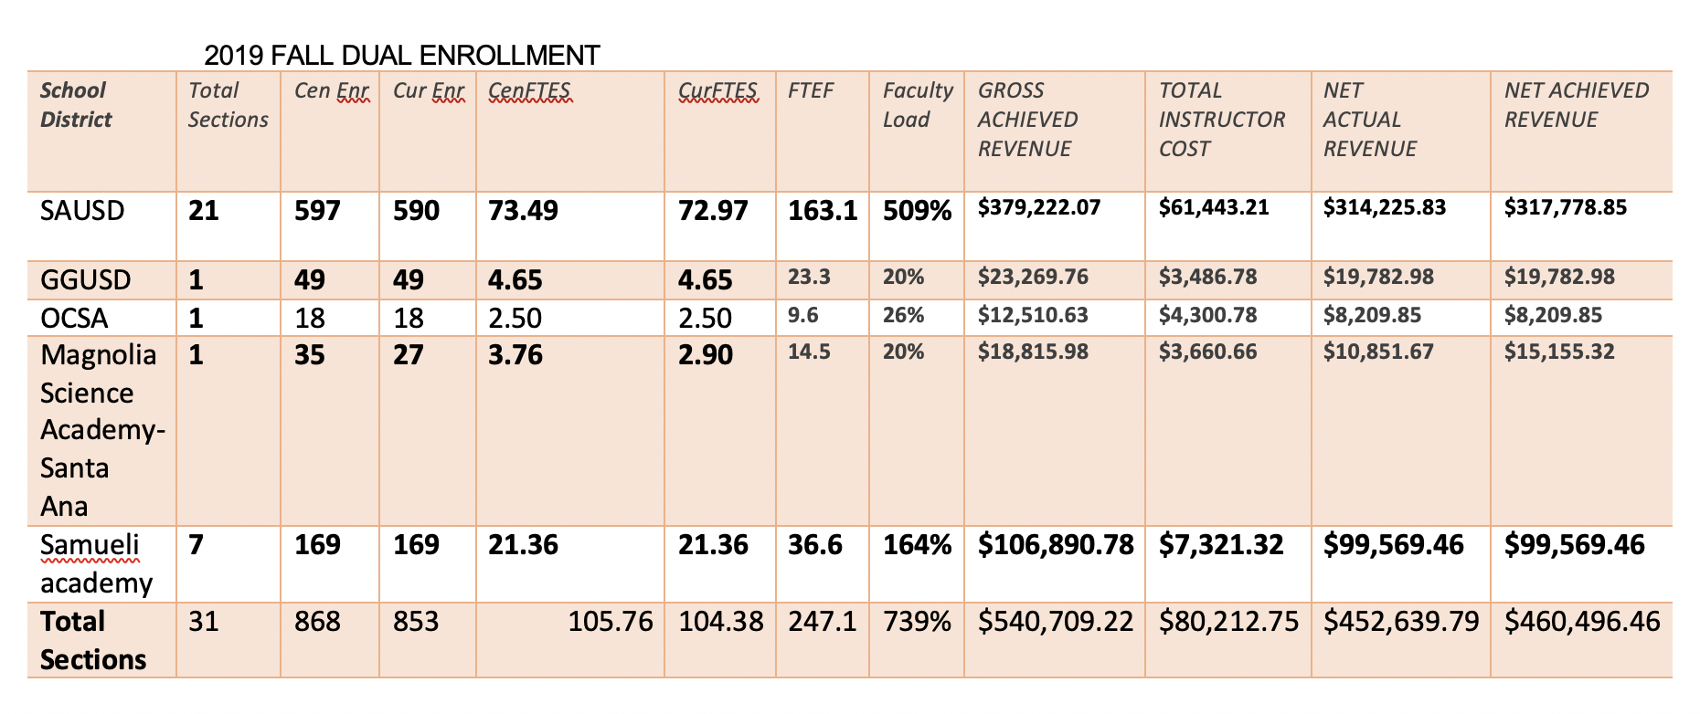
Just a Little About the Numbers
FTEs & Revenue

Slide 13
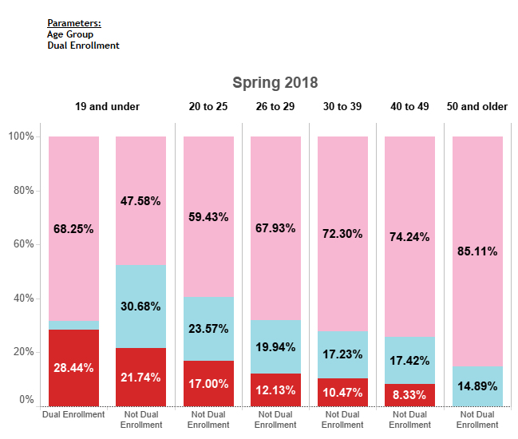
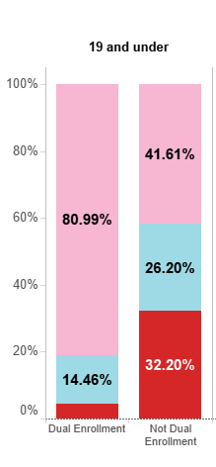
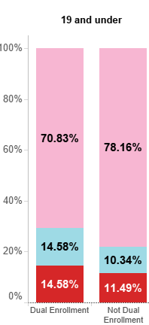
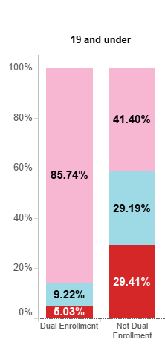
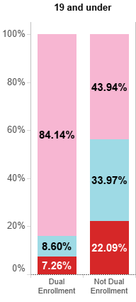

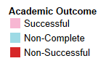
SPRING 2018
SUCCESS RATES COMPARISON BY AGE
*SAUSD ONLY
FALL 2017
SUMMER 2018
FALL 2018
SPRING 2019
KEY

Slide 14

Retention: Numbers!
There were 803 unduplicated students enrolled 2018-2019 in Dual Enrollment courses.
803 unduplicated students enrolled 2018-2019 in Dual Enrollment courses.
206 of the 803 have enrolled in RSCCD courses as of 8-20-19 – some have signed up at SCC.
200 enrolled at SAC and 10 enrolled at SCC
14

Slide 15
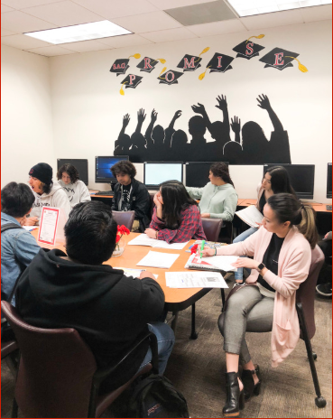

Benefits & Challenges
Students choose to be in these rigorous classes.
These classes are a stimulating and creative learning environment.
Oftentimes the classes are much smaller with a lower teacher to student ratio.
Students are able to experience college success in a familiar environment.
Limited Faculty
School calendars don’t always align with SAC Academic Calendar. Having to reconcile days/hours.
Registration & enrollment procedures
SAC application process
15

Slide 16

Thank you!
Q& A
16

Slide 17
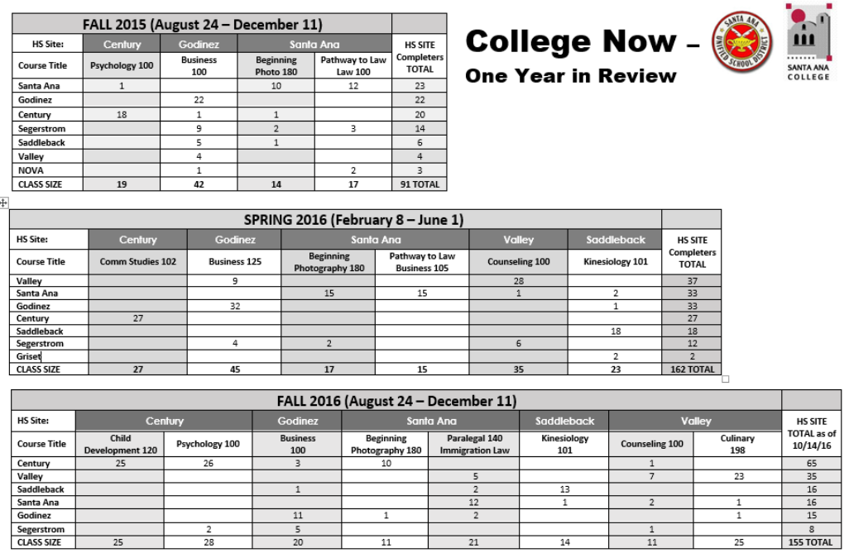
Singleton courses that were randomly selected.
No support structure in place.
Courses offered after school & students were bused by SAUSD to location.
Building a plan without considering the theme or context of the entire school.
No comprehensive multi-year plan in place.
Ineffective communication between both institutions. No “single-point of contact”.
17

Slide 18

Goal to complete
Have dual enrollment training for SAC Faculty & HS teachers every semester.
Implement an advisory board composed of Deans, Faculty Chairs, Staff, and counselor for dual enrollment.
Move away from the paper process and have efficient application process.
Scale up dual enrollment efforts with Career Technical Education programs so that students can complete vocational certificates.
Hire student workers & DE team.
Distribute faculty & student handbooks.
18

Slide 19
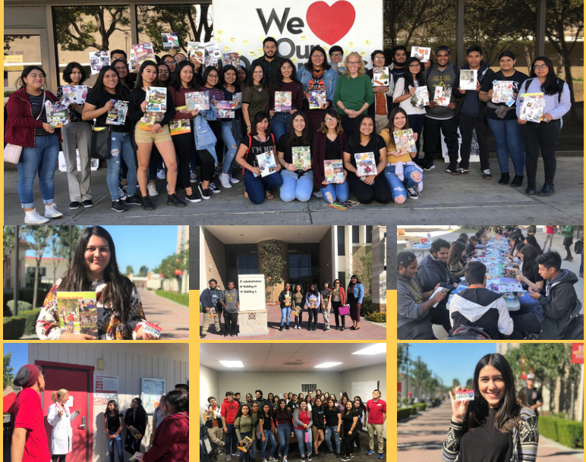
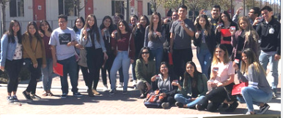
Growth & Structure…
Collaboration & input of Deans & Department chairs to create pathways at the school.
  Comprehensive multi-year plans in place.
  Communication is streamlined.
  High schools, have staff to ensure that students complete enrollment and pass courses.
  Student & parent orientation nights
  Students tour SAC & learn about programs and services.
70% of courses are during the school day:
  SAC collects FTES
  If SAC faculty, SAC pays instructor. If HS instructor, HS pays their instructor.
  HS provides textbooks/materials.
29% of courses are afterschool (at the request of the high school):
  SAC collects FTES
  SAC pays SAC Faculty/HS instructor
  SAC Provides Textbooks/Materials
.6% are completely online & use ZTC/OER
Tripling the number of sections & increase number of enrollment

Slide 20
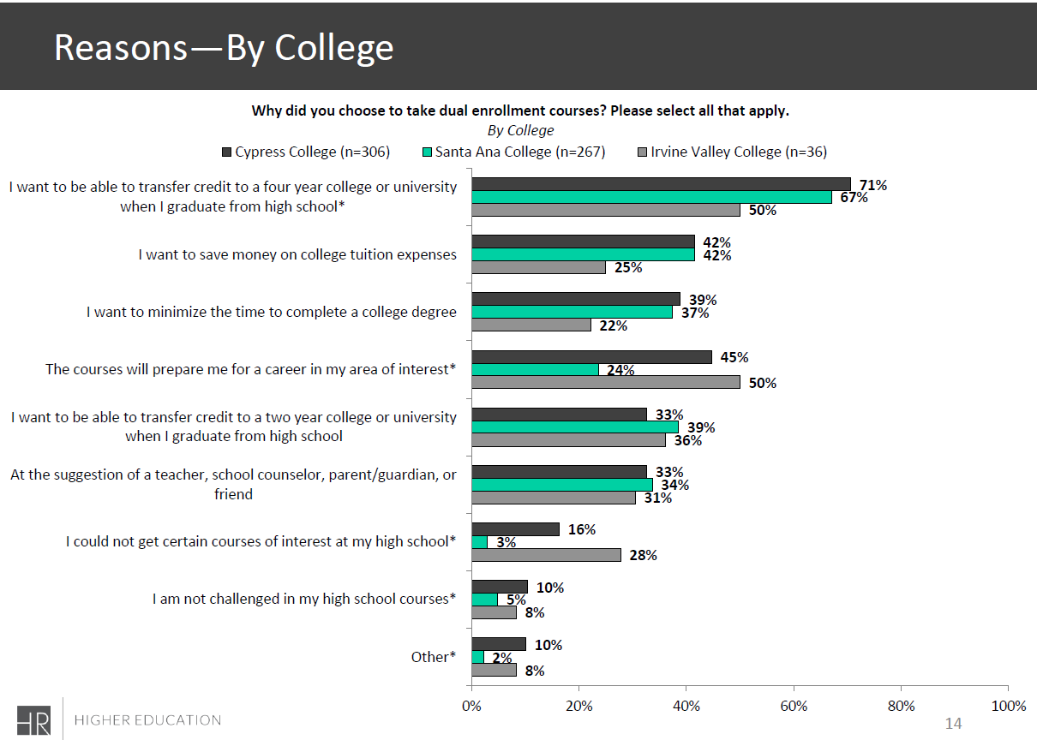


20

Slide 21

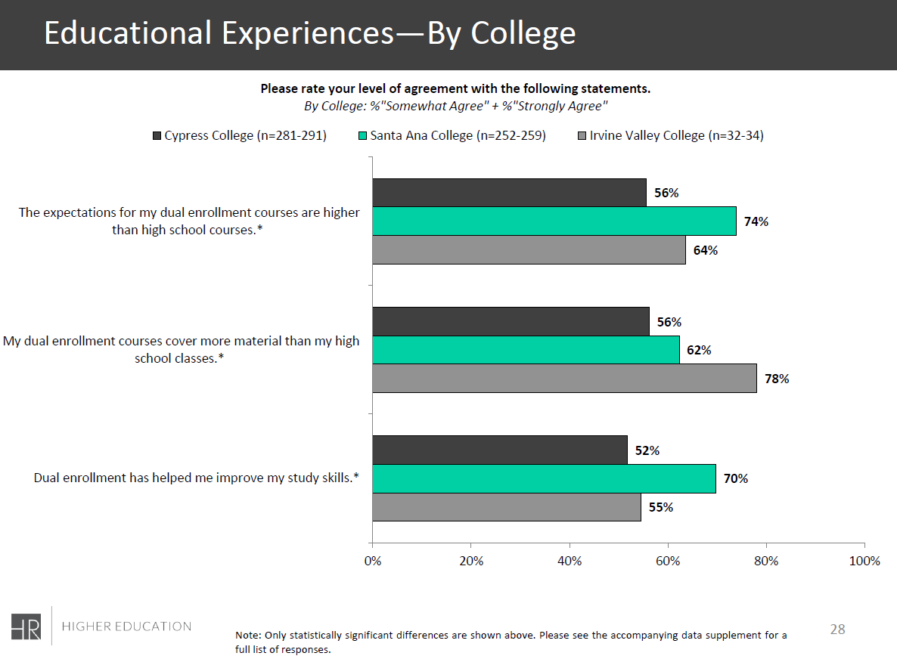
21

Slide 22
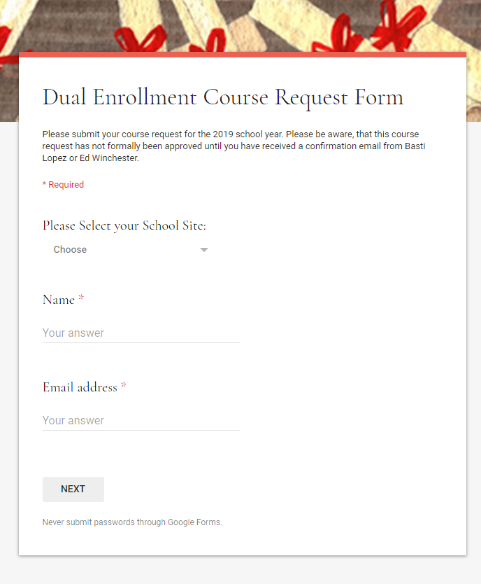
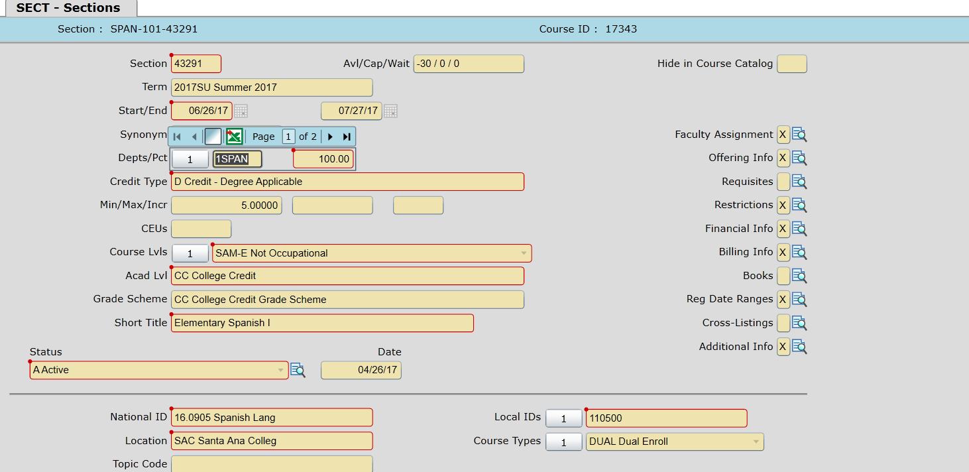
Course Request & Building Procedures
Schools submit course request via google forms in mid-late September for spring semester.
Schools submit course request via google forms in mid-late March for Fall semester.
Courses are sent to Dean & Department Chair
Once faculty is identified, administrative secretaries build courses.
  School academic calendars are provided to align courses.
  Courses are coded “DUAL” in SECT in the Course Type Field for repository collection.
  “X” funding when not HS paying instructor.
  Courses are audited to ensure that contact hours are met.
22

Slide 23
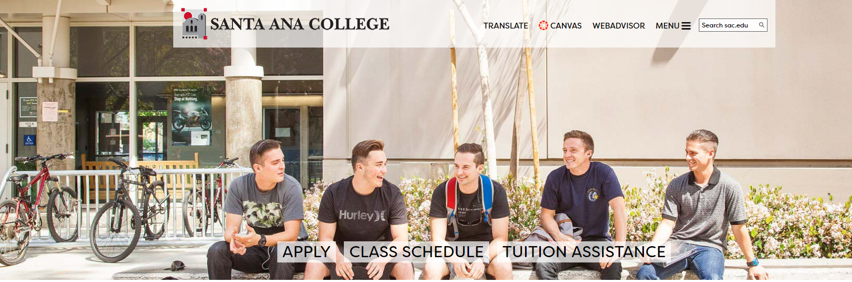
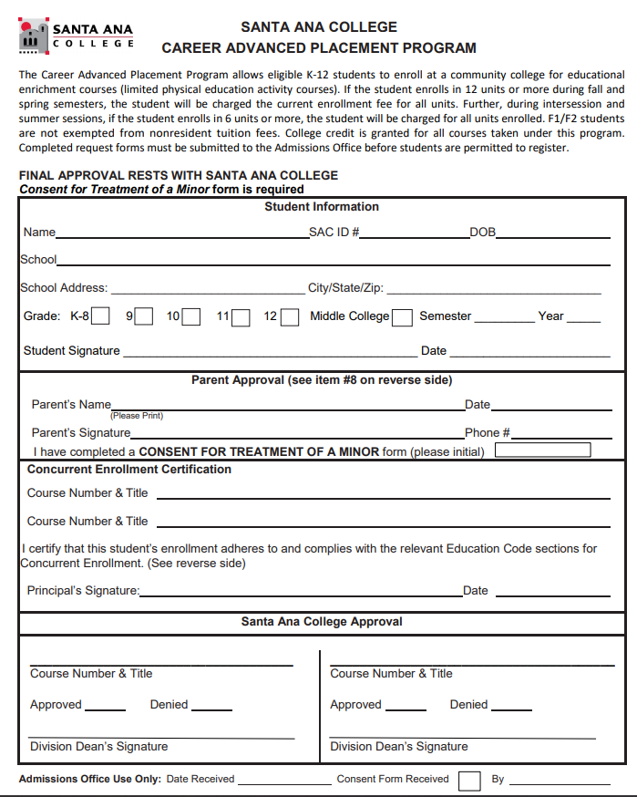
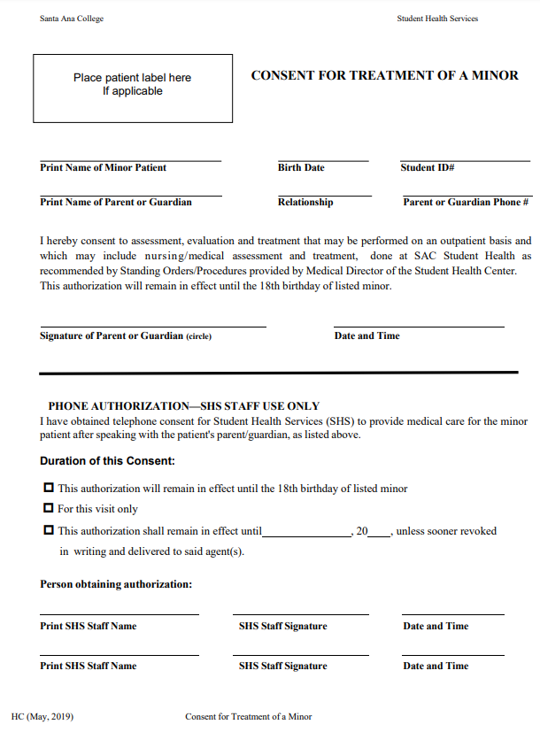
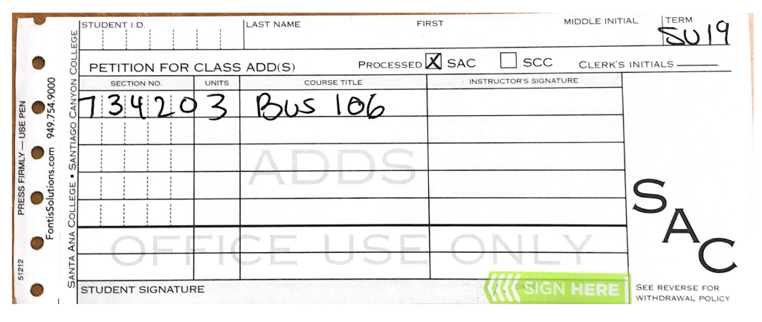
Why don’t I have student enrolled?
Step 1
The process…
Step 2-4
Paperwork & signatures
Step 5-6
Verification & Registration

