Slide 1

Santa Ana College inspires, transforms and empowers a diverse community of learners
SANTA ANA COLLEGE
PARTNERSHIP RESOURCE TEAM VISIT
In November 2021, Santa Ana College sent a letter of interest to the California Community Colleges related to the Institutional Effective Partnership Initiative (IEPI) Grant. The initiative dispatches a Partnership Resource Team (PRT) to visit colleges and assist in strengthening the institution. Santa Ana College was approved and chosen for a visit in Spring 2022.
Dr. Jeffrey Lamb
Vice President, Academic Affairs,
Santa Ana College

Slide 2
Santa Ana College inspires, transforms and empowers a diverse community of learners
AREAS OF FOCUS
1. Solidifying support to the Career and Academic Pathways (CAP) (aka Meta-Majors)
Institutionalization
Sustainability
2. Program Mapping Project completion
Technology
Sustainability
3. Learning and Engagement Equity Team
Resistance to change
Institutionalizing change
4. Integrated Planning—Nuventive Tool
Review Systems/Processes
Institutional Change

Slide 3
Santa Ana College inspires, transforms and empowers a diverse community of learners
AREAS OF FOCUS/TREATMENT
1. Solidifying support to the Career and Academic Pathways (CAP)
Institutionalization
Sustainability
Pointed Questions:
What are examples of how other colleges have used disaggregated data to make curricular and onboarding systemic changes that center the CAP’s new meta-majors?
Are there examples of program and curricular evaluations?
Are there recommendations for collecting and disaggregating marketing data that can authentically inform our equity efforts?
Upon applying to Santa Ana College, students are provided with the option of identifying a Meta-Major that best aligns with their career interests. Based on best practices from other community colleges, the identification of an undecided major often prolongs the time to the completion of a degree. The Guided Pathways team decided early on to eliminate the undecided major as an option.
Santa Ana College’s Meta-Majors were launched in the fall of 2019. Incoming and ongoing students were invited to participate in an introduction to their preferred Meta-Majors during a pre-semester workshop. Evidence shows that students who can identify their paths sooner will complete their degrees in a shorter time, and it will increase the likelihood of persistence.
Identified Activities:
Continue to evaluate programs under each CAP per curriculum changes to programs.
Enhance marketing efforts to promote CAPs to all incoming students.
Increase access to the SuperStrong assessment which includes CAP (meta-major) recommendations to non-traditional incoming students.
Align Santa Ana College CAPs with existing Santa Ana Unified School District pathways so that students can easily transition into college.

Slide 4
Santa Ana College inspires, transforms and empowers a diverse community of learners
AREAS OF FOCUS/TREATMENT
2. Program Mapping Project Completion
Technology
Sustainability
Currently, Santa Ana College’s Guided Pathways team is working to establish a process for the annual maintenance of program maps as part of the established program review process. It is anticipated that personnel and technology resources will be needed to create this process.
Program maps are a fundamental part of the Guided Pathways framework and are designed to increase student completion by providing an articulated plan for students’ coursework across semesters. The concept of mapping has begun to influence other areas of Santa Ana College to improve student guidance. There has been an interest in developing a career-oriented map to assist students to develop their professional profiles during their academic journey as well as a rethinking of Santa Ana College’s math map to reflect quantitative reasoning as more course options become available to serve students with differing educational goals aligned with their respective Meta-Majors.
Identified Activities:
Update existing program maps for AA degrees.
Publishing of all maps to public website.
Create program maps for remaining certificate programs and ADT degrees.
Upload program maps to Curriculum Tracks to integrate with electronic educational planning.
Approval process for quadrennial review of program maps.
Pointed Questions:
Any effective practices around sustaining our work to develop and maintain program maps?
Any recommendations on ways to leverage technology to link ed planning, program maps, and schedule development?
Recommendations to address the potential increase of workload to faculty/staff?

Slide 5
Santa Ana College inspires, transforms and empowers a diverse community of learners
AREAS OF FOCUS/TREATMENT
3. Learning and Engagement Equity Team
Resistance to Change
Institutionalizing Change
One of the most challenging aspects of Guided Pathways implementation has been the operationalization of the fourth pillar: ensuring that students are learning. Santa Ana College’s Learning & Engagement Team was initiated to address student learning with a focus on student equity. Currently, the Learning & Engagement Team consists of student equity coordinators for credit and noncredit programs, a professional development coordinators for credit and noncredit programs, an outcomes assessment coordinator, and Guided Pathways coordinators for credit and noncredit programs.
We have adopted a framework to achieve systemic transformation that involves an analysis of our services, practices and policies through a personal, professional, and systemic approach.
The personal involves us having a common understanding of the equity and social justice terminology, learn about the inequitable historical context of our institution, and engage in ongoing critical reflection that leads to increasing our self-awareness.
The professional involves incorporating inclusive, equity-minded and culturally responsive andragogy practices, services, and environment for students.
The systemic involves evaluating, transforming, and designing flexibility in our campus culture, policies, processes, and procedures to support the diverse needs of our students.
We are currently piloting the first year of the Equity Minded Teaching and Learning Institute with a cohort of 10 diverse discipline specific faculty. The facilitators are members of the Learning and Engagement Team.
Pointed Questions:
How do we systemically make meaningful changes that will support faculty engagement in this work through diversity, equity, and inclusion?
Also, how do we create systemic accountability in partnership with faculty?
Are there any excellent examples from other institutions of evaluation methods for documenting the progress of this equity-based work in curriculum, pedagogy, or student life?

Slide 6
Santa Ana College inspires, transforms and empowers a diverse community of learners
AREAS OF FOCUS/TREATMENT
4. Integrated Planning—Nuventive Tool
Review Systems/Processes
Institutional Change
Pointed Questions:
What are some effective practices in closing the
loop to ensure that funded activities are evaluated and reviewed to meet student success prior to receiving future funding through the integrated planning process?
Any suggestions on creating sustainable practices to ensure meaningful engagement with integrated planning processes? From assessment to review to allocation and implementation…
How can the College ensure linkages between the developing institutional effectiveness efforts (College plans, revised committee structures, PGC handbook), our newly revised planning processes/college goals and resource allocation to support initiatives?
Any recommendations on mobilizing the College around integrated planning (in particular, re-engaging outcomes assessment, understanding the value of program review, and resource allocation processes)?
Suggestions on how to move off legacy processes and procedures to newer and hopefully more efficient processes?
We’d like to incorporate more funding sources into our newly developed integrated planning process… any recommendation on changing a newly developed process?
What are promising practices to keep the College informed and our practices transparent to strengthen trust and collaboration throughout the College?
Starting spring of 2019, SAC began the process of more fully integrating outcomes assessment, program review (PR), and resource allocation (RAR). By leveraging the former database software (TracDat, that later became Nuventive Improve), SAC was able to link and more fully integrate these processes. In fall of 2021, SAC was able to fully engage in this more streamlined and integrated way of assessing, reviewing, and funding its efforts.
Closing the Loop:
Tie between annual report and RAR
No clear connection between RAR, PR, Outcomes, and evaluation/results of funded activities.
Software implementation issues
Consistent funding for classified staffing support
Student Services Outcomes (SSO)
Clearly identify “program”
Develop SSO for all Programs
All SSO in Nuventive
Better utilization/analysis of data and ensure it has the capacity to disaggregate data by race, ethnicity, gender, and other equity groups.
Campus conversation/agreement on the centrality of assessment and links to planning and resource allocation; and level of support (faculty and staff for course and service area outcomes) for the work to ensure continuity. Include assessment and accountability.
As a means of further integration, the College is looking to blend resource request and allocation processes for multiple funding sources into a single process. (Guided Pathways, Equity, SWP, etc).

Slide 7
Santa Ana College inspires, transforms and empowers a diverse community of learners
NEXT STEPS
FOR SAC
The Partnership Resource Team, comprised of about eight colleagues from across the state, will visit SAC at least twice.
VISIT ONE
Confirmed for March 24th
VISIT TWO
Confirmed for May 5th
VISIT THREE
To be determined

Slide 8
Santa Ana College inspires, transforms and empowers a diverse community of learners
PREPARATION FOR VISIT ONE
COMPLETED
The IEPI Project Director requests from the institution a somewhat more detailed (but still concise) treatment of the Areas of Focus, which the CEO will prepare in consultation with the Academic Senate President and other applicable leadership.
The PRT reviews the following documentation, in addition to the Letter of Interest and the Areas of Focus treatment:
A relatively small set of documents regarded by the institution as crucial to understanding the Areas of Focus and provided to the Project Director by the point persons
Accreditation documentation, and IEPI documentation as applicable
Other documentation available on the institutional website, or provided by the institution at the team’s request, that is related to the Areas of Focus
IN PROGRESS
To ensure a productive visit, it’s very important for the CEO and point persons to inform the institutional community, and especially the participants in visit meetings, about the nature and purposes of the PRT visit, and that participants will be asked to share their observations and perspectives on the Areas of Focus in the meetings. Sufficient functional and constituency representation in the meetings is also very important.
The CEO designates before Visit 1 a working group that will start drafting the institution’s Innovation and Effectiveness Plan (the I&EP Drafting Group) with the guidance of the PRT during the second visit. The group may be ad hoc or existing, and if necessary, the CEO may designate two or even three groups, each of which is to draft one or more sections of the Plan. The group(s) should be relatively small, yet reasonably representative with respect to applicable functions and constituencies, to strengthen both the Plan and its subsequent implementation.
The PRT reviews the draft list of individuals and groups and the schedule that the institution has suggested for interviews/meetings (both provided by the point persons to the Project Director), which should include at least some members of the I&EP Drafting Group. The PRT then requests any additional interviews or meetings that are needed to gain a fuller understanding of the institution’s needs and decides who on the PRT should meet with whom.
In most cases, the PRT stays together throughout the day and meets with everyone, but scheduling constraints might require meetings to occur in parallel with the PRT split in halves or even thirds, and some interviews/meetings might work best with just one or two PRT members.
The initial visit day typically starts at 8:00 or 8:30, and includes short breaks between meetings, a 45-to-60-minute working PRT lunch, an afternoon wrap-up meeting just for PRT members, and then time for an oral Summary of Initial Visit to the CEO (and others at the CEO’s discretion). In some cases, the PRT might wish to include a meeting on-site to finish the draft of the written Summary of Initial Visit. The target finish time is typically 4:30 or 5:00. The PRT Lead works with the point persons to finalize the schedule for the day.

Slide 9
Santa Ana College inspires, transforms and empowers a diverse community of learners
VISIT ONE:
GATHERING INFORMATION AND ESTABLISHING SCOPE
The PRT holds interviews and meetings with the individuals and groups as scheduled, and asks questions that the PRT has identified for each interview or meeting, with clarifying and follow-up questions as appropriate.
The PRT analyzes the information gathered in the interviews and meetings.
The PRT meets as a team to share preliminary observations about the institution’s Areas of Focus, what the institution has already done or plans to do about them, and what additional IEPI resources, if any, might help the institution make progress.
If the date for the second visit has not already been set, the PRT Lead works with the CEO, point persons, and PRT members to identify it. The second visit should take place as soon after the first visit as schedules permit, consistent with development and timely delivery of the List of Primary Successes and Menu of Options as described below. An interval of about five weeks is ideal.
Based on the team’s discussion, the PRT prepares and presents a brief oral Summary of Initial Visit to the CEO.

Slide 10
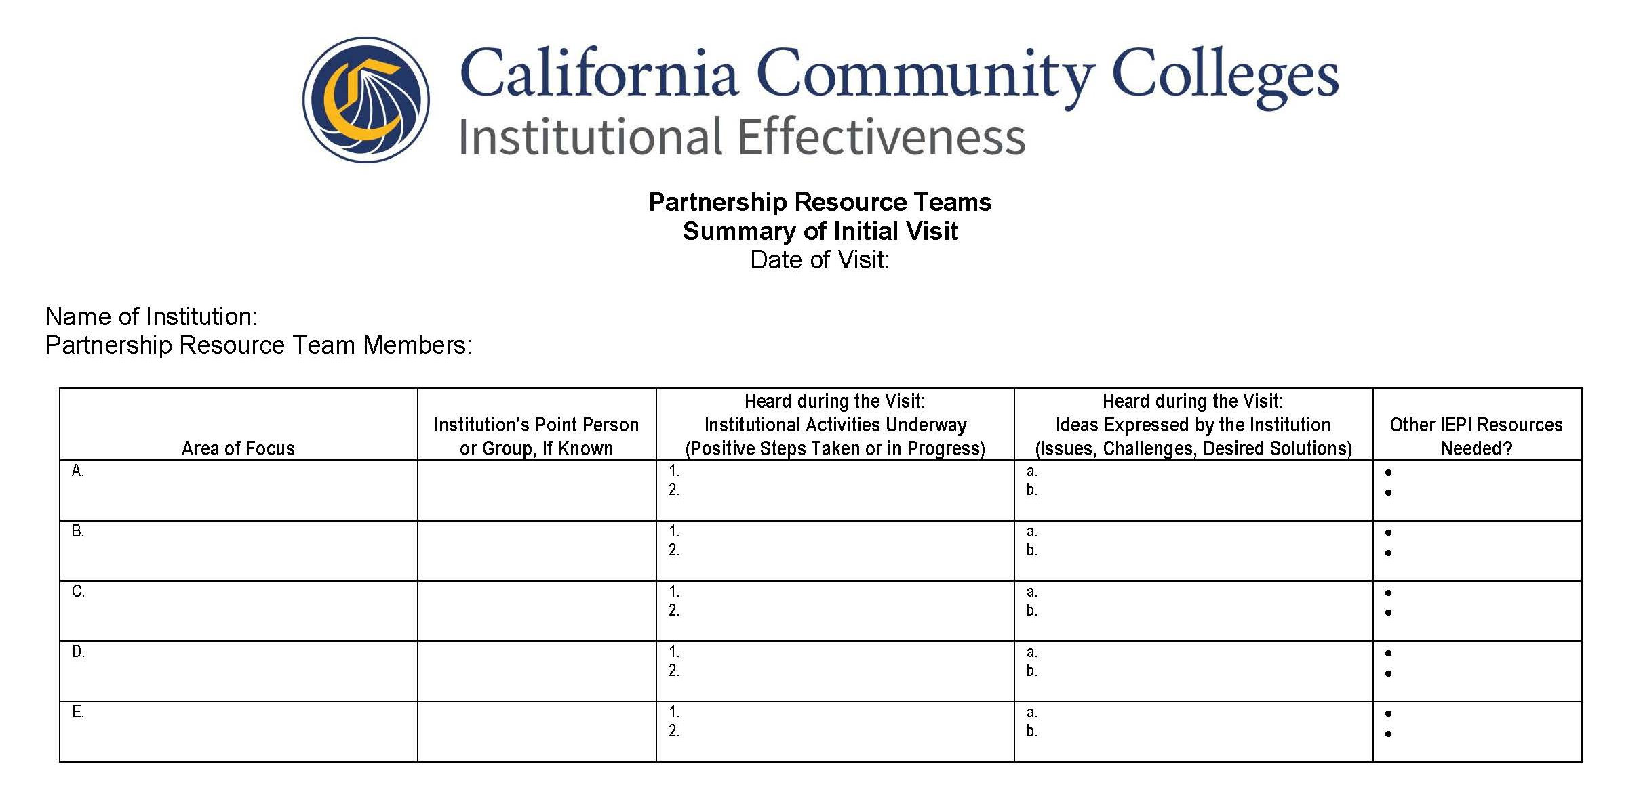
Santa Ana College inspires, transforms and empowers a diverse community of learners
FOLLOW-UP TO VISIT ONE
The PRT prepares and submits the written Summary of Initial Visit within two weeks of the visit, if at all possible. This document summarizes what the PRT heard during the visit: ideas expressed by institutional personnel, along with activities that the institution has already undertaken to address its Areas of Focus, if any. It does not contain findings, conclusions, suggestions, recommendations, or prescriptions.
The PRT Lead forwards any request for additional documentation to the institutional point persons.
The CEO, point persons, and others who had substantial interaction with the PRT are asked to participate in the post-visit evaluation.

Slide 11
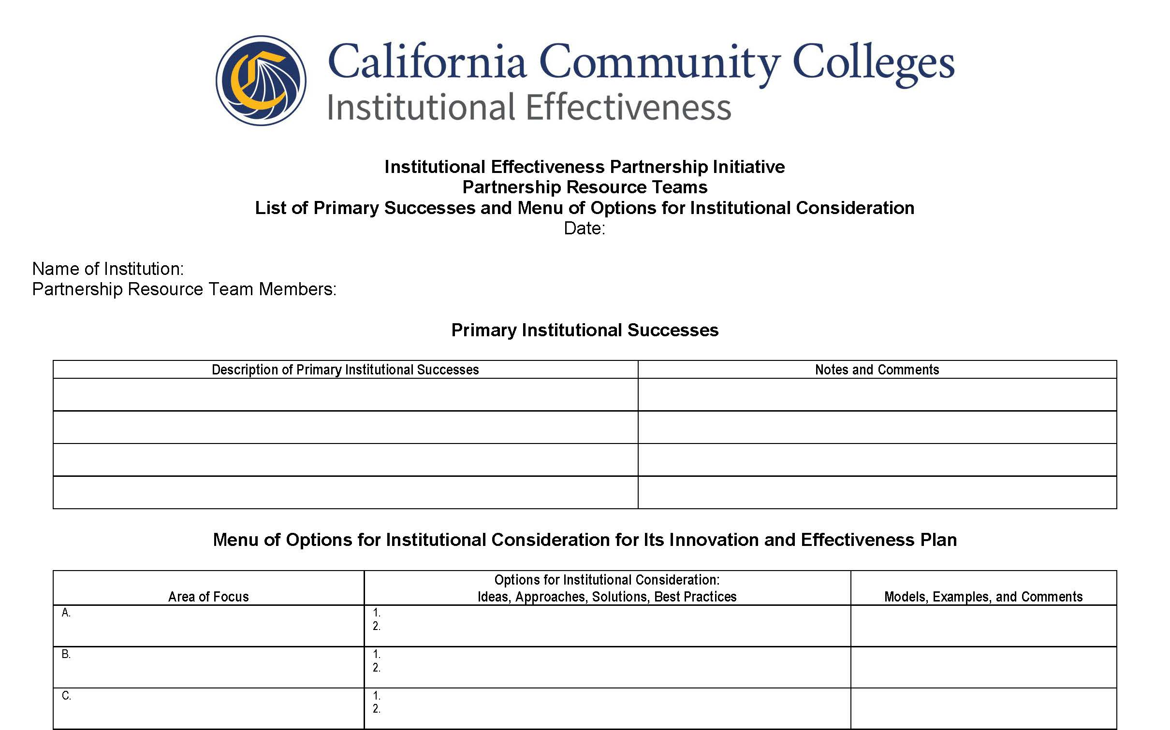
Santa Ana College inspires, transforms and empowers a diverse community of learners
PREPARATION FOR VISIT TWO
Based on the documentation review, interviews, meetings, further discussions, and their own collective expertise, the PRT creates a List of Primary Successes and Menu of Options (MOO) for consideration by the institution as it develops its Innovation and Effectiveness Plan (I&EP). The MOO consists primarily of ideas for improvement and/or best practices, along with references and models or examples of applicable practices successfully used at other institutions, in each Area of Focus. At least a week before the second visit, the PRT Lead sends this document to the CEO and point persons for review. The CEO reviews it, and if any tweaks are in order, suggests them to the Lead, who incorporates them as appropriate and sends the final to the CEO and point persons for distribution to the I&EP Drafting Group, which should read it carefully and, if feasible, meet to discuss it prior to Visit 2.
At least two weeks before the visit, the point persons send a draft schedule for the visit and list of I&EP Drafting Group(s) members to the Lead. Then, in a brief zoom/phone meeting, the PRT Lead, CEO, and point persons confirm the structure and schedule of the second visit. The length of the visit depends on the I&EP Drafting Group(s) involved and the complexity of the issues to be covered, and might range from half a day to a full day.

Slide 12
Santa Ana College inspires, transforms and empowers a diverse community of learners
VISIT TWO:
HELPING THE INSTITUTION DEVELOP ITS INNOVATION AND EFFECTIVENESS PLAN
The PRT typically meets with the CEO (and others as he or she wishes) at the beginning of the visit, the end, or both.
The PRT meets with the I&EP Drafting Group, discusses the MOO, reminds them of the I&EP template to be used, and assists the I&EP Drafting Group as they draft the I&EP over the course of the visit, providing constructive, colleague-to-colleague advice, commentary, and feedback as needed.
The components of the I&EP should at some point be integrated into the institution’s existing planning processes and documents, but the template is an important transitional repository for objectives, associated planning elements, and, assuming the institution wishes to request a Seed Grant to expedite implementation of the I&EP, the Request for IEPI Resources, which is required to obtain that grant (see below).
If the I&EP Drafting Group does not finish an approved draft I&EP during the visit (which is likely), the Group should finish the draft within about one week if possible, and the point person or CEO should then email the draft I&EP in Word (not PDF) to the PRT Lead and Project Director for feedback.
When the time comes, the final I&EP is to be signed by both the CEO and the Academic Senate President. The signature of the Senate President (or Presidents, on an I&EP in a multi-campus District that does not have a District-level Senate) simply signifies that collegial consultation with the Senate or its President has occurred.

Slide 13
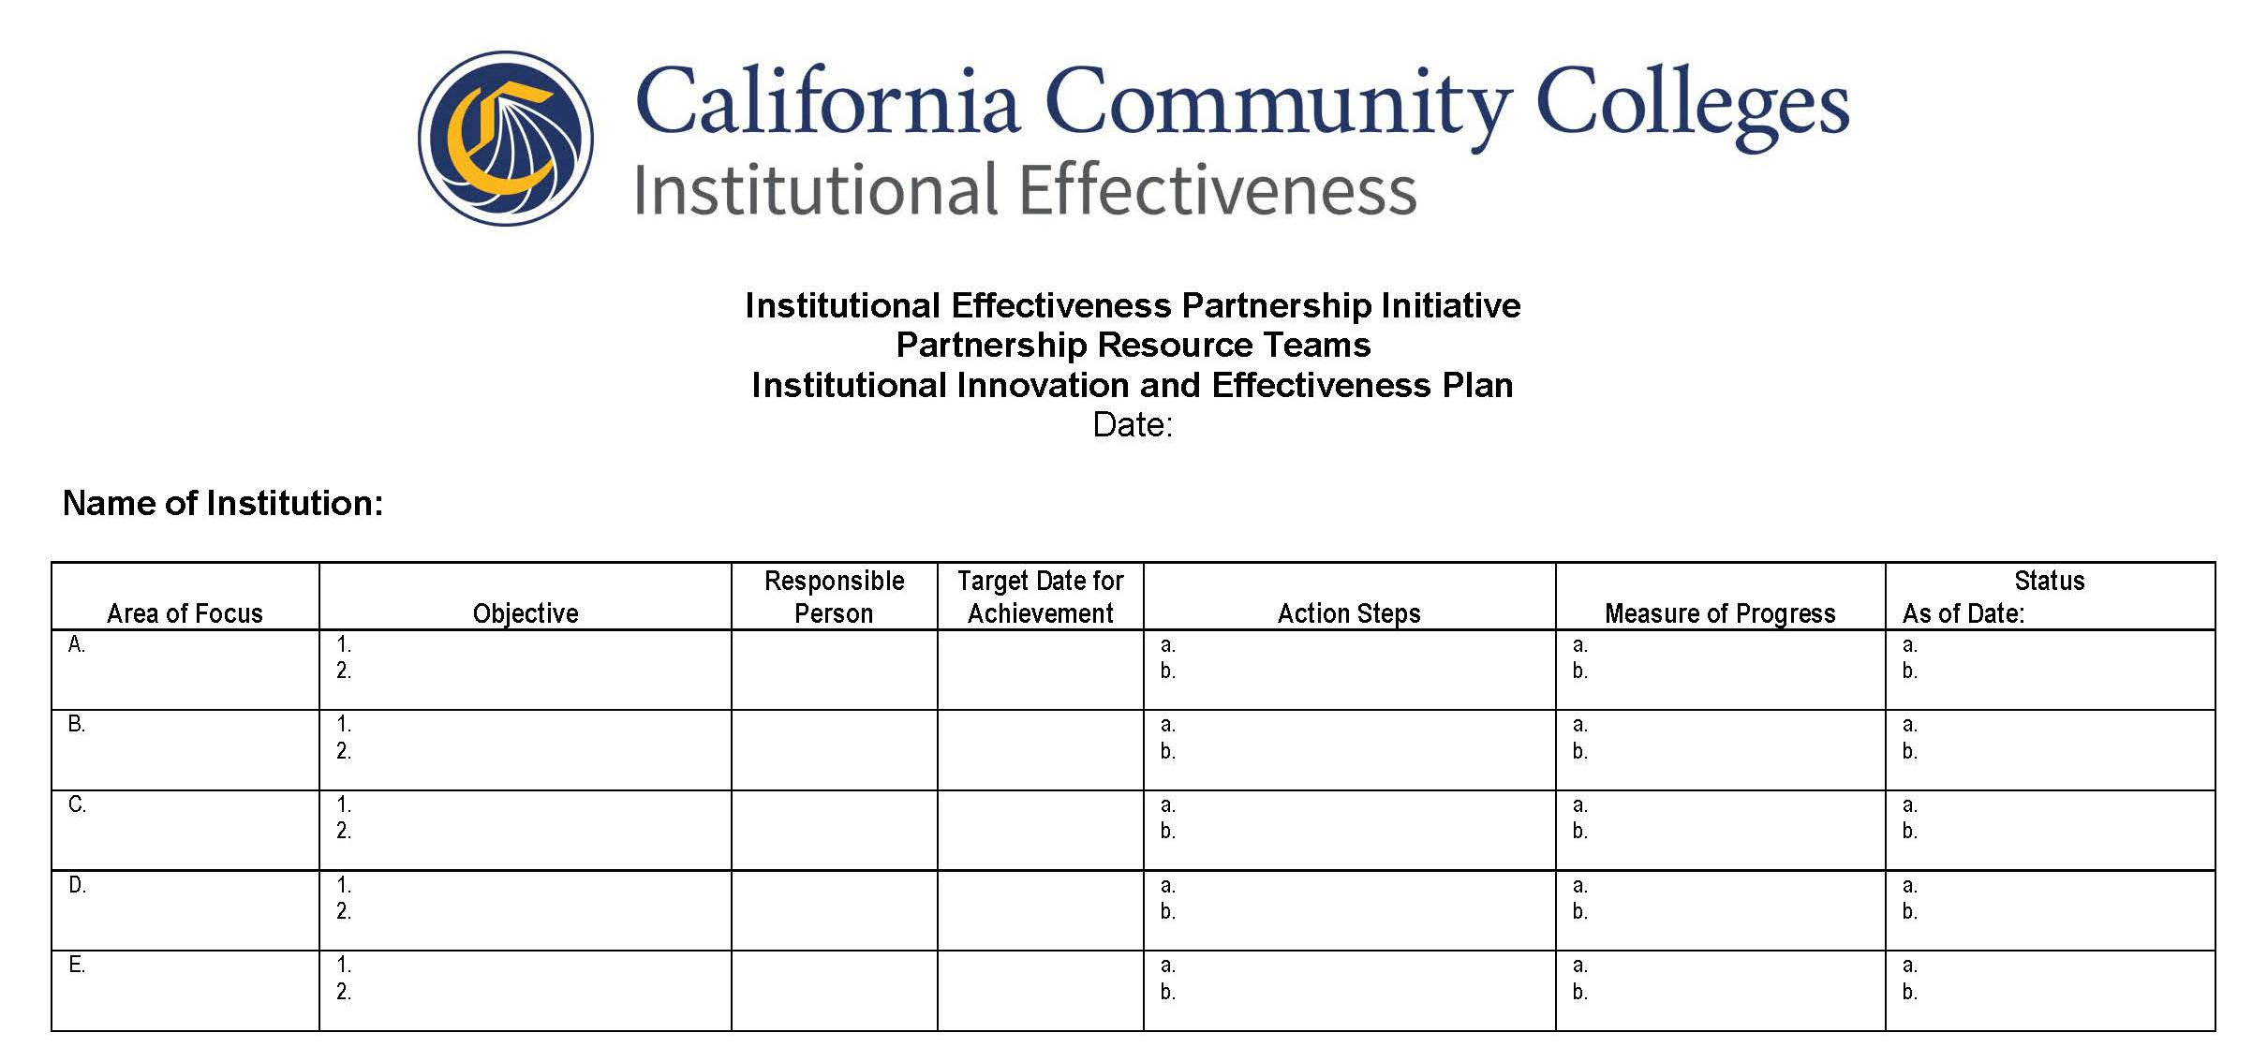
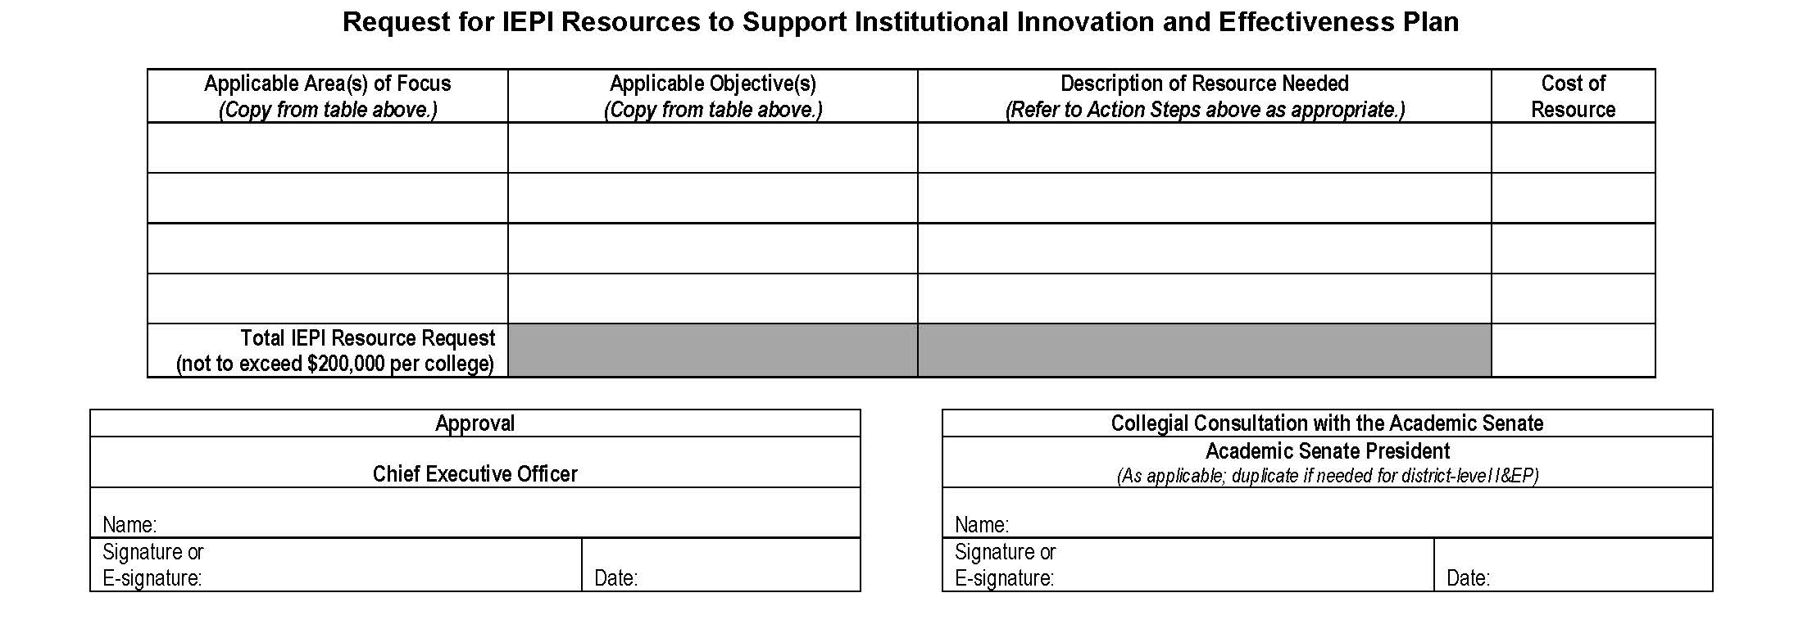
Santa Ana College inspires, transforms and empowers a diverse community of learners
FOLLOW-UP TO VISIT TWO
The PRT and Project Director provide constructive written feedback on the draft of the I&EP. The Project Director forwards the final version of the feedback to the CEO. The CEO then incorporates the feedback as he or she sees fit, adds the signatures, and emails the final I&EP to the Project Director, with a copy to the Lead for distribution to the PRT.
Upon receipt of the final I&EP, assuming that it includes a request for IEPI resources to expedite its implementation, the Project Director forwards to the CEO and point persons the application and agreement forms for a Seed Grant. Ordinarily, the time elapsed from receipt of the properly completed and signed Seed Grant forms to issuing the check is no more than 45 days.
The CEO, point persons, and others who had substantial interaction with the PRT are asked to participate in the post-visit evaluation.

Slide 14
Santa Ana College inspires, transforms and empowers a diverse community of learners
PREPARATION FOR VISIT THREE & ANY SUBSEQUENT VISITS
After completion of the final I&EP, the Project Director or PRT Lead requests date options for the third visit from the CEO and point persons. If none of these date options works for the PRT, the Lead requests alternatives until a mutually agreeable date (ordinarily about three primary-term months later, as schedules permit) is identified.
About a month before the visit, the Project Director asks the substantive point person to provide a status report on implementation of the I&EP within two weeks. (The status report consists of one or more update entries in the last column of the I&EP for each Objective or Action Step.) The Project Director also asks for any quarterly reports on the Seed Grant already submitted, any documents called for in the I&EP that the institution has produced to date, and any particular aspects of I&EP implementation on which the institution needs additional PRT guidance during the visit. The Project Director distributes this information to the PRT upon receipt.
The PRT reads the status report and any other documentation supplied by the institution, and assesses overall progress on the I&EP, paying particular attention to the sustainability of the improvements underway.
The CEO invites individuals and/or groups who are in the best position to report on progress or wish to request implementation guidance from the PRT to participate in Visit 3. That set of people often includes the members of the I&EP Drafting Group.
At least one week before the visit, the point persons send a draft schedule for the visit and list of participants to the PRT Lead. The CEO discusses both with the Lead in a zoom/phone meeting at least a week before the visit. After discussion, the CEO or point person sends the final list of participants and agenda to the PRT Lead for distribution to the PRT (with a copy to the Project Director).

Slide 15
Santa Ana College inspires, transforms and empowers a diverse community of learners
FOLLOW-UP TO VISIT THREE AND ANY SUBSEQUENT VISITS
The third visit is an important component of the PRT process, and has five primary purposes:
Gather information about early progress on implementing the I&EP to supplement the status report. Note that this visit is not designed as a summative assessment of the extent to which the institution has achieved the Objectives in the I&EP, but rather as an opportunity for the institution to request the PRT’s advice on potential course corrections in the early stages of implementation.
Recognize and celebrate progress where appropriate, in keeping with IEPI’s positive approach to technical assistance.
Provide advice on those course corrections where requested or otherwise appropriate, as colleagues helping colleagues.
Assess sustainability of the improvements underway, and provide advice as needed on sustaining long-term progress.
Reach closure on the visits component of the PRT process, for both the institution and the PRT, unless the institution requests one or more additional visits.
The PRT meets with the CEO (and others that he or she might wish to include) to discuss her or his perspective on progress to date, and then shares any positive comments or questions that the initial discussion has not already covered, and asks questions as needed.
The PRT meets with the people who are in the best position to know what progress has been made in implementing the I&EP, and those who have specific implementation questions or issues (often including members of the I&EP Drafting Group) to discuss their perspective on progress to date; shares any positive comments or questions that the initial discussion has not already covered; provides constructive advice, commentary, and feedback, including ideas or suggestions to improve implementation of the I&EP and sustainability of progress as needed; and discusses whether one or more additional visits would be helpful to the institution.
Upon request, the PRT meets once more with the CEO to answer any questions and provide an oral summary of ideas or suggestions to improve implementation and/or sustainability of the I&EP.
The CEO, point persons, and others who had substantial interaction with the PRT are asked to participate in the post-visit evaluation.

Slide 16
Santa Ana College inspires, transforms and empowers a diverse community of learners
FINAL WRAP-UP
& EVALUATION
• The PRT prepares a brief (typically one or two pages) written PRT Process Summary Report summarizing the institution’s progress to date on its I&EP objectives in each Area of Focus, along with any suggestions for sustaining progress or addressing remaining challenges.
• The Project Director may ask the CEO to provide a description of any PRT-related improvements in institutional structures or processes that have proven especially successful, for possible posting in the Vision Resource Center (https://visionresourcecenter.cccco.edu/) or sharing in other venues.
• About 10-12 months after the third visit, the external evaluator may contact the CEO and/or point persons to gather initial information about longer-term effects of the PRT process.
• Annually thereafter, the external evaluator may contact the CEO and/or point persons to gather more information about longer-term effects of the PRT process.

