Slide 1

VP of CO
NOVEMBER 25, 2024
ThePhoto by PhotoAuthor is licensed under CCYYSA.

Slide 2
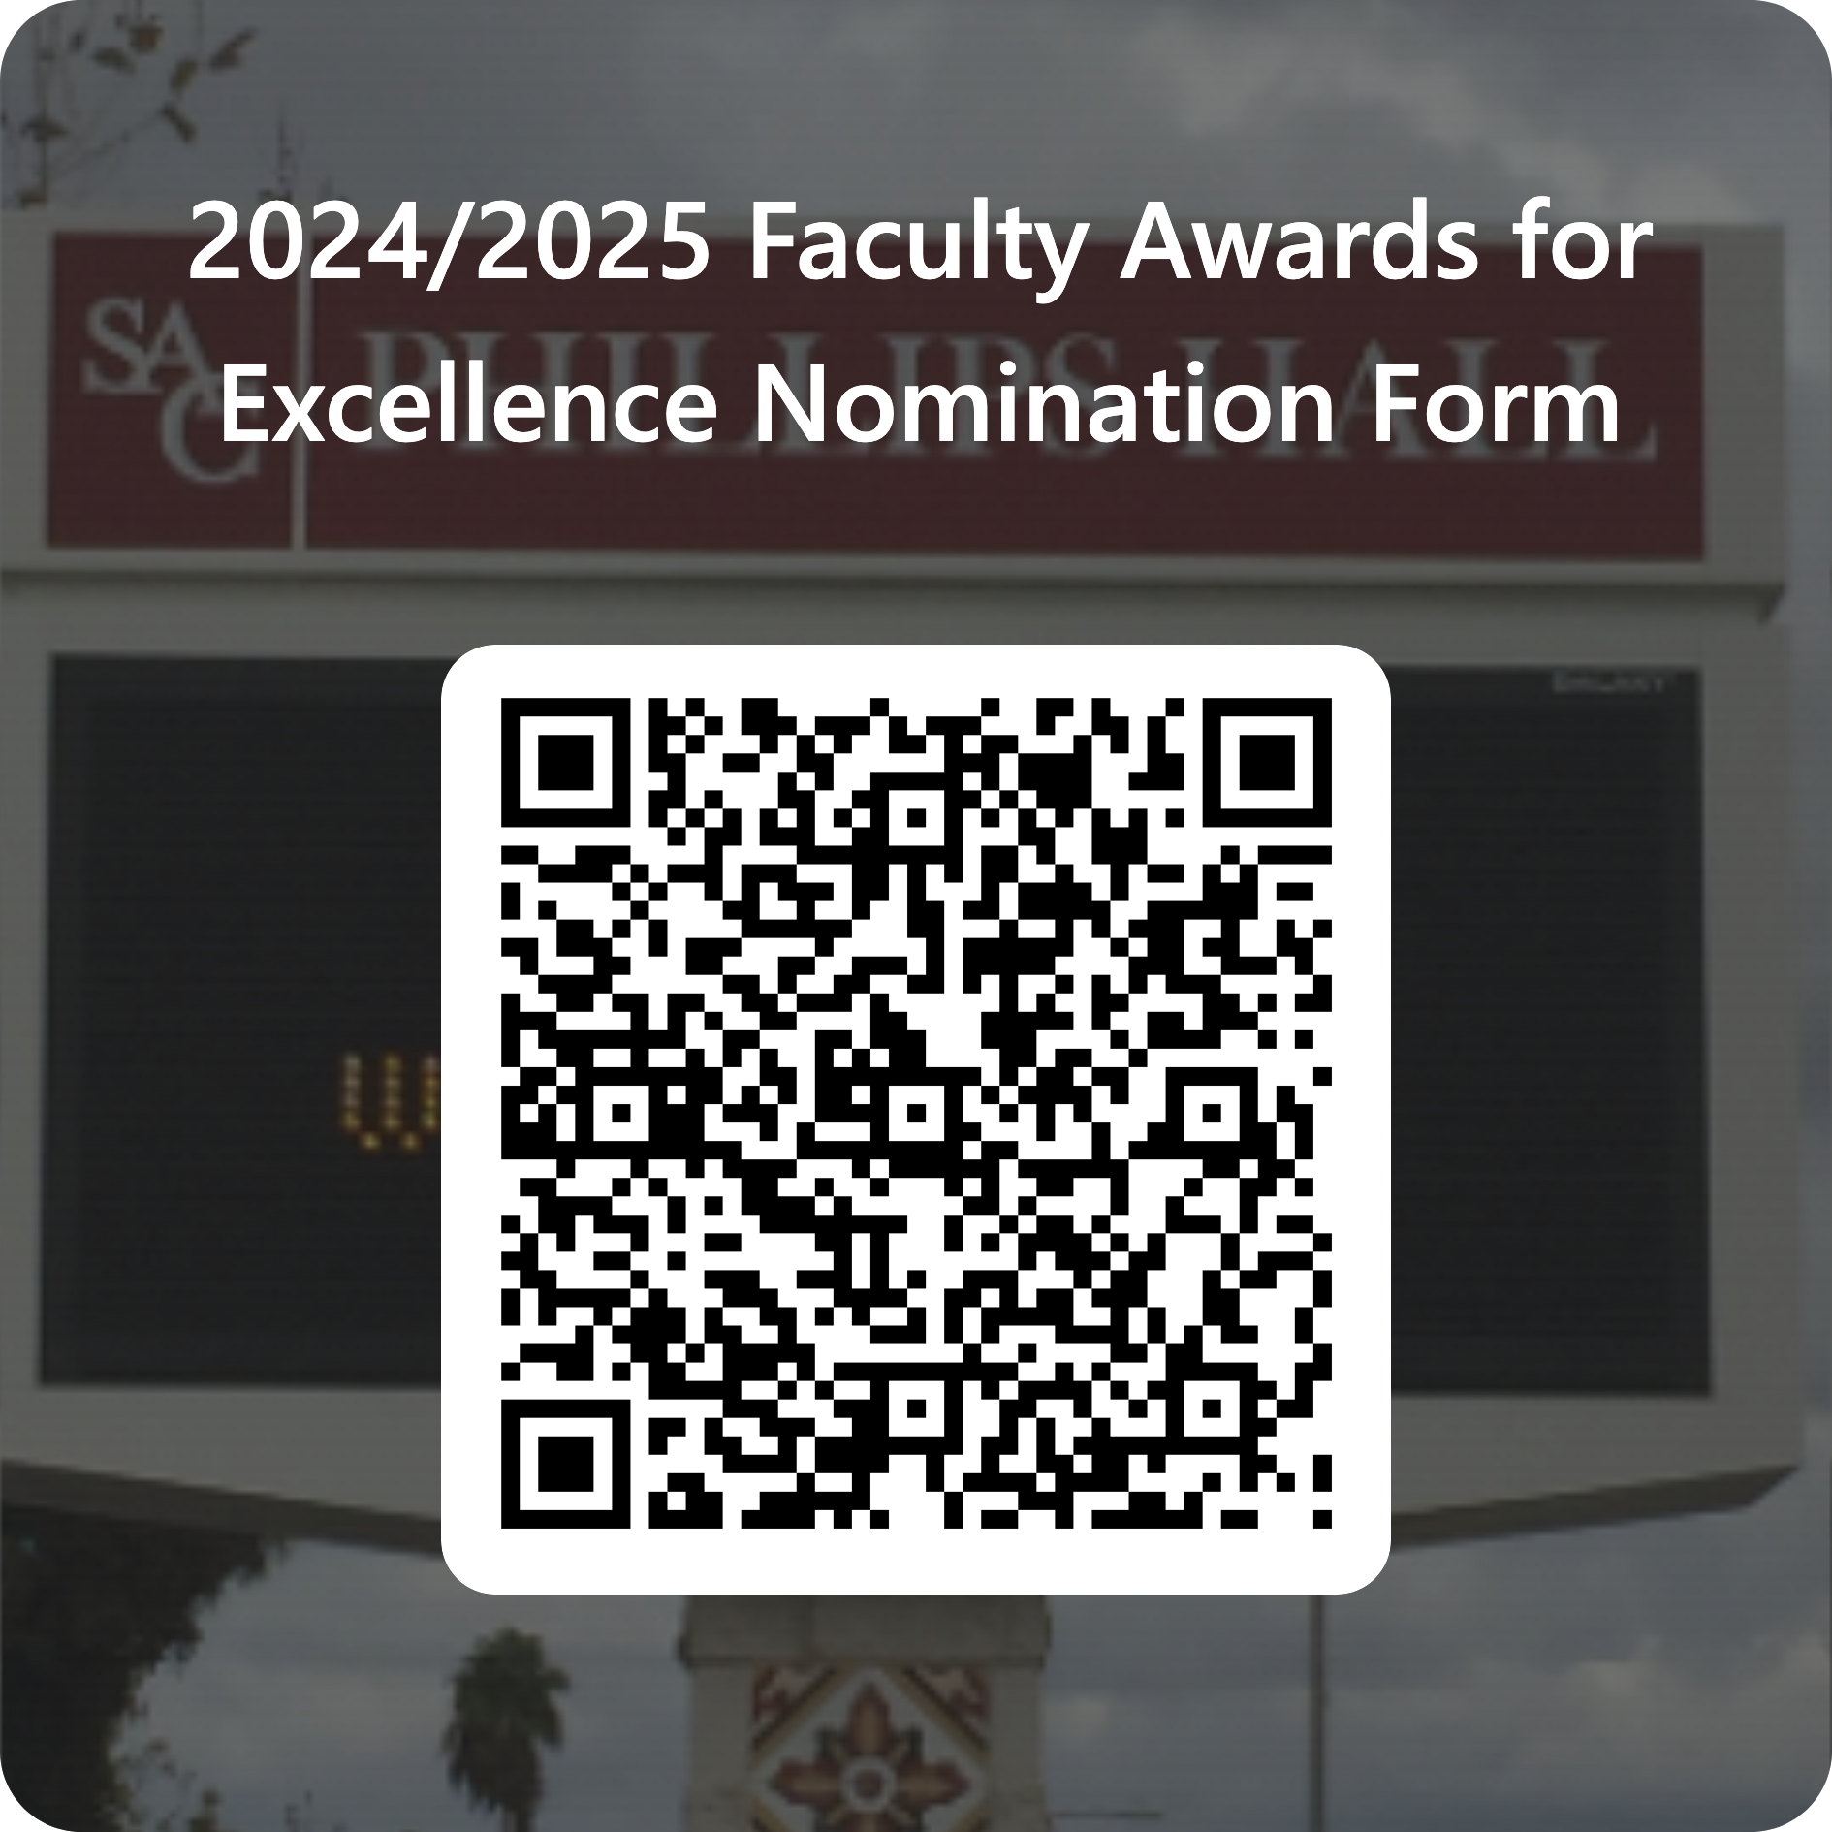
Nominations Open
Nominate yourself and/or your colleagues for the Profiles of Excellence Awards & Distinguished Faculty Award. Due date and time to submit is February 24th, 2025. (Multiple nominations can be made for different awards. However, you will need to submit a new form for each.)

Slide 3



ACUE Self-Study AI Series
82 seats remaining as of 11.25.24

