Slide 1

President’s Report
Fall Plenary 2024 – Resolutions Update
101.01 F24 Adopt Using Outcomes for The COR in Title 5 – Failed
101.04 F24 Automatic CalGETC Approval of CCC Ethnic Studies Courses – Failed
105.04 F24 Support the Establishment of Guidance for Course Syllabi - Failed
101.02 F24 Nutrition Science Integration in Gen Ed Curriculum as Cal-GETC Subject Area 5B Course – Passed
105.01 F24 Investigate Academic Renewal Policies – Passed
105.06 F24 Reevaluation of Data Analysis & Implementation Guidelines for AB1705 – Passed
113.01 F24 Legislative Advocacy to Restore Student Choice on English & Math Courses – Passed
Approved by Acclimation
105.05 F24 Acknowledge Extended Opportunity Programs & Services’ 55 Years of Student Success
113.02 F24 Designating an Official Native American Holiday for the California Community College System

Slide 2
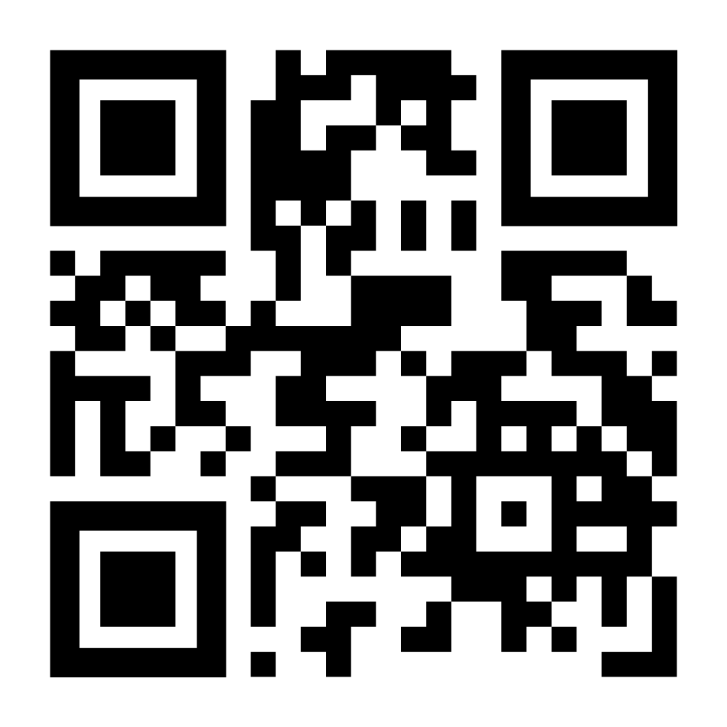
President’s Report
Professional Development Presenters
Have you offered a workshop this semester?
If the workshop was not held due to low sign-ups, you still need to submit the attendance.
PLEASE MAKE SURE YOU HAVE TAKEN ATTENDANCE – PART TIME CONTINUING EDUCATION FACULTY ARE DOCKED PAY FOR NOT FULFILLING FLEX OBLIGATION
Digital Center Founding Partner MOU
Founding Partner participate in the development and operation of the Digital Center….resources, and expertise towards the common goal of the Center.
Contributions of the Founding Partner
  District resources
  Financial and/or in-kind district resources
    Financial will include minimum annual payment at the start of each calendar year with the remaining funds and/or in-kind contributions
      In-kind = staff time

Slide 3

President’s Report
SAC Updates
Faculty Priorities Replacement Requests and Final Ranking Event
Meeting Minutes will be shared once approved
Survey to be sent out to Department Chairs, Committee Members
FPP Workgroup interest email to be sent out to Committee Members first, then to all faculty/deans
  Process/Timeline/Rubrics/Data Needs
Vista Meridian
Continue to share concerns with me
Bookstore – After hours/Weekends
Testing materials provided by bookstore – status?

