Slide 1

President’s Report
Vision 2030 Non Credit Summit
Credit for Prior Learning – Mirrored Credit/Continuing Ed courses with Credit By Exam
Shorter time to completion and closing equity gaps!
Doing this in some areas but could be doing it in more
Continue the work of building bridges for our students!
Leglislative Update
SB1244: require a community college district to allow an existing CCAP partnership to be amended, or a new CCAP agreement to be established with a school district (et al.), and a community college district outside of the primary community college district’s service area, if the primary community college district has declined a request from the school district (et al.), or has failed to take action within 60 calendar days of a request by the school district (et al.), to either amend into the existing CCAP partnership the requested courses, or to approve another community college district to enter into a CCAP partnership to offer those courses.

Slide 2
President’s Report
Senate Committee/Councils/Advisory Groups
Review committee membership for more balanced representation AA, CE, & SS
Do Faculty Coordinators exist in Continuing Ed? If so, co-chair model?
Discussions on CPL, Dual Enrollment faculty leads/coordinators – should they be a voting member on a committee?
Participatory Governance Committees (College and District) are reviewing their membership and purpose.
I am requesting that Senate Committees/Councils/Advisory Groups review membership and purpose with recommended updates to present at Senate for first reading at November 12th meeting

Slide 3

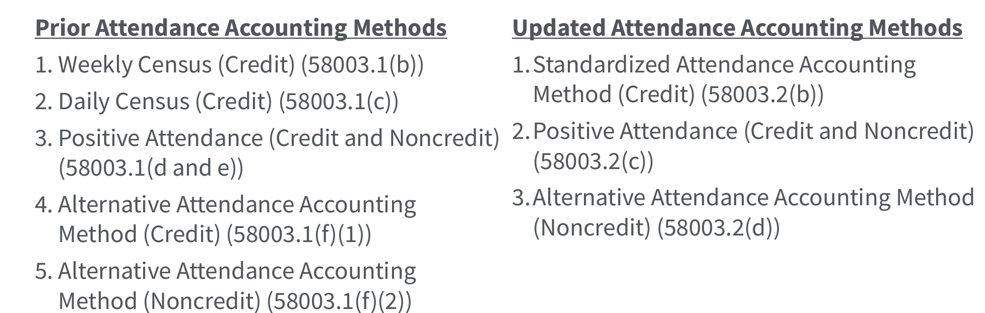
President’s Report
New Standardized Accounting Method – effective 8/21/2024
Used for all credit courses regardless of modality or course length.
Open entry-open exit-credit courses will still be required to use Positive Attendance.

Slide 4
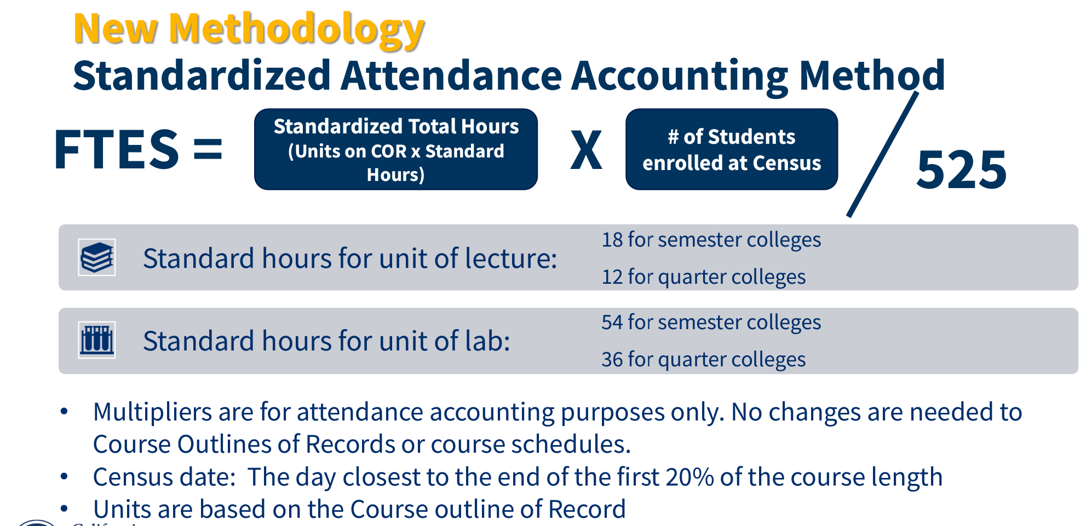
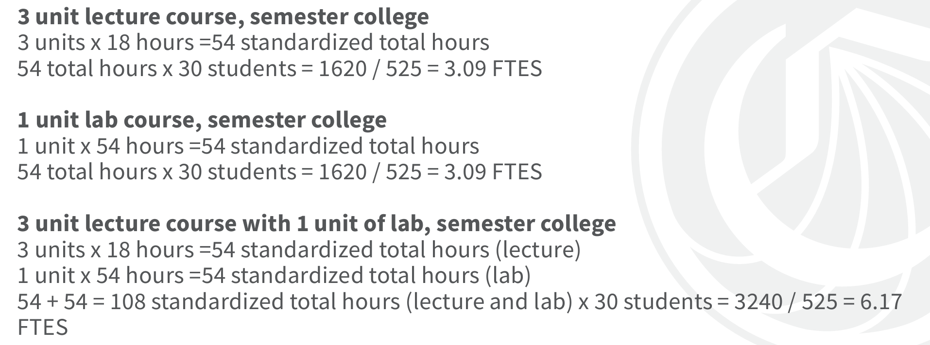
President’s Report

Slide 5
President’s Report
Implementation
2024-25 and 2025-26, districts have the option of using the prior attendance accounting methodologies or transitioning to the new Standardized Attendance Accounting Method.
Beginning in the 2026-27 fiscal year, all credit courses (except for courses required to use positive attendance) must use the Standardized Attendance Accounting Method to calculate FTES
Discussions to be had in CIC: Possibility of Quarter-units (PCAH), Impact to total units for programs

Slide 6
President’s Report
Implementation
2024-25 and 2025-26, districts have the option of using the prior attendance accounting methodologies or transitioning to the new Standardized Attendance Accounting Method.
Beginning in the 2026-27 fiscal year, all credit courses (except for courses required to use positive attendance) must use the Standardized Attendance Accounting Method to calculate FTES
Discussions to be had in CIC: Quarter-units, Impact to total units for programs

Slide 7
President’s Report
SAC Updates
Vista Meridian
Regular meetings with President Nery and Principal
Moved from A-bldg., 2 in D-bldg. and rest in Hammond Hall
Additional security on SAC for Vista: M-F 9am-2pm
Additional staff hired to monitor students
Small gym to be used for break times (instead of Johnson Center) & Don Express by Middle College
Move to DMC → Dec/Jan
Bookstore – After hours/Weekends
Survey sent out to Senators to share with faculty

Slide 8
President’s Report
Faculty Priorities
Drafts due by 11:59pm Monday, October 14
Feedback provided and formatting addressed
Final form submission by 11:59pm Monday, October 16
**Do not let frustration set in while working on these forms – contact Claire**
Faculty Interested in working on Ranking Rubrics – let me know!

