Slide 1

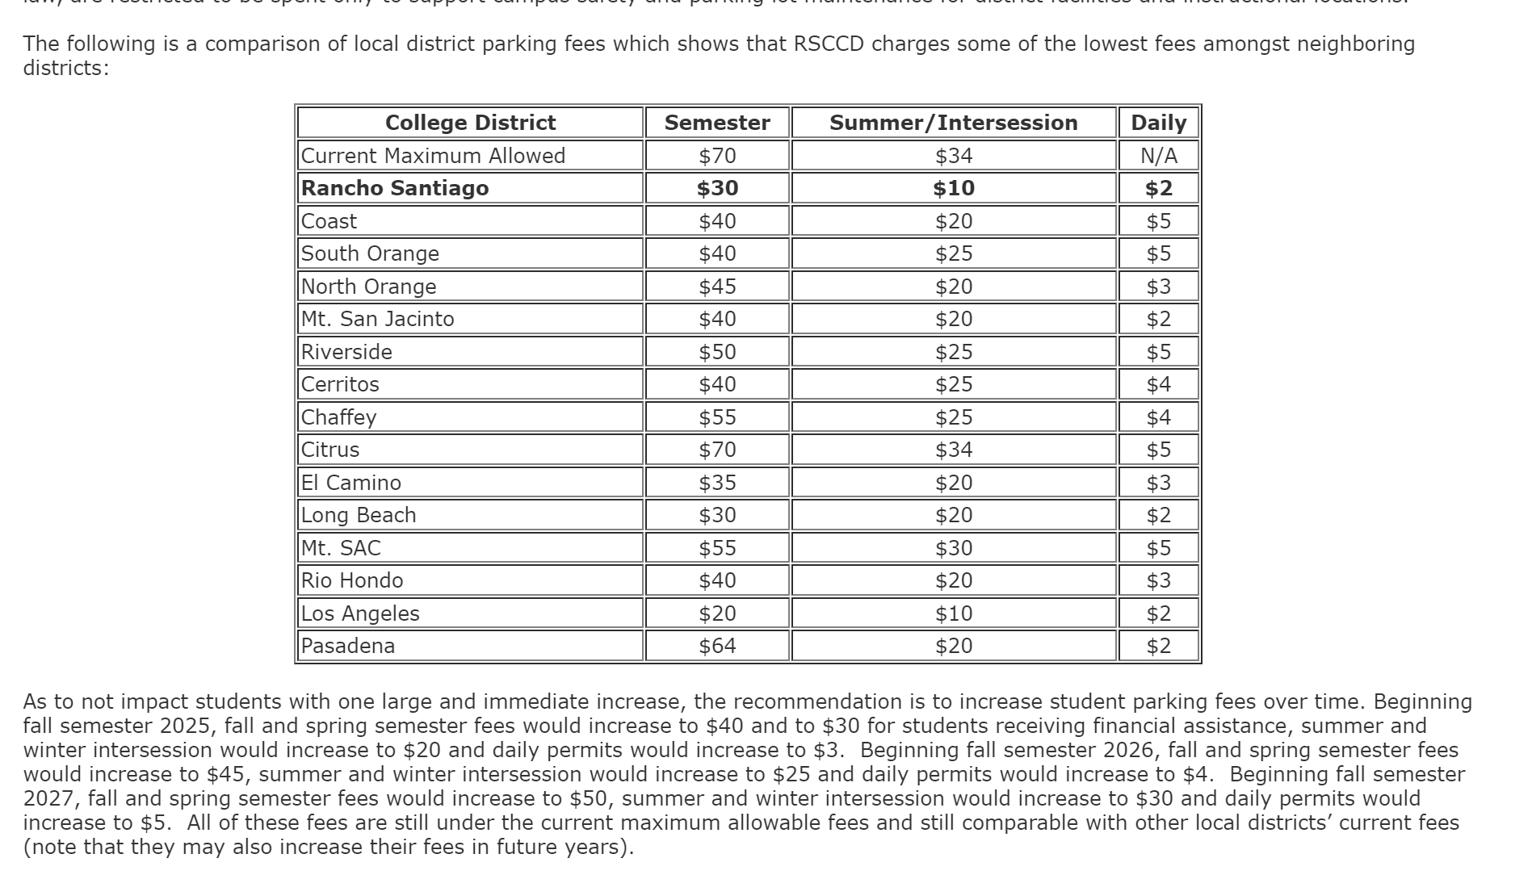
President’s Report
Board of Trustee's Meeting – October 14
Student Parking Fee Proposal

Slide 2

President’s Report
Plenary Session Resolutions – Recommendations to update submitted resolution for inclusion of Continuing Ed faculty in the FON.
Resolutions for Plenary – Email for feedback will be sent once new packet is posted
October 30 – Native American Heritage Event 10:30am
Insurance Requirement for General Liability – Any help is appreciated!

Slide 3
President’s Report
REMINDER: Senate Committee/Councils/Advisory Groups
Review committee membership for more balanced representation AA, CE, & SS
Do Faculty Coordinators exist in Continuing Ed? If so, co-chair model?
Discussions on CPL, Dual Enrollment faculty leads/coordinators – should they be a voting member on a committee?
Participatory Governance Committees (College and District) are reviewing their membership and purpose.
I am requesting that Senate Committees/Councils/Advisory Groups review membership and purpose with recommended updates to present at Senate for first reading at November 12th (next) meeting

