Slide 1

VP of CO
September 24, 2024
ThePhoto by PhotoAuthor is licensed under CCYYSA.

Slide 2
AS Scholarship Balance To Date & Update
97-9024 had a current balance of $1,421. The Foundation distributed the following scholarships:
2024-2025 9024-1 Academic Senate Leadership Scholarship
Camargo, Janet, $500
Alcaraz, Ricardo, $500
9024 Academic Senate Continuing Education Scholarship
Sepulveda, Gilberto, $500
We voted to honor the above scholarships. The Foundation agreed to transfer $79 into the 9024-1 Academic Senate Leadership Scholarship Account to correct the negative balance and the remaining balance of $0
Current balance is $0.00.
Will transfer $3,000.00 the first week of October to cover the updated scholarships and Thrive donation for this new scholarship/donation cycle.

Slide 3

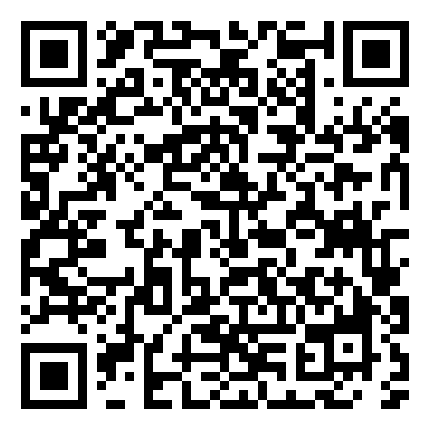
Academic Senate Dues
July 2023
84
September 2024
131
Please visit our Self-Service under the Daily Work Faculty tab labeled "Academic Senate Dues" to sign up.
Please continue sharing to fold in new faculty or faculty that have not signed up yet.

Slide 4
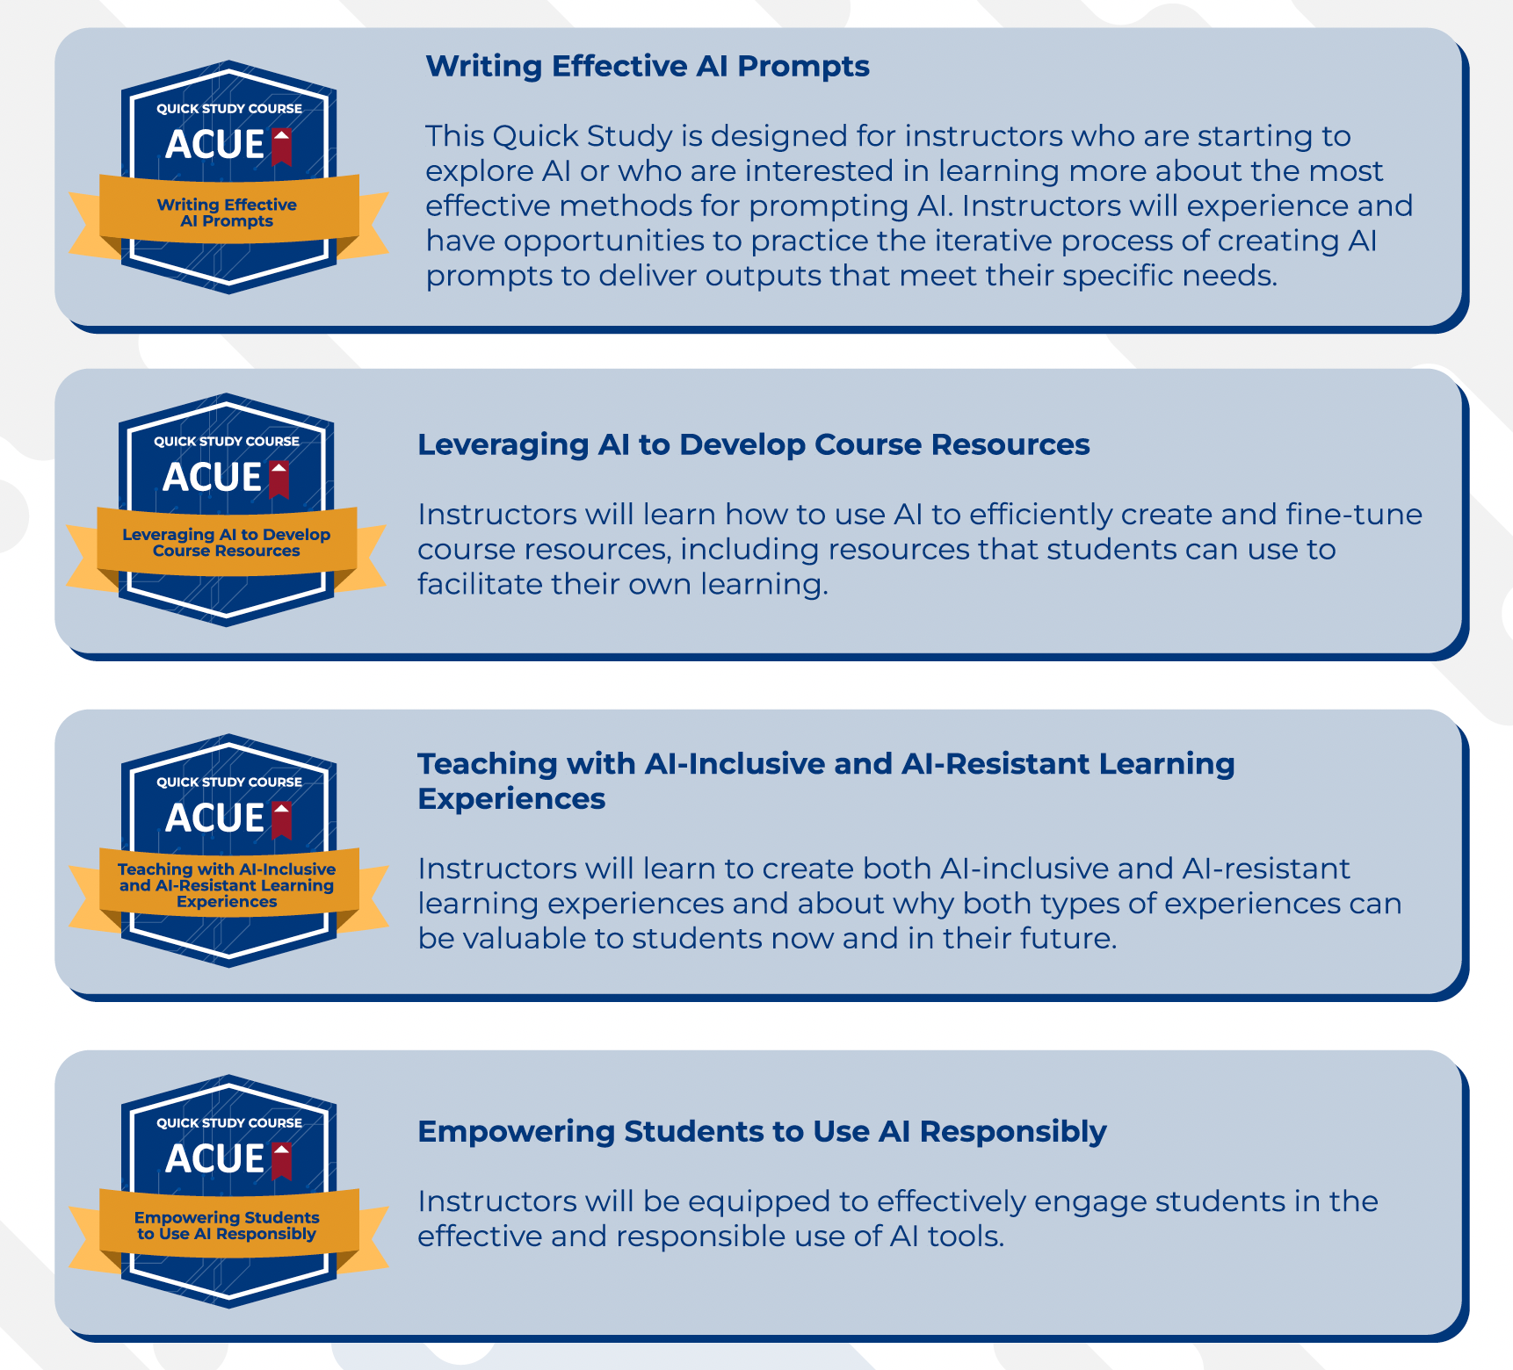


ACUE Self-Study AI Series

Slide 5
Licenses Distributed
Faculty
PT - 69
FT – 74
Credit – 69
Continuing Ed – 69
Both - 5
*101 licenses remaining
Completed = 16
PT – 8
FT – 8
Credit – 7
Continuing Ed - 9

