Slide 1

President’s Report
Board of Trustee's Meeting – Sept 9
Budget Presentation
State Budget
Governor declared fiscal emergency – rainy day funds (Prop 98) can be used
Multi-year deficit ($45B for 24/25 & $30B for 25/26)
10,000 state positions to be eliminated
(28 from State Chancellor’s Office)
Apportionment deferrals
$446M from SCFF for 23/24 to 24/25
$244M from SCFF for 24/25 to 25/26
$22.5M from Student Success Completion Grant taken back
$8.4B withdrawal from rainy day fund
No major reductions to core CC programs/services
(Adult Ed/EOPS/DSPS/Apprenticeships/CalWorks/CARE/Mandated Costs Block Grant/Childcare Tax Bailout/SCFF)

Slide 2

President’s Report
SAC Updates
RSCCD Budget
General Fund (Funds 11, 12 and 13): $512M
Additional $27.2M one-time funds to colleges
SAC received $20M
Additional $18.6M in one-time funds to BP Contingency reserve
2 months of General Fund expenditures
Balance: $71.5M (16.67%)
SCFF Rates
FTES – Credit $5294
FTES – Incarcerated Credit, Special Admit (DuE), CDCP (Non-Credit) $7425
FTES – non-CDCP (Noncredit) $4465
Chancellor’s Report
Santa Ana College (2023-2024)
#4 - Total FTES
#2 – Credit FTES
#1 – Non-Credit FTES

Slide 3
President’s Report
SAC Updates
Repurposing of Campus Spaces and Relocation of Faculty
I-Building: Math - Classes, Faculty Offices and Math Center (possibly MESA)
The Village: el Don, Fashion Design and Merchandising
C-building: Once el Don has relocated, that space will be repurposed for SAC’s Mural Program
Health Sciences Building: Speech – Language Pathology (HS-124)
A-building: Digital Music from DMC
DMC Update – attempt to rent space on 2nd floor to VISTA Meridian
Any questions or unaddressed programs – let me know!

Slide 4
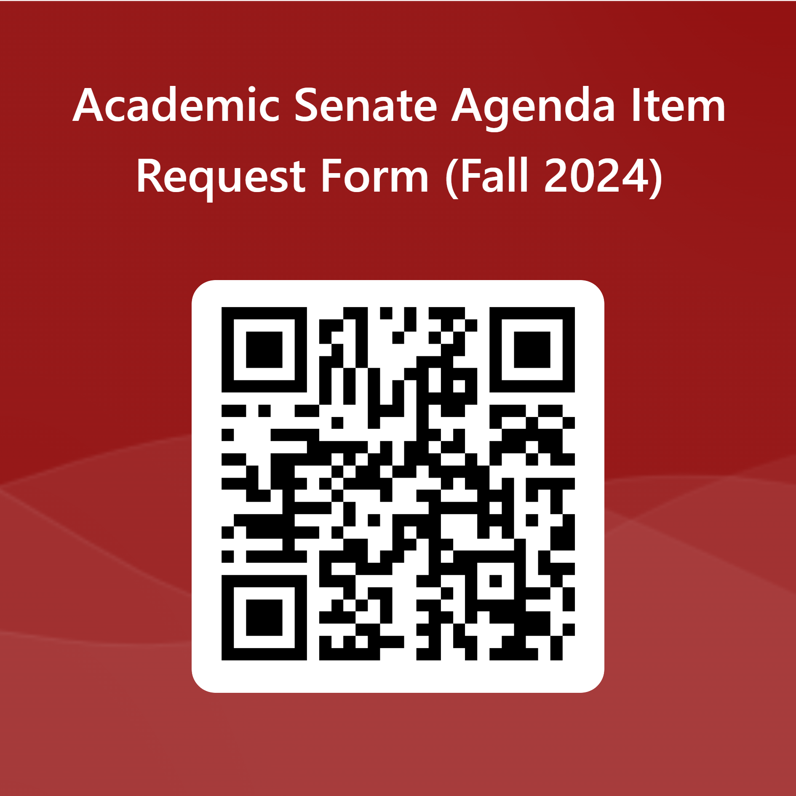

President’s Report
Agenda Item Requests
https://forms.office.com/r/Wtrc4GMcMy
Opportunities to Serve on Hiring Committees https://forms.office.com/r/9WzctRAULE

Slide 5

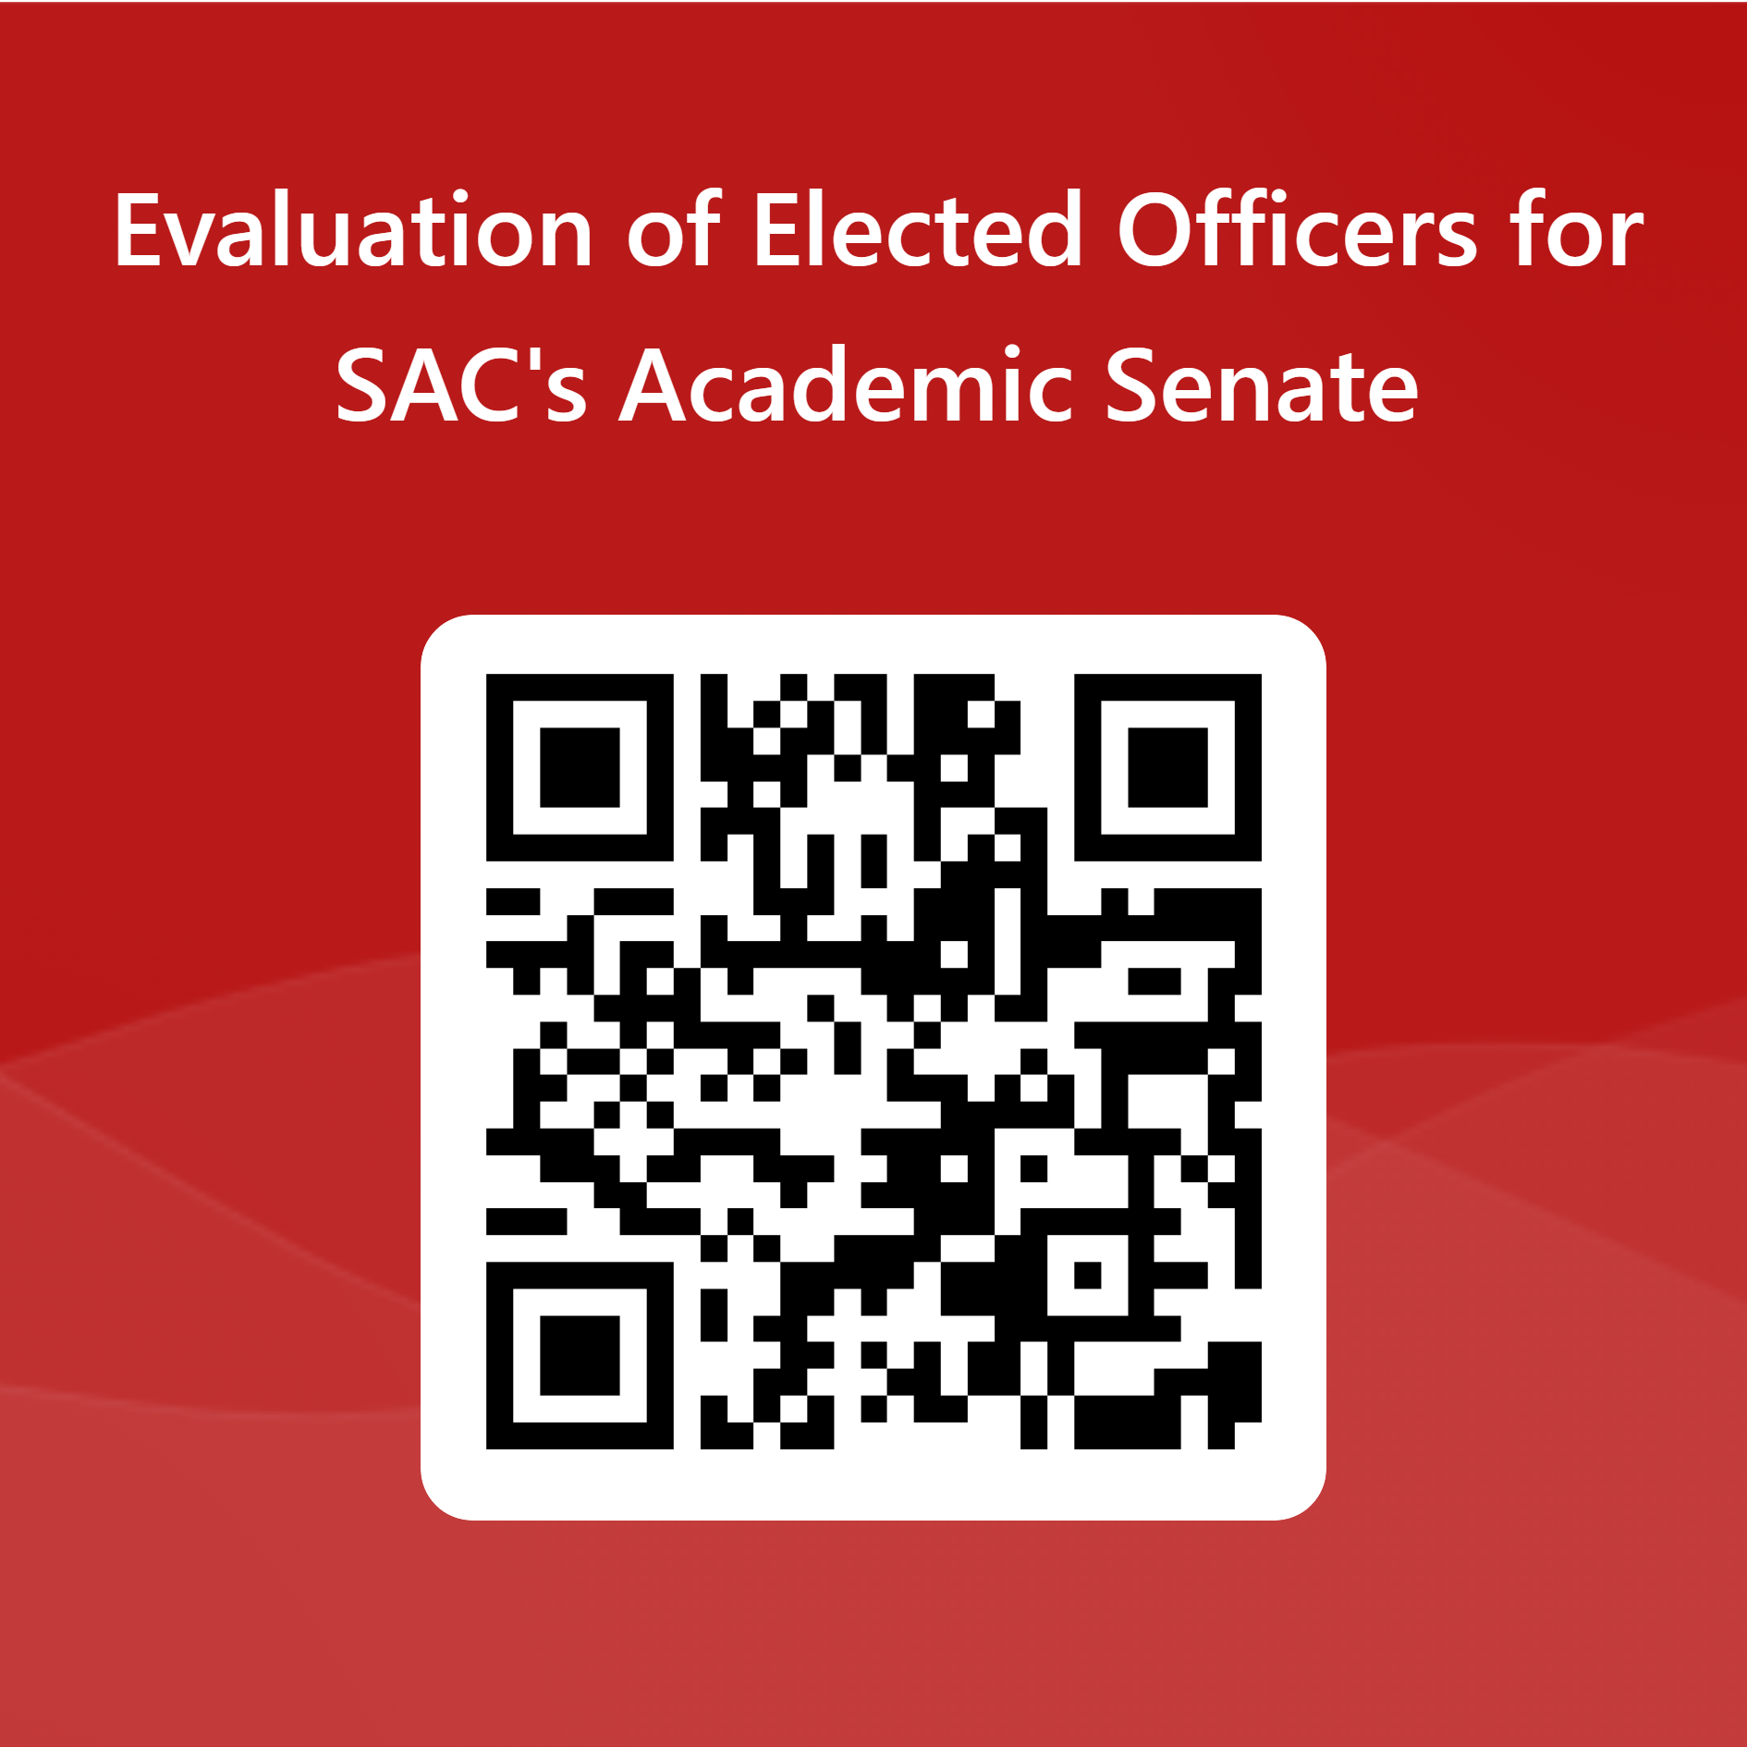
President’s Report
IdeazBoard – Questions, Concerns, Suggestions, Frustrations & Other https://ideaboardz.com/for/Senate%20Retreat%20Fall%202024/5355658
Evaluation of Elected Officers for SAC's Academic Senate
https://forms.office.com/r/5FBGpaHWCC

