Slide 1
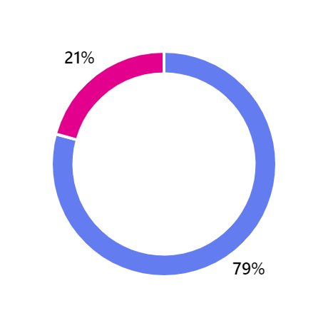
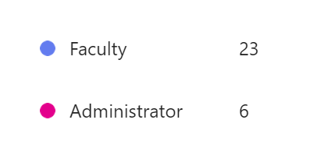
Faculty Prioritization Process Recommendations
Survey Results (n=29)

Slide 2
Recommendation 1: Creation of Faculty Prioritization Committee (FPC)
Subcommittee of the Academic Senate with the primary purpose to evaluate and prioritize requests for full-time faculty (tenure-track and long-term temporary) positions
Membership
Academic Senate President (non-voting Chair) (Admin Co-Chair (non-voting) – VP Admin Services/Director of Research (?)
Senior Senators for each Senate Division (15)*
Deans (5) - Appointed by President or designee
Student Services (Counseling, Library, Psychologist and DSP&S Faculty) (1)
Continuing Education (2),
1 from Instruction and
1 from Student Services
Academic Affairs (2)
1 from either Humanities, Fine & Performing Arts or SMHS, and
1 from either Business, Kinesiology or Human Services and Technology
Total Members: 21 (20 voting, 1 non-voting)
*If a Department Chair is serving as a Senior Senator AND submitting a faculty request, the Junior Senator will serve on FPC

Slide 3
Recommendation 2: Presentation to Department Chairs of Division and Dean
Department Chairs meet with Division Dean to discuss submitting a faculty request and review the request form.
B. Faculty Requests will be shared presented at Division/Dept Chairs meeting for discussion and feedback.
C. If there are multiple requests from a Division, Department Chairs and Dean will rank the requests
That ranking will be shared with FPC as a metric in the final ranking event.

Slide 4
Recommendation 3: Replacement Requests
Replacement requests due to tenure track attrition (e.g., resignation, retirement, or any departure of the current full-time faculty member) are given first priority and will be filled unless compelling and/or extenuating circumstances are provided by College President.
The replacement may be set aside, temporarily or permanently, the reasons for the President's decision will be provided to the FPC, in writing, and based on clear and substantive rationale which puts the explanation for the decision in an accurate, appropriate, and relevant context.
FPC can support or oppose the President's recommendation. Ultimately, President's decision.
Special Process for next 2 -3 cycles to address vacancies not replaced since before Covid (2019)
Ranking of Replacement Requests separate from Growth Requests

Slide 5
Recommendation 4: Create Ranking Rubrics (Quantitative and Qualitative metrics) for Final Ranking Event
Faculty Prioritization Committee will create and/or review Ranking Rubrics each year for edits/updates
Recommendation 5:
Final Ranking Event in-person (9am – 4pm)
FPC members come with completed ranking (submitted prior to meeting)
Pre-Meeting 9-11am (Deans and Faculty Rank Separately)
Final Ranking Noon – 4pm (All)
Department Chairs invited to answer questions and/or address items included in request

Slide 6
Final Recommendations for 2024 Faculty Prioritization
Incorporate the following recommendations into 2024 process
Creation of Faculty Prioritization Committee (FPC)
Replacement Requests given first priority and will be filled unless compelling and/or extenuating circumstances are provided by College President. Replacement request will not be included in final ranking.
Create Ranking Rubrics (interested in working on this? Let me know!)
Ranking Event In-person, no presentation but Dept Chair invited to attend via Zoom to answer questions and/or address items included in requests
Dean and Faculty meet separately and create Final Rankings
Meet together to discuss and establish the Finalized List of Prioritized Faculty Hiring for 2024.

Slide 7
Tentative Timeline
Hiring Request Form (Replacement and Growth) available September 13
Training on Wednesday, September 18 4:30pm (via Zoom)
Full-Time Faculty Hiring Request Form Due: Friday October 11 by 11:59 PM
FPC Review and Rank Requests: October 12 – October 24
Final Ranking Meeting: Friday October 25 - 9 AM to 4 PM
Affirmation of Final Rankings by the SAC Academic Senate: November 8 or Special Meeting (October 29 via zoom)
Special Meetings
The President may call special meetings if in their judgment such special meetings are warranted. Special meetings shall be called by the President upon a written request submitted to the President by twenty-five (25%) of the faculty or by ten percent (10%) of the members of the Senate. (3.4 members of Senate)

