Slide 1
VP of CO
August 2024

Slide 2
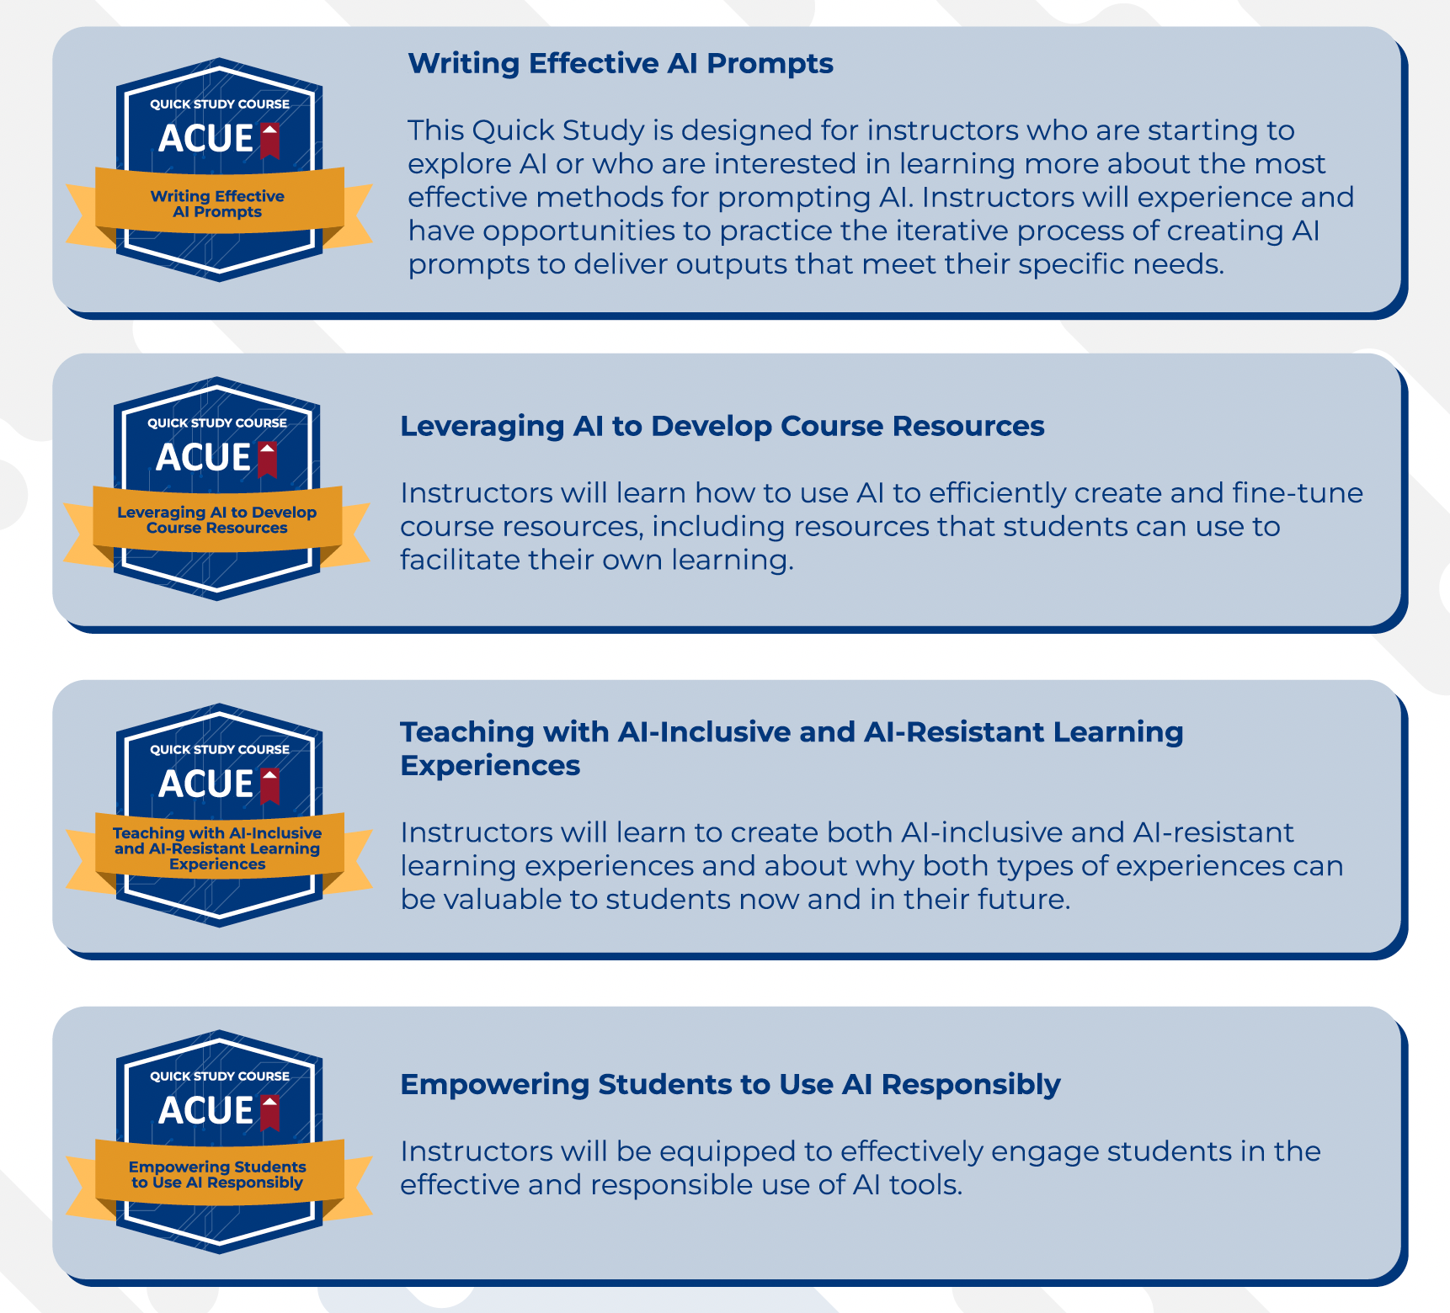


ACUE Self-Study AI Series

Slide 3

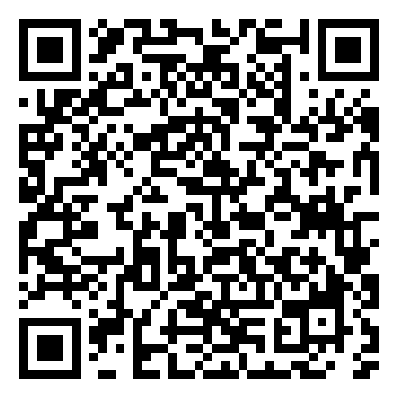
Academic Senate Dues
July 2023
84
August 2024
129
Please visit our Self-Service under the Daily Work Faculty tab labeled "Academic Senate Dues" to sign up.
Please continue sharing to fold in new faculty or faculty that have not signed up yet.

