Slide 1

DE Advisory Updates
1st Spring 2025 meeting scheduled for 10am to 11am, Thursday February 13th.

Slide 2
DE Advisory Fall 2024 Overview
Reviewed the Faculty Resources course, the redesigned SAC Quest course, and others.
Discussing new tools and resources, such as:
  Proctorio/Respondus trial
  Smart Search
  Enhanced Canvas Rubrics
  Translations Tools
Created a DE Handbook & Faculty Resources Course which is dynamic and easily accessible. No need to enroll unless you want it to be available on your Canvas dashboard.
Reviewed the DE Advisory PG Handbook sections and updated and aligned the DE Advisory Goals, Mission, and Purpose

Slide 3

Spring 2025 Goals
Combined Accessibility Training Course and Video Creation Course into one single PD course.
Online Teaching Conference, June 16-18, 2025, looking for faculty that would like to attend.
Ensure we have 125 quality reviewed courses (we are currently at 119!)
Work with curriculum and faculty department chairs to update and modernize the DE Addendum.

Slide 4
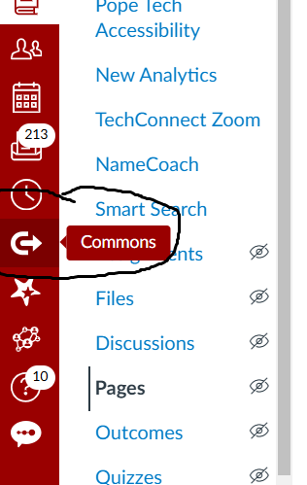
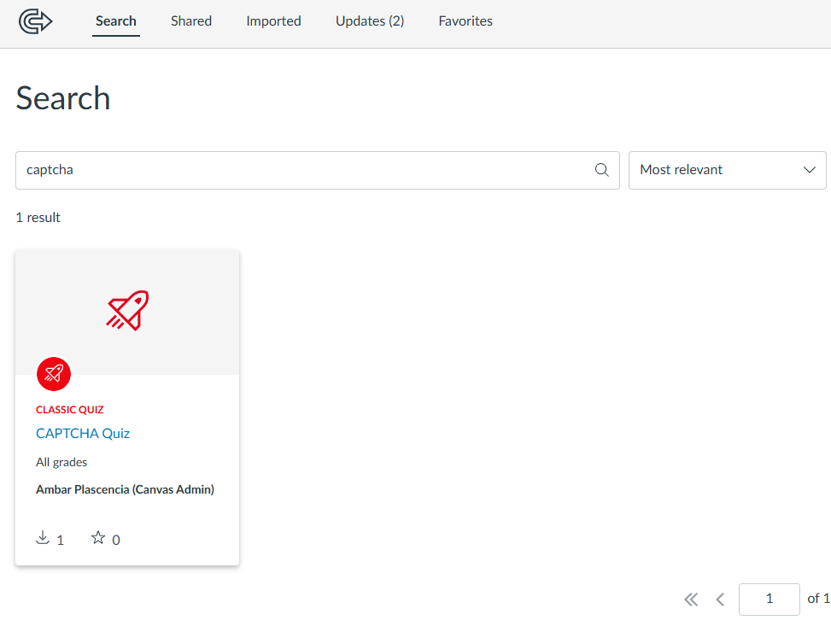
Tool to combat bots
How to add content from Canvas Commons to your course.
Search "Captcha" and it is the only result

