Slide 1

Add SAC Logo
Santa Ana College
Guided Pathways 2.0 ​
        Tanisha L. Burrus, Interim Director of Student Success
        Claire Coyne, Faculty Senate President
        Hang Le, Business Systems Analyst, Student Info. Support
        Dr. Gregory J. Toya, Dean of Student Affairs
Notes:
Toya

Slide 2
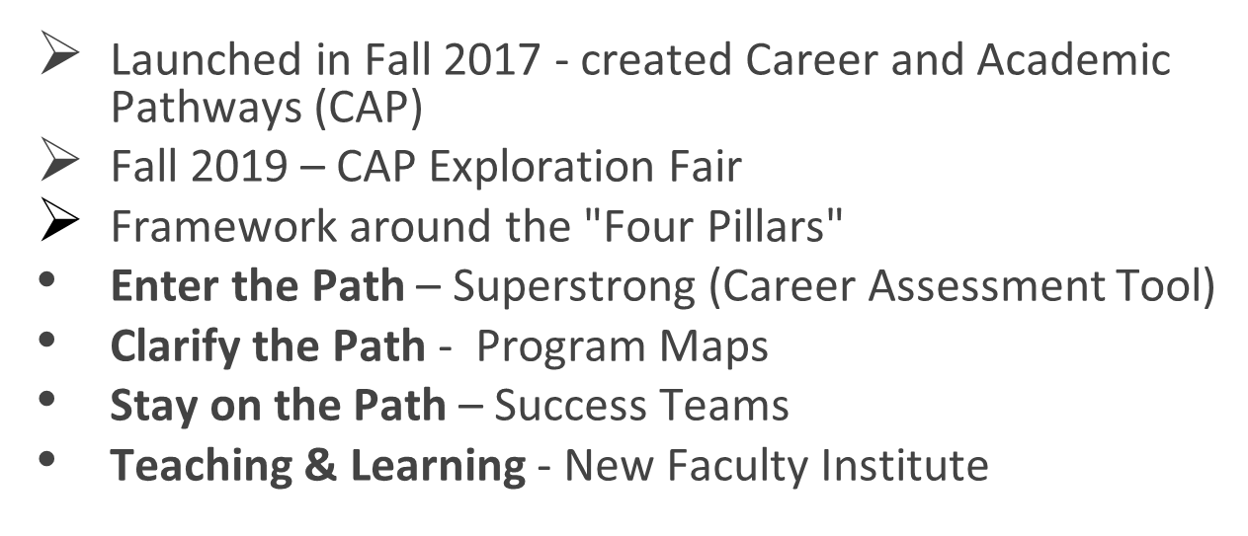
Santa Ana College Guided Pathways 1.0
Notes:
Toya

Slide 3
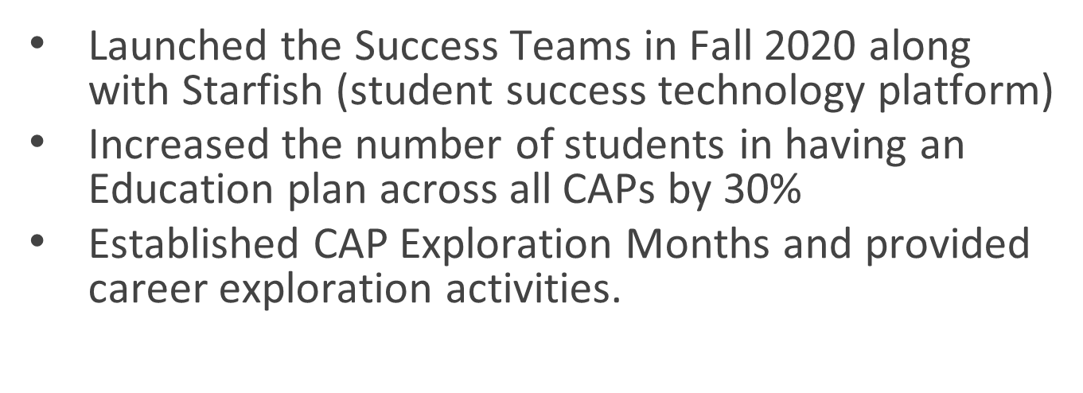
Success Teams Accomplishments
Notes:
Toya

Slide 4
Santa Ana College Guided Pathways 2.0
Guided Pathways Steering Committee: 1st Wednesday of every month/ 9 am-11 am
Charge: Implement the Guided Pathways 2022-2026 Work Plan
* Reporting Committee to College Council
Membership: Students, Faculty, Classified Professionals, Directors & Administration
Committee Co-Chairs: Director of Student Success and Faculty (Academic Senate, Chair)
Notes:
Claire

Slide 5
Santa Ana College Guided Pathways 2.0
GP Work Plan Goals 2022-2026
Integrated with Student Equity and Achievement Program
10 Goals/Metrics
Successful Enrollment
Persistence: First Primary Term to Secondary Term
Completed Transfer-Level Math & English
Transfer
Completion
Student Equity and Achievement (SEA) Program Integration
Associate Degrees for Transfer (ADT) Integration
Zero Textbook Cost to Degree (ZTC) Program Integration
California Adult Education Program (CAEP) Integration
Strong Workforce Program WP Integration
Notes:
Toya/Coyne: Highlight ZTC (Clarie)/Persistence: First Primary Term to Secondary Term (Toya)

Slide 6
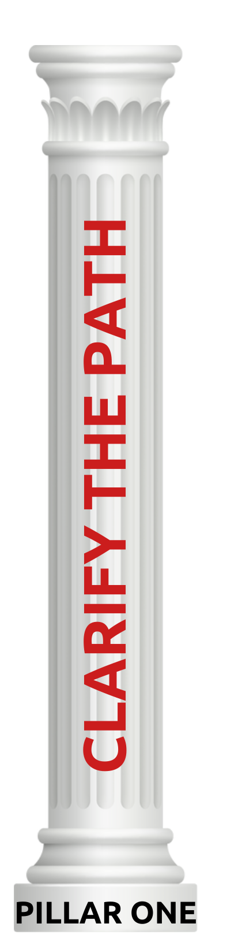



Santa Ana College Guided Pathways 2.0 ​
SAC College Council
Guided Pathways
Steering Committee
Creation of Guided Pathway Pillar Subcommittees
Notes:
Clarie

Slide 7
Santa Ana College Guided Pathways 2.0
Persistence: First Primary Term to Secondary Term
A target goal of 57% or more of all SAC students will persist from their first primary term to the second term.
Focus:
  To support, male students, and intend to increase from 1305 to 1482 students (177 students or 13.5%)
Zero Textbook Cost to Degree​
Identify ZTC pathways for the Zero Textbook Cost Program grant (Intermediate and Long Term)​
Focus: ​
  Develop and implement plan for permanent funding​
  Necessary faculty release time for creating Open Educational Resources ​
  OER/ZTC courses and updating curriculum per Curriculum and Instruction Council regulations​
  Establishing a dedicated faculty OER/ZTC coordinator​
Pillar 3: Stay on the Path
Notes:
Highlight ZTC (Clarie)/Persistence: First Primary Term to Secondary Term (Toya)

Slide 8

CAP Coordinators & Success Coaches
CAP COORDINATORS
Creating Our World – Dr. Kristi Blackburn and Robert Manson
Design, Make and Move – Dr. Larisa Sergeyeva and Deisy Romero
Future Educators – Dr. Armando Soto and Dr. Sara Butler
Helping Others – Dr. Tim Winchell and Dr. Brenda Estrada
Money Matters – Anthony Pagan and Jennifer Dela Rosa
People, Ideas and Culture – Dr. Walter Jones, John Nguyen, Veronica Hurtado
STEM – Dr. Saied Eidgahy and Ann Cass
SUCCESS COACHES
Creating Our World – Javier Garcia
Design, Make and Move – Natalie Rodriguez
Future Educators – Sara Vu and Daniel Cristobal
Helping Others – Amber Vasques-Nodal
Money Matters – Monique Moreno
People, Ideas and Culture – Lorena Alvarez
STEM – Helen Barriere
Notes:
Toya

Slide 9
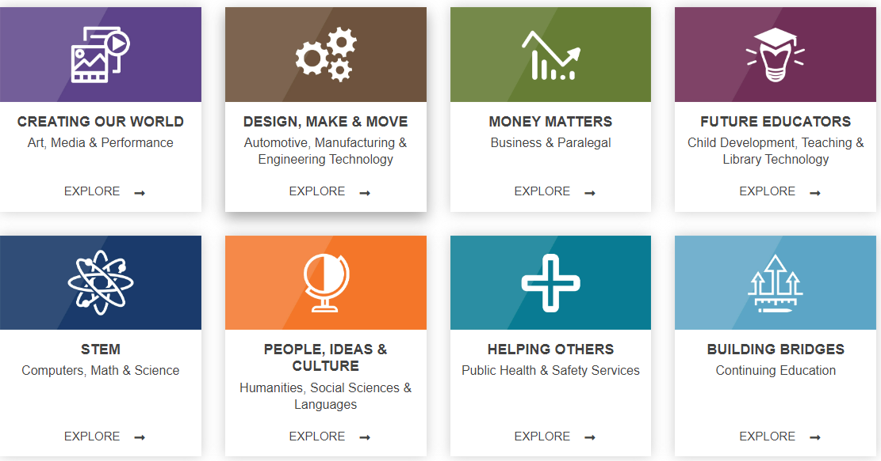
Career & Academic Pathways (CAPS/Success Teams)
September
March
February
November
April
October
May
TBD
Notes:
Toya-Present each Pathway and discuss the Exploration Month

Slide 10
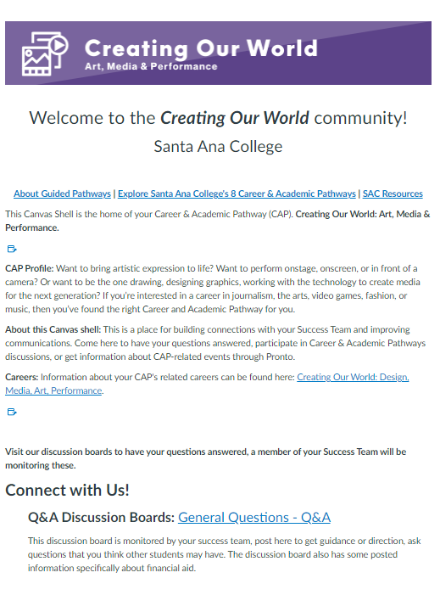
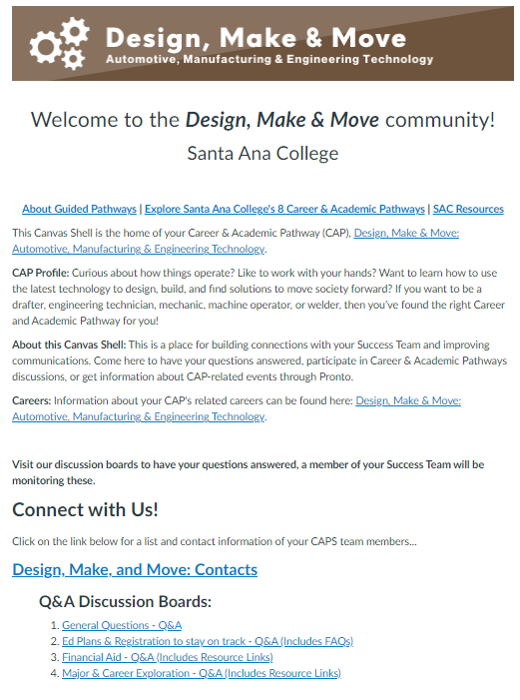
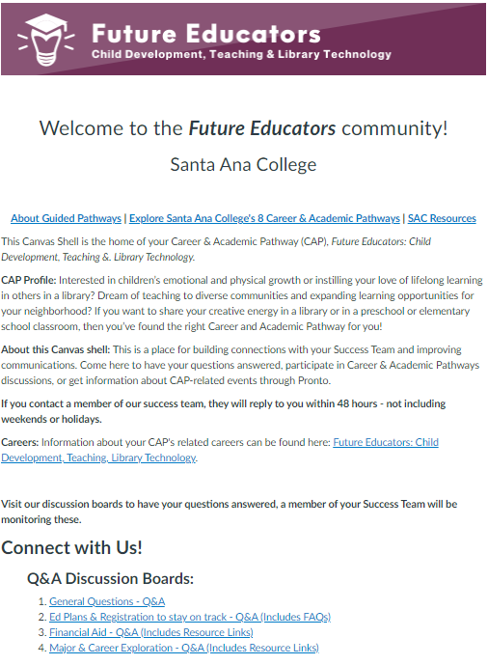
Pathways Canvas Shells
Notes:
Coyne: The Success Teams send announcements and emails through the Canvas Shell to students

Slide 11

Starfish Early Alert/Progress Survey
SAC uses the Starfish system for early alert to raise success items: flags, referrals and kudos.
Success coaches track these, and service areas enter a resolution code on each item that you can see.
Success items can be raised in Starfish at any time during the term.
Periodically, you will be notified of a student progress survey with select success items for you to choose.
Surveys usually remain open for about two weeks.
Visit the faculty resource page at https://sac.edu/starfish. It includes:
Full video library, including on how to respond to a progress survey.
Wording of the emails that go out to students when an item is raised.
Links to previous SAC PD session videos.
Notes:
John, Hang, Dr. Martinez

Slide 12
Get Connect to Guided Pathways 2.0!
Connect with the Guided Pathways work by:
Attending a Career & Academic Program (CAP) Exploration event
Attend a GP Steering Committee meeting (1st Wednesday each month; 9 am-11 am)
Participate in a GP Subcommittee (Pillar)
Promote sense of belonging within your CAP
Update CAP webpage information
Contact Tanisha L. Burrus, Interim Director of Student Success/burrus_tanisha@sac.edu
Notes:
Toya/Coyne

