Slide 1
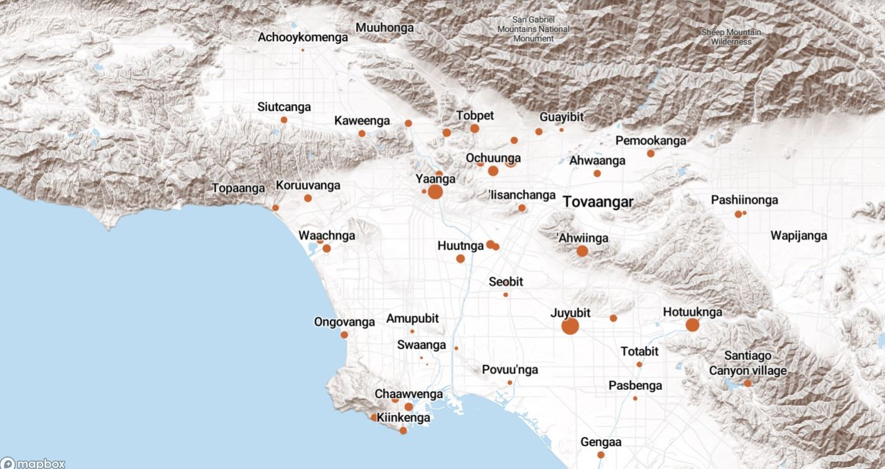
Land Acknowledgement
We acknowledge that the land on which Santa Ana College exists today is the ancestral land of the Tongva people, whose presence and resilience in Santa Ana continues to this day. We take this opportunity to honor the original caretakers of this land and recognize that histories of land theft, forced removal and assimilation, genocide, and erasure, and settler colonialism that have brought our institutions and ourselves here.
To acknowledge is not enough. This land acknowledgement is additionally a call to act, to consider our positionality and complicity in relations to these forces, and to engage in relationships and solidarity with the Tongva and other indigenous peoples.

Slide 2

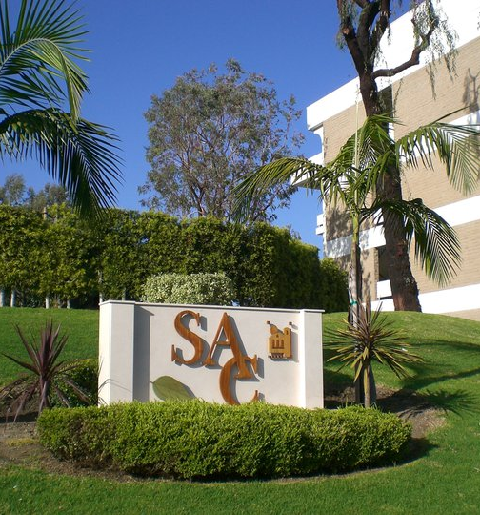
President’s Report
Updates:
Transfer Agreements/Partnerships - Transfer Center Coordinator, Leo Pastrana and Dean of Counseling included in meetings
Digital Media Center – Discussed at Facilities and Safety
Campus Safety Alerts – Discussions to continue in Facilities and Safety on non-Rave alert events and how to inform campus community
Artificial Intelligence and Academic Honesty – Something to be addressed this semester/year. Stephanie Fondren has attended some conferences addressing this topic and will be starting a workgroup this semester – Contact Fondren_stephanie@sac.edu
College Council meeting information should now be received by all SAC – This semester will be reviewing District Planning Guide to ensure all processes outlined in the guide are being followed. Also, reviewing Program Reviews of each District Department – are requests for positions, etc. addressed in program reviews?

Slide 3
IdeazBoard Senate Retreat Fall 2023
What topics/areas would you like to see addressed this semester by the Academic Senate?
Bathrooms, clean, working, open! (b) Cleaning facilities- bathrooms cleaned, water working! (c) Bathroom facilities, especially in the I building
Provide a better pathway to communicate with the senate when you are not a senator/on the board. Maybe giving tips at the first senate meeting for how to relay things back to the division as a junior/senior senator duty.
(1) Let’s contribute towards being sure our Whittier College transfer students are well served at that institution. (2) Need transfer partnerships should be developed in collaboration with faculty to ensure that students are getting their needs met (3) Increasing communication and collaboration from our chancellor with our faculty. We appreciate ideas but they will not be effective (even detrimental) without sufficient input from faculty.
(1) Ensure shared governance is followed by all to ensure faculty voice is strong and budgets are monitored. (2) Let’s focus on principles of Shared Governance so that all stakeholders can contribute effectively.
Can you put a hiring committee form link on the Senate Website so people can volunteer or put their name down that they are willing to consider participating? Maybe consider allowing them to edit their form to update what they are interested in or if they want to pull it.
Please get admin and the district out of these faculty spaces.
Work with faculty to find our voice by serving on committees - questioning, sharing concerns and opportunities.
Concerns about over reach from district and college administration discussed at Spring 23 retreat never had sufficient discussion or resolution. Lack of respect, collaboration and an oppressive climate continue to challenge our growth as a college
Equivalency for part-time faculty.
Class caps in general but especially for online asynchronous courses. We have been getting asked to be as big as our in person courses and that is going to burn out our faculty and is unsustainable.
Relay some key state webinars/surveys for us to give more input from our college.
Dual enrollment updates and participation especially because the new state chancellor is pushing this even more. We need to involve more of the HS faculty who are cross hired with SAC because they may be mixing up the processes used at the HS vs SAC.

Slide 4
Faculty Priorities Timeline – SAVE THE DATES
Friday, September 22 (via Zoom, invite to follow) Noon – 1:30pm
Information Session – Department Chairs and Senior Senators
Recording sent out this morning.
Faculty Request Submission through Canvas Due – Friday, October 13
Senior Senators Ranking Event via Zoom– Friday, October 20 11:30am – 3:30pm
Academic Senate Affirmation of Final Rankings – Tuesday, October 24

Slide 5
Questions raised during Information Session:
Should there be an opportunity for Department Chairs to advocate/speak during the ranking session?
Should powerpoint presentations be allowed/required/optional?
Should there be a time limit for presentation of requests? If so, how long?
Recommendation: A poll/survey be sent out to faculty with these questions with report out at next Senate meeting

Slide 6
Dual Enrollment
Late Adds after start of course
Form to be developed for instructor sign-off if AFTER start date
Possible Resolution supporting the creation of a Dual Enrollment Committee under the College Council PG structure. Possibly under IE&A or SEAP
Ashly Bootman, DuE Workgroup Faculty Co-Chair, will be providing report to Senate with updates, etc. Any faculty issues, concerns, praises – please reach out to Ashly

Slide 7


Board of Trustees Meeting – Tonight
Honoring SAC Distinguished Faculty of the Year – Justin Tolentino
SAC’s New Faculty will be introduced
College Council – Tomorrow via Zoom, 9-11am
Announcements

