Slide 1
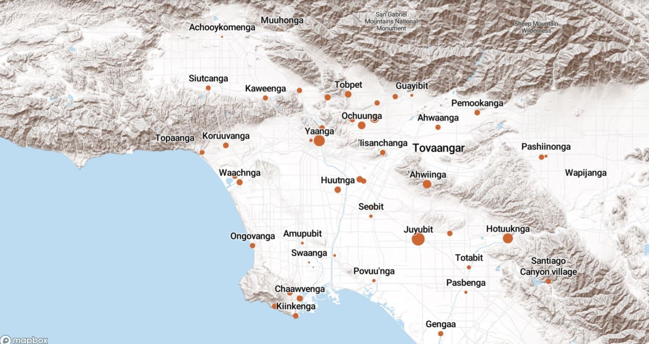
Land Acknowledgement
We acknowledge that the land on which Santa Ana College exists today is the ancestral land of the Tongva people, whose presence and resilience in Santa Ana continues to this day. We take this opportunity to honor the original caretakers of this land and recognize that histories of land theft, forced removal and assimilation, genocide, and erasure, and settler colonialism that have brought our institutions and ourselves here.
To acknowledge is not enough. This land acknowledgement is additionally a call to act, to consider our positionality and complicity in relations to these forces, and to engage in relationships and solidarity with the Tongva and other indigenous peoples.

Slide 2

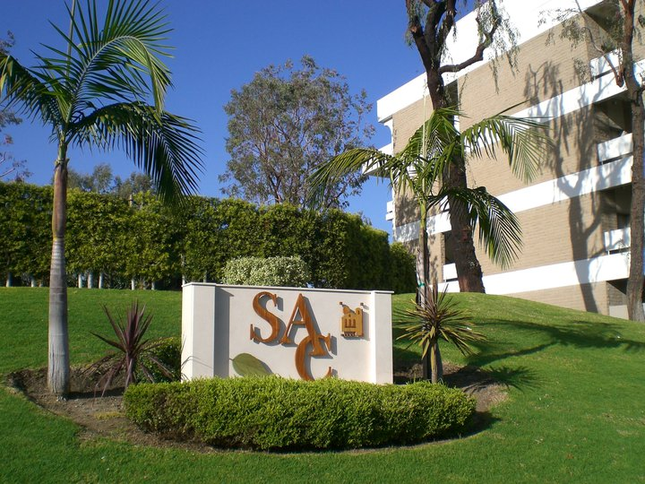
President’s Report
9/5/2023: Kim Smith and Kristen Robinson submitted Bachelor of Arts in Paralegal Studies – Notification by 12/31/2023
9/7/2023: Greg Gonzalez (Welding) and David Roper (Auto Tech) + students spoke with Rep Correa (CA-46) about $2 million in funding to develop career technical Education (CTE) pathways for disadvantaged, dislocated or at-risk adult learners that start in noncredit courses (e.g., CTE skill development, basic skills and English) and transition to credit certificate and degree programs.
Updates:
People & Culture:
Vice Chancellor of People & Culture contract terminated at Board of Trustees meeting last night
Meeting with Asst. Vice Chancellor, Alistair Winter in next two weeks to discuss P&C role in equivalency process

Slide 3
Agenda Items
    Discussed at IRSJ meeting 9/8
Transfer Agreements/Partnerships
UCLA, UCI, Whittier and University of LaVerne (upcoming)
Dual Enrollment
Late Adds w/out faculty knowledge, A&R processing
Dual Enrollment Workgroup Meeting
Tue 9/19/2023 2:30 PM - 4:00 PM
Purchasing Timeline
Fiscal year starts July 1
Due to accounts being set up – Purchasing begin early-mid Sept
Purchasing Ends – Mid-March – Fiscal Close-out
Digital Media Center
Next Facilities meeting, 9/19/2023 1:30-3:30pm

Slide 4
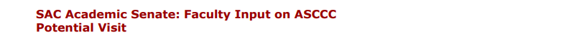

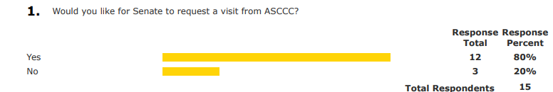
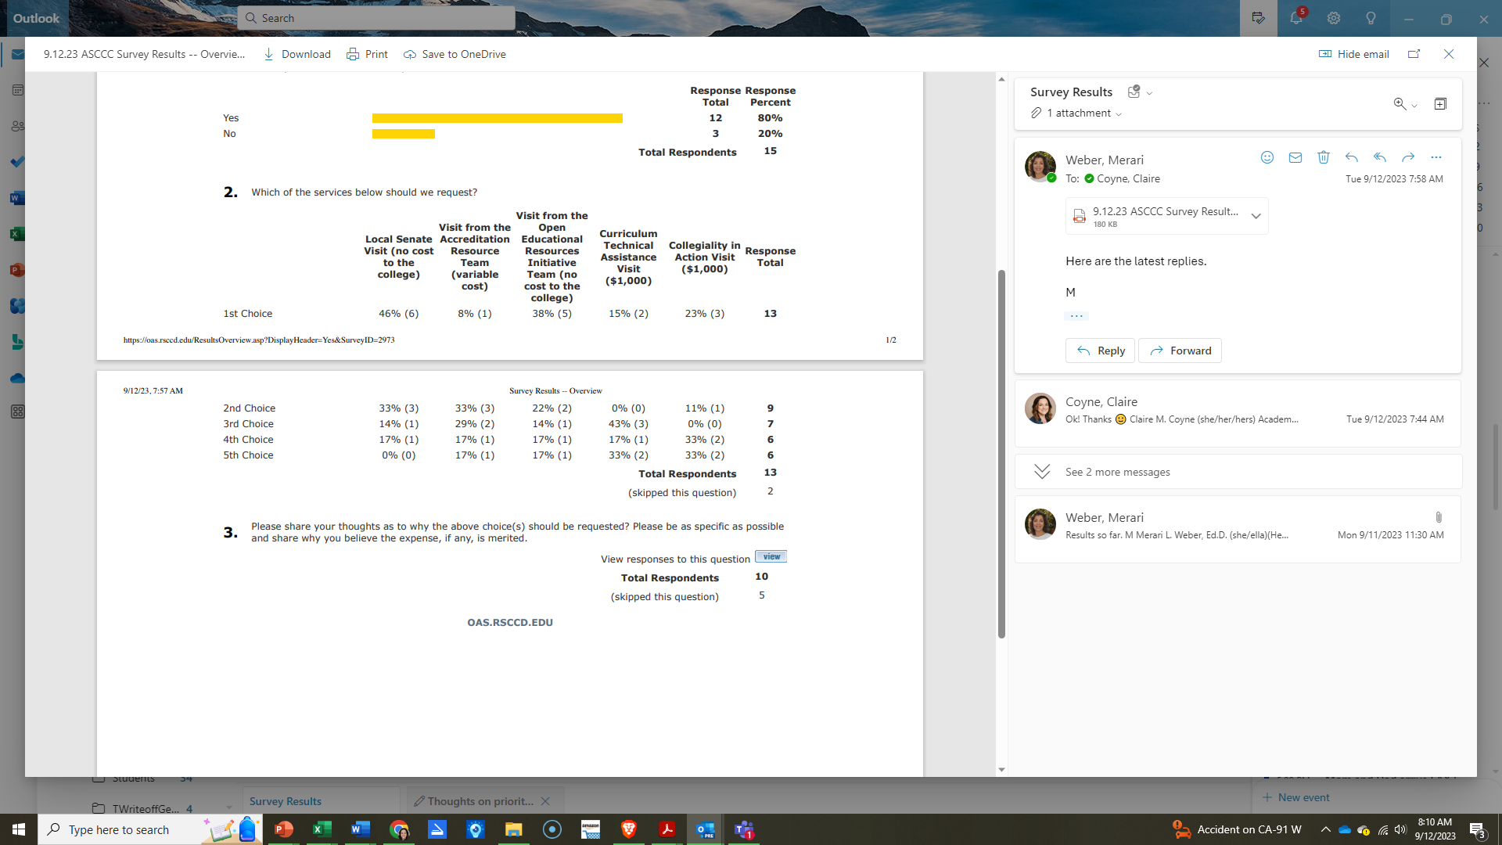
President’s Report
Link to Responses for Q3: Please share your thoughts as to why the above choice(s) should be requested?
11
8
10
8
8

Slide 5
Faculty Priorities Timeline – SAVE THE DATES
Friday, September 22 (via Zoom, invite to follow) Noon – 1:30pm
  Information Session – Department Chairs and Senior Senators
Faculty Request Submission Due Date – Friday, October 13
Senior Senators Ranking Event – Friday, October 20 11:30am – 1:30pm
Academic Senate Affirmation of Final Rankings – Tuesday, October 24

Slide 6
IdeazBoard Senate Retreat Fall 2023
What topics/areas would you like to see addressed this semester by the Academic Senate?
Bathrooms, clean, working, open! (b) Cleaning facilities- bathrooms cleaned, water working! (c) Bathroom facilities, especially in the I building
Provide a better pathway to communicate with the senate when you are not a senator/on the board. Maybe giving tips at the first senate meeting for how to relay things back to the division as a junior/senior senator duty.
(1) Let’s contribute towards being sure our Whittier College transfer students are well served at that institution. (2) Need transfer partnerships should be developed in collaboration with faculty to ensure that students are getting their needs met (3) Increasing communication and collaboration from our chancellor with our faculty. We appreciate ideas but they will not be effective (even detrimental) without sufficient input from faculty.
(1) Ensure shared governance is followed by all to ensure faculty voice is strong and budgets are monitored. (2) Let’s focus on principles of Shared Governance so that all stakeholders can contribute effectively.
Can you put a hiring committee form link on the Senate Website so people can volunteer or put their name down that they are willing to consider participating? Maybe consider allowing them to edit their form to update what they are interested in or if they want to pull it.
Please get admin and the district out of these faculty spaces.
Work with faculty to find our voice by serving on committees - questioning, sharing concerns and opportunities.
Concerns about over reach from district and college administration discussed at Spring 23 retreat never had sufficient discussion or resolution. Lack of respect, collaboration and an oppressive climate continue to challenge our growth as a college
Equivalency for part-time faculty.
Class caps in general but especially for online asynchronous courses. We have been getting asked to be as big as our in person courses and that is going to burn out our faculty and is unsustainable.
Relay some key state webinars/surveys for us to give more input from our college.
Dual enrollment updates and participation especially because the new state chancellor is pushing this even more. We need to involve more of the HS faculty who are cross hired with SAC because they may be mixing up the processes used at the HS vs SAC.

Slide 7
The Executive Committee shall be comprised of the following members:
• Officers:
  • President of the Senate
  • Vice President of Culture & Engagement
  • Vice President of Community Operations
  • Historian
• Chair, Curriculum & Instruction Council (CIC)
• Members-At-Large:
  • Up to two (2) Members-At-Large representatives
  • One Adjunct Faculty Member-At-large representative
  Members-At-Large: Appointments will occur for at least one semester. Appointments will be affirmed by the Senate body.

Slide 8
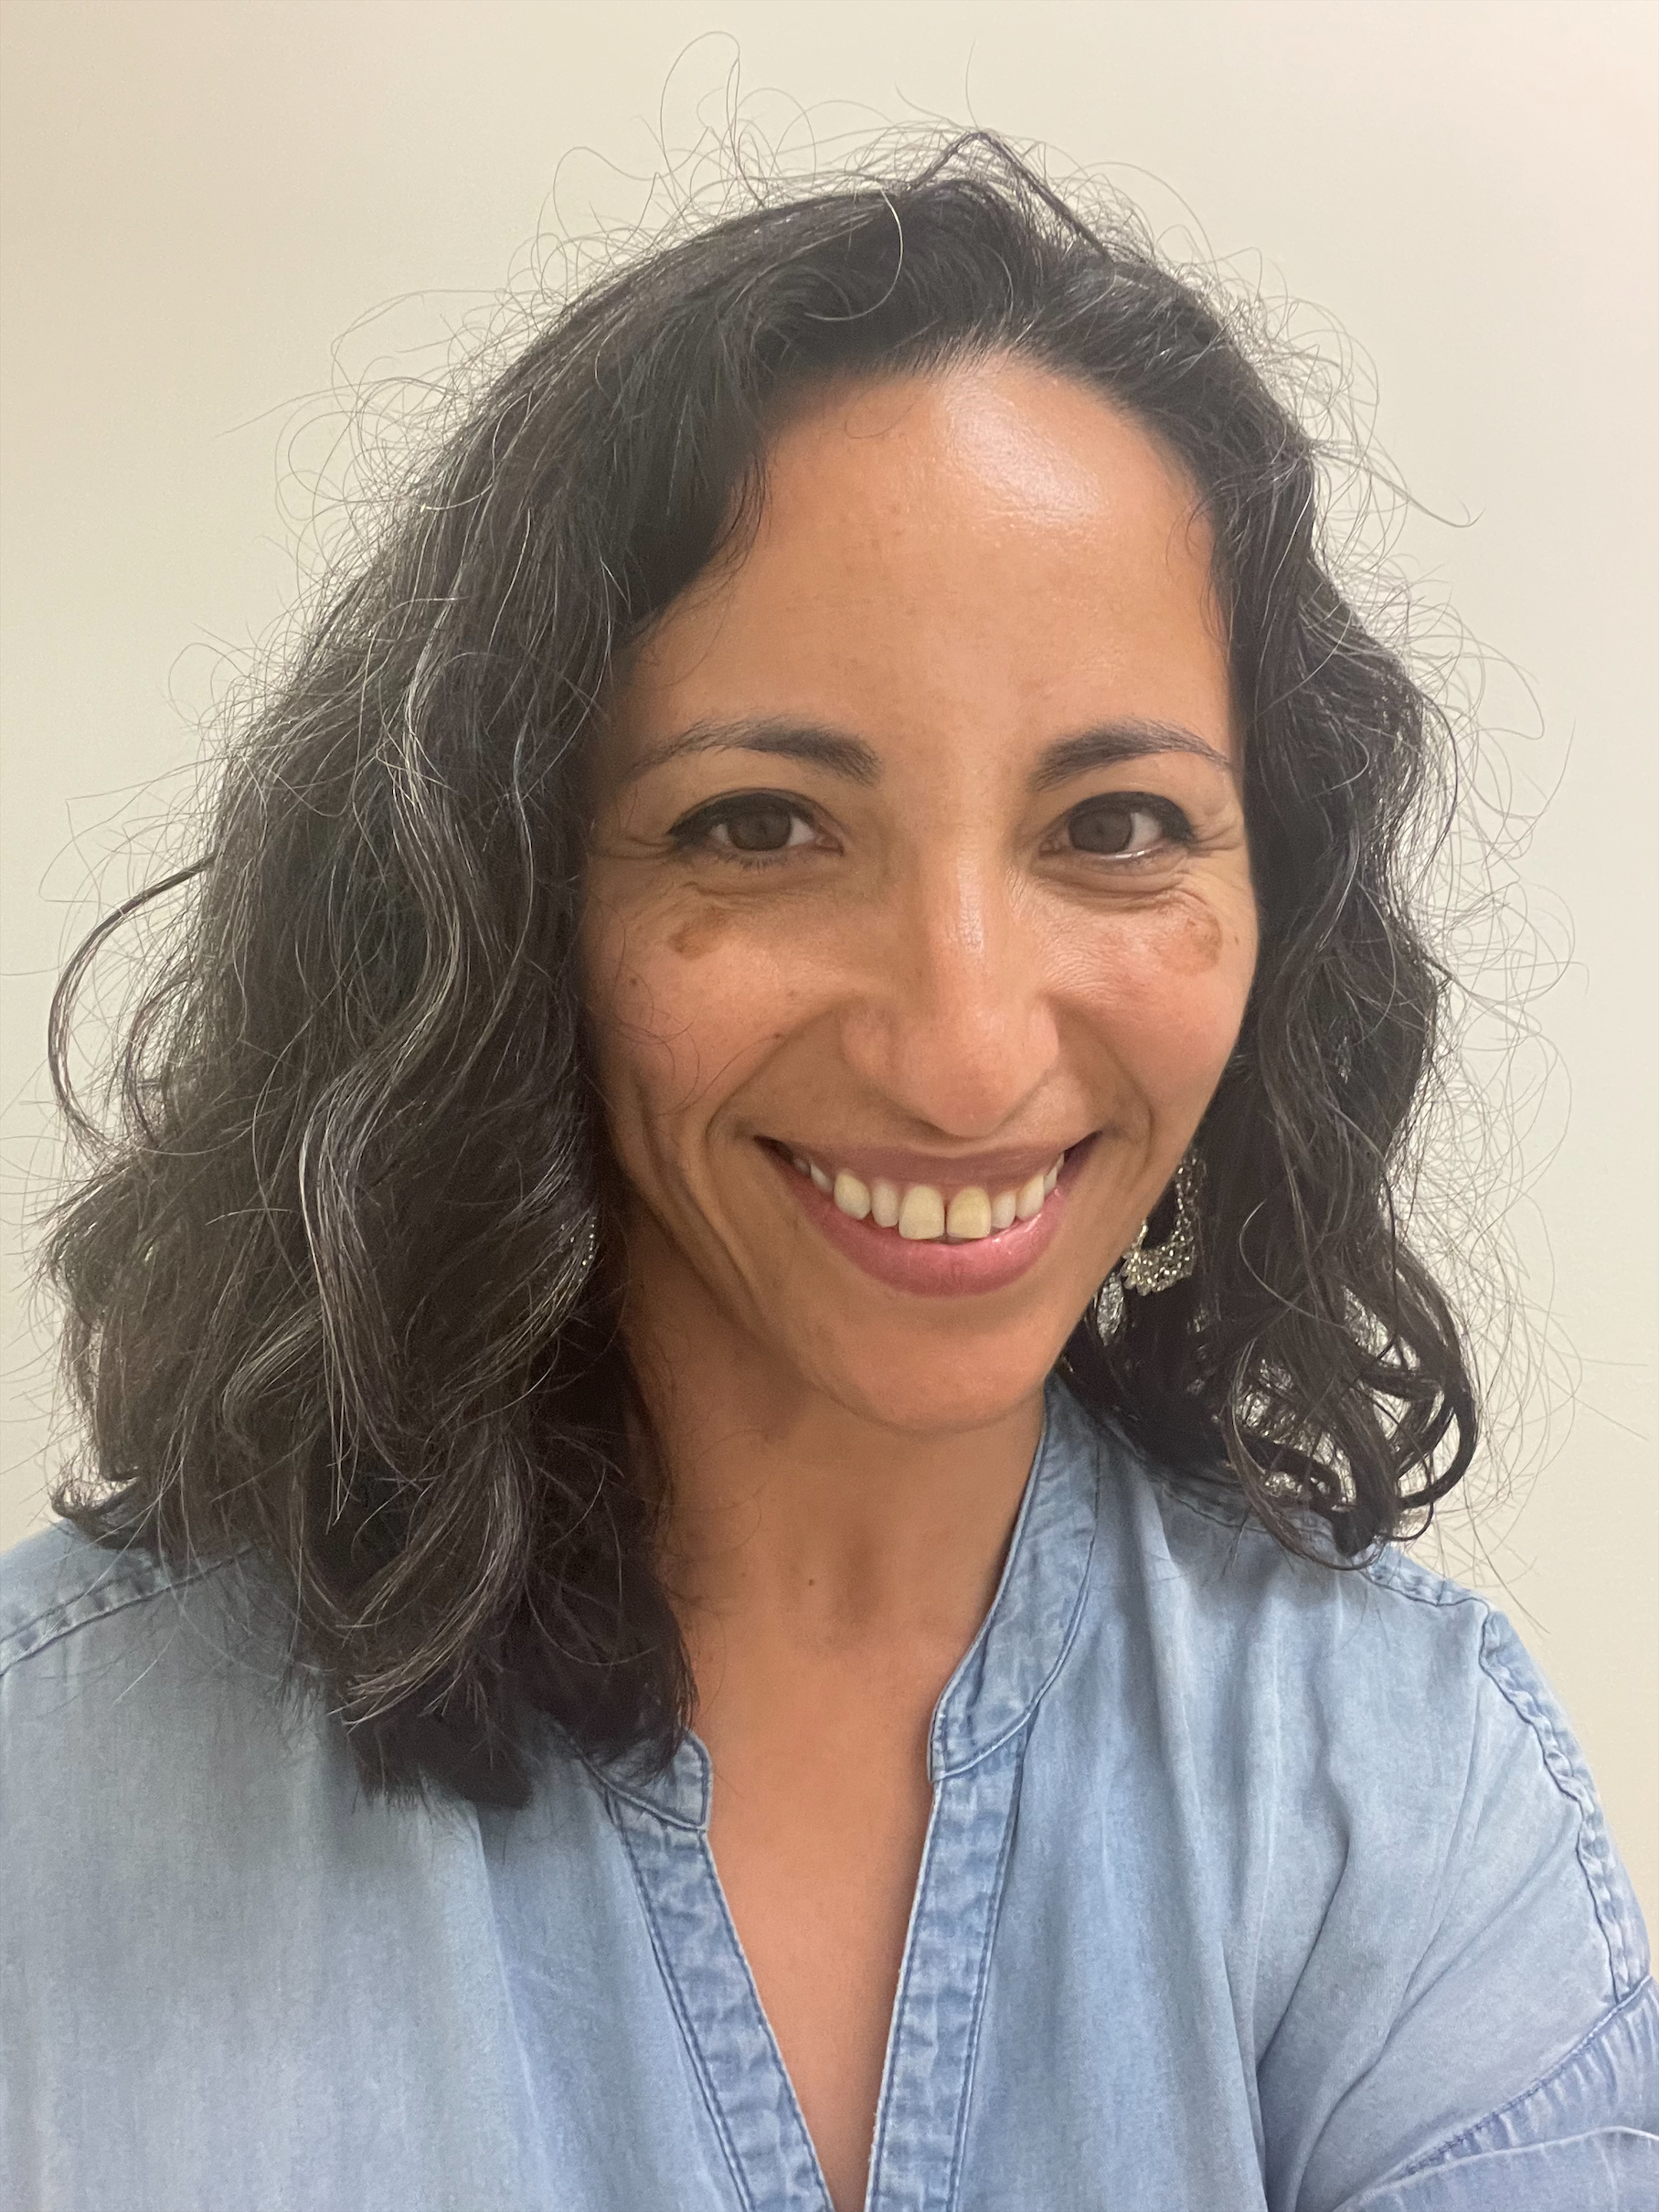
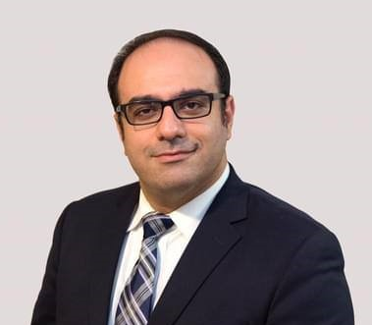

Senate Affirmation of At-Large Faculty to Senate Executive Committee for Fall 2023
Jennie Beltrán, Biology
Reza Mirbeik, Ed.D.,
Math
Non Credit
Karen Bravo,
Adjunct Counseling

