Slide 1










Services & Resources
Created & Presented by: The Fainbarg Chase Thrive Center Staff

Slide 2







Mission
We provide holistic resources to alleviate challenges to students’ basic needs.
We advocate for access to basic needs as a fundamental right to promote a just environment where every student has the opportunity to thrive.

Slide 3

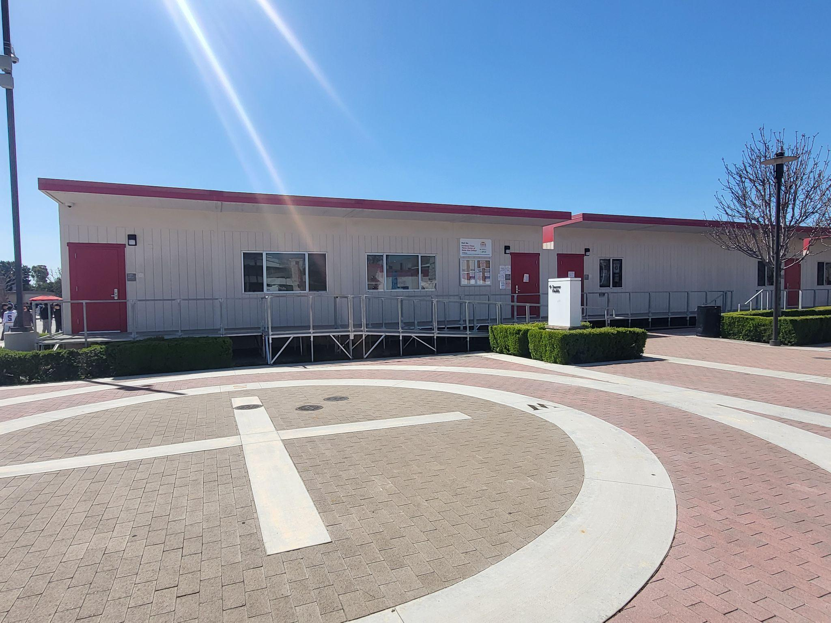
Location - Village 206

Slide 4

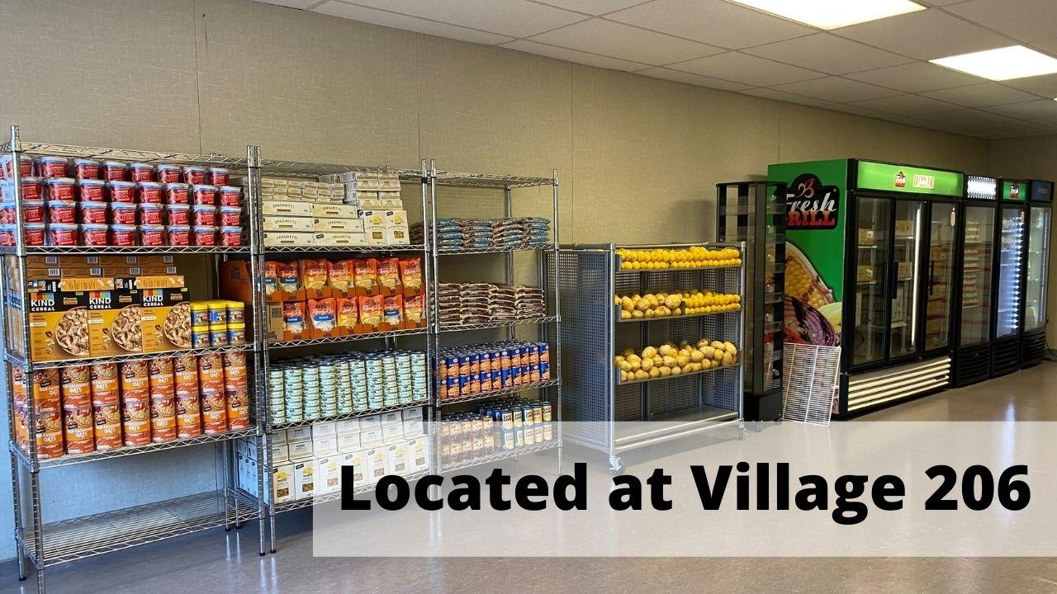

Food Pantry
Food
  Groceries
    Milk
    Non-dairy alternative milk
    Eggs
    Fresh produce
      All provided by Second Harvest
    And MORE!
  Snacks
    Ready-to-eat frozen meals
      Provided by Bracken’s Kitchen
    Snack bars
    Water bottles
    And MORE!
Visitation Policy
  Once per week for FREE groceries
  Once per day for FREE snacks
  One visit per day total

Slide 5
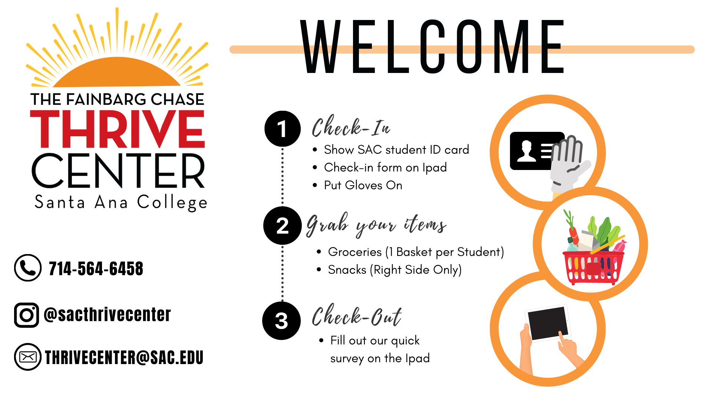
Food Pantry
Located @ Village 206
Hours of Operation
Mon/Wed/Thurs: 10am-12pm, 1-6pm
Tues: CLOSED
Fri: 12-2pm

Slide 6


Slide 7





CalFresh Application Assistance
CalFresh =
California’s Supplemental Nutrition Assistance
Program (SNAP)
We can help with:
  Applications
  Eligibility screening
  Answer Questions
  Helpful materials
  Follow-Up on Applications
  And MORE!

Slide 8
CalFresh Income Guidelines
Effective Oct. 1st, 2022
Household Size | Max Gross Monthly Income | Max CalFresh Allotment
1 | $2,266 | $281
2 | $3,052 | $516
3 | $3,840 | $740
4 | $4,626 | $939
5 | $5.412 | $1,116
6 | $6,200 | $1,339

Slide 9
CalFresh Application Assistance
If students meet one of the following …
  Receiving Cal Grant A/B (TANF Funded)
  Federal Work Study Student
  Working 20 hours a week
  Care for a child under age of 6
  A single parent enrolled full-time in college and taking care of a child under 12
They are likely eligible to apply!

Slide 10
CalFresh Application Assistance
NEW WAY FOR STUDENTS TO BE ELIGIBLE
*Local Programs that Improve Employability (LPIE)
Adult Basic Education
Career & Technical Education
English Language Acquisition
Work Readiness Training
Work Experience
Programs are currently pending to be approved.
Once approved, our office will communicate with you!
Students in these programs can apply for CalFresh!

Slide 11



Emergency Housing Assistance
Shelter and Housing Referrals
Partner Non-Profit Agencies

Slide 12


Emergency Aid Assistance
Assist with access to food (via grocery benefit gift card)
  Especially for students who are not eligible for CalFresh
Housing Assistance
  Facing eviction
  Past due rental payments
Cost of Living Expenses impacting basic needs
  Multiple missed utilities payments

Slide 13
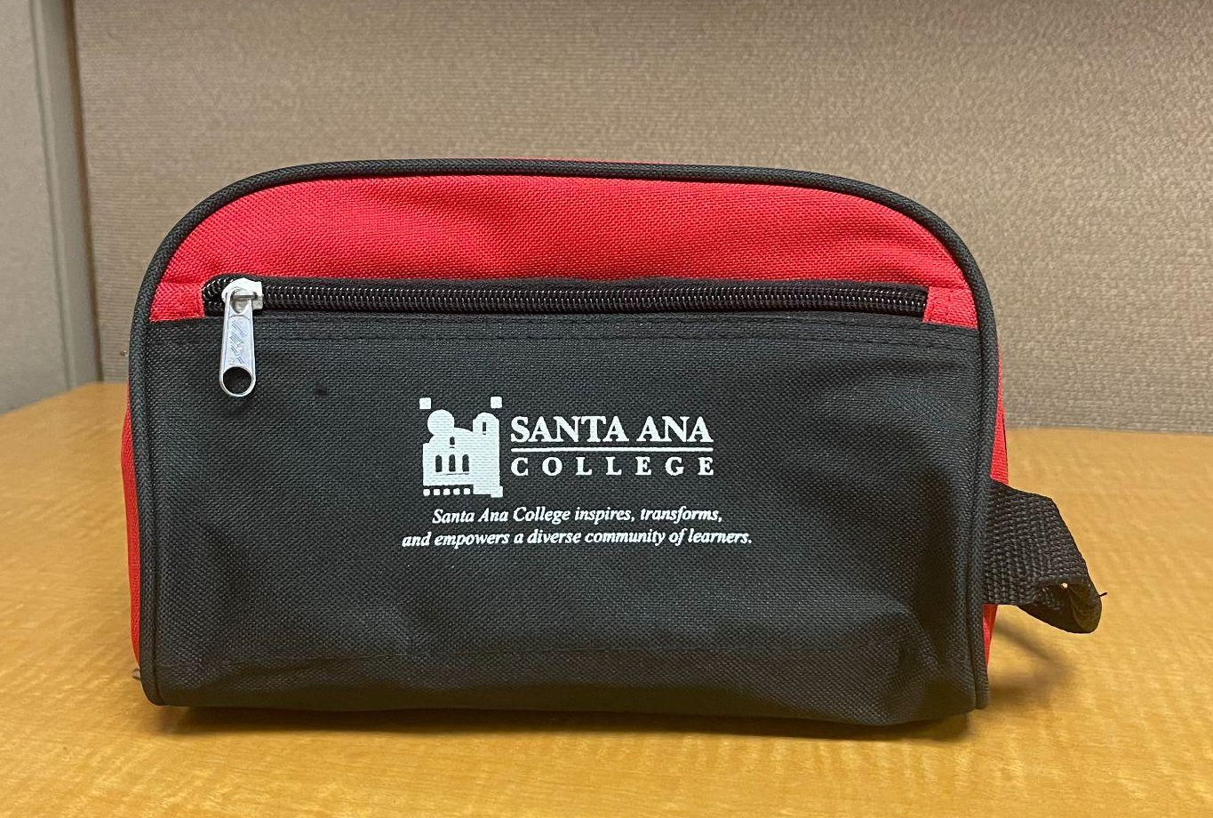
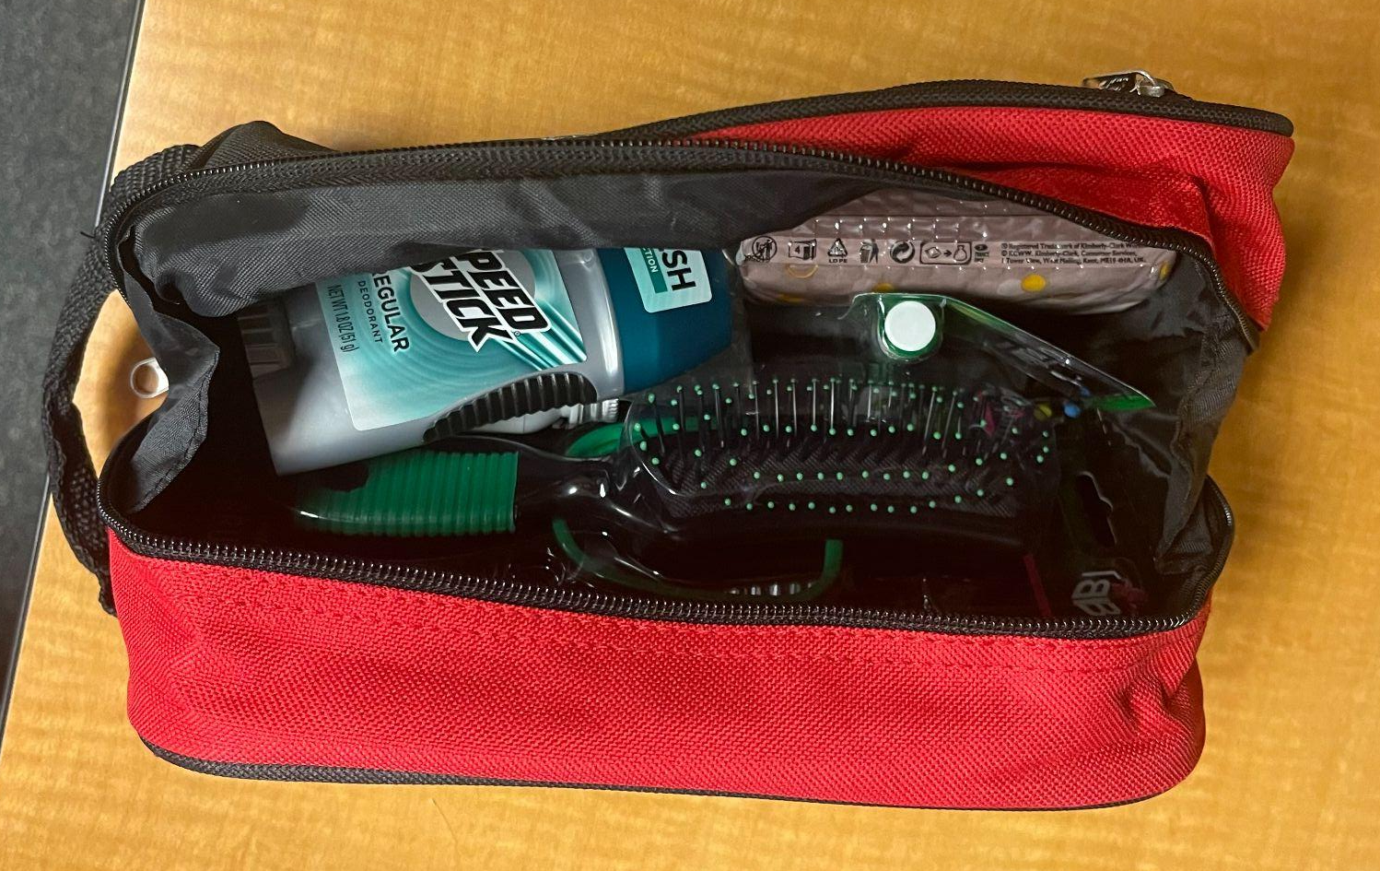
Hygiene Support
Hygiene Kits

Slide 14
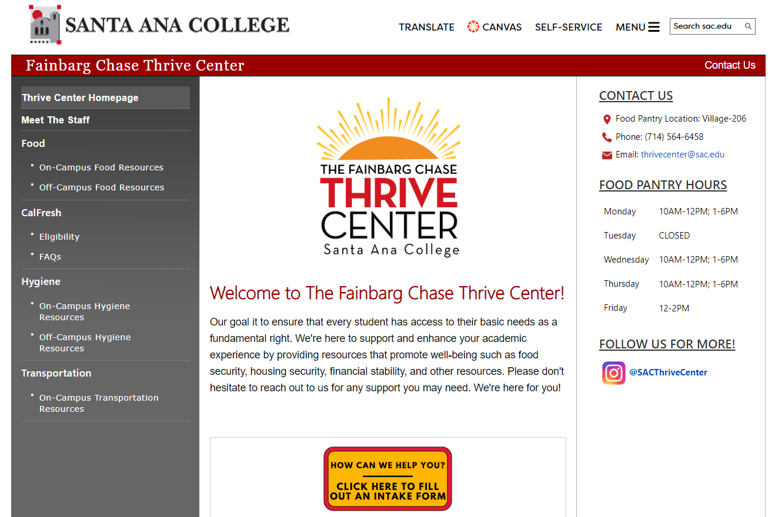
Basic Needs Resource Request
For Students
Website:
https://sac.edu/StudentServices/thrivecenter/Pages/default.aspx
Form Link Here:
https://cm.maxient.com/reportingform.php?RanchoSantiagoCCD&layout_id=15

Slide 15

Hygiene Support
Our Diaper Program provides
75 diapers per month!
We provide sizes:
Size 0 - 6
Med, Large, XLarge Pull-Ups
Sign-up for Fall 2023 program
Begins August 1 - 25
to receive diapers in September!

Slide 16

Career Closet
Helping you THRIVE in your career goals!
SIGN-UP HERE:
bit.ly/THRIVECLOSET

Slide 17

How to get involved
with the Thrive Center!
Volunteers would be assisting with:
• Unloading Heavy Boxes
• Quality Checking Food
• Unboxing and Unpacking
• Stocking Inventory
• Breaking Down Cardboard Boxes
Volunteer Times for Fall 2023:
Tues 10am - 12pm | Wed 10am - 12pm
*Students may volunteer anytime during these time-frames at the Food Pantry.

Slide 18
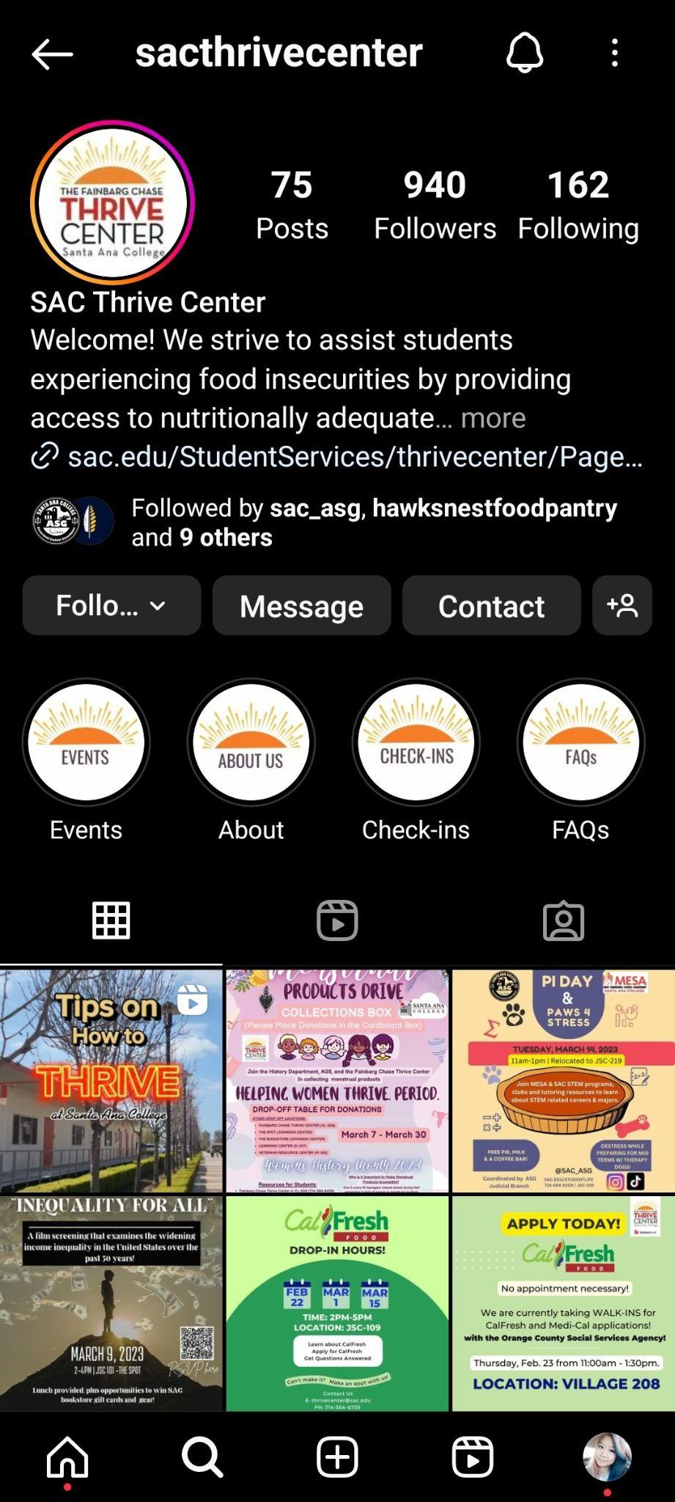
@sacthrivecenter on Instagram!

Slide 19

Thank you for your time!
Questions?
(714) 564-6458
thrivecenter@sac.edu
Village 206

