Slide 1



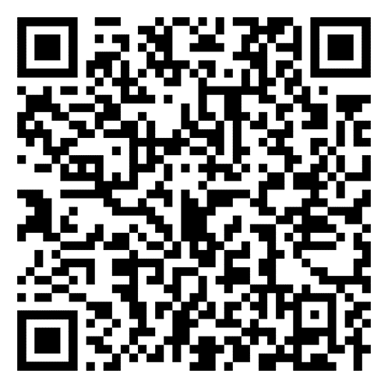
Guided Pathways
2022-2026 Work Plan
        Professor Chantal Lamourelle
        Dr. Armando Soto
        Dr. Gregory J. Toya
Notes:
Armando

Slide 2
* To create an inclusive climate and culture to engage all constituent groups to develop and implement the Guided Pathways Work Plan
* Identify and eliminate student friction points
* Assume everything can and should change
* Work together to improve student outcomes and close achievement gaps
Purpose – Guided Pathways Work Plan (p.3)
Notes:
Armando
System’s commitment to 1) engage in institutional change that improves student outcomes and closes achievement gaps; 2) identify and eliminate student friction points; 3) assume everything can and should change; and 4) work together to change student outcomes

Slide 3
Work Plan Timeline
October 1, 2023 – Extended Due Date
September 27-29 – CAGP #5: Oakland, CA
Sept 21-25, 2023 – Final NOVA Updates and Approvals
September 18-20, 2023 – Project Lead Final Review
Sept 14-15, 2023 – Initial NOVA Updates
September 13, 2023 – College Council – 2nd reading
September 12, 2023 – Academic Senate – 2nd Reading
August 14 – September 13 – Faculty involvement/consultation September 1 – Collegial feedback due
June 1 – Due Date
May 24 – College Council – 1st reading
May 16 – President’s Cabinet
May 11 – SEAP
May 11 - GP Exec Team Review
May 9 - Academic Senate – 1st reading.
May 8 - Draft complete
Notes:
Greg
15 co-authors: faculty, managers, classified contributed to writing the plan

Slide 4
Steering Committee​
* Co-Chairs: Director of Student Success and Faculty (Academic Senate, Chair)​
* Charge: Implement the 2022-2026 Work Plan​
* Reporting Committee to College Council​
Guided Pathways 2.0: 2022-2026
Notes:
Greg

Slide 5
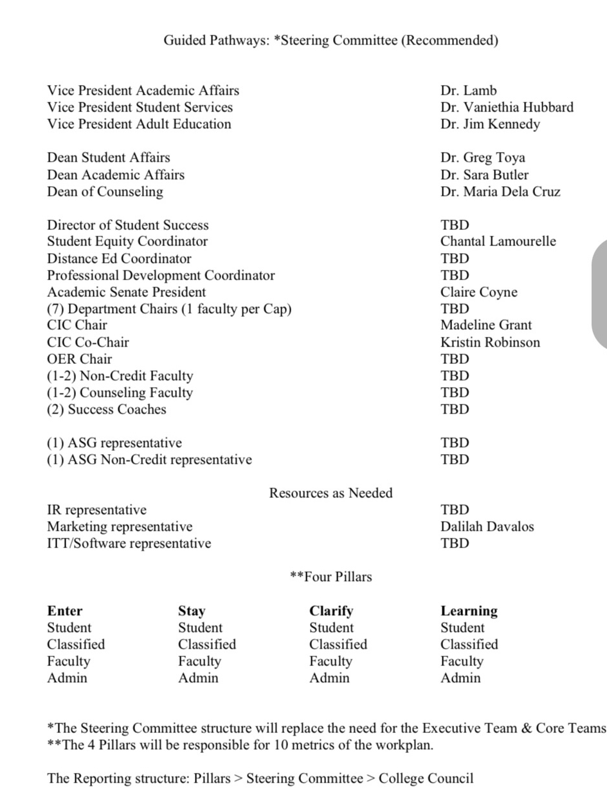

Slide 6
Relaunch CAP Success Teams​
* Creating Our World
* Design Make and Move
* Money Matters
* Future Educators
* STEM
* People, Ideas, & Culture
* Helping Others
Guided Pathways 2.0: 2022-2026
Notes:
Greg

Slide 7
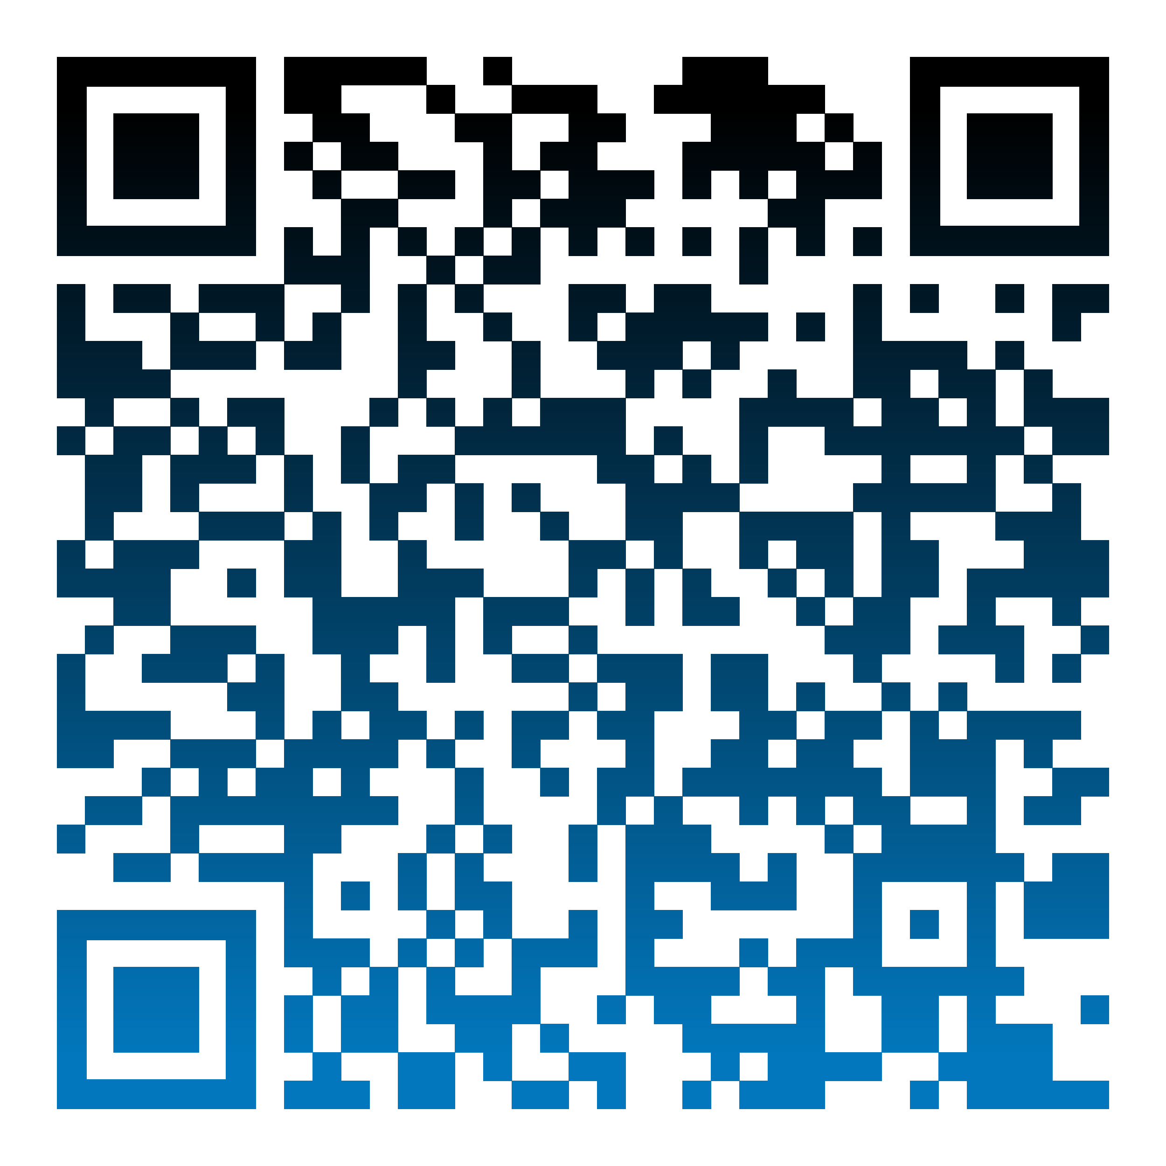
Guided Pathways 2022-2026 Work Plan Goals
Ideaboardz-Share any ideas, questions, barriers or solution that comes to mind – Please add current date to your post
https://ideaboardz.com/for/Guided%20Pathways%20Work%20Plan%20@SEAP/4930949
The Ten GP Work Plan Goals to Assess and Ascend
Successful Enrollment
Persistence: First Primary Term to Secondary Term
Completed Transfer-Level Math & English
Transfer
Completion
Student Equity and Achievement (SEA) Program Integration
Associate Degrees for Transfer (ADT) Integration
Zero Textbook Cost to Degree (ZTC) Program Integration
California Adult Education Program (CAEP) Integration
Strong Workforce Program WP Integration
Notes:
Chantal

Slide 8

Pillar 1 – Clarify the Path: Associate Degree for Transfer, Transfer
Pillar 2 - Enter the Path: Enrollment, California Adult Education Program Integration
Pillar 3 - Stay on the Path: Persistence, Completion, Zero Textbook Cost to Degree
Pillar 4 – Ensure Learning: Completed Transfer-Level Math and English, Student Equity and Achievement Program, Strong Workforce
Notes:
Chantal. Armando (8/10)

Slide 9
Guided Pathways 2022-2026 Work Plan Goals
Successful Enrollment: More than 75% complete
Professor Chantal Lamourelle
Daniel Marquez
Dr. Gregory J. Toya
75% of high school seniors participating in SAC's "Early Decision" initiative will enroll and matriculate in the upcoming fall semester. Early Decision is an initiative in which Santa Ana College buses high school seniors to the college to provide a brief orientation, meet with a counselor and register for fall courses. Moreover, congruent with the Student Equity and Achievement Plan (SEAP), we will increase Black/African student enrollment from 26 to 43 students (17 students) and create a sense of belonging and community for Black/African American and other disproportionately impacted students.
Notes:
Greg

Slide 10
Guided Pathways 2022-2026 Work Plan Goals
Persistence: First Primary Term to Secondary Term –
0-50% Complete
Professor Chantal Lamourelle
Dr. Daniel Martinez
Dr. Armando Soto
A target goal of 57% or more of all SAC students will persist from their first primary term to the second term. Further, we will simultaneously focus on our highest student population in need of support, male students, and intend to increase from 1305 to 1482 students (177 students or 13.5%)
Notes:
Greg

Slide 11
Guided Pathways 2022-2026 Work Plan Goals
Completed Transfer Level Math & English
Less than 50% Complete
Dr. Said Eidgahy
Dr. Walter Jones
Our institutional local goal is to increase the current completion rate of Transfer level Math and English from 9% to 25% by end of 2026.
Notes:
Armando

Slide 12
Guided Pathways 2022-2026 Work Plan Goals
Transfer - More than 75% Completion
Dr. Armando Soto
The goal is to increase student success transfer rates by 2% by providing our students with the most current transfer information and transfer services, pertaining to admissions to California State University, University of California, Private, HBCUs, and other Out-of-State institutions.
Notes:
Armando

Slide 13
Guided Pathways 2022-2026 Work Plan Goals
Completion: Less than 50% Complete
Professor Amberly Chamberlain
Professor Chantal Lamourelle
Our local goal is to increase the vision for success definition of completion within three years by at least 12.5%. Additionally, in alignment with our current SEAP plan goal is to focus our initial efforts on our male students and create a community culture where male students have stronger connections to support services and develop cross campus relationships/mentorships that foster their sense of belonging to increase their completion rates also by 12.5%
Notes:
Chantal

Slide 14
Guided Pathways 2022-2026 Work Plan Goals
Student Equity and Achievement Program
Integration in Progress
Professor Chantal Lamourelle
Immediate: Increase capacity for positions that are solely dedicated to the Guided Pathways and Student Equity and Achievement Plan work by surveying and evaluating the current SEAP positions and the level of work capacity among leadership, administration, classified staff and faculty to fully integrate both plans.
Intermediate: Continue to engage in deep inquiry to assess effective ways our SAC community may develop race-conscious and retainment practices of staff and students so that the GP goals can be realized.
Long-Term: Create dedicated GP and SEAP combined workgroups that continue to communicate and propose ways to embed culturally relevant pedagogy and practices across the SAC curriculum and the culture and practical ways that we can remove barriers and redesign systems for our SEAP identified student populations as well as successful campus wide student achievement.
Notes:
Chantal

Slide 15
Guided Pathways 2022-2026 Work Plan Goals
Associate Degree for Transfer (ADT) Integration
Fully Integrated
Professor Paula Canzona
Dr. Armando Soto
SAC has fully integrated the ADT Program within Guided Pathways to achieve Key Performance Indicators (KPI) metrics, which is to respond within an 18-month clock of ADT development when new Transfer Model Curriculums (TMC) are made available.
SAC will continue to increase the campuswide awareness by marketing the ADTs through the University Transfer Center and in the SAC Catalog.
Notes:
Armando

Slide 16
Guided Pathways 2022-2026 Work Plan Goals
Zero Textbook Cost (ZTC) to Degree Program Integration: Integration in Progress
Dr. Marvin Gabut
Professor Annie Knight
Immediate
Identify ZTC pathways for the Zero Textbook Cost Program grant
Intermediate and Long Term
Develop and implement plan for permanent funding, necessary faculty release time for creating Open Educational Resources (OER)/ZTC courses and updating curriculum per Curriculum and Instruction Council regulations, and establishing a dedicated faculty OER/ZTC coordinator
Notes:
Armando

Slide 17
Guided Pathways 2022-2026 Work Plan Goals
California Adult Education Program (CAEP) Integration
Integration in Progress
Dean Lorena Chavez
Dr. Osiel Madrigal
Immediate
Continue the Student Success Conference
Intermediate
Support from credit faculty for expanded CAEP noncredit curriculum and program development to facilitate transition to credit programs
Long Term
Creation of an affinity center for adult education
Notes:
Greg

Slide 18
Guided Pathways 2022-2026 Work Plan Goals
Strong Workforce Program (SWP) Integration
Integration in Progress
Susan Cardenas
Associate Dean Matt Valerius
Immediate: Review highest priority Career Education (CE) programs to identify needed equipment and curriculum updates
Intermediate: High priority programs leverage SWP funding to work with regional employers to update curriculum and purchase needed equipment
Long-Term: All CE programs complete the process of reviewing curriculum and equipment to ensure labor market relevance
Notes:
Greg

Slide 19
Thank you! & Questions?
Notes:
Greg

