Slide 1

President’s Report
Board of Trustee's Meeting – Tonight
Bond Presentation – Recommended Districtwide Bond $720 million
Board will vote whether to support a Bond on November ballot on June 10
Public Hearing for Tentative Budget
The budget will be available for public display the last three workdays of the week prior to the June 10 Board of Trustees meeting at the District Office, 2323 N. Broadway, on the 4th floor reception area between the hours of 8:00 a.m. and 5:00 p.m.
BOT Committee Meetings
Fiscal & Audit– May 30 at 8am via Zoom (and in-person District Board Room)
Safety & Security – June 11 at 5pm via Zoom (and in-person District Board Room)
Links will be sent out to all Faculty
District Council – Next Meeting June 3rd

Slide 2
President’s Report
Relocation of Faculty from H-building
Repurposing of space in Cesar Chavez Bldg and vacant offices in D Bldg.
Facilities Concerns in C-Bldg
Several facilities modification requests (FRMs) have been approved by Dr. Nery, some issues already resolved (doors, ceiling tiles)
el Don will likely be moving from C-bldg to Cesar Chavez and Mural will be getting current el Don space and the adjacent room
Faculty Prioritization – Fall 2024
Requests sent to Dept Chairs – will you be submitting a request?
19 responses, 15 YES, 2 No, 2 Not-Sure
Responses requested by May 31 so you can be updated over the summer
https://forms.office.com/r/mpGw5YZT2m

Slide 3
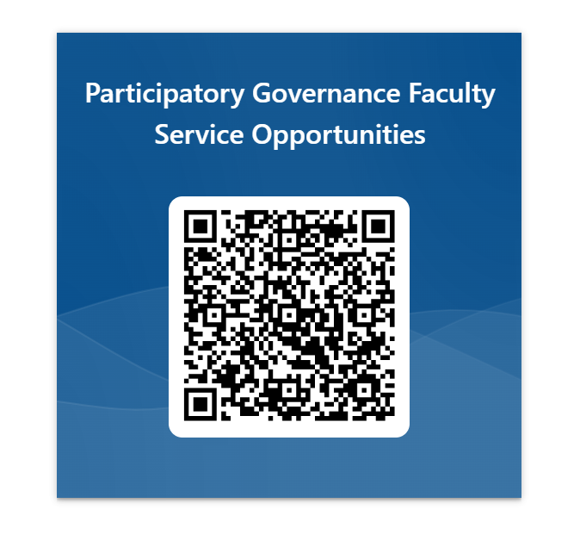
President’s Report
Faculty Recruitment Committee Assignments
Extended until June 7th
New Committees Added
https://forms.office.com/r/CyeeJNQnCi
Agenda Item Requests for Fall 2023
3 – all approved
Agenda Item Requests for Spring 2024
12 – all approved

Slide 4
President’s Report
Coming up….
Senate Retreat!!
SAVE THE DATE: Wednesday, August 14th
8:30am – 2:30pm (1:30-2:30pm Faculty Breakouts)
Senate President Evaluation

