Slide 1

May 14th DE updates

Slide 2
Online Teaching Conference
The DE office is going to be sending 17 individuals to the 2024 Online Teaching conference in Long Beach. June 26th – 28th.
Friday Keynote:
Navigating the Wave of Generative AI: Principles, Limitations & Ethics with Dr. Maya Ackerman

Slide 3
Upcoming Respondus Training
Respondus is a potential replacement for Proctorio.
There is a training/informational session with Respondus staff on Tuesday, May 21st at 11am over Zoom. If you are interested in joining Dr. Gabut and Jaki King, please let us Jaki know, and she will get you the link.

Slide 4
Joint Ai Taskforce
Collaborating with SCC, there will be an initial meeting of the Joint Ai Taskforce this Friday the 17th from 9am-10:30am.
If you like to attend please email Jaki King and they will get you the zoom link.

Slide 5
Workshop on Outcomes in Canvas
There is workshop scheduled for May 16th from 10am to 11am.
Conducted by Jaki King and Dr. Merari Weber.
Please register in the PD Gateway.

Slide 6
Updates to the Summer and Fall 2024 Template
We have streamlined and updated the Summer and Fall canvas templates.
2 big changes are as follows:
Added "Version 2024" to the title of updated and most recent modules. For example, Student Resources (version 2024) or Course Information (version 2024). This should make it much easier when you are copying in past material.
Removed all of the extra modules and pages. Now there is only one module example.

Slide 7
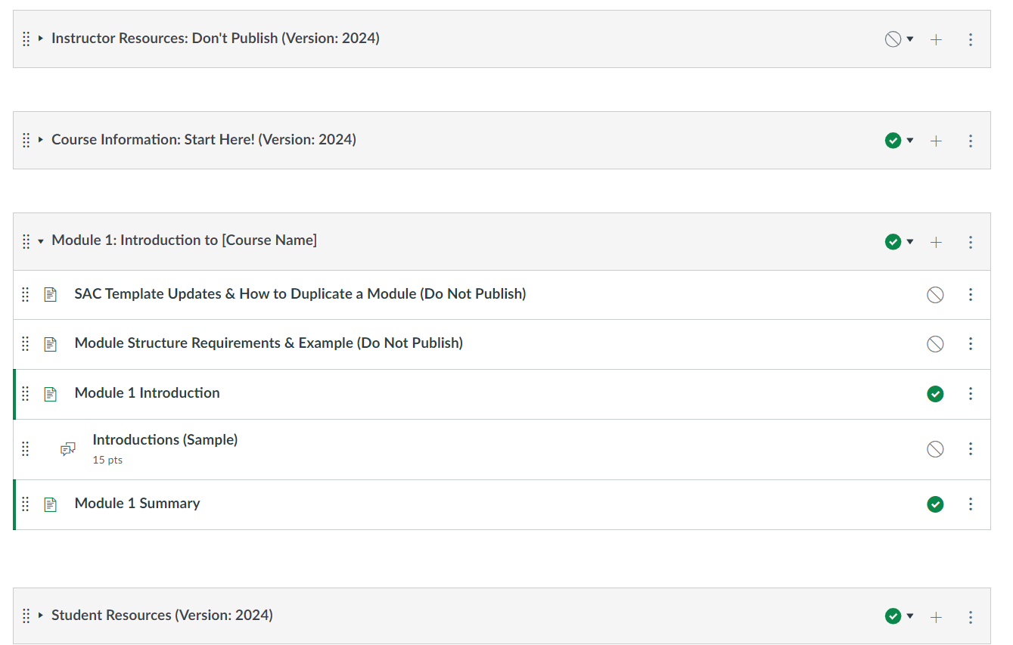
Example of what that looks like:

Slide 8
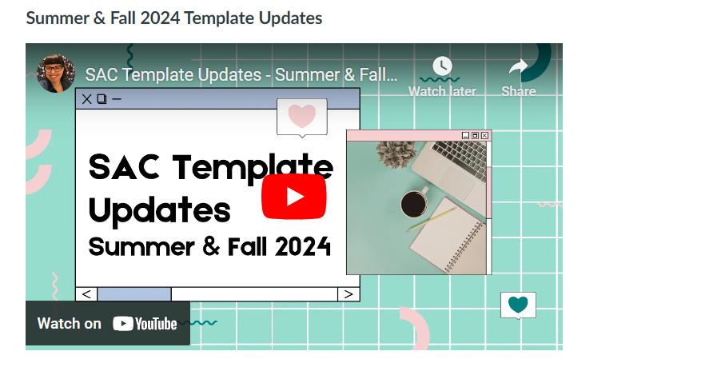
In the new Instructor Resources Module, in the "Using the SAC Template" page there is a new video that explains how to use and modify.

