Slide 1

President’s Report
Board of Trustee's Meeting – May 13th
Bond Presentation – Recommended Districtwide Bond $720 million
CEC Renovation/Redevelopment
Applied Technology Center
Arts and Workforce Building
Board will vote whether to support a Bond on November ballot in June
May Budget Revise
Governor’s projected deficit 27.6 billion (was 38 billion in Jan)
Nonpartisan Legislative Analyst’s Office has not provided an update yet
13.7 billion in cuts, as of now, no cuts to Community Colleges
New Student Trustee – Ricardo Alcaraz – SAC Student has been serving on ASG
BOT Committee Meetings
Board Policy – Tonight at 5pm via Zoom
Legislative – Tomorrow night at 5pm via Zoom
Notes:
AB 1818 would require each campus of the California State University and the California Community Colleges, and would request the University of California, to allow overnight parking by a student attending its campus if the student uses the vehicle as housing, the student has a valid parking permit issued by the campus, and the vehicle is parked in or on a campus-owned and controlled parking lot or parking structure.
The bill would additionally prohibit each campus of the California State University and the California Community Colleges from citing or otherwise penalizing, and would request each campus of the University of California to not cite or otherwise penalize, a student attending its campus for using a vehicle as housing if specified circumstances apply.
This assembly bill has been referred to the Assembly Higher Education Committee and is currently awaiting a hearing date.

Slide 2
President’s Report
District Council – May 6th
Recommended change to language for AR3502 Networked Video Camera
Proposed Change to Language: Confidential investigations may require the use of unmarked camera locations; however, use will be limited in duration to meet a specific objective.
Approved Language: Confidential investigations may require the use of unmarked camera locations; however, use will be limited to the duration of the investigation.
AR 6250 Budget Management: Brought back to the June 3 to allow for further research and revision if needed
Except as identified in the District’s Budget Allocation Model, excess funds must be added to the general reserve of the District…Can a District process make an exception to Title 5 regulation?

Slide 3
President’s Report
Establishment of Data Committee that will report to College Council
· Recommend and monitor college goals to address requirements for external constituencies (e.g., ACCJC, Chancellor’s Office Initiatives)
· Monitor goals established by the College annually
· Educate constituents regarding data sources, data collection, data availability, and processing protocols
· Create and train data coaches
Faculty Prioritization – Fall 2024
Requests sent to Dept Chairs – will you be submitting a request?
14 responses, 10 YES, 2 Not-Sure
Responses requested by May 31
https://forms.office.com/r/mpGw5YZT2m

Slide 4
President’s Report
From A&R
Beginning May 24th Students will be asked to select a reason for dropping a course
All four A&R Offices have agreed to use the following drop reasons as follows:
Financial Stress
Transportation
Technology Issue
Wrong Class
Overwhelming
Time Conflict
Teaching Style
Personal Issue

Slide 5
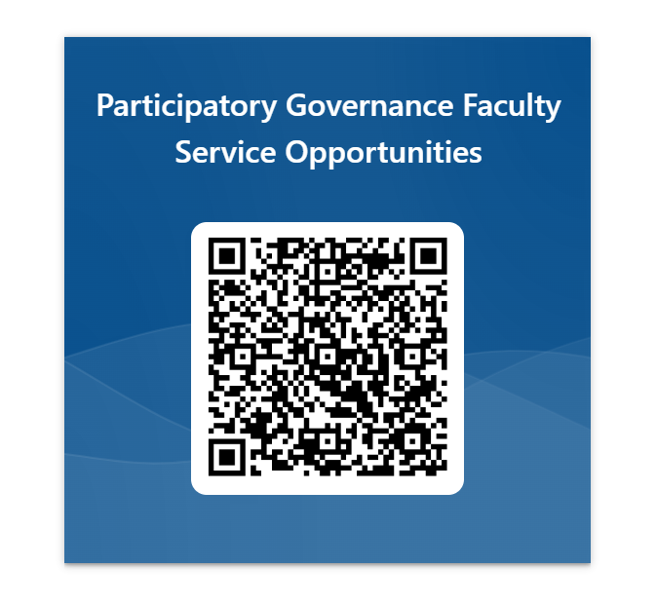
Faculty Recruitment Committee Assignments
Due Friday, May 17th
https://forms.office.com/r/CyeeJNQnCi
Spring Planning Summit, Monday, May 13
Discussion/recommendations for increasing
campus involvement in Participatory Governance work &
Deconstructing Comprehensive Educational Plan objectives
for baseline data collection over the summer
Fall Planning Summit – TBA – September?

Slide 6

Here is the link to the Kudoboard that was set up with the assistance of the Academic Senate to honor Jodi.
https://www.kudoboard.com/boards/CG8zoOkL

