Slide 1
VP of Community Operations
March 26, 2024

Slide 2
Bylaws Task Force
Had two meetings so far.
Will meet again this Thursday.
Moving along and may meet the proposal to present proposed amendments on April 23rd with possible final reading on 5/14 and 5/28, if needed.

Slide 3
Congratulations to Justin for his Distinguished Faculty Lecture!
Unlocking Worlds: An Exploration of Our Personal Mathematical Languages
When: Wednesday, March 20, 2024
Time: 2:00 p.m. to 3:30 p.m.
Will be sharing the recording by Friday of this week. It will be both on the website and in our PD Gateway for those who wish to get PD credit for listening to it.
*Special thanks to Chef Tiffany, our SAC Culinary Arts & Hostpitality students, and the SAC Art Gallery!

Slide 4
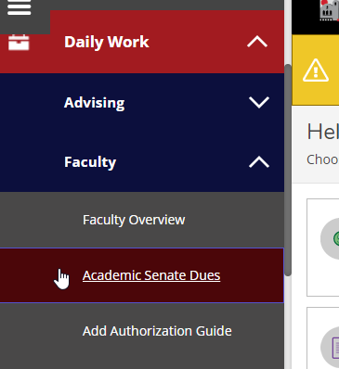
Dues (Dynamic Forms) Update
Now live! Email sent out yesterday to all faculty with this information. Hooray!
*Please excuse the typos on it... Got a little comma happy (lol).

Slide 5
Awards for Excellence Updates
All paperwork submitted for nominees who have accepted.
Task Force will convene on Friday.
All in order and on time so far.

Slide 6
Water Bottles

