Slide 1

President’s Report
Board of Trustee's Meeting – March 26, 2024
New Student Trustee – Kathryn Quick (SCC)
Board Legislative Committee – Assembly Bill 1818: Public Postsecondary Education: Homeless Students: Parking
Student Senate CA Community Colleges, SAC and SCC ASG support bill, BOT vote did not pass to support: oppose unless additional resources provided by State
Next BOT meeting – April 15th at SAC
Notes:
AB 1818 would require each campus of the California State University and the California Community Colleges, and would request the University of California, to allow overnight parking by a student attending its campus if the student uses the vehicle as housing, the student has a valid parking permit issued by the campus, and the vehicle is parked in or on a campus-owned and controlled parking lot or parking structure.
The bill would additionally prohibit each campus of the California State University and the California Community Colleges from citing or otherwise penalizing, and would request each campus of the University of California to not cite or otherwise penalize, a student attending its campus for using a vehicle as housing if specified circumstances apply.
This assembly bill has been referred to the Assembly Higher Education Committee and is currently awaiting a hearing date.

Slide 2
President’s Report
Senate Resolution S2024.01 Update
Increase Response and Support from Facilities and Maintenance and Operations team
Presented to College Council on Wednesday, March 13
Dr. Nery requested it be added to Facilities and Safety agenda for March 19th meeting
Dr. Nery provided updates on action taken on several issues of concern
H-bldg: Fall 2024 classes can be held on first floor (unless a student requests otherwise)
C-bldg: Walk-through conducted with numerous concerns identified. Some to be addressed but ultimately, building will have to be demolished. President’s Cabinet walk-through during Spring Break.

Slide 3
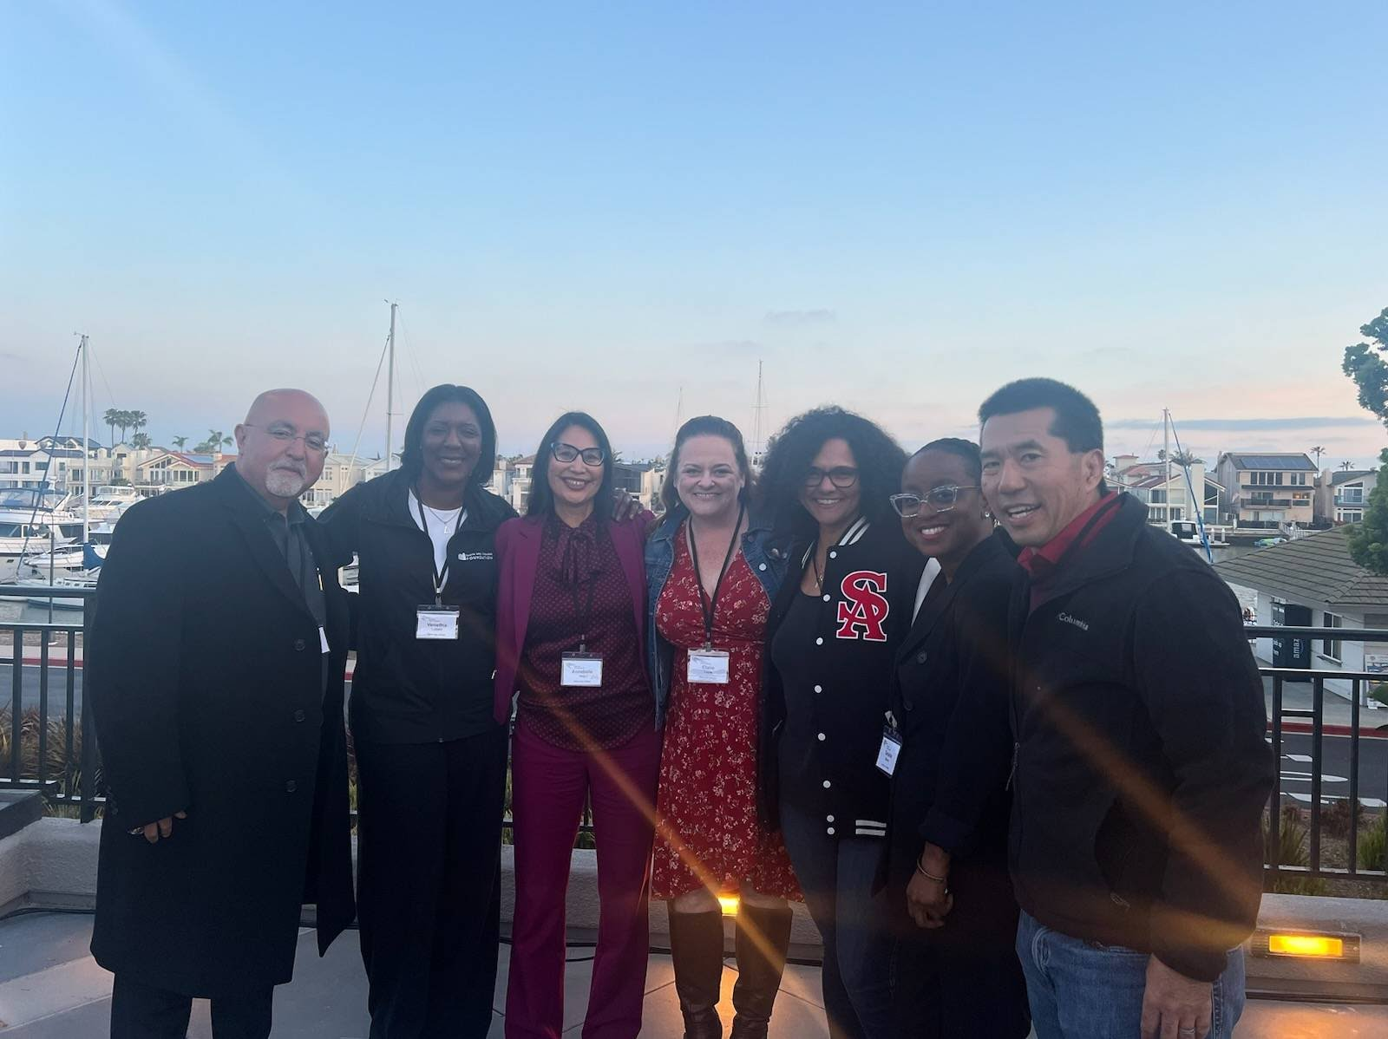
President’s Report
CAGP Institute #6: Creating Sustainability and
Charting the Path Forward
Some take-aways...with more to come...
Convening of Committee Chairs/Co-Chairs –
Are we duplicating efforts?
What resources do you have available to meet goals?
Data Committee with Faculty Data Liaisons for Each Division and a Data Summit!
Bring in and Engage Classified Professionals - Acknowledge Contributions
Integrating Starfish with Canvas
Auto Flags/Kudo
Milestone Events for Students

Slide 4
President’s Report
Faculty Prioritization Process Review/Update
Tentative Timeline
March 2024
Meeting with VPs and Assoc Dean Research, Institutional Effectiveness and Planning – Review Process from Fall 2023, Initial Recommendations for Update
Share feedback with those faculty interested in serving on Taskforce, Request recommendation from faculty on next steps
Survey faculty to get an idea of which areas are likely to be submitting a faculty request in the Fall
April & May 2024: 2-3 meetings of Taskforce to provide direction for work of Senate President over the Summer
August 2024
Senate Retreat: Presentation of Updated Process
1st Senate Meeting: 1st Reading
September 2024
2nd Senate Meeting: 2nd Reading (if needed)
Mid-September: Training
October 2024 Submissions and Ranking

Slide 5
Feedback Requests…
Lock Down Drill – Any problems locking doors, door lock malfunctions, you don’t have a key, there is no locking mechanism or any other concerns/issues –
Email Chief David Waters at waters_david@rsccd.edu
Educational Master Plan – Feedback due by Monday, April 15 (email sent out March 19th)
Committee Assessment – Academic Senate: 26 questions due by Friday, April 5 (email sent March 22nd)
Participatory Governance Committee Co-Chairs: send an email of interest to AcademicSenate@sac.edu by April 19th
Planning and Budget Co-Chair
Facilities and Safety Co-Chair

