Slide 1

Calculating and Understanding FTES & Productivity
June 1, 2018 IEPI SEM Academy

Slide 2
CALCULATING FTES

Slide 3
Q: How is Apportionment Revenue allocated?
A: On the basis of Full-time Equivalent Students (FTES) in attendance, as reported to the Chancellor’s Office on the CCFS-
320 Report three times each year.

Slide 4
Full-Time Equivalent Student
1 FTES =
1 student
15 hours per week
2 semesters of 17.5 weeks
(3 quarters of 17.5 weeks)
= 525 contact hours

Slide 5
Sources of Authority
California Legislature
Education Code
Board of Governors of the California Community Colleges
Title 5 of the California Code of Regulations

Slide 6
Attendance Accounting Methods
Weekly Student Contact Hour
Daily Student Contact Hour
Actual Hours of Attendance (Positive Attendance)
Alternative Attendance Accounting Method (Independent Study/Work Experience)
Noncredit Distance Education

Slide 7
Weekly Student Contact Hour
Primary terms only
Course coterminous with primary term
Must meet regularly every week of the term
Same number of contact hours each week including TBA hours
No deductions for holidays

Slide 8
Census Week
The week nearest to 20% of the number of weeks in the primary term
Census date is Monday of census week
If that Monday is a holiday, census date is the following day

Slide 9
Term Length Multiplier
Number of weeks in primary term with at least three days of instruction and/or examination
The term length multiplier for each college is set by the CCC Chancellor’s Office based on the college’s academic calendar
Maximum TLM:
17.5 for semesters
16.6 for compressed calendar at SAC
11.67 for quarters

Slide 10
Compressed Calendars (SAC)
Typical 3-unit course:
48-54 contact hours scheduled at 52.5 hours
54 hours/17.5 weeks = 3 hours per week
(more weeks, less time per class)
54 hours/16.6 weeks= 3.2 hours per week
(fewer weeks, more time per class)

Slide 11
FTES Calculation (WSCH)
Multiply Census Week WSCH by the TLM and divide by 525
FTES = (CWSCH x TLM) / 525
Class meets 3 hours/week
35 students enrolled on Census Day TLM = 17.5
Example:
FTES = (3 x 35 x 17.5) / 525 = 3.50
FTES = (3.2 x 35 x 16.6)/ 525 = 3.54

Slide 12
Daily Student Contact Hour
Course meets five or more days
Meets the same number of hours on each scheduled day, including any TBA hours
NOT coterminous with primary term
No hours counted for holidays

Slide 13
Census Day
The day of the class meeting that is nearest 20% of the number of days the course is scheduled to meet
When the census day falls on the first day the class meets, census is taken on the second day.

Slide 14
Course Length Multiplier
Number of days the course is scheduled to meet (CLM)

Slide 15
FTES Calculation (DSCH)
Multiply Census Day DSCH by the Course Length Multiplier and divide by 525
FTES = (CDSCH x CLM) / 525
Example:
Course meets 2 hours per day
35 students enrolled on Census Day Course meets on 24 days
FTES = (2 x 35 x 24) / 525 = 3.2

Slide 16
Positive Attendance
Based on actual count of enrolled students
present at each class meeting
Courses meeting fewer than five days
Courses irregularly scheduled with respect to the number of days per week or the number of hours on scheduled days
All noncredit courses

Slide 17
FTES Calculation (PA)
Divide total hours of actual attendance by 525
FTES = PAH / 525

Slide 18
Maximizing FTES for Traditional (Face-to-Face) Classes
Best:
Second Best: Worst:
Weekly Census Daily Census
Positive Attendance

Slide 19
Alternative Attendance Accounting Method
(Independent Study/Work Experience)
WSCH method for courses coterminous with primary term
DSCH method for all other courses

Slide 20
Productivity and Efficiency Metrics
Resources Needed to “Produce” FTES:
Facilities (Classrooms)
FTES Capacity (Potential FTES)
FTES Per Room/Section/Faculty
Fill Rates Per Room/Section/Faculty
Faculty
FTES Per FTEF
WSCH Per FTEF

Slide 21
Productivity
FTES = OUTPUT = WORKLOAD = REVENUE
Potential FTES: Amount of FTES if all classrooms scheduled at their capacity
Target FTES: Amount of FTES the college needs to reach to achieve base plus growth
Actual FTES: Amount of FTES attained by a college in a term

Slide 22
I. FTES Productivity & Capacity
Potential FTES: Online and Classrooms.
Online Capacity: Limited By Availability of LMS-proficient Faculty. Online Important But Is Not the Focus of Today’s Discussion.
Lecture and Laboratory Classroom Capacity: Determined By Seats/stations In Laboratory and Lecture Classrooms and How Efficiently They Are Used.

Slide 23
Target FTES
Should Be Data-based and Established in Advance
Statewide Norm Used for Budgeting: 35 students per 3- hour section or 3.5 FTES per 3-hour section, 4.7 FTES per 4-hour section, etc.
35 Is An Average for a College, NOT a Universal Section Cap
Sections Enrolling “Under-35” Need the “Over-35” Seat Classrooms To Offset Their Smaller Size
Courses needing smaller class sizes due to pedagogical, safety, contractual, or other reasons should be assigned to classrooms of the same size whenever possible

Slide 24
Actual FTES & Fill Rates
Room Fill Rate: Actual Enrollment ÷ Room Capacity
Section Fill Rate: Actual Enrollment ÷ Section Cap or Limit
Optimal Efficiency: Assigning Sections To Rooms That Have Capacities Equal to the Section Caps

Slide 25
Efficiency
Efficiency is attained when resources (classrooms & faculty assignments) are allocated to their most productive uses.
Examples:
Block Scheduling Practices are followed
Section caps match classroom capacities
Quality and Pedagogical Goals Are Considered
Sections offered (supply) matches sections needed (demand by students)
Over-scheduling and Under-scheduling Are Minimized

Slide 26
Inefficiency
Inefficiency occurs when resources are not being used to their
full potential
Examples:
Section caps have been set lower than classroom capacities
Too many course sections offered relative to number needed (over-scheduling)
Too few course sections offered relative to number needed (under-scheduling)
Scheduling too many courses that fulfill the same General Education requirement or in the same time block

Slide 27
Why Inefficiency Is Undesirable
Costs-per-section Are Pushed Upward, thus denying other programs budget support
Student Access Suffers When Too Few Needed Course Sections Are Being Offered
Student Completion and Success Suffer When Needed Sections Not Available Or Offered

Slide 28
Enrollment Target At 35/Section
What’s Needed To Reach An Enrollment Target of 35 Students Per Section
A Sufficient Number of Classrooms Larger Than 35 to Pull Up the “Under-35s”
Sufficient Student Demand
A Sufficient Number (Supply) of Sections That Students Demand
Section Caps That Match Room Capacities and Pedagogical Needs

Slide 29
The Average of 35 Will Fall If….
More Under-35 sections Get Scheduled relative to Over-35s
Over-35s Cannot Fill Sections (student demand shifts)
Number of Over-35s Scheduled Declines
Sections are not filling at rates of 90%+ generally (overscheduling)

Slide 30
II. Utilizing Faculty Resources
Two ratios are used to Track Faculty Productivity
FTES/FTEF
WSCH/FTEF
FTES = (WCH x N x TLM)/525 WSCH = WCH x N
FTEF = 15 WCH aka LHE
1 (3 unit) CLASS = 0.20 FTEF
Faculty Cannot Generate More FTES Than Their Room’s Capacity—Set Targets Accordingly

Slide 31
FTES, WSCH CROSSWALK
N = No. Enrolled | WSCH* | FTES** | FTEF | FTES ÷ FTEF*** | WSCH ÷ FTEF***
20 | 60 | 2.0 | .2 | 10.0 | 300
25 | 75 | 2.5 | .2 | 12.5 | 375
30 | 90 | 3.0 | .2 | 15.0 | 450
35 | 105 | 3.5 | .2 | 17.5 | 525
40 | 120 | 4.0 | .2 | 20.0 | 600
45 | 135 | 4.5 | .2 | 22.5 | 675
*WSCH = WCH x N = 3 x 20 = 60 for 20 students enrolled. **FTES = (WCH x N x TLM) ÷ 525 = (3 x 20 x 17.5) ÷ 525 = 1,050 ÷ 525 = 2.0 FTES. ***FTEF (full-time equivalent faculty) for one 3-hour class is 0.20 (one-fifth) of a faculty’s semester load. Dividing by one-fifth is the same as multiplying by 5.

Slide 32
Keeping Productivity High
Productivity approaches its capacity whenever section caps match room capacity.
Block Scheduling Structure (e.g. MW 8-9:15 a.m., 7:30-9:20 a.m., 9:30-10:45 a.m., etc.) Enhances Student Access (FTES Productivity)
Reallocation of Classrooms to Reflect Student Demand Enhances Student Access.
Allocating Classrooms by Term and by Time Blocks/Modules Enhances Productivity

Slide 33
Wrapping Up
Creating a Culture of Quality with Efficiency
promotes sustainable financial health.
FTES Targets are affected by classroom capacity and pedagogical needs.
WSCH/FTEF and FTES/FTEF Targets are affected by classroom capacity and pedagogical needs.
Over-35 Classrooms are needed to hit a
college’s Target 3.5 FTES per section average.

Slide 34
Building the Schedule

Slide 35
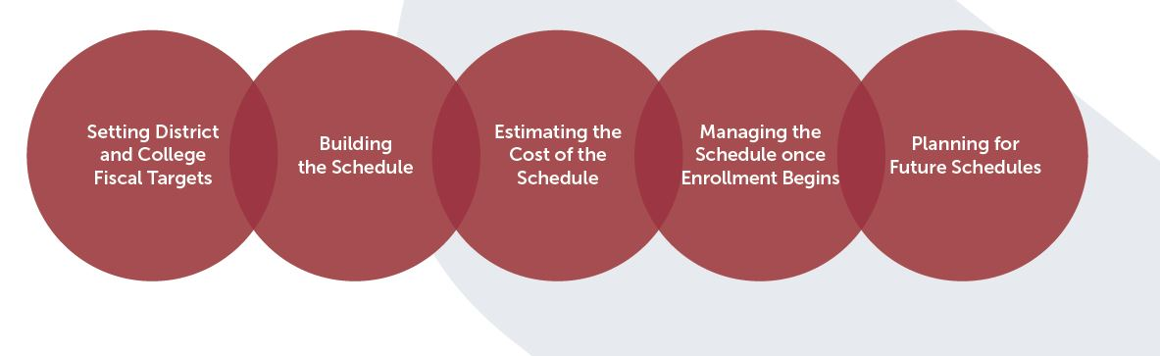
Considerations

Slide 36
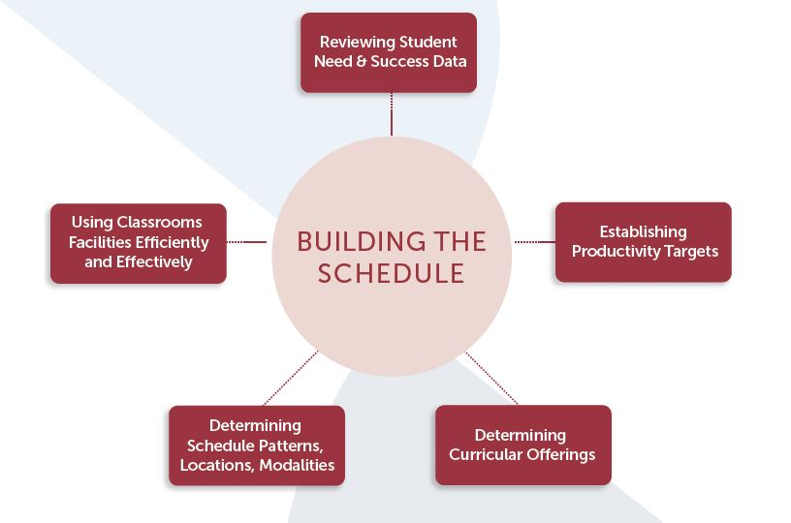

Slide 37
Scheduling Considerations
College Funding
SEM goals
Faculty Role
Completion
Serve Students
Overscheduling
Appropriate Pedagogy
Under-scheduling
Optimizes FTES Generation
Notes:
A balanced schedule of classes impacts college operations and SEM in multiple ways:
• The class schedule represents a collection of courses the college has assembled
to meet its mission and effectively serve students.
• Student attendance in classes generates the FTES: the primary source of
college funding.
• Faculty provide the instruction and facilitate the learning environment inside and
outside the classes. In addition, they recruit and retain students, fulfilling a critical
role in SEM.
• Overscheduling (e.g., offering too many sections, or not offering the right mix of
courses) leads to cancellations, which negatively impacts both students interested
in taking the courses and faculty who are assigned to teach the courses.
• Under-scheduling (e.g., offering too few sections or not the right mix of courses)
leads to student frustration in not being able take required courses, which
can have both short term and long term effects on their ability to reach their
educational goals.
• A well designed and balanced schedule considers the needs of students,
the appropriate pedagogy, and the required resources. It facilitates student
completion and is constructed in a way that optimizes FTES generation.
• When scheduling is done right, it also supports the college in meeting
its SEM goals.

Slide 38
Potential Data Points
Enrollment trends
Regulatory and/or operational changes
Wait list data
Student retention
Student persistence
Student success
General education pattern offerings
Student Educational Plan data
Notes:
Before beginning the scheduling process, the CIO, deans, and researchers need to analyze past schedule performance and student success indicators.Some key performance metrics are:
Enrollment trends and fill rates (number enrolled to available seats expressed as a percentage) in courses
Wait list data, including attempts to enroll in class sections that were full
FTES earned by section and/or department
Regulatory and/or operational changes that may affect enrollment patterns
Student retention, persistence, and success rates by course/discipline
CSU and UC general education pattern offerings
Student educational plan data

Slide 39
Example
10 sections of History 1
Agreed-upon maximum is 45 students= capacity of 450 students served.
Average of 15 students= 150 students served
150 students would fill 4 sections (capacity of 180)
Reallocate 6 sections
Exceptions?

Slide 40
Enrollment Data – by Modality
Follow the Students
INSERT EXAMPLE GRAPH

Slide 41
Successes
Online Degree Program
Short-Term/Fast Track
Block Scheduling
Dual Enrollment
Bottleneck Study:
English and Math Completion: Summer “Boot Camp”
Impact Transfer Rates: How many students are within 80% of complete? What classes do they need?

Slide 42
Goal
Build a two-year schedule using student education plan data at the section level

Slide 43
For Further Discussion
Determining Course Scheduling Patterns, Locations, And Modalities
Using College Classroom Facilities Efficiently and Effectively
Estimating the Cost of the Schedule
Managing the Schedule Once Enrollment Begins
Planning for Future Schedules

