Slide 1
VP of Community Operations
March 12, 2024

Slide 2
Bylaws Task Force
Had our first meeting last week.
Will meet again this Friday.
Have proposed to present proposed amendments on April 23rd with possible final reading on 5/14 and 5/28, if needed.

Slide 3
Save the Date: Distinguished Faculty Lecture
Unlocking Worlds: An Exploration of Our Personal Mathematical Languages
When: Wednesday, March 20, 2024
Time: 2:00 p.m. to 3:30 p.m.
Location: Phillips Hall
Reception to follow in the C Building Foyer and Arts Gallery
Courtesy of SAC's Academic Senate
*Register in the PD Gateway for Flex Credit

Slide 5
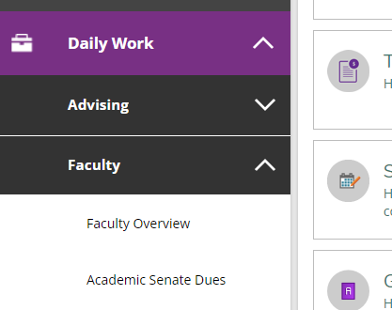
Dues (Dynamic Forms) Update
SAC and SCC Ready to Go:)

Slide 6
Awards for Excellence Updates
Nomination emails have gone out
Task Force has convened & Canvas shells have been created for each Award for nominees to submit paperwork
Nomination acceptance due date – 3/18/2024
All in order and on time so far.

Slide 8
Water Bottles

