Slide 1

Land Acknowledgement Accountability
Presented by Annie Knight & Merari Weber
IRSJ Representatives
Notes:
Annie

Slide 2

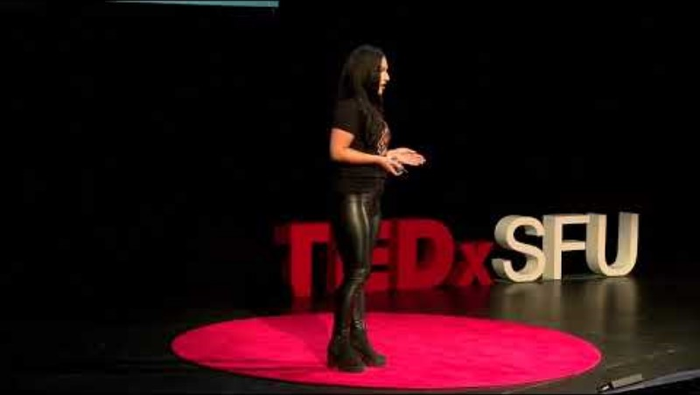
Selecting visual aids
Decolonization is for Everyone
Decolonization is for everyone
Nikki Sanchez – TEDx SFU
Notes:
Annie

Slide 3
A commitment to action
As an IRSJ advisory committee, we recommend pausing land acknowledgement readings until an action plan is developed for our campus with firmer commitments to reparations so as not to cause further harm to those most impacted.
Notes:
Merari

Slide 4
A commitment to action
Taking this semester IRSJ goals for supporting this work and developing an action plan.
  Including inviting local experts to join campus planning efforts and ask that senators reach out to their contacts, including compensating the emotional labor of experts who become involved with this initiative.
Notes:
Annie

Slide 5

Seeking Campus and Community Input
Faculty, students, staff, and local experts invited to provide input on action plan.
  Please share access to this collaborative document with your SAC and community contacts for their input!
Land Acknowledgement Initiative Recap and Action Items (video presentation by Maria Aguilar Beltran)
Notes:
Merari

Slide 6
Resources
PBS The Conversation: Analysis: How well-meaning land acknowledgements can eras Indigenous people and sanitize history
Native Land Acknowledgments are not the same as land: This article explicitly addresses Southern California First Nation people and the growing practice of acknowledging Indigenous land ancestry as a positive change, ultimately, we need tribal stewardship to be the end goal.
Native Governance Center: Going Beyond Land Acknowledgements
Native Land Map: This tool is helpful to identity the tribal nations that currently and historically occupied the lands in which conservation work takes place: Native-Land.ca | Our home on native land
Notes:
Annie

Slide 7
Resources (Cont.)
Native Governance Center - A Guide to Indigenous Land Acknowledgement: This tool is helpful as a step by-step guide to being intentional about creating a land acknowledgment statement. Their blog and guide is available at: A guide to Indigenous land acknowledgment - Native Governance Center
LSPIRG: Creating Agents of Social Change - Know the Land: The LSPIRG (Laurier Students’ Public Interest Research Group) is a nonprofit organization that helps develop advocacy tools and avenues for action. Their land acknowledgement resource is a helpful tool to move beyond the acknowledgement: KNOW THE LAND — Laurier Students' Public Interest Research Group (lspirg.org)

Slide 8
Resources (Cont.)
U.S. Department of Arts and Culture - Honor Native Land: A Guide and Call to Land Acknowledgement: In consultation with Indigenous leaders throughout the country, this tool offers a downloadable guide and rationale for the practice of land acknowledgement:
Cross-Cultural Protocols in Rites of Passage: Guiding Principles, Themes and Inquiry – Youth Passageways
California Indian History (calindianhistory.org)
California Indian History – California Native American Heritage Commission
TED Talk-Nikki Sanchez: Decolonization is for Everyone
Fitchburg State University - Understanding Land and Labor Acknowledgements
Redbud Resource Group – Going Beyond Land Acknowledgements Resource Database

Slide 9

Thank you
Merari Weber
Weber_Merari@sac.edu
Annie Knight
Knight_Annie@sac.edu

