Slide 1
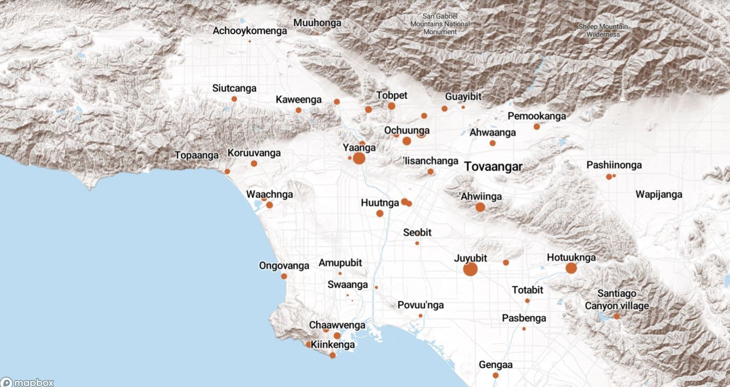
Land Acknowledgement
We acknowledge that the land on which Santa Ana College exists today is the ancestral land of the Tongva people, whose presence and resilience in Santa Ana continues to this day. We take this opportunity to honor the original caretakers of this land and recognize that histories of land theft, forced removal and assimilation, genocide, and erasure, and settler colonialism that have brought our institutions and ourselves here.
To acknowledge is not enough. This land acknowledgement is additionally a call to act, to consider our positionality and complicity in relations to these forces, and to engage in relationships and solidarity with the Tongva and other indigenous peoples.

Slide 2

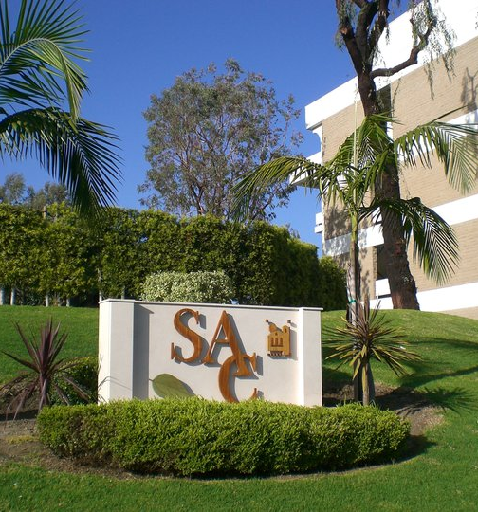
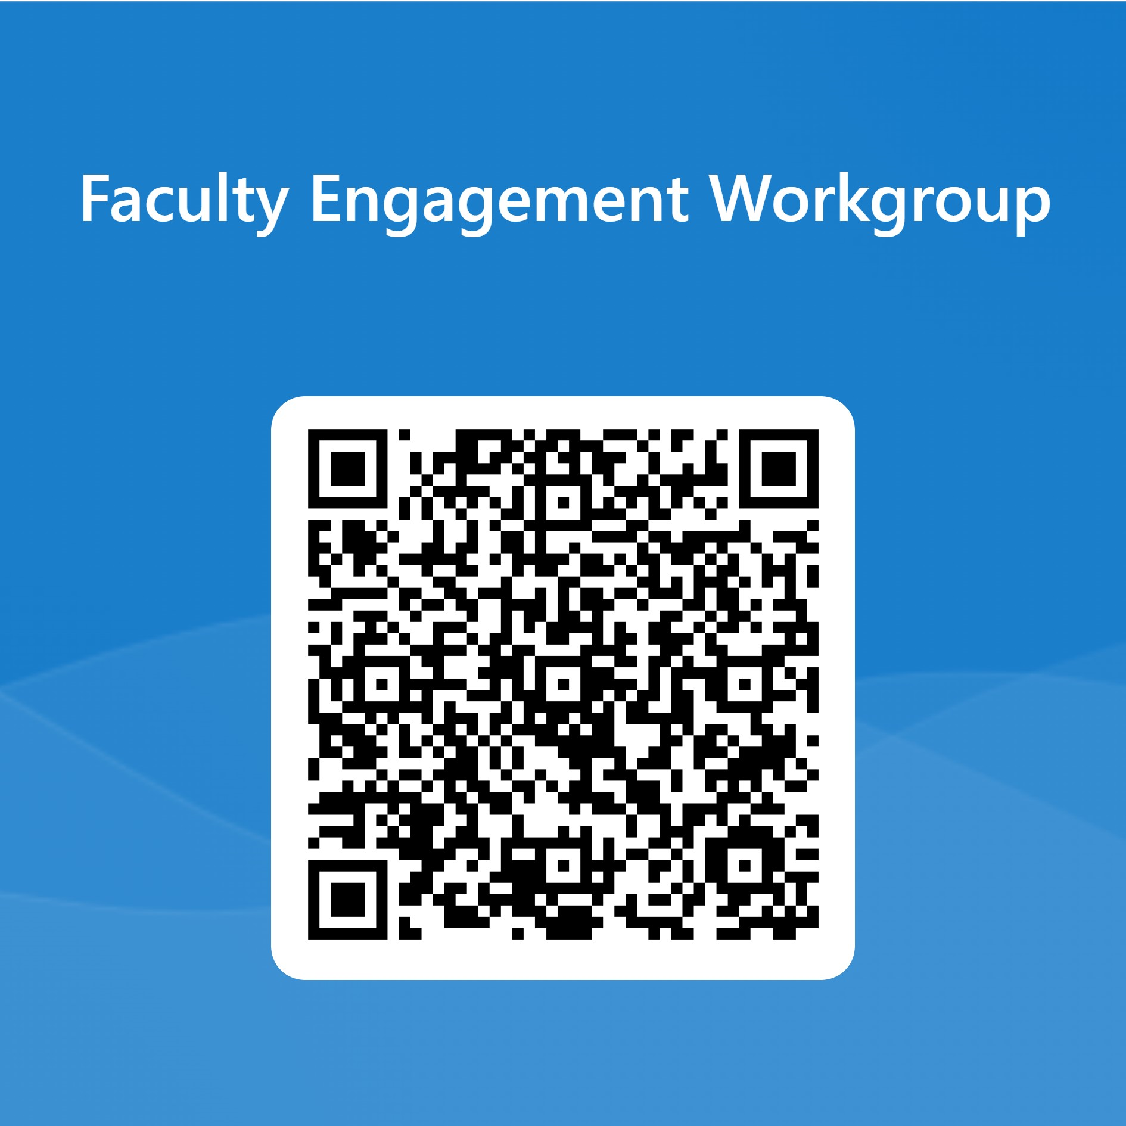
President’s Report
Local Senate Visit from ASCCC
First Meeting on Spring Semester: February 13
Institutional Effectiveness Partnership Initiative Grant through CA Chancellor’s Office intended to accelerate Innovation and Effectiveness Plan implementation.
  Objective: Encourage more full-time faculty participation in various College Planning activities
        Funding available for data/information gathering (survey?) and analyzing with recommendations for increasing faculty involvement (Sign up via QR Code, possibly a subgroup of Faculty Leadership and Engagement Workgroup)

Slide 3
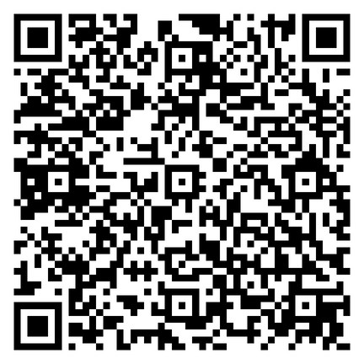
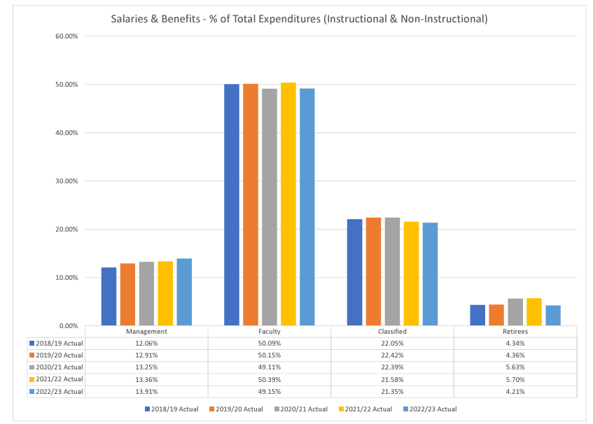
FRC (Fiscal Resources Committee – November 15)
uptrend in management, downtrend in faculty and classified
FRC Meeting Materials
Discussed FON
What counts what does not
How calculated
Prior to VC Ingram arrival, calculated by HR
From District: Fill all faculty vacancies and any long-term subs
More to come following P&B December meeting

Slide 4
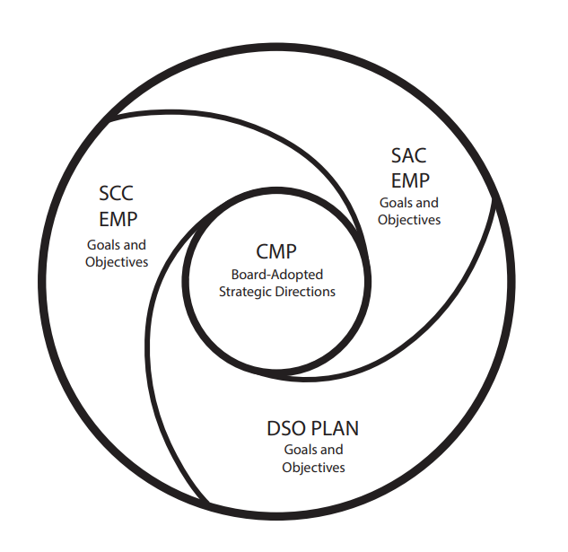
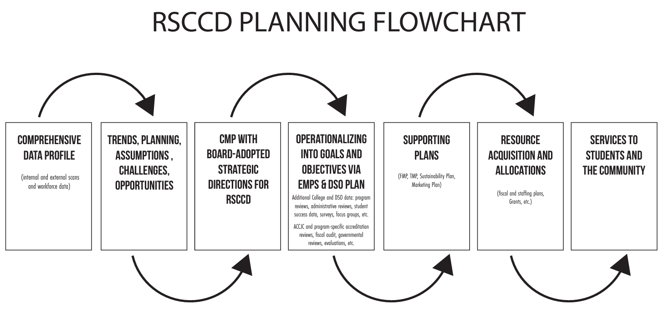
Planning and Organizational Effectiveness (POE) – November 15 (next meeting December 6)
Presentation by CBT (Collective Brain Trust)
EMP: Educational Master Plan (4-year cycle)
DSO Plan: District Services and Operations Plan (New; replaces 2-yr Planning Portfolios, 4-year cycle)
CMP: Comprehensive Master Plan (8-year cycle)
Feedback needed on Infographics; to be finalized in January

Slide 5
BOT – Next Meeting December 11
Bond presentation sent to all faculty
Access to audio recording of meetings
College Council – Next Meeting December 13
Faculty Opportunities:
Outcomes Assessment Faculty Coordinator - Vacant
Scholarship Committee Faculty Chair – Vacant

Slide 6
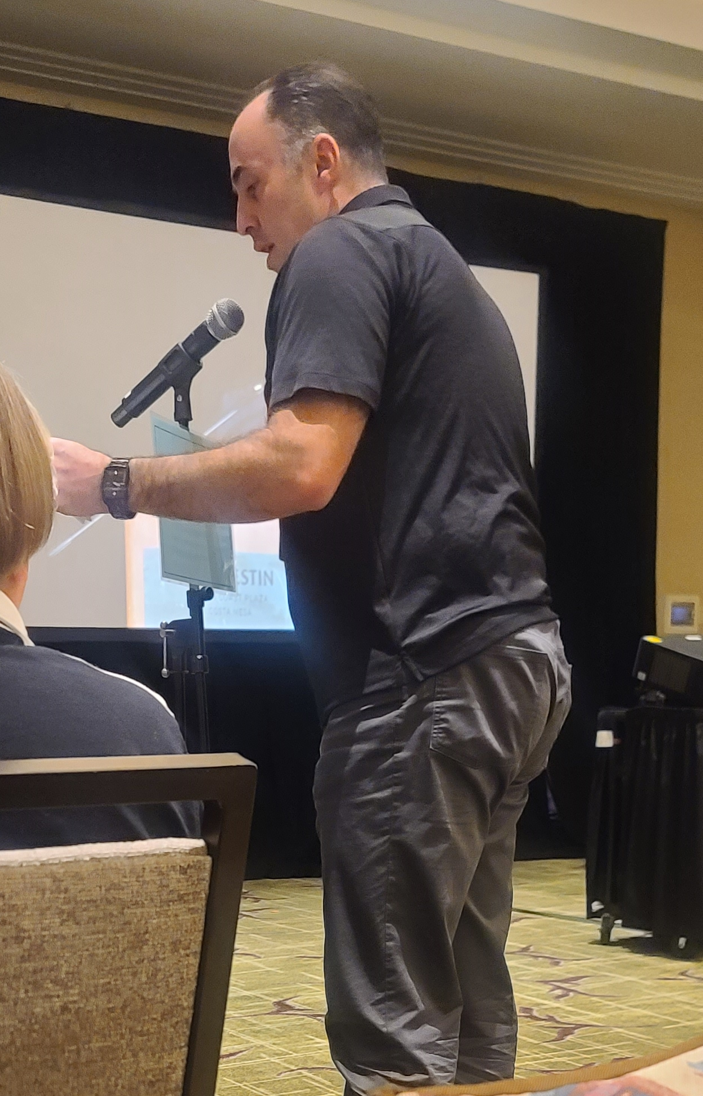
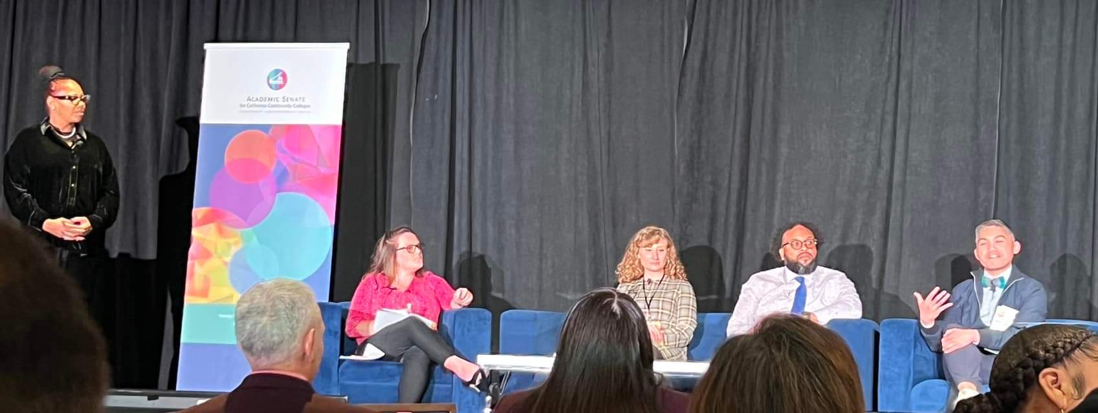
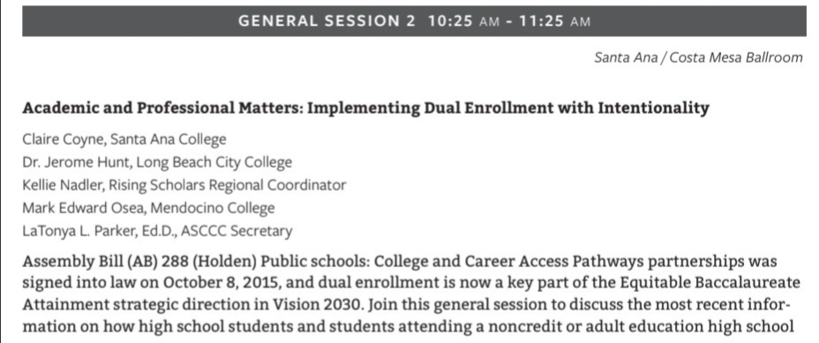
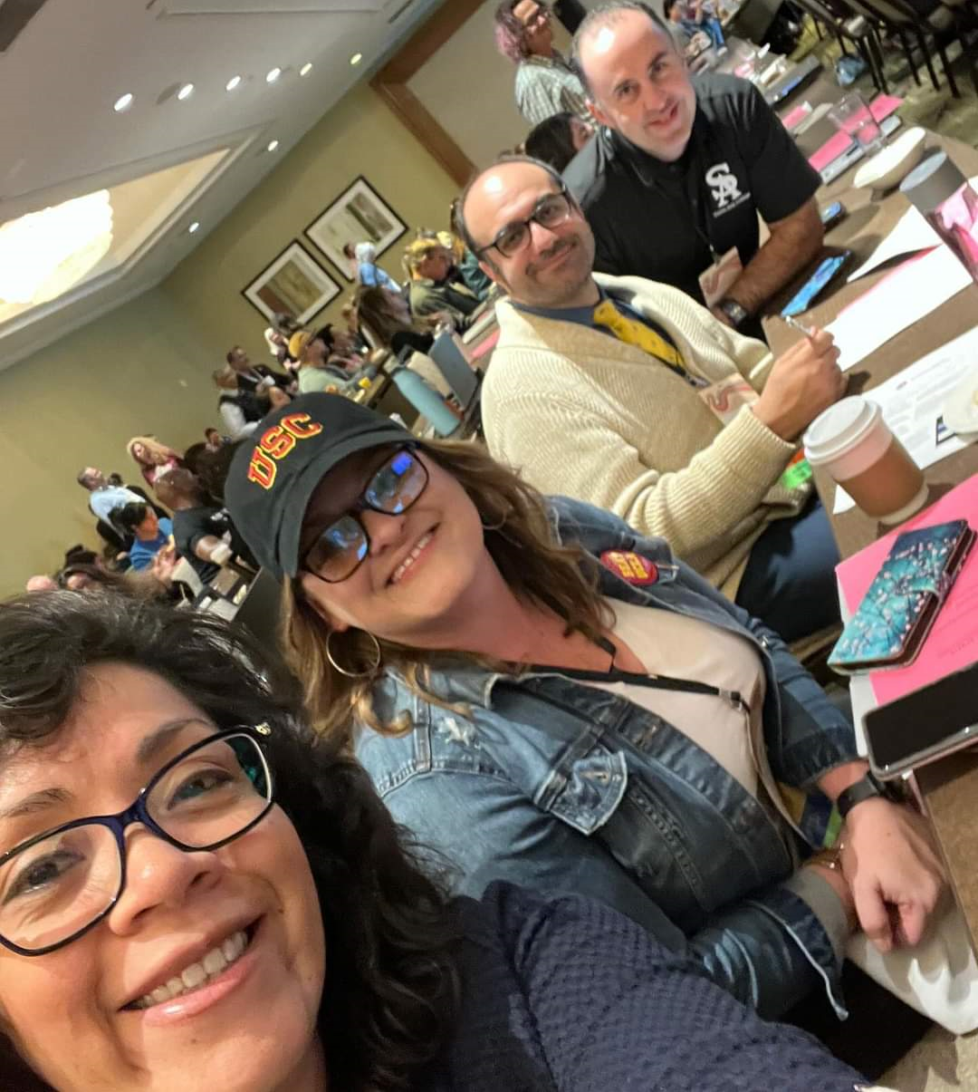
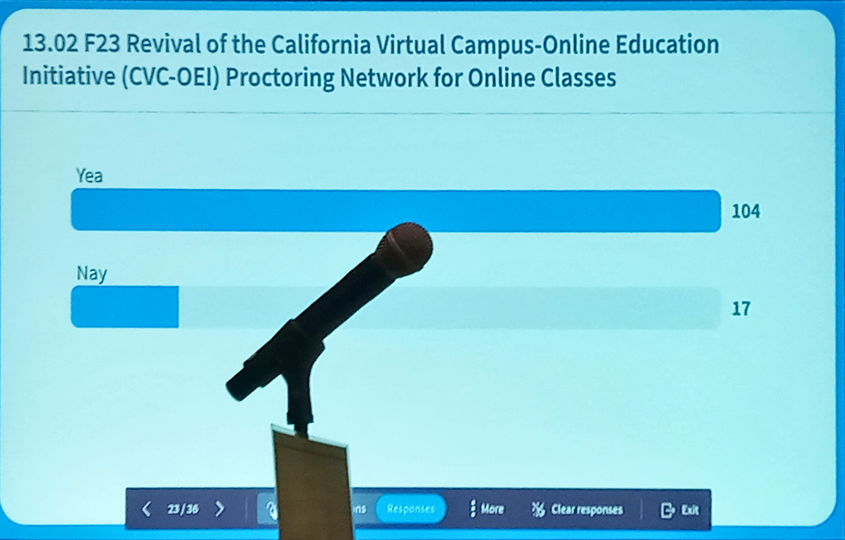
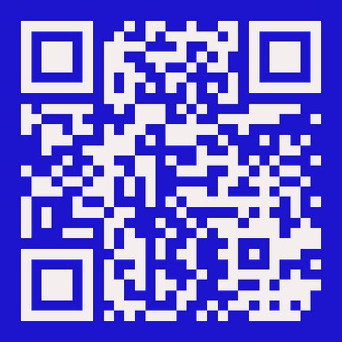
Fall Plenary 2023
Claire Coyne, President
Merari Weber, VP Community Operations
Alejandro Moreno, Parliamentarian
Reza Mirbeik, At-large Representative
Roy Shahbazian, Former AS President
Final Fall Resolutions
Merari submitted amendment to 09.02 F23 Support of an Equitable Course Prefix in Lieu of ESL

Slide 7

Congratulations, Dr. Merari Weber, you have been accepted into the mentee cohort of the 2023-2024 Faculty Empowerment Leadership Academy!
PROGRAM MISSION
TO CONNECT: Providing one-on-one mentoring to diverse faculty for personal and professional development with mentors who are campus leaders and/or administrators.
TO EMPOWER: Creating safe and brave spaces for courageous conversations to investigate equity, diversity, and inclusion; to share personal and collective experiences on race, privilege, and oppression; and to embolden new faculty leaders to advocate for transformative change on their campuses.
TO GUIDE: Providing networking opportunities and sharing guidance for navigating the systems of higher education. The focus of the mentoring will be to address the specific goals of the mentee.

Slide 8
Academic Freedom and Faculty Rights
Initial Proposed Language for an “Academic Freedom” component to be included within a proposed new “Faculty Rights”
Article to tentatively be added within the FARSCCD Contract
Review of AR 4030 Academic Freedom
Discussion/feedback during Senate Retreat Spring 2024

