Slide 1
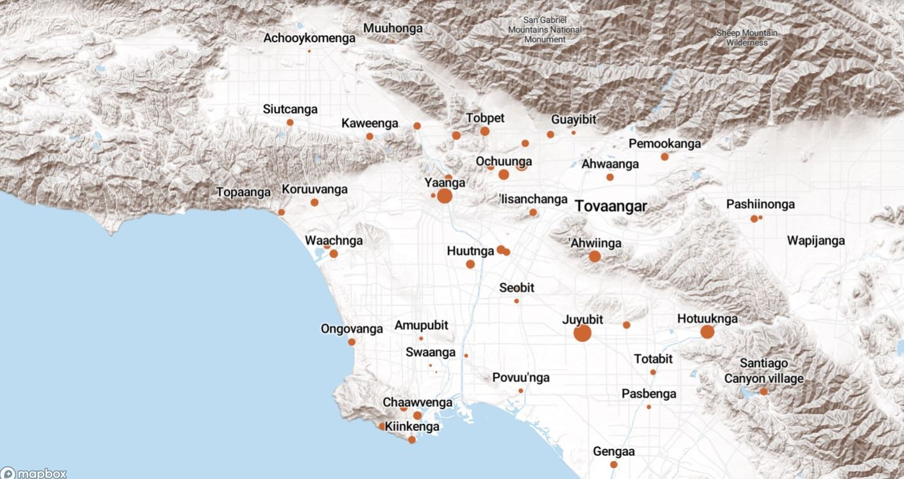
Land Acknowledgement
We acknowledge that the land on which Santa Ana College exists today is the ancestral land of the Tongva people, whose presence and resilience in Santa Ana continues to this day. We take this opportunity to honor the original caretakers of this land and recognize that histories of land theft, forced removal and assimilation, genocide, and erasure, and settler colonialism that have brought our institutions and ourselves here.
To acknowledge is not enough. This land acknowledgement is additionally a call to act, to consider our positionality and complicity in relations to these forces, and to engage in relationships and solidarity with the Tongva and other indigenous peoples.

Slide 2

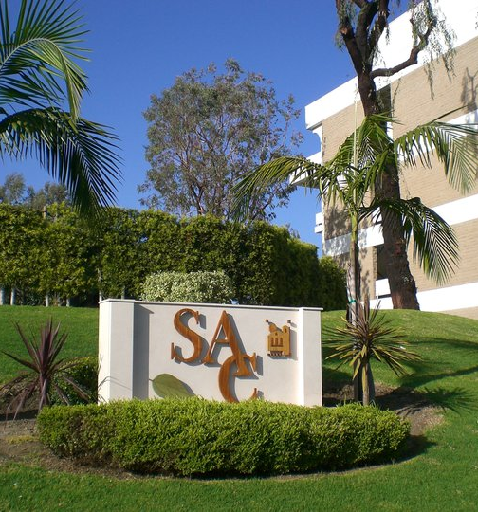
President’s Report
College Council – November 8
Reviewed District Planning Guide and Portfolios (program review)
  ITS – Jesse Gonzalez
  People and Culture: Alistair Winter
  Educational Services: Enrique Perez
Planning and Organizational Effectiveness (POE) – reviews requests for positions/reorganizations
November 15 3:30 – 5pm via zoom
    Review initial requests for ITS and Business Services for resource allocation 2024-2025

Slide 3
BOT Report
Bond for 2024 – No significant difference in support between SFID and District Wide
Santa Ana greater support now versus areas in Orange/Villa Park
Office of Diversity, Equity and Inclusion
Notice of Interest to Run for Board Positions
Phil Yarbrough: Clerk
Daisy Tong: VP
David Crockett: VP or Clerk
Sal Tinajero: President

Slide 4
Faculty Opportunities:
Outcomes Assessment Faculty Coordinator - Vacant
Scholarship Committee Faculty Chair – Vacant
Rancho Santiago Community College District (RSCCD) Police & Campus Safety Advisory Committee – Faculty Representative: Alejandro Moreno
Educational Masterplan Taskforce Faculty Representatives
CTE: Zachary Diamond and David Roper
GE: Zack Fish
Non-Credit: Donna Khalid and Merari Weber
Transfer: Leo Pastrana
Faculty Prioritization Process Taskforce – Survey coming soon!
Interested: Contact Claire

Slide 5
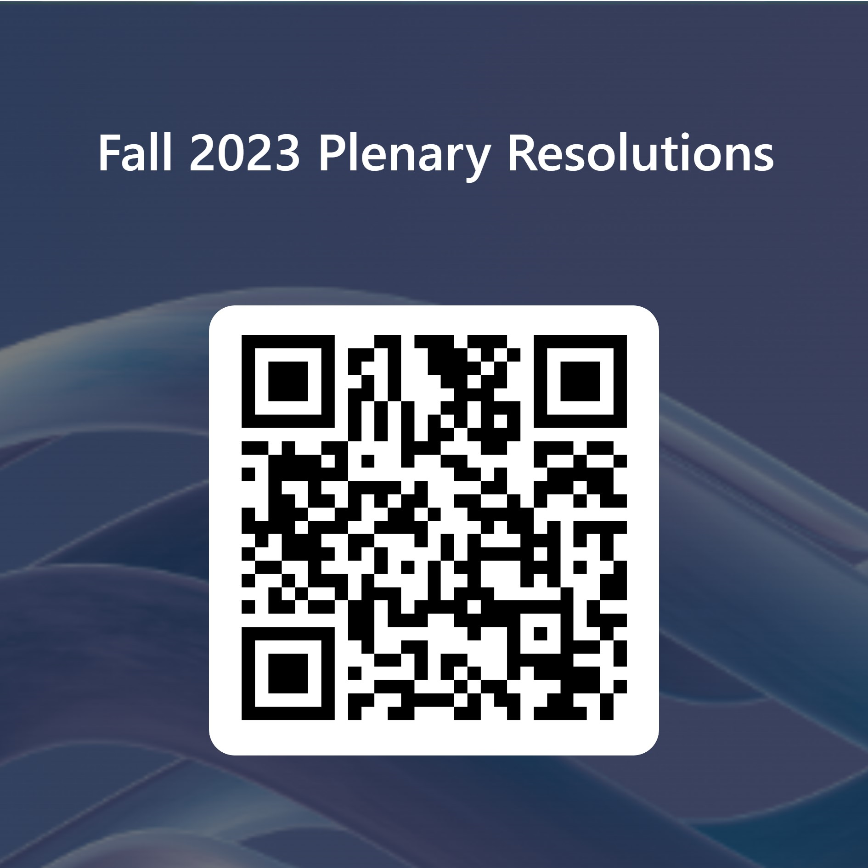
Plenary Resolutions – Please vote!

Slide 6
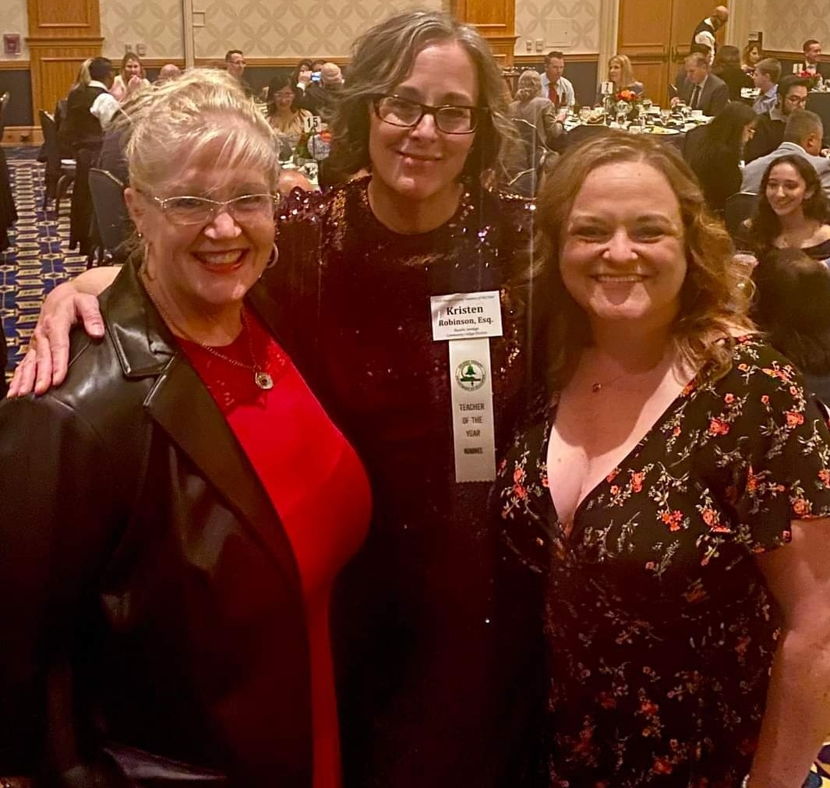
Kristen Robinson – 2023 OC Teacher
of the Year Nominee
Faculty Accolades and/or Announcements – Send to AcademicSenate@sac.edu

Slide 7
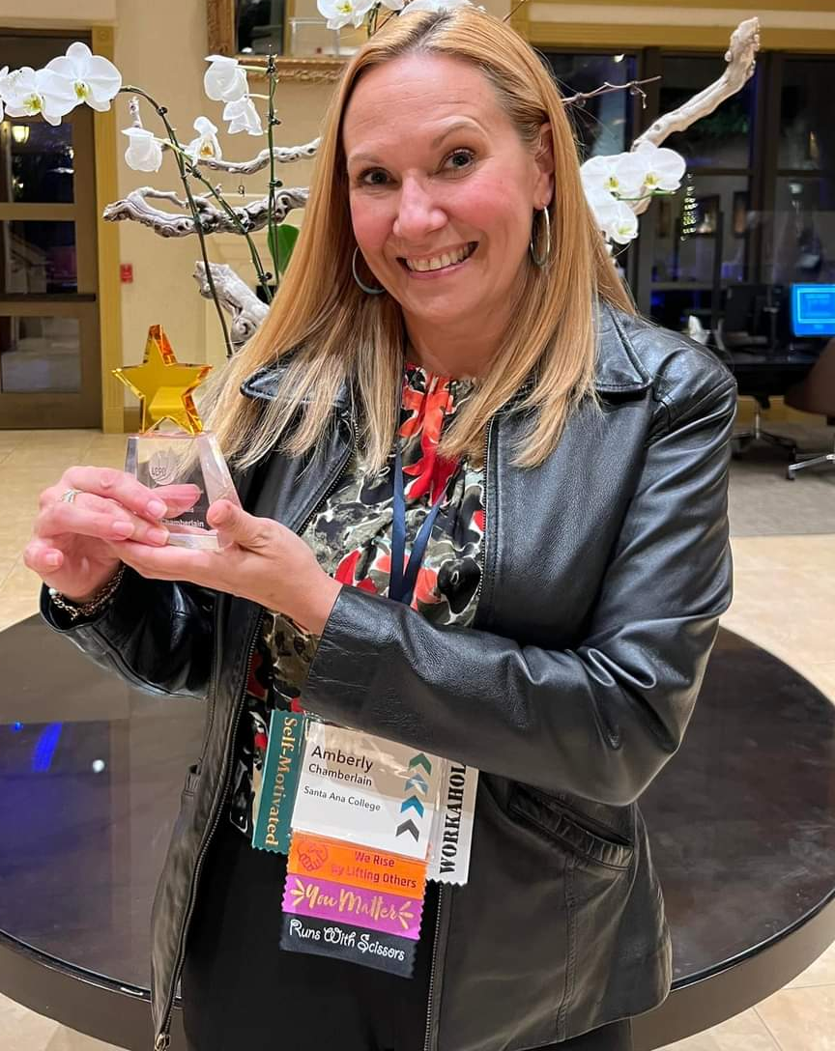
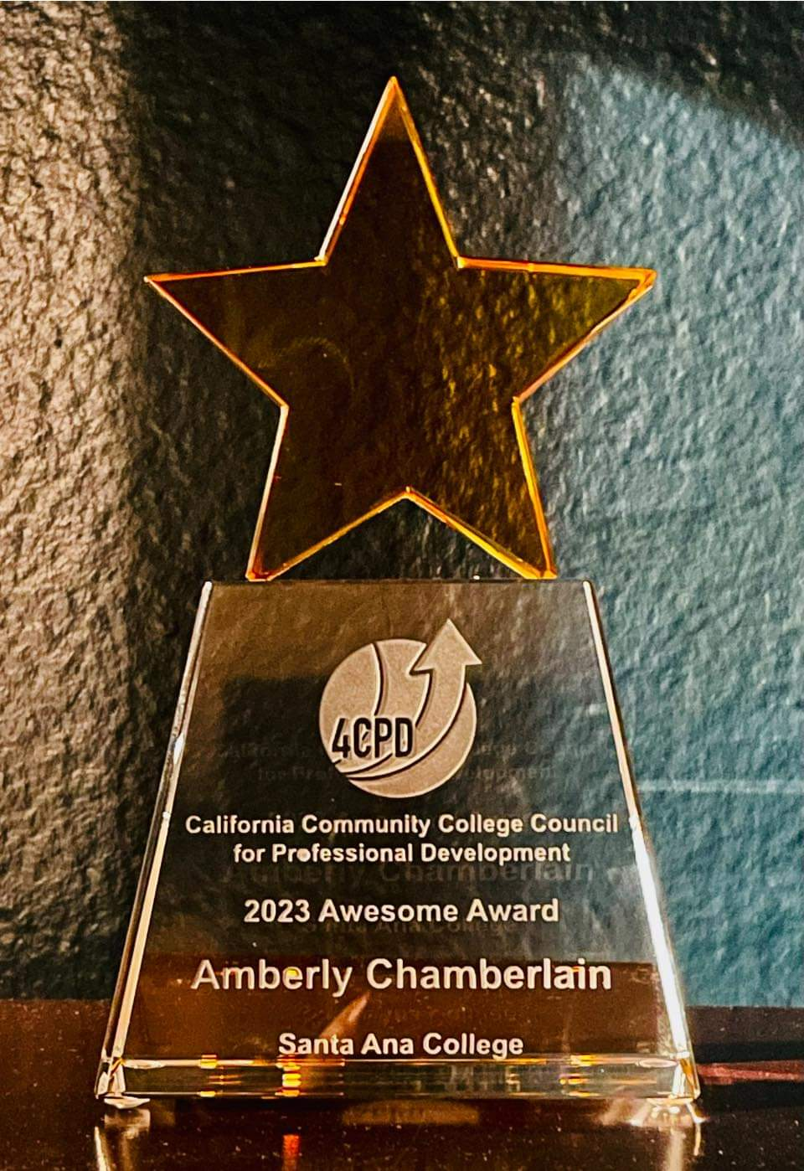
Amberly Chamberlain is AWESOME! 2023 CA Community College Council for Professional Development

Slide 9
Equivalencies
https://sac.edu/President/AcademicSenate/Pages/Equivalency-Information.aspx
Approved Equivalencies Form I are posted on the H-Drive (Public Folders/Academic Senate)

