Slide 1
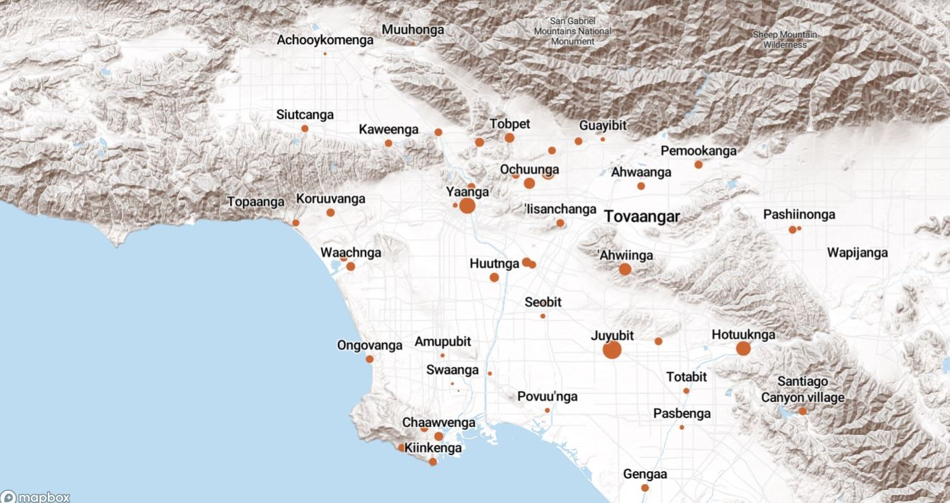
Land Acknowledgement
We acknowledge that the land on which Santa Ana College exists today is the ancestral land of the Tongva people, whose presence and resilience in Santa Ana continues to this day. We take this opportunity to honor the original caretakers of this land and recognize that histories of land theft, forced removal and assimilation, genocide, and erasure, and settler colonialism that have brought our institutions and ourselves here.
To acknowledge is not enough. This land acknowledgement is additionally a call to act, to consider our positionality and complicity in relations to these forces, and to engage in relationships and solidarity with the Tongva and other indigenous peoples.

Slide 2

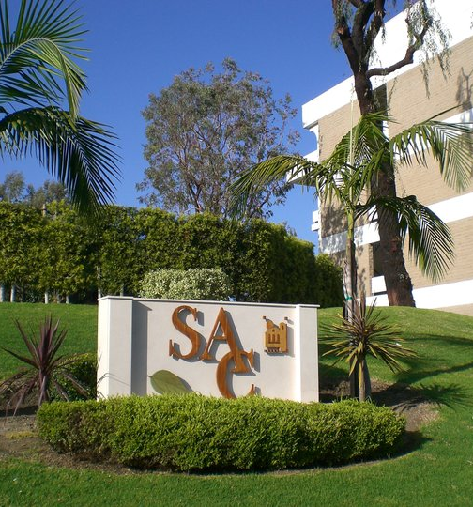
President’s Report
Math Center - Reorganization
  Concerns shared with President Nery and she will be attending an upcoming Department meeting
Fine & Performing Arts on October 13th
  Faculty to create new job description for Technical Director to be vetted by Administrators and CSEA
  Support for Assoc Dean and Ticket Booth
AA Reorg Meeting on October 13th
  Faculty to create job description for Dean to oversee new Division (Career Tech and Workforce Development?)
  No departments to move divisions at this time (other than Fashion Design and Merchandising)

Slide 3
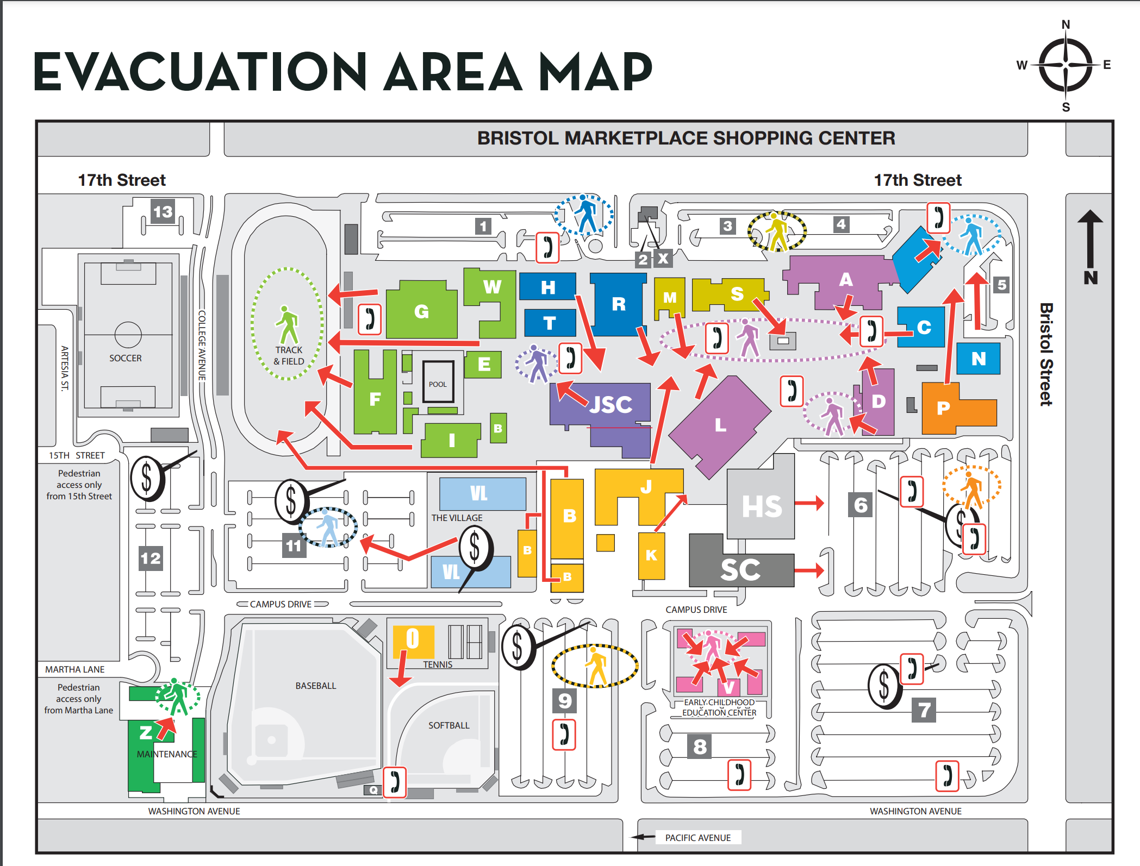
Campus Safety
Update to evacuation locations for Health Sciences and Science Center

Slide 4
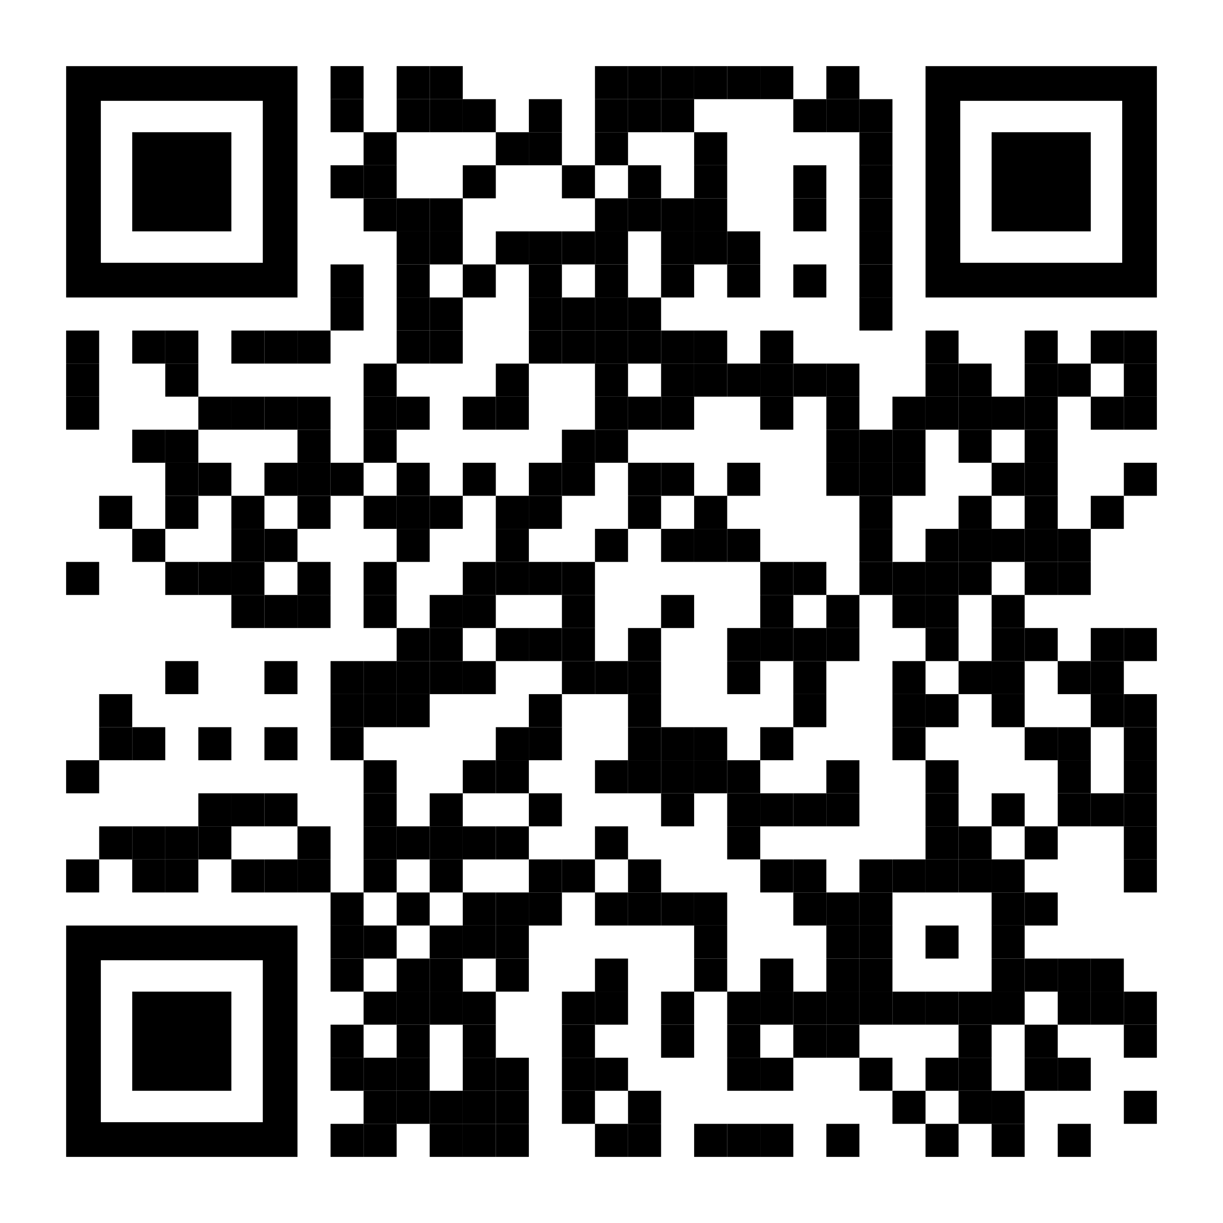
Faculty Coordinator Opportunities
  OER/ZTC
  Outcomes Assessment
  LETTER OF INTENT DUE BY 3PM FRIDAY, OCT 27
Scholarship Committee Faculty Chair

Slide 6
Rancho Santiago Community College District (RSCCD) Police & Campus Safety Advisory Committee
  promotes effective communication and collaboration between constituent groups and District Safety & Security Committee to maintain a positive campus relationship with regard to public safety issues and
  advises the District Safety & Security Department in promoting a culture of openness and transparency while supporting diversity, equity, and inclusion.
The charge of this Committee includes:
Establishing and supporting guidelines for effective community-oriented policing that is reflective of the RSCCD campus cultures.
Assisting the District Safety & Security Department with campus campaigns on emerging issues related to campus community safety and security.
Making recommendations regarding ongoing training for campus constituents on managing campus safety concerns.
Reviewing and making recommendations regarding the District Safety & Security policies, procedures, incidents, and training.
Senators seek input from Divisions
Provide Senate President with faculty recommendation by November 3rd
Senate Nomination due to District by November 10

Slide 7

Opportunities!
ZTC Acceleration Grant Funding
The Chancellor’s Office has funding to develop and implement Zero Cost Textbook program pathways for new and existing associate degrees or career technical education certificate programs. They are offering up to $200,000 per degree or certificate. Open Education Resources development funded through the grant will be permitted for free use and repurposing by others. Funding is limited to programs that have not yet been funded through the grant.
DE Office available for support – due November 1

Slide 8
Faculty Priorities Timeline – SAVE THE DATES
Friday, September 22 (via Zoom, invite to follow) Noon – 1:30pm
  Information Session – Department Chairs and Senior Senators
  Recording sent out this morning.
Faculty Request Submission through Canvas Due this Friday, October 13 by 11:59pm
Senior Senators Ranking Event via Zoom– Friday, October 20 11:30am – 3:30pm
Academic Senate Affirmation of Final Rankings – Tuesday, October 24

