Slide 1
Steering Committee Meeting
September 13, 2018

Slide 2
Guided Pathways Updates
CAGP Institute #4 – Sep. 6-8, focus on optimizing onboarding process and student support
Upcoming Conferences:
Growth Mindset & GP – Sep. to Nov.
RP Conference – Oct. 12-13
Webinar series – Sep. to Nov.

Slide 3
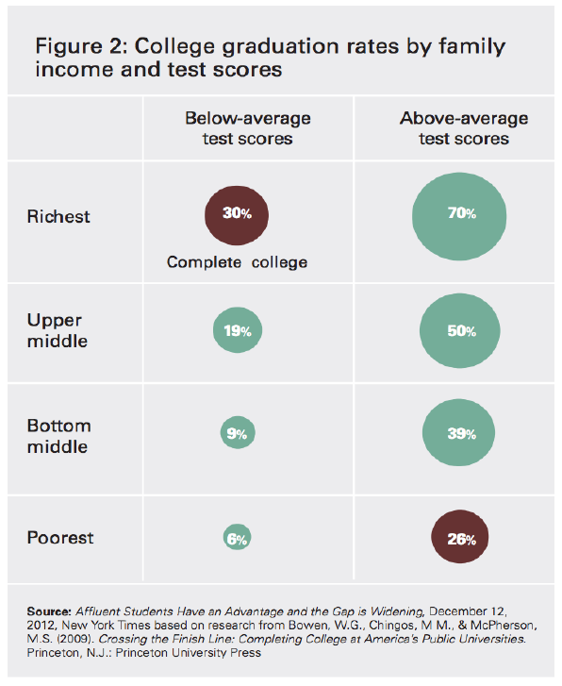
The Meritocracy Myth

Slide 4
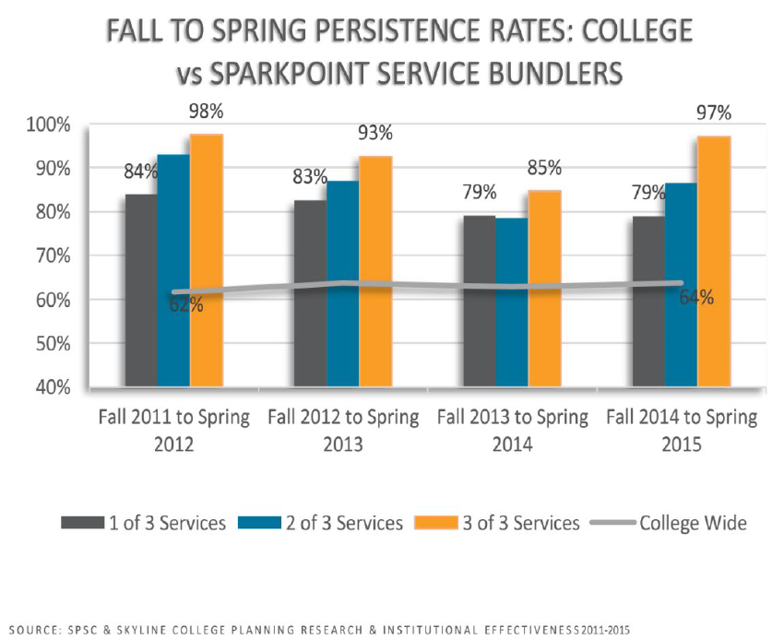
The Importance of Bundling Student Services

Slide 5
Guided Pathways Updates
SCC and RSCCD collaboration
District representation at GP Steering Committee meeting
GP Meeting with SCC on Oct. 5
AACC Scaling Institute on Nov. 28-29

Slide 6
Guided Pathways Updates
Bakersfield Site Visit – Nov. 13-14
Observe GP Implementation Team Meeting
Meet with GP Leadership to discuss:
Financially supporting GP
Evolution of implementation teams
Shifting from planning to implementation
IT Challenges
DT co-lead meetings with campus teams

Slide 7
Feedback from Program Mapping Session, N=7
“Great concept especially for saving the state monies and narrowing the chances that students will use their early college years to explore subjects and topics beyond their immediate interests. Will probably slowly kill small disciplines and departments, which will in turn save the state more taxpayer funds.”
“Great day working together for a common purpose!”
“It is better for our programs to show clear path”
“Challenging to collaborate due to the room’s layout and volume”
“All dept can assist”

Slide 8
Feedback from Program Mapping Session, N=7
“The gym was absolutely not conducive to a workshop. It was so loud we could not hear people at our table without shouting. I agree it was the right time, but it wasn't the right place.”
“I am completely on board with Guided Pathways and believe it will bring great benefits to our students. The objective of the activity was unclear and many of the faculty member I sat with were confused about what was being expected of them. Although, our group was able to complete the activity with the support of a counselor this activity could of been explained better. Perhaps this could of been explained while at the Phillips Hall instead of the gym where it was loud and hard to hear.”

Slide 9
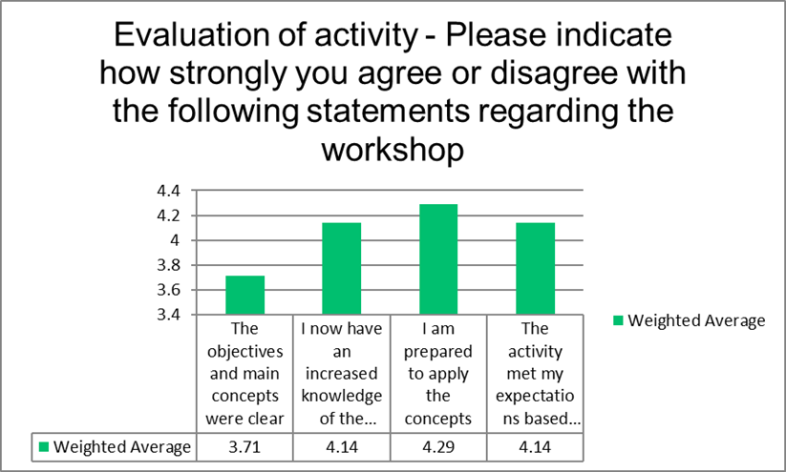
Feedback from Program Mapping Session, N=7

Slide 10
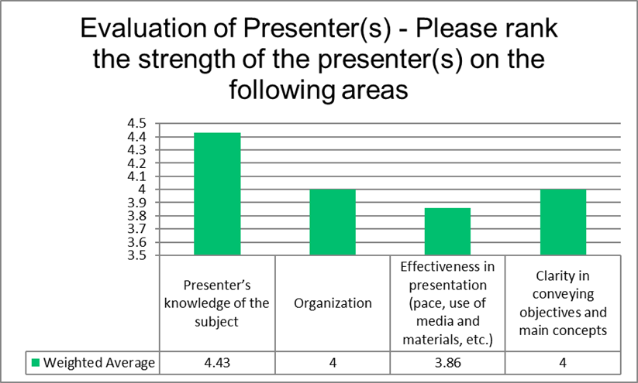
Feedback from Program Mapping Session, N=7

Slide 11
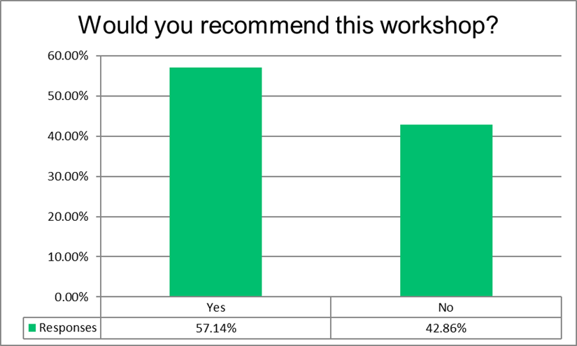
Feedback from Program Mapping Session, N=7

Slide 12
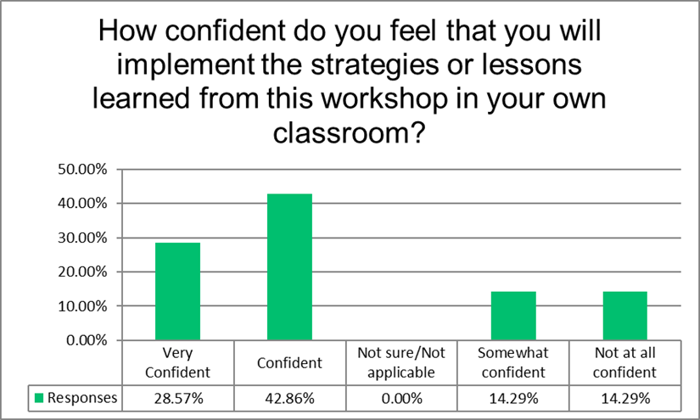
Feedback from Program Mapping Session, N=7

Slide 13
Design Teams
Academic
Clusters
Advising
Communi-cation
Guided Pathways Steering Committee
Mapping Curriculum
Entry
Student Support

Slide 14
Data and Assessment Team
Will work on finding relevant data to inform our Guided Pathways implementation. Will also work to gather data on effectiveness of our implementation team work and student success as we move toward implementation.

Slide 15
Guided Pathways Operating Model
Guided Pathways Steering Committee
Advising Implementation Team
Entry Implementation Team
Mapping Curriculum Implementation Team
Student Support
Implementation Team
Communication Team
Data & Assessment
Team

Slide 16
Power Mapping
Anchored by a clear goal
Map stakeholder groups
Map influential individuals
Plan action steps

Slide 17
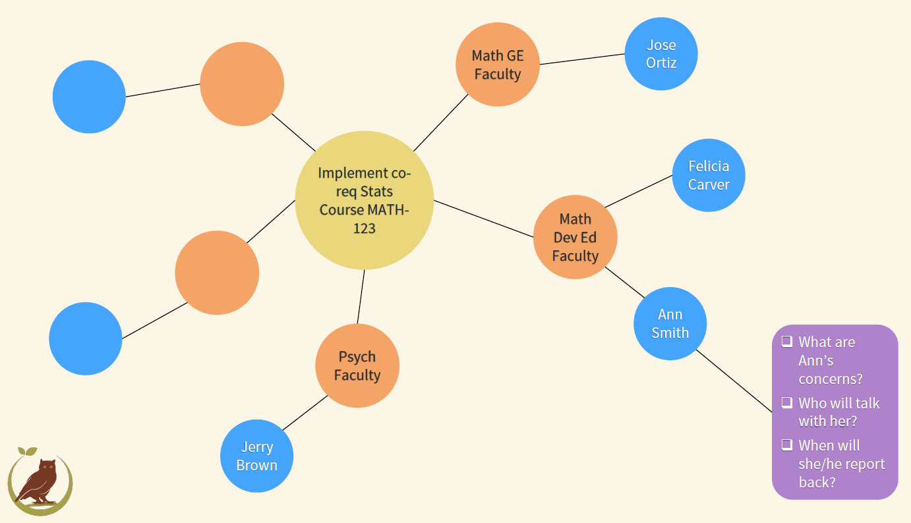
Power Mapping

Slide 18
90-Day Cycles
Clear Goals
Clear Accountability
Clear Timelines
Clear Evaluation

Slide 19
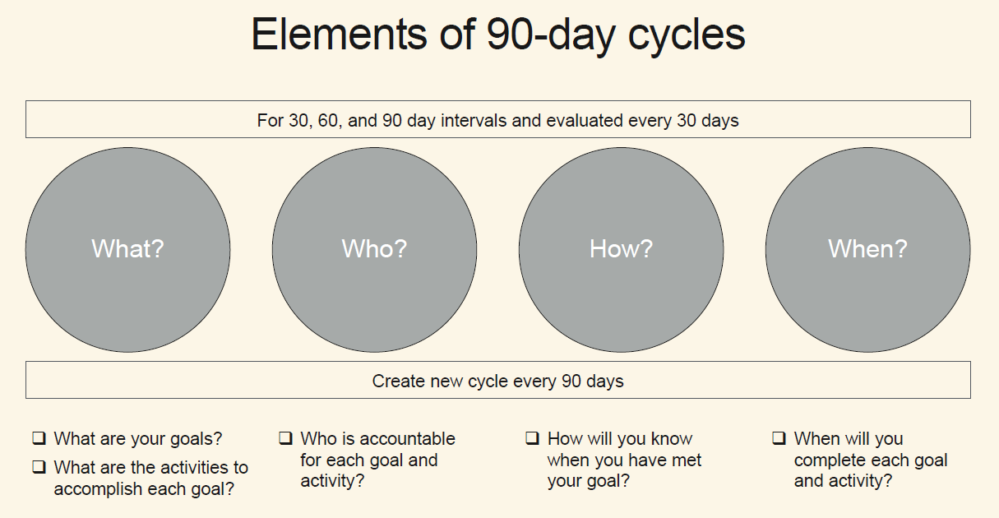
90-Day Cycles

Slide 20
The “91 Day” Challenge
Select one action item that your team will implement by Dec. 13 – be ambitious!
Chart paper #1 - Create a Power Map of your plan
Chart paper #2 – identify the What, Who, How, and When
Dr. Rose will buy lunch for Winning team

