Slide 1

Career & Academic Pathways (CAP) Fall 2021 Data
01/21/2022
01/21/2022, kk

Slide 2
% of Students with Online Ed. Plans, FAFSA, and Dream Act Applications Submitted by CAP
Two time points in fall 2021:
Baseline = One day before fall 2021 first census (09/04/2021).
Follow-up = Fall 2021 end of term.

Slide 3
Large increases across each CAP.
Notes for the charts on this slide and next two slides:
Baseline = One day before fall 2021 first census (09/04/2021).
Follow-up = Fall 2021 end of term.
Source: Starfish Early Alert & Connect data joined with RSCCD Research Data Warehouse daily batch data from 09/04/2021 to match the data download date from Starfish. Excludes “Exclusively Academy” students.

Slide 4
Largest increases in % in Money Matters and People, Ideas & Culture CAPs.

Slide 5
Relatively unchanged from baseline to follow-up.

Slide 6
Students by CAP and Top 5 Academic Programs (Majors) per CAP
Includes data from degree-seeking students and their most recent major in fall 2021.

Slide 7

Number of Students* per CAP
% of Total
*Includes only degree-seeking students’ most recent academic program (major) in Fall 2021. Sorted in decreasing order of size. Source: RSCCD Research Data Warehouse and SAC Research ‘Academic programs with CAP listed.xlsx’ file.
3248 | 34%
2103 | 22%
1243 | 13%
1081 | 11%
668 | 7%
476 | 5%
474 | 5%
General, e.g., CSU or IGETC: | 332 | 3%
Undecided: | 27 | 0.3%
Unknown: | 13 | 0.1%
Total: | 9665 | 100%

Slide 8




Top 5 Academic Programs/Majors per Career and Academic Pathway in Fall 2021
Career and Academic Pathway | Academic Program Title | Degree/Certificate Type | Distinct Count
Helping Others - Public Health and Safety Services | Nursing-Registered Nursing | AS | 743
 | Law Enforcement Option | CA | 357
 | Public Fire Service | AS | 315
 | Pre-Nursing for the Bachelor's Degree in Nurs | AS | 236
 | Criminal Justice | AS | 228
People, Ideas, and Culture - Humanities, Social Sciences, and Languages | Liberal Arts: Arts, Humanities & Communications | AA | 844
 | Psychology | AA | 196
 | Psychology for Transfer | AAT | 194
 | Liberal Arts, University Transfer Studies | AA | 131
 | Liberal Arts: Social and Behavioral Sciences | AA | 101
Money Matters - Business and Paralegal | Business Administration | AA | 249
 | Business Administration for Transfer | AST | 225
 | Accounting | AS | 120
 | Business Administration | AS | 112
 | Paralegal | AA | 84
STEM - Computers, Math, and Science | Engineering | AS | 177
 | Biological Science | AS | 163
 | Computer Science | AS | 119
 | Computer Science for Transfer | AST | 95
 | Liberal Arts: Mathematics and Science | AA | 85

Slide 9



Top 5 Academic Programs/Majors per Career and Academic Pathway in Fall 2021 (cont'd.)
Career and Academic Pathway | Academic Program Title | Degree/Certificate Type | Distinct Count
Creating Our World - Art, Media, and Performance | Art | AA | 85
 | Digital Media Arts | AA | 69
 | Graphic Design | AA | 63
 | Music | AA | 48
 | Film, TV, and Electronic Media for Transfer | AST | 39
Future Educators - Child Development, Teaching, and Library Tech | Elementary Education (Pre-Professional) | AA | 102
 | Early Childhood Education for Transfer | AST | 75
 | Early Childhood Teacher | CA | 51
 | School Age Teacher | CA | 40
 | Elementary Teacher Education for Transfer | AAT | 38
Design, Make, and Move - Automotive, Manufacturing, and Engineering Tech | Automotive Technology | AS | 82
 | Welding Technology | AS | 47
 | Civil Engineering Technology | As | 31
 | Welding Technology | CA | 30
 | Automotive Engine Maintenance | CERT | 21
General majors such as CSU or IGETC | CSU GE-Breadth (Plan B) | CA | 151
 | IGETC (Plan C) | CA | 126
 | IGETC/UC Certification | CTF | 46
 | CSU Certification | CTF | 7
 | IGETC/CSU Certification | CTF | 1
Undecided | Undeclared Program at SAC | ND | 27
Unknown | Unknown | 13

Slide 10
Student Demographics by CAP
Includes data from degree-seeking students and their most recent major in fall 2021.

Slide 11
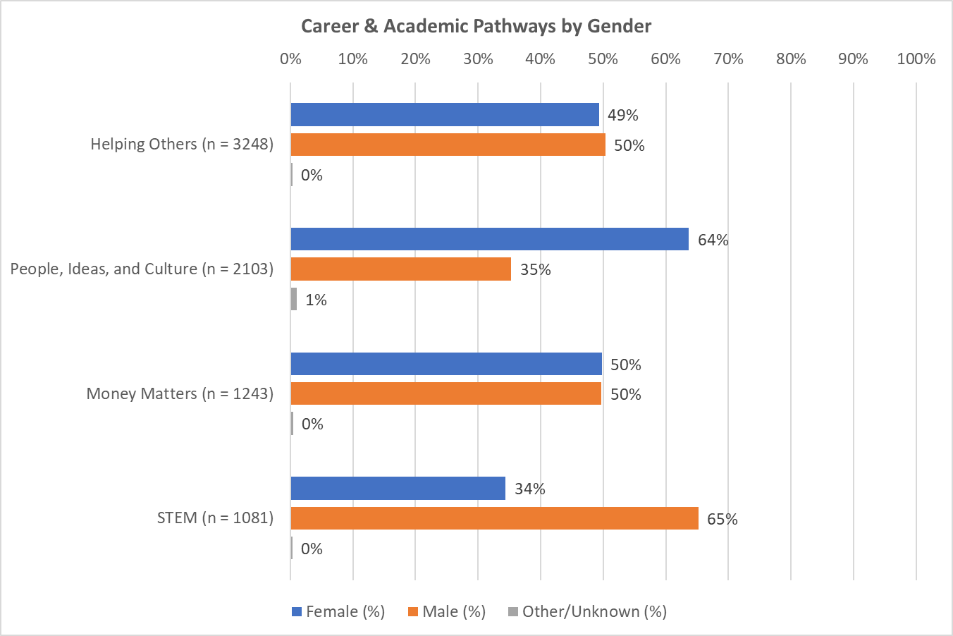
Greater % of females than males in People, Ideas & Culture.
Opposite pattern for STEM.

Slide 12
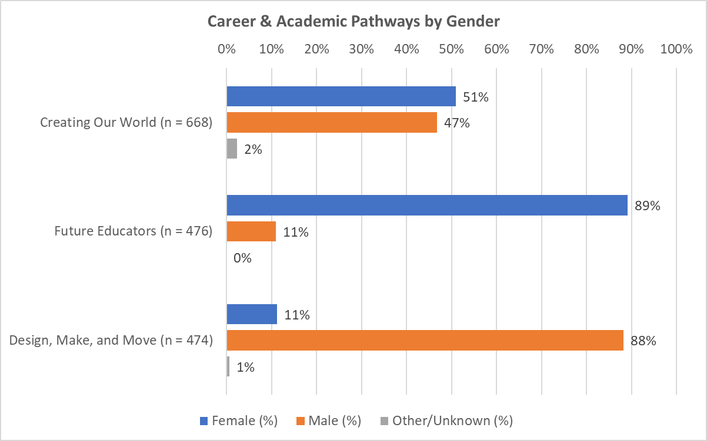
Much greater % of females than males in Future Educators.
Opposite pattern for Design, Make & Move.

Slide 13
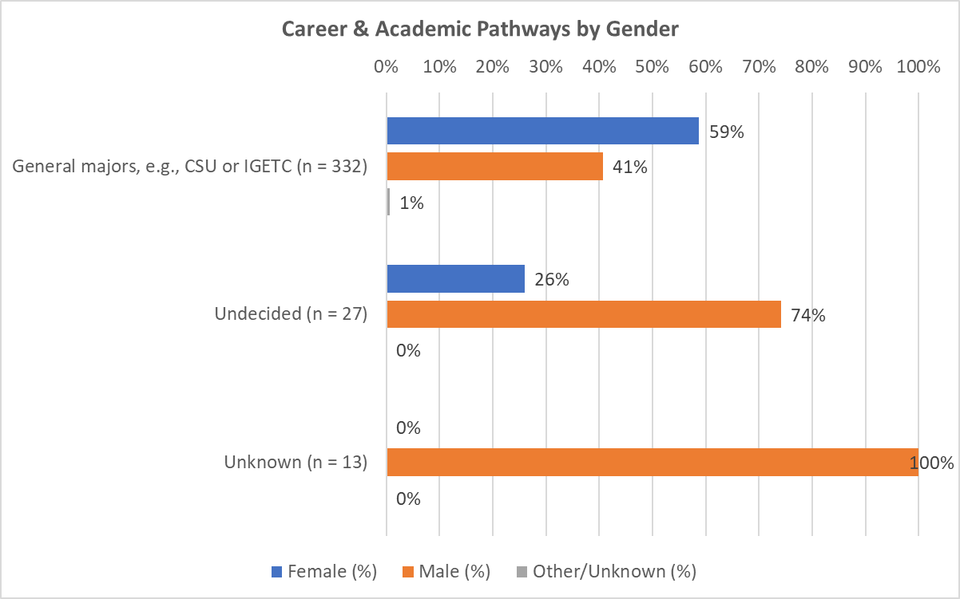
Greater % of females than males with General majors.
Opposite pattern for Undecided students; however, notice the relatively low sample size.

Slide 14
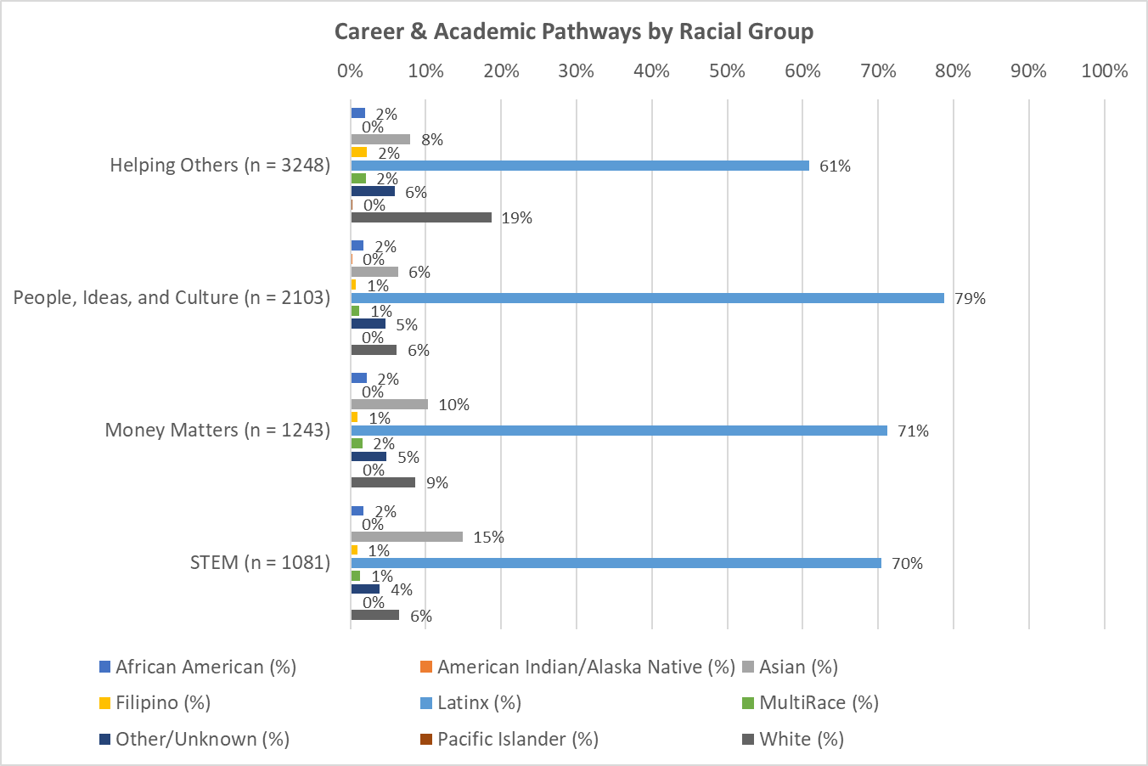
Generally similar pattern of racial group representation across each CAP with the following exceptions:
Greater % of Latinx students in the People, Ideas & Culture CAP relative to their representation in other CAPs.
Greater % of Asian students in the STEM CAP relative to their representation in other CAPs.
Greater % of White students in the Helping Others CAP relative to their representation in the other CAPs.

Slide 15
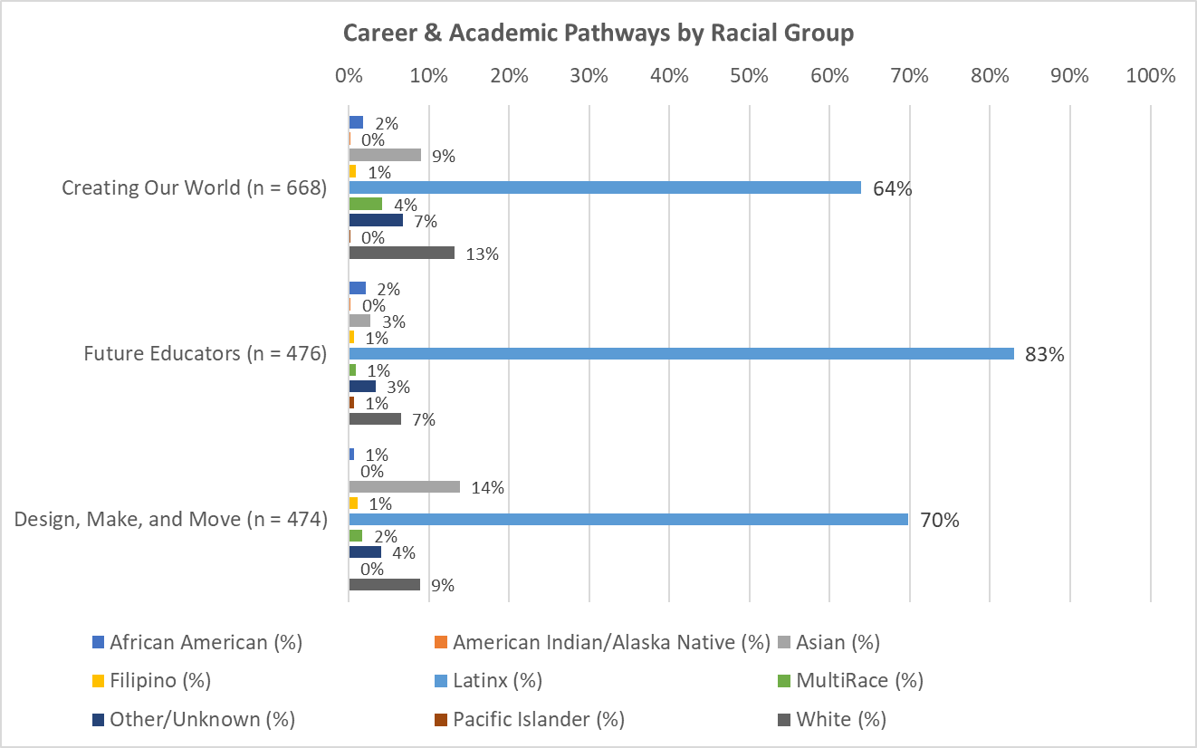
Generally similar pattern of racial group representation across each CAP with the following exceptions (cont’d.):
Greater % of Latinx students in the Future Educators CAP relative to their representation in other CAPs.
Greater % of Asian students in the Design, Make & Move CAP relative to their representation in other CAPs.

Slide 16
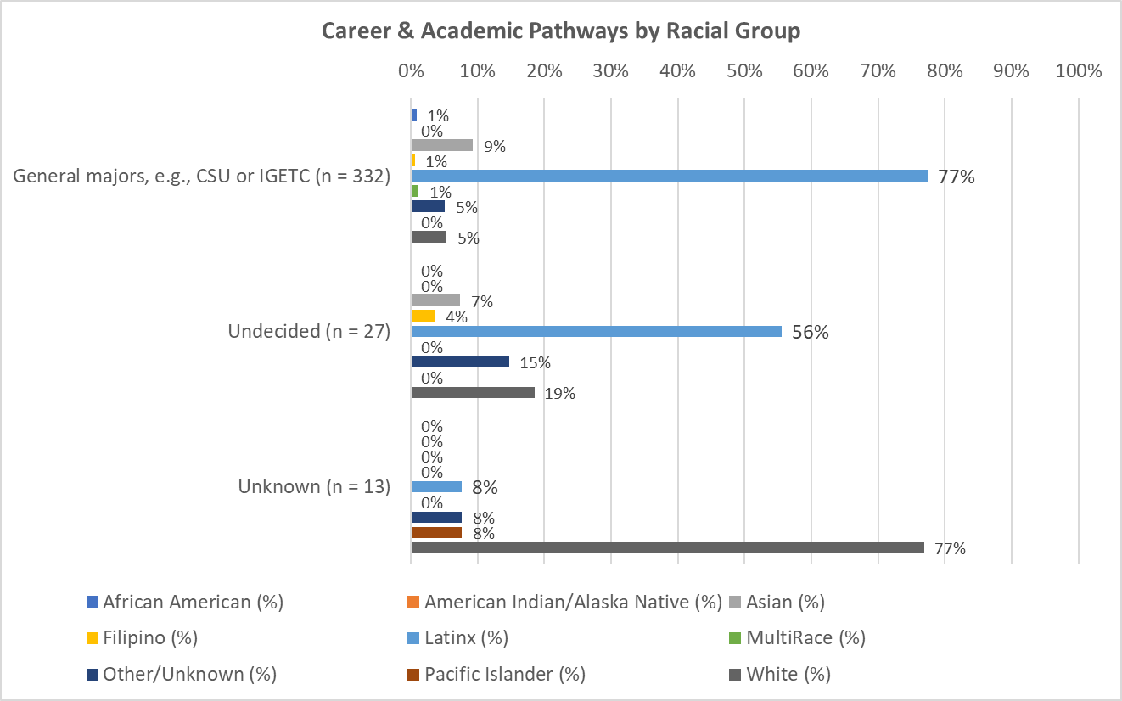
Generally similar pattern of racial group representation across each CAP with the following exceptions (cont’d.):
Greater % of Latinx students with General majors relative to their representation in other CAPs.

Slide 17
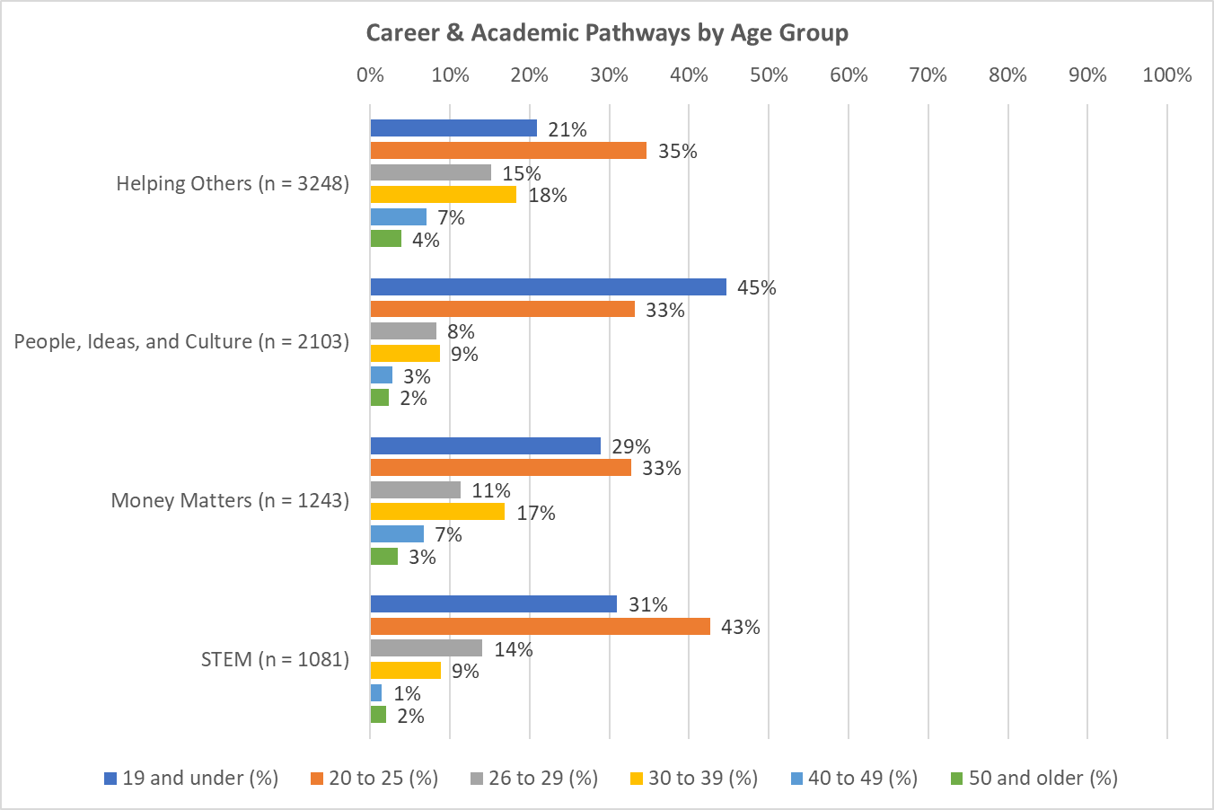
Notice the higher % of 30-39 year olds in the Helping Others and Money Matters CAPs relative to their representation in other CAPs.
Regarding 20-25 year olds, they had greater representation in the STEM CAP.
The 19 and under age group had greater representation in the People, Ideas & Culture CAP.

Slide 18
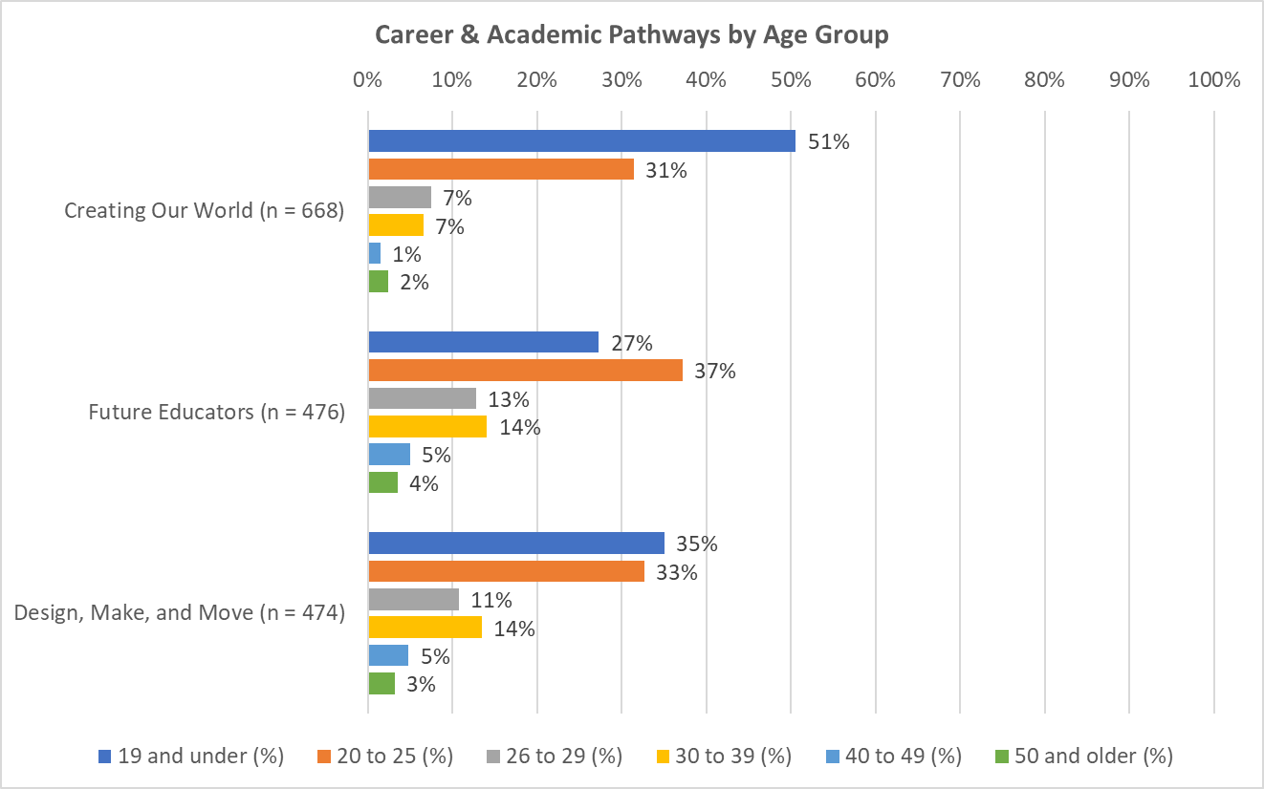
The 19 and under age group also had greater representation in the Creating Our World CAP.

Slide 19
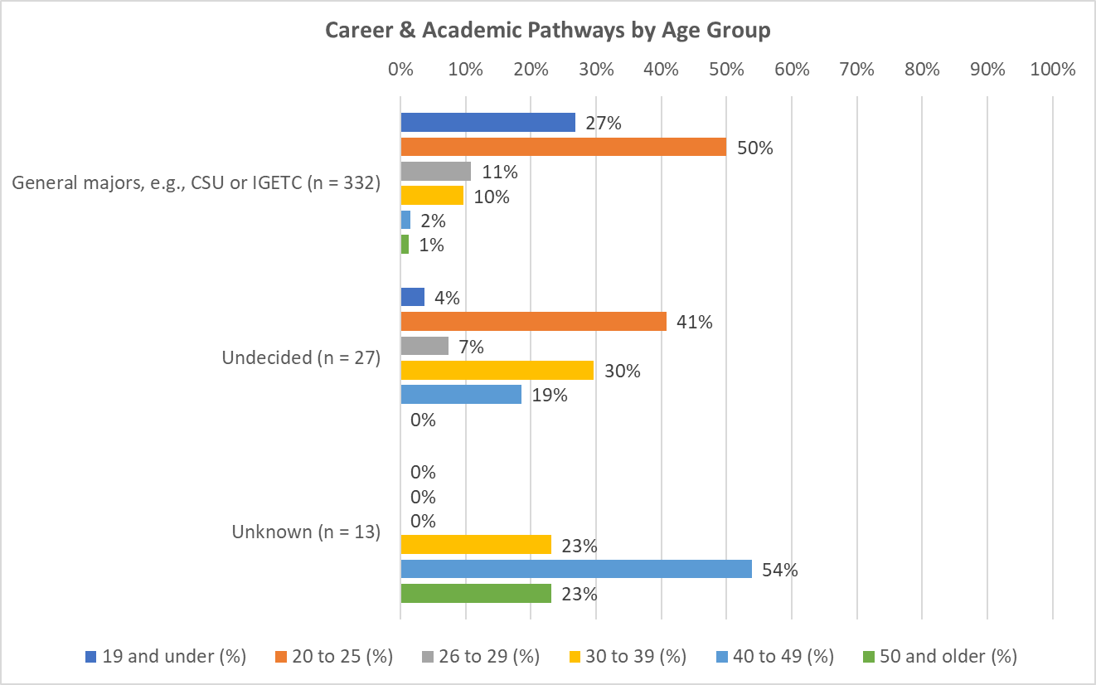
The 20-25 year old age group also had greater representation in the General majors group.

Slide 20
Demographics of Students who Used Counseling Services in Fall 2021
Includes data from degree-seeking students.

Slide 21
Students who used Counseling Services in Fall 2021
Gender | % | Count
Female | 58% | 1089
Male | 41% | 778
Other/Unknown | 0.5% | 9
Total | 100% | 1876
Racial Group | % | Count
African American | 2% | 40
American Indian/Alaska Native | 0% | 2
Asian | 10% | 190
Filipino | 1% | 20
Latinx | 72% | 1347
MultiRace | 2% | 32
Other/Unknown | 5% | 93
Pacific Islander | 0% | 2
White | 8% | 150
Total | 100% | 1876
Age Group | % | Count
19 and under | 26% | 481
20 to 25 | 42% | 795
26 to 29 | 13% | 253
30 to 39 | 13% | 246
40 to 49 | 4% | 75
50 and older | 1% | 26
Total | 100% | 1876
Students who used SAC’s Counseling Services were primarily female, Latinx, and 20-25 years of age.
Source: Counseling Center Fall 2021 MIS Data file joined with RSCCD Research Data Warehouse.

