Slide 1
Undergraduate Preparation for Future Teachers
Caren Bautista
caren.bautista@gmail.com

Slide 2

If you want to be a teacher, you need…
  Bachelor’s degree
  and
  Teaching credential

Slide 3
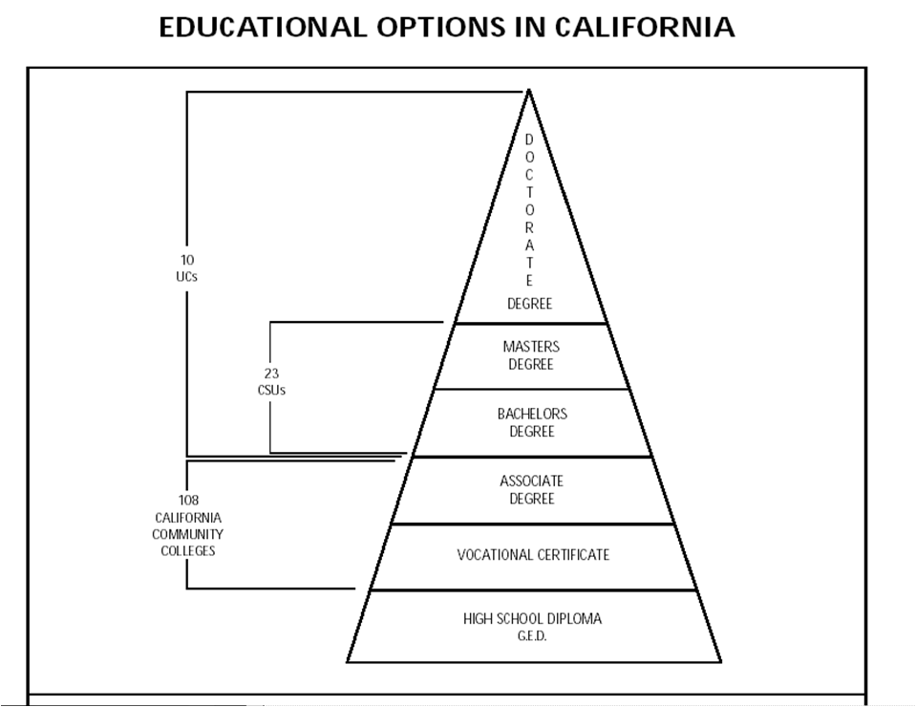
Pathways to a Bachelor’s Degree

Slide 4
Pathways to a Bachelor’s Degree
Complete all General Education lower division requirements
  At a CSU or UC
  at a local community college
    Apply for CSU/GE certification
    Apply for IGETC certification for UC
Choose a BS/BA major to support your teaching goal

Slide 5
Pathways to a Bachelor’s Degree
Choose a major to suit your area of expertise:
Elementary School
Liberal Studies
Child and Adolescent Studies
Middle/High School
Math
Science
English
Art
Music
Social Science*
Kinesiology
Foreign Language
Notes:
Some universities mandate the major for multiple subject candidates – ex. CSULB must be Liberal Studies

Slide 6
Popular Majors for the Social Science Credential
American Studies
Anthropology
Asian American Studies
Chicano Studies
Criminal Justice
Economics
Geography
History
Liberal Studies
Political Science
Notes:
6

Slide 7

What does a teacher need to know?
Subject matter
(What you learn as an undergraduate getting your bachelor’s degree)
and
How to teach
(What you learn in the credential program)
To teach is to touch the future….

Slide 8
What is a Credential Program?
Traditionally , a two semester program following the Bachelor’s degree; sometimes referred to as a 5th year program.
Includes student teaching
PEDOGOGY! Credential programs teach the methodology and practical applications of how to be a teacher

Slide 9

What Does a Multiple Subject Credential Authorize You to Teach?
The Multiple Subject credential authorizes its holder to teach all areas of the curriculum for grades K-6/8 in a self-contained classroom

Slide 10
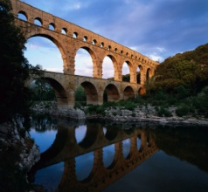




What Does a Single Subject Credential Authorize You to Teach?
Teach the specific subject named on the credential (i.e. Math, English, etc.)
Most single subject educators teach their subject in grades 7-12; middle and high school

Slide 11
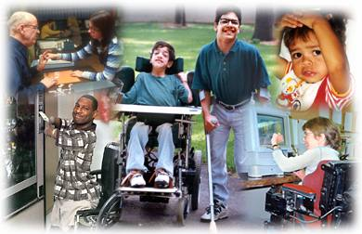
What Does a Education Specialist Credential Authorize You to Teach?
Credentials in Mild/Moderate and Moderate/Severe Disabilities authorize the provision of services to individuals in grades K through 12, including adults.
Early childhood special education includes the provision of educational services to children from birth through pre-kindergarten who are eligible for early intervention, special education, and/or related services under federal and state laws.

Slide 12
Steps to a credential program…
Obtain a Bachelor’s Degree
Prove knowledge of basic skills
  CBEST: California Basic Educational Skills Test
Prove subject matter competency
  CSET: California Subject Examinations for Teachers
  SMPP: Subject Matter Preparation Program (single subject only)
Complete required prerequisites & fieldwork
Notes:
Multiple subject fieldwork – 45 hours; Single subject fieldwork – 40 hours

Slide 13
Tests!!!
Teachers have to take tests too! Don’t worry! You can do it!!!

Slide 14
CBEST
What is it?
  The CBEST is the California Basic Educational Skills Test that assesses you on basic skills in reading comprehension, math and writing skills through an 8th/9th grade level.
Who is it for?
  Anyone who wants to substitute teach or desires a career as a classroom teacher must pass the CBEST or its equivalent.

Slide 15
Subject Matter Competency
All teachers need to prove to the Commission on Teacher Credentialing (CTC) that they “know their stuff”
  For future elementary school teachers this is done by passing the Multiple Subject CSET test.
  For future middle/high school teachers this is done by passing the CSET in your area of specialty.

Slide 16
Subject Matter Competency
California Subject Examination for Teachers: Multiple Subjects (CSET)
Offered in three separate subtests which are divided by subject matter
  Language Arts, Literature & Social Science
  Math & Science
  Visual & Performing Arts, Physical Education, & Human Development
Each Subtest is $96* or $238 for all subtests taken together
*Excludes additional fees

Slide 17
Subject Matter Competency
California Subject Examination for Teachers: Single Subject in Social Science (CSET)
Offered in three separate subtests which are divided by subject matter focus
  World History; World Geography
  US History; US Geography
  Civics; Economics; California History
Each Subtest is $49-99*
*Excludes additional fees

Slide 18
How Do You Prepare for the CSET?
Choose a major to help prepare you in subject matter knowledge.
Take classes to support your knowledge in the subject matter areas.
Keep and review notes, exams and papers from all subject matter classes.
Do the FREE practice test online at the CSET website www.ctcexams.nesinc.com

Slide 19
Subjects Available for Single Subject Teaching Credentials*
Languages other than English*
Mathematics*
Foundational Level Mathematics*
Music*
Physical Education*
Physics*
Social Science*
NEW:
  Foundational Level General Science*
Agriculture
Art*
Biological Sciences*
Business
Chemistry*
English*
Geosciences*
Health Science
Home Economics
Industrial & Technology Ed.
*Check your desired university to see if the credential you seek is offered
* Offered by CSUF

Slide 20
Credential Program Prerequisites
Check with the universities you are interested in attending to see what their specific prerequisites are as they vary from school to school.
Some universities offer blended programs where you can earn your bachelor’s degree and teaching credential at the same time.
Many universities offer their credential programs as a 5th year program completed the year after the bachelor’s degree.

Slide 21
Choosing the Right Program for You
Important things to think about
  Cohort v. non-cohort
  Cost

Slide 22
Cohort v. Non-cohort
Credential Programs
Just like degree programs are structured differently from university to university, so are credential programs!
Some universities have structured their Multiple Subject and Single Subject Credential Programs to follow a cohort format:
  A cohort is a learning community in which all classes for the credential program contain the same students each semester.
  Each semester is specifically structured, the classes are arranged in a particular format, and you are guaranteed that you will be able to register for all of your classes.

Slide 23
Cohort v. Non-cohort Credential Programs (cont.)
  You build strong relationships and support structures with the other students and faculty members in your cohort.
  Limits ability to work outside program hours.
Non-Cohort programs:
  Non-cohort programs are a little more flexible in regards to how you arrange your schedule and how many classes you take at a time.
  Allows more time to work outside program hours.

Slide 24
Credentialing Costs
Cost is an important factor when deciding on a credential program
For academic year 2011-2012
  $7004/yr @ CSUF (2 semesters)
  $7114/yr @ CSULB (2 semesters)
  $15,063/yr @ UCI (3 quarters)

Slide 25
Financial Aid Opportunities
The Assumption Program of Loans for Education (APLE)
  If you teach in California, the State may help you pay back your student loans up to $19,000 http://www.csac.ca.gov
TEACH Grant (Teacher Education Assistance for College and Higher Education) – http://studentaid.ed.gov
  K-12 public/private school
  May be awarded up to $4,000/yr
  Full-time teacher in “high need field” and low-income area for 4 academic years (within 8 years of graduating)

Slide 26
Questions?
Current High School Students - See a counselor
Current Community College Students – See a counselor( preferably in the Teacher Education program)
Current University students – See major advisor and/or teaching pathway advisor. www.fullerton.edu/cct
Teaching is a work of

