Slide 1
Overview of the Special Education
Programs at Cal State Fullerton
Change the World!
Be a Special Educator. . .
by
Melinda R. Pierson, Ph.D.
California State University, Fullerton
Department of Special Education

Slide 2
Setting the Stage….
All students are able to learn.
All students deserve appropriate differentiated curriculum and accommodations to support their individual learning.
Appropriate behavior is seen in classrooms where researched based effective teaching strategies are utilized.
Inclusion is what society is all about
Inclusion Percentage of placements for Children with Disabilities in the United States:
  General Education Classroom 43.4%
  Resource Room 29.4%
  Separate Class 22.7%
Inclusion Improves achievement

Slide 3
Education Specialist Credential Programs
“One Teacher Can Change the World-
One Child at a time…
One Family at a time…
One School at a time…
  One Teacher Can Make a Difference.”

Slide 4
Why Select Cal State Fullerton for Your Education Specialist Credential or Special Education Graduate Program?
PROGRAM QUALITY
CSUF grants over 200 special education credentials each year.
Programs are accredited by the National Council on Teacher Education (NCATE) and the California Commission on Teacher Credentialing (CCTC).
Programs include Authorization in teaching English Learners and Autism.
Our nationally recognized Internship program allows candidates to earn their credential while employed as classroom teachers.
Online class offerings and day, evening and Saturday classes provide flexibility in scheduling.
RELEVANT CURRICULUM AND FIELDWORK
Field based program allows students to apply theory to practice in classroom settings.
FACULTY AND LOCAL PARTNERSHIPS
Program faculty members are involved in neighboring schools, collaborating with teachers to improve policy and practice.

Slide 5
Special Education Specialist Credential and Certificate Programs
Available at Cal State Fullerton
Special Education Specialist Credential
  Mild/Moderate: K-12 Authorization
Special Education Specialist Credential
  Moderate/Severe: K-12 Authorization
Special Education Specialist Credential
  Early Childhood Special Education Credential , 0-5 yrs
  Early Childhood Special Education Certificate, 0-5 yrs
Added Authorizations – Autism, RSP, EC

Slide 6
Education Specialist Credential Areas
The Cal State Fullerton Department of Special Education offers three Education Specialist Credentials. Each credential authorizes the holder to work with a different population of students with disabilities.
  Education Specialist, Mild/Moderate Disabilities: This credential authorizes the teaching of individuals with specific learning disabilities, mental retardation, other health impaired, mild autism, and serious emotional disturbance.
  Education Specialist, Moderate/Severe Disabilities: This credential authorizes the teaching of individuals with autism, mental retardation, deaf-blindness, serious emotional disturbance, and multiple disabilities.
  Education Specialist, Early Childhood Special Education: Early childhood special education includes the provision of educational services to children from birth through pre-kindergarten who are eligible for early intervention, special education, and/or related services under federal and state laws.
Notes:
6

Slide 7
Two Program Options
Full-Time Day Program
  Designed for full-time students who are available from 7:30 am - 4:00 pm daily.
  Classes are scheduled during the day and front loaded into the first eight weeks of the semester to facilitate dedication to the directed teaching experience.
  Candidates may earn their Preliminary Special Education Specialist Credential in one calendar year.
  Candidates are placed in a PDS (Professional Development School) with a cohort of student teacher-peers.
  Candidates move through the program as a cohort and receive support from their Master Teachers and University Supervisors.
Evening Program for Interns or persons working full time
  Designed for students who are employed as full-time teachers during the credential program.
  Evening classes are held 4-6:45 pm, 7-9:45 pm, and on Saturdays
  Students receive on-the-job site support from Mentors and University Supervisors for their directed teaching requirements.
  Additional application materials and coursework are required to be an Intern.
Notes:
7

Slide 8
Recommended Majors
Child and Adolescent Studies
Liberal Studies
Speech Communication
Psychology
Mathematics (for secondary sped)
Biology (for secondary sped)

Slide 9
SPED Admissions Staff and Faculty
Address:
- 2600 E Nutwood Ave., P.O. Box 6868, Fullerton, CA 92831
Admissions Coordinator:
- Lori Sadler, MS, lsadler@fullerton.edu
Admissions Administrative Support Specialist:
-Anne Shanahan, anshanahan@fullerton.edu CP 540 ; (657) 278-4196
Department of Special Education Website:
- http://ed.fullerton.edu/sped
Admission to Teacher Education:
- http://ed.fullerton.edu/adtep
Graduate Program Coordinator:
- Woo Jung, Ph.D., ajung@fullerton.edu, CP 570

Slide 10
Admission Requirements
Attendance at an overview or verification of the online overview powerpoint presentation
University graduate application submitted – www.csumentor.edu
-apply as post-bac,
Education (credential only)
Department of Special Education application submitted- http://ed.fullerton.edu/adtep

Slide 11
Admission Requirements
Transcripts for ALL colleges and universities attended
-Official for university application
-Unofficial for program application
GPA for last 60 units or cumulative GPA
2.75 for credential and 3.0 for MSE
4 letters of recommendation
(current, within one year)
- 2 from faculty
- 2 from child/youth experience

Slide 12
Admission Requirements
Letter of intent explaining why you are choosing this career path
( 2-3 pages in length)
Passage of California Basic Education Skills Test (CBEST) http://www.cbest.nesinc.com/
Subject Matter Competency -CSET for MM, MS
K-6: Multiple Subject CSET
7-12: Single Subject CSET (ex: English, Math or Science)
-9 units of child development coursework for EC
Current CPR card (Infant, Child and Adult required)
-Both sides copied
-No online courses accepted

Slide 13
Admission Requirements
Certificate of Clearance http://www.ctc.ca.gov/credentials/online-services/pdf/cc-tips.pdf
Documentation of completion of U.S. Constitution/Government requirement
TB test (current within 4 years)
-can be done at the CSUF health center if you are a current student
Passing Faculty Interview
-granted when file is complete

Slide 14
Intern Program
The purpose is to allow teachers in high-need subject areas to begin teaching
  right away
  while earning a credential
  with extensive support
Intern Program requirements
  For a candidate to be eligible for an internship, all requirements on the Intern Readiness Form must be fully completed. The form is found on our department website.
  You must also have a job offer with start date from a district with which we have a MOU.

Slide 15
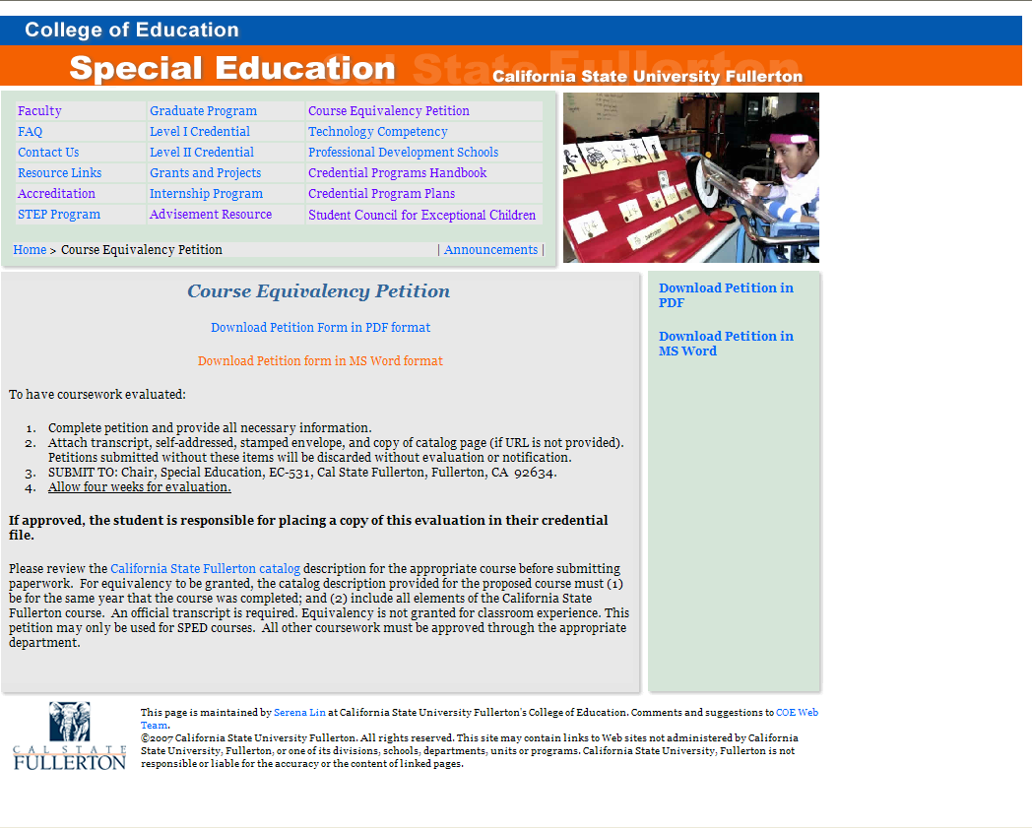
Course Equivalency Petitions
Students are responsible for having coursework from other Universities approved as equivalent and placing copies of approved petitions in their SPED credential file in CP 540.
Form is on SPED Website.
FOLLOW DIRECTIONS!
Click on the image to go to the Website.
15
Notes:
15

Slide 16
Scholarships and Financial Aid
Complete the FAFSA first: www.fafsa.ed.gov
APLE Assumption Loan
  See next slide for details.
More financial aid and scholarship information
  http://ed.fullerton.edu/current/scholarships.html
  Aimee Nelson, 657.278.4161 or anelson@fullerton.edu

Slide 17
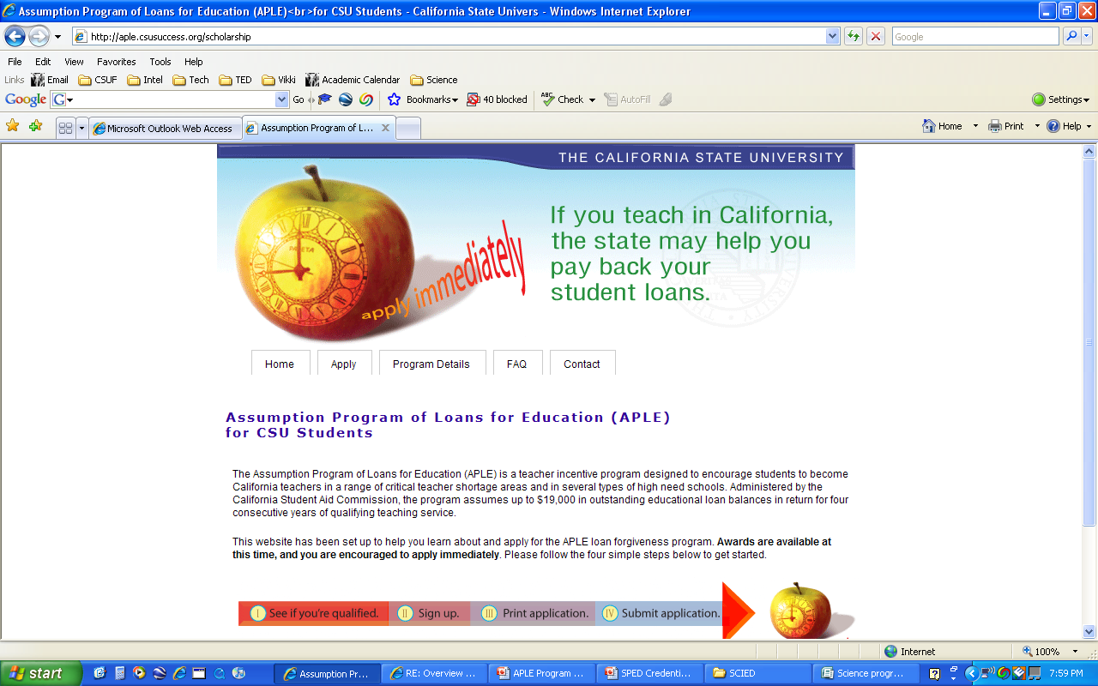
APLE Loan
Where do you go to apply?
http://aple.csusuccess.org/
scholarship
CSU Fullerton APLE advisor
  Debra Blackley
  657-278-3125
  dblackley@fullerton.edu

Slide 18
Your Success is Your Responsibility
Be sure to submit all documentation!
  Make sure you have submitted transcripts for ALL universities attended for both the University and the Program applications; complete your file!!!!
  Make sure you submit examination scores as soon as you receive them. Have them sent to you not the university.
Keep copies of all documentation for your own files.
  We do not provide copies.
Plan to attend Preorientation and Orientation Meetings
  Dates will be posted on the website!
Stay on track by:
  Following your Credential Program Requirement Plan!
  Reviewing the Education Specialist Credential Program Handbook before each semester begins.
  Communicating with your Program Coordinator if you have any questions.

Slide 19
Important Websites
SPED Department: www.ed.fullerton.edu/sped
SPED Admissions: www.ed.fullerton.edu/adtep
University admissions: www.csumentor.edu
$50 Department Processing Fee: http://ed.fullerton.edu/adtep/AtedProcessFee.htm
Certificate of Clearance: http://www.ctc.ca.gov/credentials/online-services/pdf/cc-tips.pdf
CBEST: www.cbest.nesinc.com
CSET: www.cset.nesinc.com
Open University: www.csufextension.org
CSUF Career Center: www.fullerton.edu/career
California Commission on Teacher Credentialing: www.ctc.ca.gov
Center for Careers in Teaching: www.fullerton.edu/cct
Financial Services: http://sfs.fullerton.edu

Slide 20

Announcing the AIMS Scholar Program
AIMS (Autism, Inclusion, Mathematics Core and Science Innovation) Scholar program is currently recruiting Math, Science, and Special Education Candidates.

Slide 21
Our Program Completers are
Able to work with persons with Autism and other disabilities.
Able to implement a fully included classroom.
Able to use the common core standards in mathematics
Able to implement innovative science ideas aligned with the common core

Slide 22
Our program completers are
Knowledgeable and Competent Specialists who
demonstrate strong foundation in subject matter
Reflective and Responsive Practitioners who
promote diversity
engage in collaborative endeavors
Committed and Caring Professionals who
become change agents
maintain professional and ethical standards
demonstrate ability to use technology as a resource
demonstrate strong understanding and implementation skills in the field
think critically and make informed decisions
become life-long learners

Slide 23
Benefits
Don’t Delay, Apply Today!
Teacher candidates will participate in focused professional development to use research based effective teaching strategies and to collect data based outcome to assess and support teaching and learning.
An initial stipend of $500 is rewarded at the beginning of the program, then a $100 stipend will be provided for each seminar attended; a participant can earn up to $5,000

Slide 24
District Partners
Alhambra Unified School District
Anaheim Union High School District
Anaheim School District
Azusa Unified
Magnolia School District
Mountain View School District
Ocean View School District
Ontario Montclair School District
Pomona Unified School District
Santa Ana Unified School District

Slide 25
Your “To Do” List
Apply to the university at www.csu.mentor.edu
-Apply as either Credential Only (Post-Bacc) or Credential and Masters(Graduate)
-Identify one of the following objectives: Mild/Moderate (481), Moderate/Severe(482) or Early Childhood (436)
- $50 Credential Program Processing Fee
Apply to the Special Education or Secondary Credential program
- Deadlines: February 28 for Fall semester entrance and September 30 for spring semester entrance
Pass all appropriate CSET for specific subject discipline
Pass all appropriate SMPPs and credential program prerequisite requirements
Contact Cheryl Creager at ccreager@fullerton.edu for program application and interview schedule. Contact Dr. Belinda Karge bkarge@fullerton.edu for program specifics and financial questions.

Slide 26
AIMS Scholar Program
Hit the bull’s eye with CSU Fullerton, College of Education AIMS Scholar program!
Contact Dr. Karge today!
bkarge@fullerton.edu
Sponsored by the U.S. Department of Education Transition to Teaching Federal Assistance Program

Slide 27
Thank you for attending today’s presentation!
You can email me at mpierson@fullerton.edu
I am available to support you and guide you as you explore a career in special education.

