Slide 1
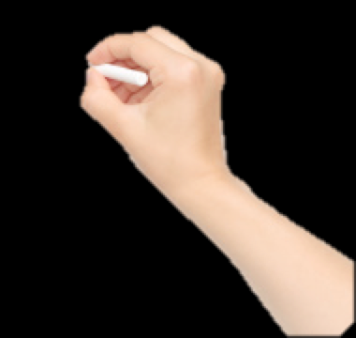
Mary Nguyen
Fullerton School District
First Grade

Slide 2
What is classroom management and why is it important?
Notes:
Discussion. Transition time is critical. Students need to have structure, consistency, and an understanding of what is expected from them

Slide 3
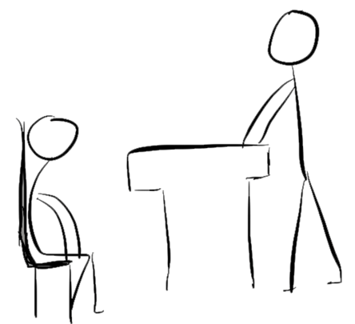
Classroom management refers to the variety of skills and techniques that teachers use to keep students organized, focused, refocused, attentive, and productive during a class

Slide 4
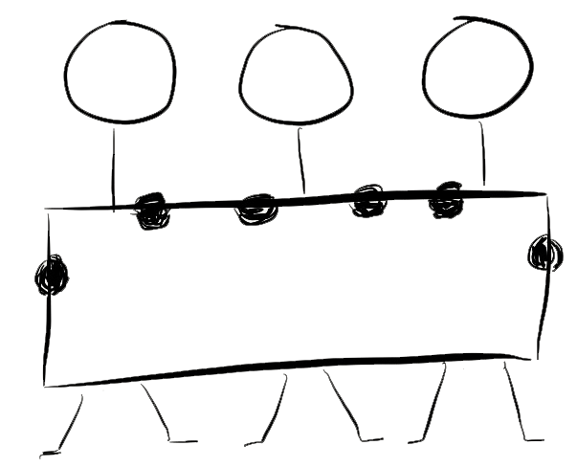
Simple and Concise Rules

Slide 5
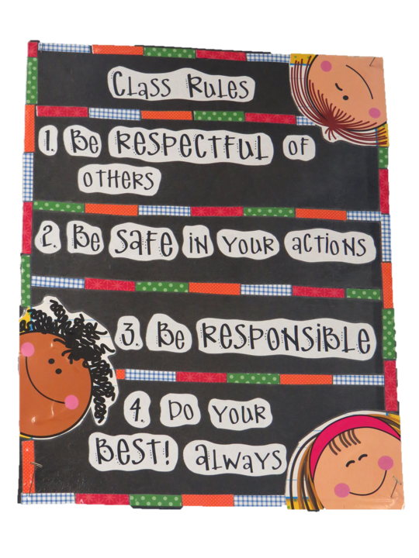
Notes:
Have simple rules to follow. Keep your rules simple. 3-5 rules. 5 may be too much for little ones

Slide 6
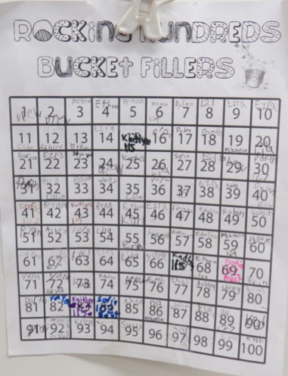
Notes:
To build a community of learners we focus on character building skills.

Slide 7
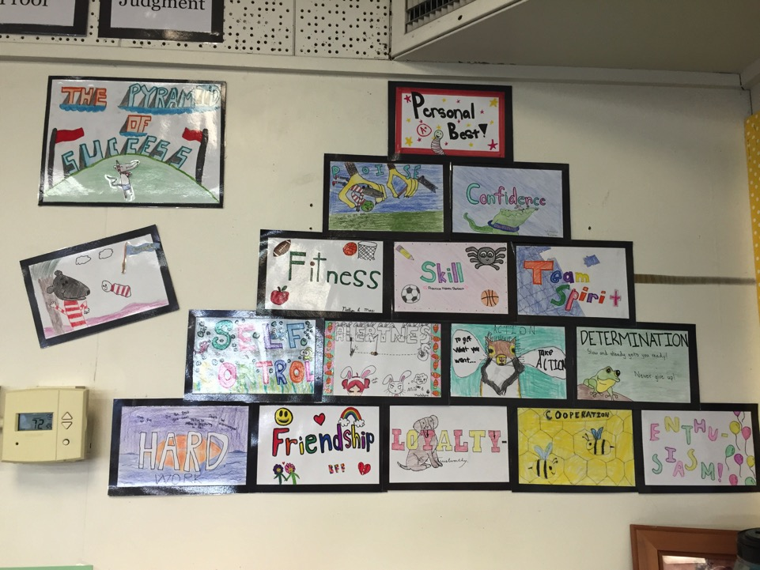
Keep Your Rules Short and Simple
Notes:
Have simple rules to follow. Keep your rules simple. 3-5 rules. 5 may be too much for little ones
Read bucket filler
Make collaborative posters about

Slide 8
Positive
Reinforcements

Slide 9
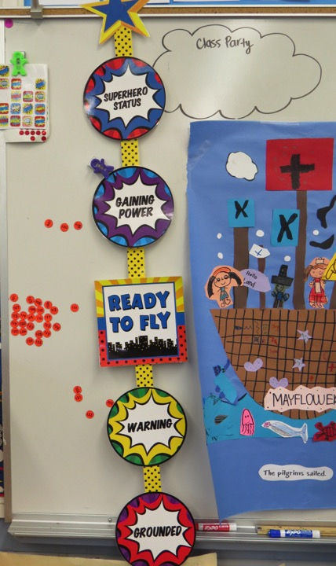
Power Up
Clip Up

Slide 10
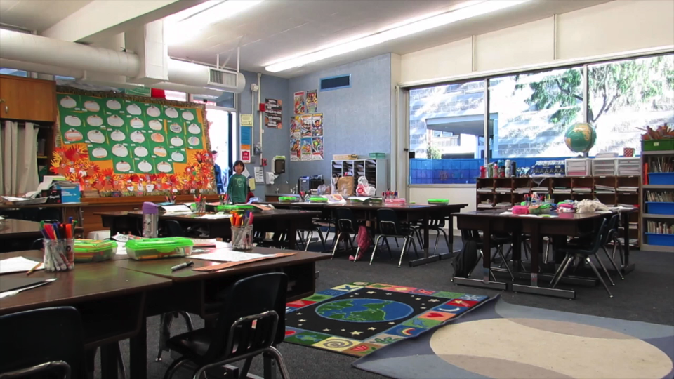
Notes:
In this clip you will hear the teacher compliment the students who are seating nicely.

Slide 11
Nothing is stronger than gentleness
Coach Wooden

Slide 12
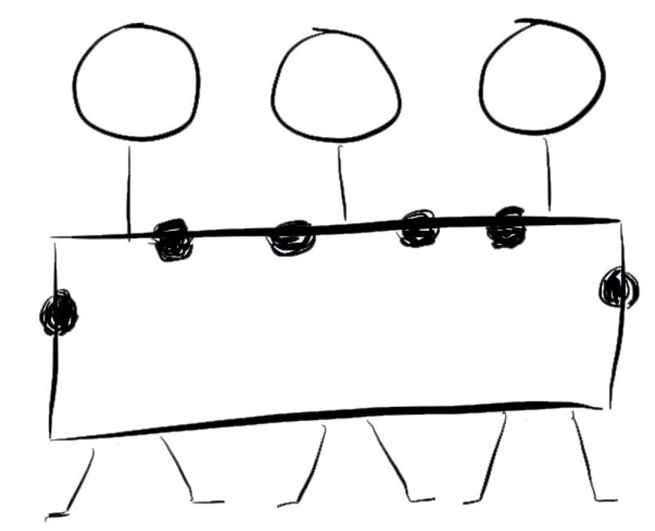
Attention
Getters

Slide 13
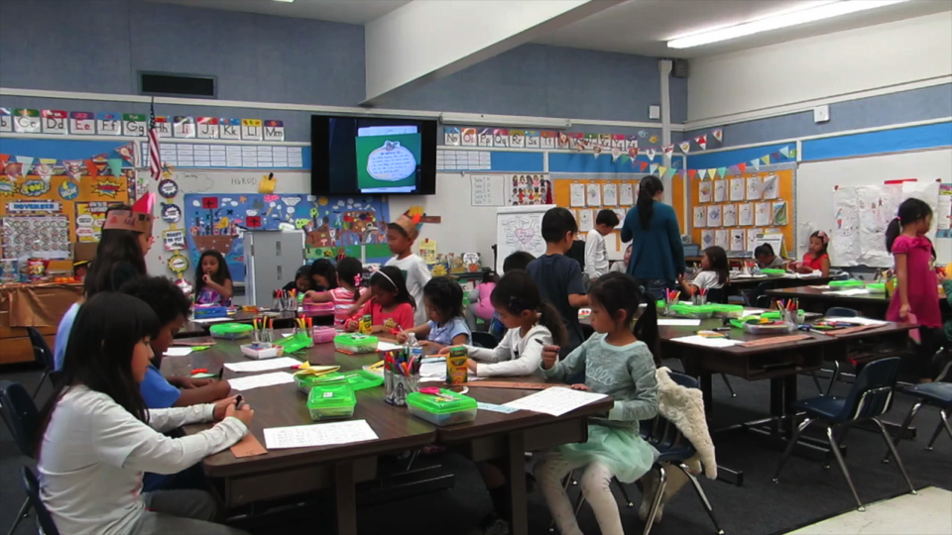

Slide 14
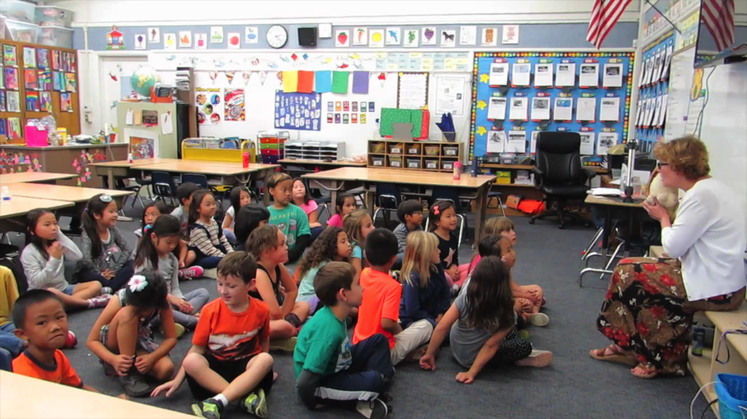
Clyde the Dog

Slide 15
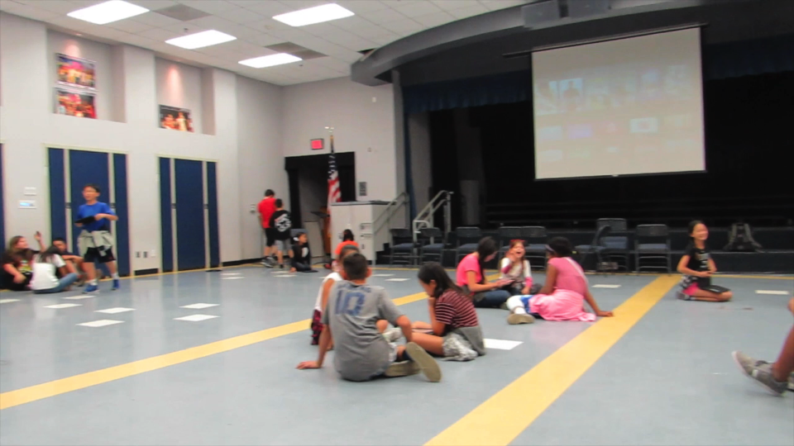

Slide 16
Engagement

Slide 17
Design Lessons that
Stimulate the brain.

Slide 18
Tom Wujec
Visual
Interactive
Persistent
Notes:
Tom Wujec (information designer)
So making images meaningful has three components. The first again, is making ideas clear by visualizing them. Secondly, making them interactive. And then thirdly, making them persistent.
Meaning when students are trying to retain information, they retain the information if they are active participants.
Persistent means relatable and meaningful to them.

Slide 19
29%
Notes:
Students who are involved in hands on activities retain the information 29% more information than students who are just listening.
Show Meet Ben

Slide 20
Meet One of the Founding Fathers
Benjamin Franklin
Notes:
Interesting Facts about Benjamin Franklin

Slide 21
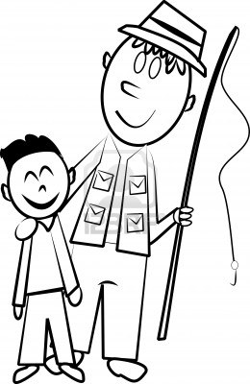
Notes:
His father made soap for the American people

Slide 22
17
15
1 2 3 4 5 6 7 8 9 10 11 12 13 14
16 17
Notes:
17 Brothers and Sisters
Benjamin was 15th in the order or brothers and sisters

Slide 23
“Well done is better than well said”
Notes:
He was an inventor

Slide 24
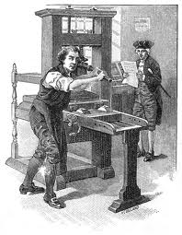
Printing Press
Notes:
Printing Press

Slide 25
Notes:
First Newspaper

Slide 26
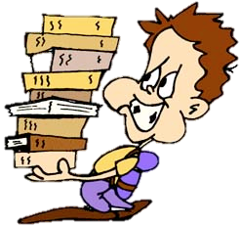
1st Public Library
Notes:
First Library in 1731

Slide 27
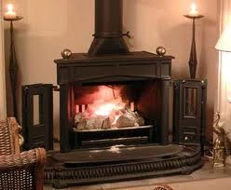
Thanks Ben!
Notes:
Pennsylvania Heat Stove or the Fire Place Known as the Franklin Stove

Slide 28
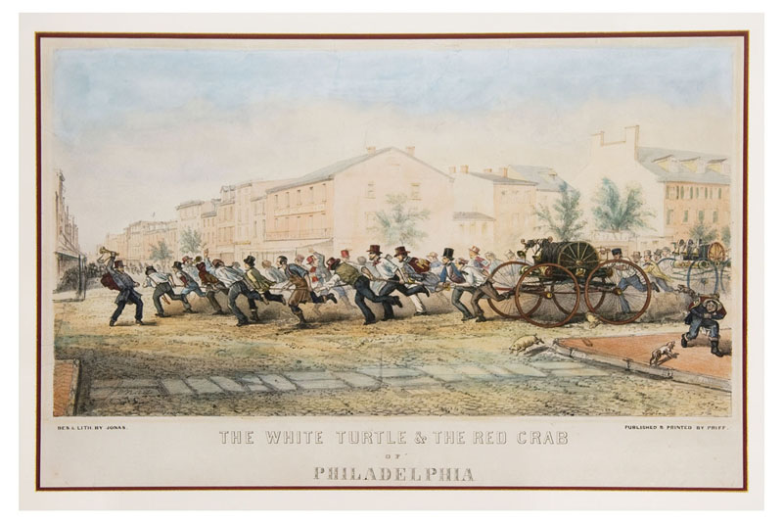
Notes:
First Volunteer Fire Department
What do you notice about the fire truck
Men pullin, clothes, etc….

Slide 29
Bifocals
Notes:
Invented the Bifocals.

Slide 30
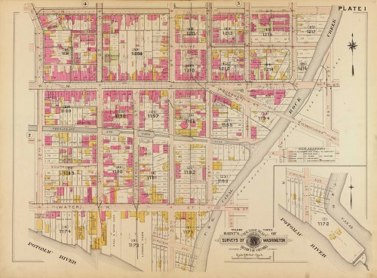
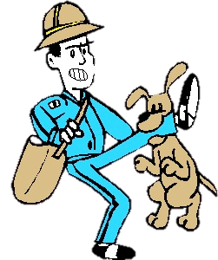
Mapmaker
Notes:
Mapmaker for the Mailman

Slide 31
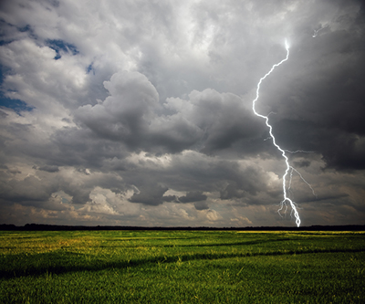
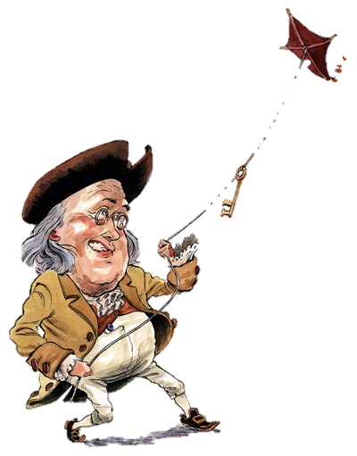
Notes:
He discovered electricity by flying a kite in a thunderstorm

Slide 32
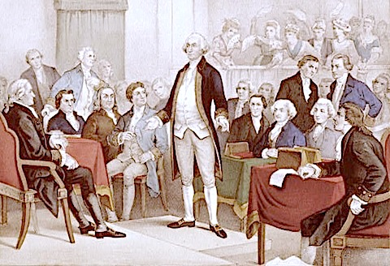
Wow! He should be our first President…
Notes:
One of the founding fathers

Slide 33
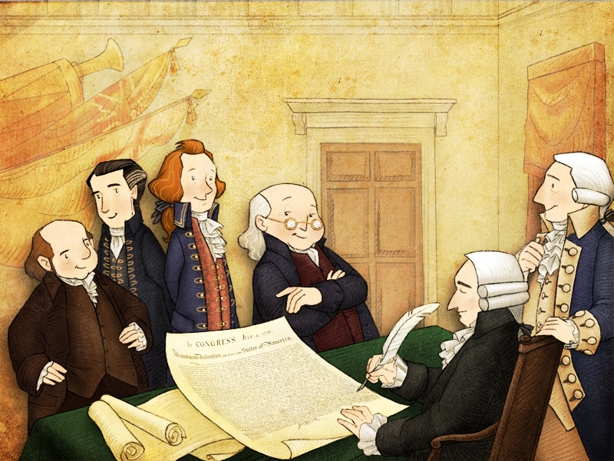
Notes:
Signed the Declaration of Independence

Slide 34
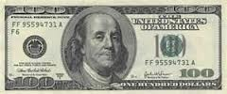
100
100
100
100
100
100
100
100
100
100
100
100
100
100
100
100
100
100
100
100
100
Notes:
He is on the 100 dollar bill

Slide 35
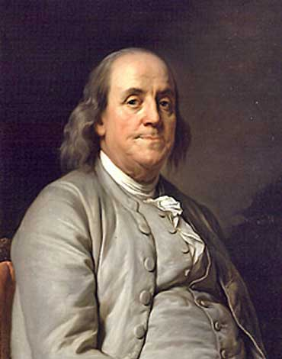
Benjamin
Franklin
Inventor
Founding Father
World Famous
Notes:
World Famous

Slide 36
Attention Span
Students’ age
= minutes
Notes:
Give mini lessons. Try not to talk for more then 5 minutes. Change it up. Give them brain breaks.

Slide 37
How you make
them feel
Notes:
Students will be most successful if you make them feel successful. That’s what they will remember, not the lessons but the love of learning.

Slide 38
Thank You

