Slide 1
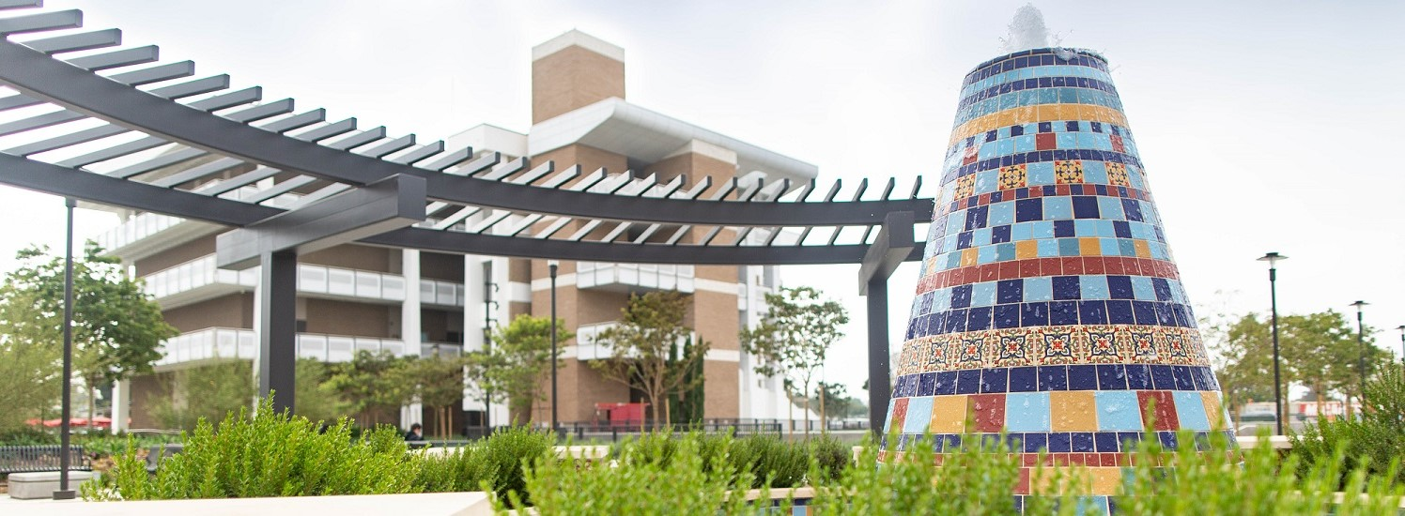
Santa Ana College
Counseling Faculty

Slide 2
Assembly Bill 1735
Open access to community colleges must be assured for all adults who can benefit from instruction[; such access] is meaningful only if supported by a system of assessment, counseling and placement that assists students in identifying their talents and abilities, directs them to courses that meet their needs, and maintains standards designed to ensure their success (Vasconcellos, 1988)

Slide 3
Title 5 §51018, §55532, Specifies Role of Counselors
Specifies the roles of counseling faculty and our contribution to the Academic Senate 10+1
Faculty in the Counseling Division (credit & non-credit) are be able to equally participate in our 10+1 functions with the current contract.
ASCCC Consultation Council Taskforce on Counseling

Slide 4
ASCCC Resolution Recognizes ALL Faculty
Revisiting the 50% Law and Faculty Obligation Resolution SP21
Recognized that 50% law does not include support faculty such as counselors, librarians, tutorial coordinators, and any other faculty (SAC-LD Specialist, Other DSPS Faculty, Psychologist, Other Coordinators, etc.) not actively in a classroom, and thus the 50% law becomes a fiscal and structural barrier to student support;
…but the FON is based on an antiquated formula and does not recognize some essential faculty groups such as noncredit faculty;
Resolved, That the Academic Senate for California Community Colleges work with the California Community Colleges Chancellor’s Office to revisit the recommendations from the 2016 “The 50% Law and the Faculty Obligation Number: A Proposal” and the 2019 update and advocate for revisions of Education Code §84362, also called the 50% Law, and the faculty obligation number while ensuring that all relevant faculty voices are included in the revision efforts.

Slide 5
Title 5 Changes to Include Counselor to Student Ratio Resolution SP10
Resolved, That the Academic Senate for California Community Colleges work with the Chancellor’s Office to change Title 5 to define the minimum number of counseling faculty required based on the recommended counselor to student ratio (1:370) cited in the Academic Senate adopted paper Consultation Council Task Force on Counseling (2003); and
Resolved, That the Academic Senate for California Community Colleges encourage local senates to work with their collective bargaining units to add language in local contracts establishing reasonable minimum counselor to student ratios and request that the Academic Senate collaborate with statewide collective bargaining organizations to jointly press for local bargaining units’ consideration of establishing reasonable minimum counselor to student ratios.

Slide 6
SAC Student Counseling Ratio
Counseling Faculty at RSCCD have high Counselor-to-Student ratio compared to neighboring CCCs
SAC 1:1,605, SCE 1:2,278
Orange Coast College: 1:783
Fullerton College 1: 581
IVC 1: 687

Slide 7
Misconception 1: Counseling Faculty only work 25 hours per week
Counseling Faculty | Instructional Faculty
25 Hours of Direct Student Contact | 15 Hours of Instruction
10 Hours of Prep | 15 Hours of Prep
5 Hours of Campus Institutional Service/Shared Gov | 5 Hours of Campus Institutional Service/Shared Gov
 | 5 Hours of Office Hours
Total: 40 Hrs/wk | Total: 40 Hrs/wk

Slide 8
Misconception 2: Counseling Faculty do not work during prep time…
During prep time, Counseling Faculty are responsible for research, documentation, follow up, and campus support. Examples to further break this down:
Evaluation of other college transcripts
Notes for electronic educational plans
Research requirements for multiple programs based on individual student educational goals
Follow up emails/phone calls
Financial aid appeals
Letters of recommendations
Faculty consultations, and more…

Slide 9
Misconception 3: Counseling Faculty focus on developing educational plans mainly
During each appointment Counseling Faculty check in with students regarding:
Overall well-being
Home life situation/support (housing and food insecurity, homelessness, access to health and other resources)
Mental health needs
Determine/recommend referrals and resources on campus/off campus (i.e.DSPS, Psychological Services, Health Center, etc.
Evaluate academic needs to support success, retention, and completion efforts
Individualized career exploration

Slide 10
How Could You Help?
Share this information with other colleagues, help correct any misconceptions
Make a public comment at committee meetings/board meeting
Next BOT is February 28th via Zoom
Use the attached zoom background and add to your signature #RSCCDFacultyUnited

Slide 11
Other ASCCC Resolutions Support Counseling Faculty
Counseling Faculty and the 50% Law FA20
Counselors As Discipline Experts FA13
Adopt Paper The Role of Counseling Faculty and Delivery of Counseling in the California Community Colleges SP12

