Slide 1
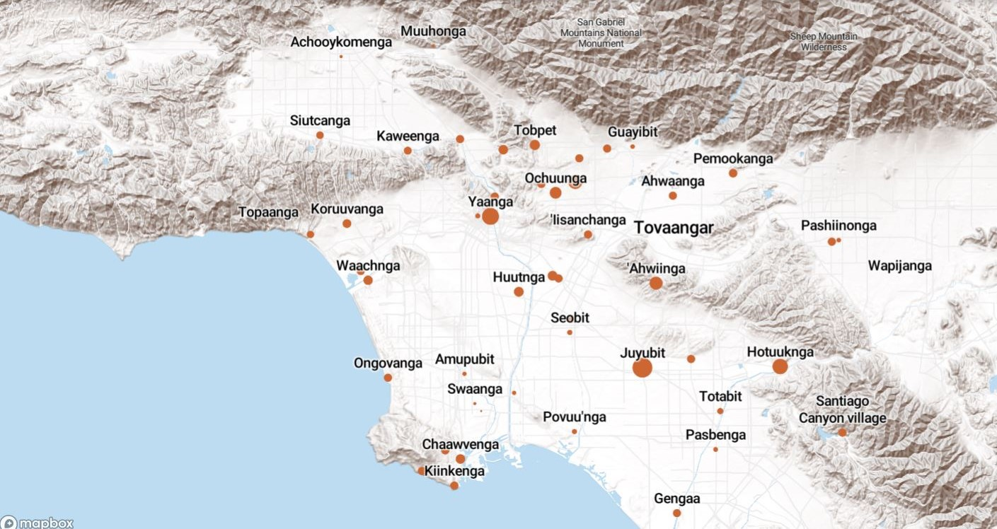
Land Acknowledgement
We acknowledge that the land on which Santa Ana College exists today is the ancestral land of the Tongva people, whose presence and resilience in Santa Ana continues to this day. We take this opportunity to honor the original caretakers of this land and recognize that histories of land theft, forced removal and assimilation, genocide, and erasure, and settler colonialism that have brought our institutions and ourselves here.
To acknowledge is not enough. This land acknowledgement is additionally a call to act, to consider our positionality and complicity in relations to these forces, and to engage in relationships and solidarity with the Tongva and other indigenous peoples.

Slide 2
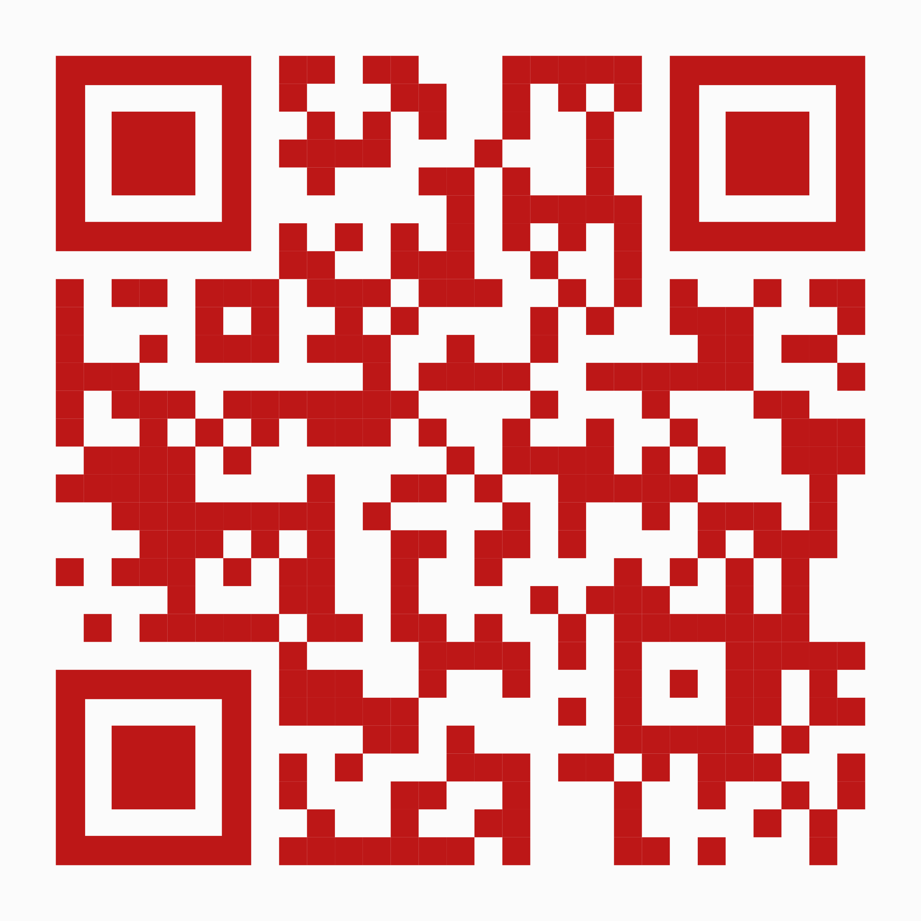
President’s Report
Board of Trustees Retreat – Friday, August 18
Vision 2030 and where the District aligns with that vision
Take-aways
Expanding Dual Enrollment
Update on CCAP Agreements
Future Agenda Item: Dual Enrollment and Faculty Contract
Non-credit to Credit Pathways (CIC)
Increase Distance Education and OER/ZTC
DE Advisory Group – Jaki King and Merari Weber
OER/ZTC Workgroup – Chair/Co-Chair Needed
OER Liaison for Academic Senate CA Community Colleges
Transfer Partnerships – Faculty Input
Apprenticeships (Non-traditional disciplines) – Future Agenda Item (CIC/Senate)
District Needs – More Support in People & Culture and Business Services
Meetings with Administrators
My Digital Business Card

Slide 3
Participatory Governance Appointments – Ongoing
District Council – Next Meeting August 28 1:30pm via Zoom
Institutional Effectiveness and Assessment - Faculty Co-Chair and Faculty Reps
Next Meeting September 6 2-3pm via Zoom (every 1st Wednesday)
Enrollment Management – Faculty Reps
Next Meeting September 19 3:30-5pm via Zoom (every 3rd Tuesday)
Senator Reports to Faculty
When? How?
Any Templates?

