Slide 1
INTERNATIONAL EDUCATION AT SANTA ANA COLLEGE

Slide 2
INTRODUCTION & INVITATION
International Student Programs

Slide 3
Direction & Vision
Director: Tina Newton
A Senior International Officer in various types of institutions for nearly two decades, my career began in supporting education abroad and international students and scholar programs at a private, Catholic, comprehensive university. I also worked at a health sciences university where I developed clinical programs abroad and quadrupled international partnerships and exchanges. I then served a large, public university and a multinational non-profit organization supporting large internationalization efforts for a wide spectrum of students and disciplines. I’m here to support your goals in international education!
IE Vision:
Increase international student recruitment, retention, and success at Santa Ana College
Broaden opportunities for intercultural experiences and skills development for all students
Increase internationalization efforts for SAC
Increase international engagement with faculty with experiential and curricular collaborations

Slide 4
1.
INTERNATIONAL EDUCATION WEEK 2024
November 4-8, 2024

Slide 5
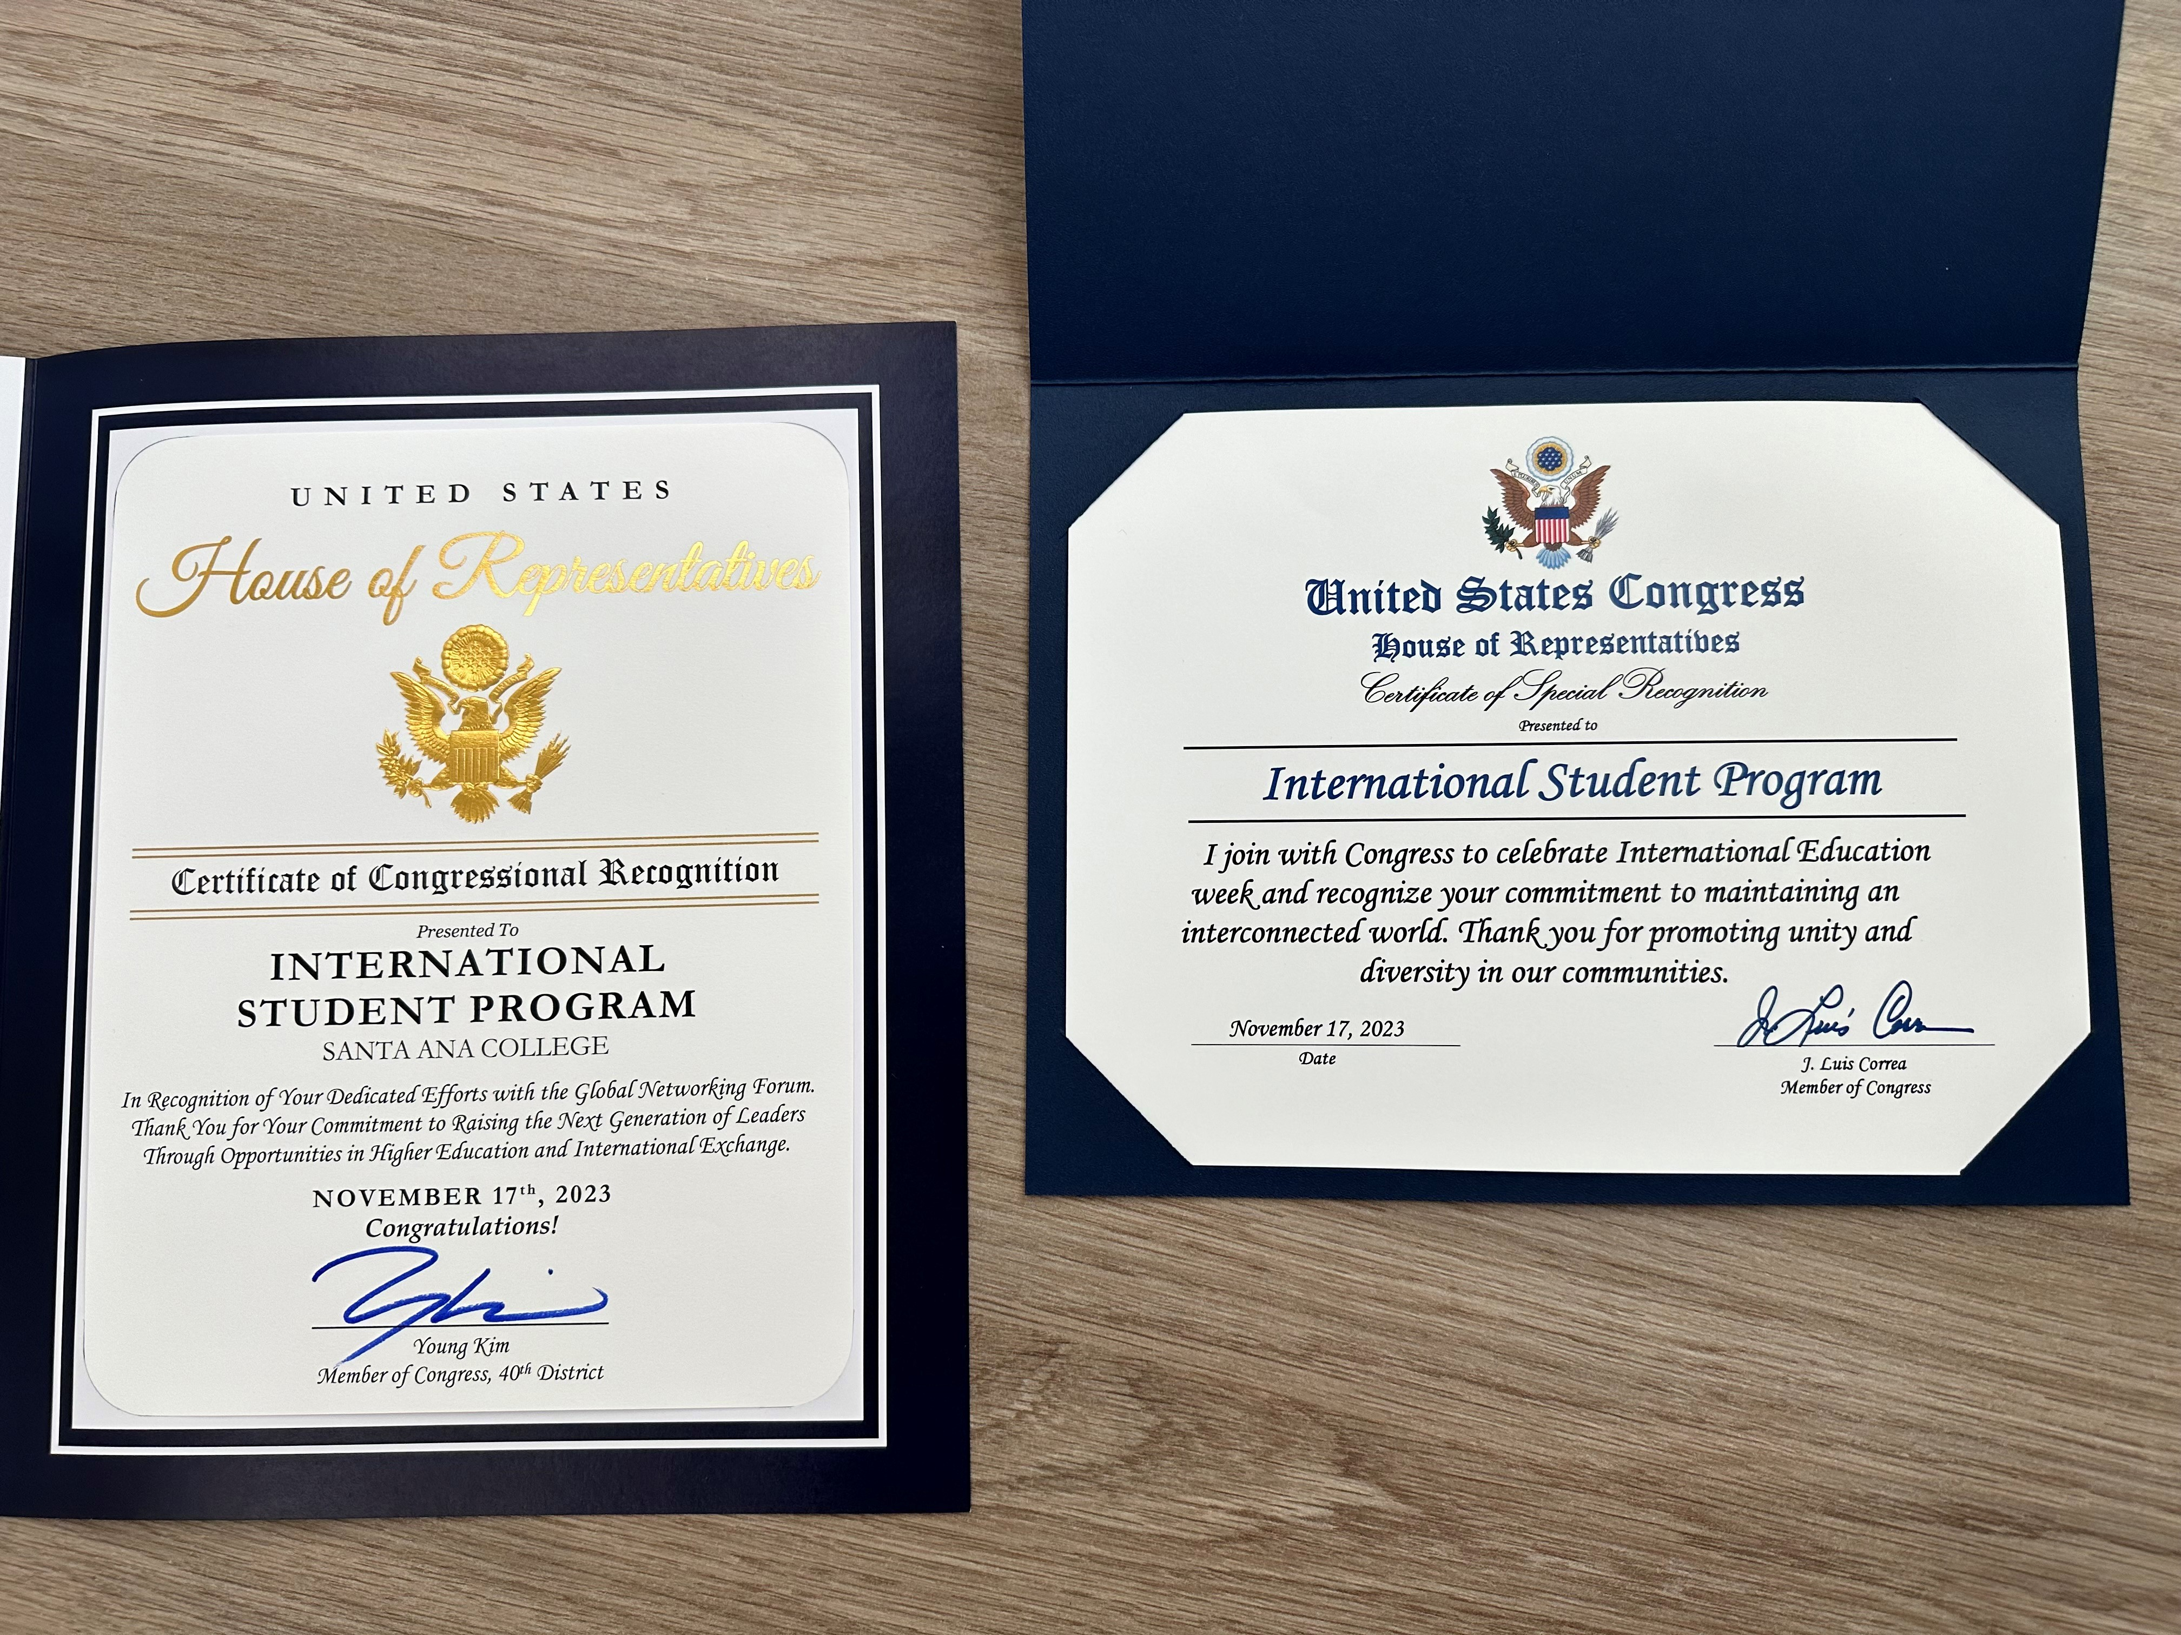
We need you!
Our inaugural IEW was recognized for its outreach, but we want 2024 to be even better with your leadership!
www.sac.edu/IEW

Slide 6
Ways to support IEW 2024
Join the IEW team! Help guide the vision for IEW at SAC! We will meet monthly and as needed until the event.
If interested, contact me for details.
Present / demonstrate / lecture / lead an event or panel during IEW! Highlight your division, your students, global trends, and insights while building global awareness on campus!
Encourage your students to attend events during IEW! Allow for assignments, extra credit, or other opportunities to join in IEW in the Fall semester.

Slide 7
2.
GLE 360 Virtual Study Abroad Resource
Available now!

Slide 8
Zero-cost course materials accessible to all faculty
ISP has partnered with the Study Abroad Association to offer 360 GLE access to all SAC faculty
Explore modules and materials for your subject area
Faculty workshops can be arranged to maximize this resource and to develop innovative uses for the material
Overview: https://www.youtube.com/watch?v=xgil2_FRUXA

Slide 9
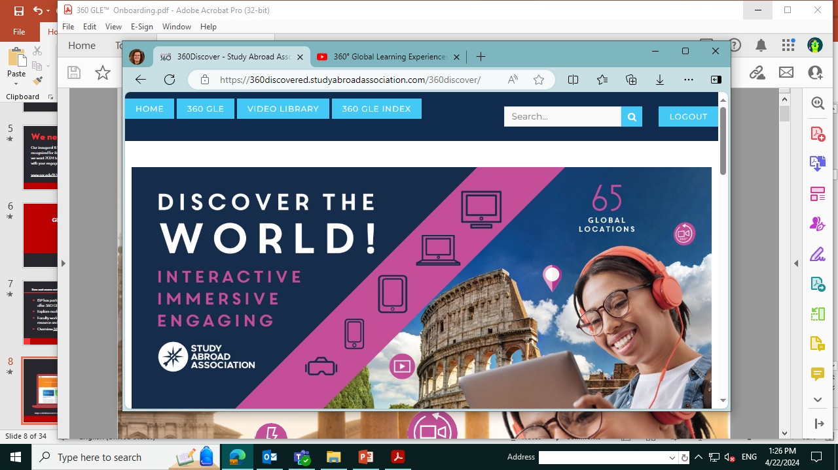
360 GLE: Study Abroad Association
Log in to check out ways to internationalize your course / materials
(which will integrate with online course platform)
https://360discovered.studyabroadassociation.com/360discover/

Slide 10
3.
Faculty Fellowships, Grants, and Awards
Faculty Development in International Education

Slide 11
Faculty Development in International Education
Explore prestigious fellowships and grants which support internationalization, teaching, research, and professional development internationally
Examples include Fulbright (competition is open now!), EPIC Faculty Fellowship (Stanford), and many more
Please consider ISP a resource for exploring these types of opportunities – let’s talk about your goals!

Slide 12
From Santa Ana to Anywhere…!

Slide 13
THANKS!
Let’s explore ways to collaborate!
You can find me at:
JSC-208
Newton_tina@sac.edu
Ext.: 46028

